Slide 1

Air Safety Analysis: Nigerian Airforce Accident and Fatality Trends
This comprehensive analysis examines the patterns of accidents and fatalities within the Nigerian Airforce operations over time. By identifying key trends, high-risk operators, aircraft types, and contributing factors, we can develop data-driven strategies to enhance safety protocols and reduce incidents.
Our findings will highlight critical areas for operational improvement, training enhancement, and resource allocation to safeguard personnel and assets while maintaining mission readiness and operational effectiveness.

Slide 2
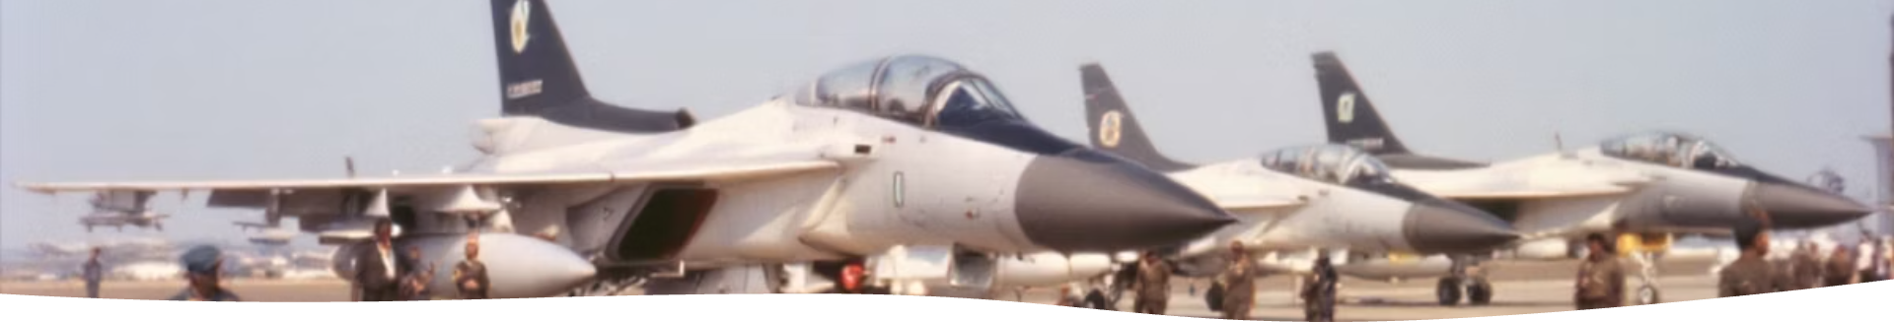
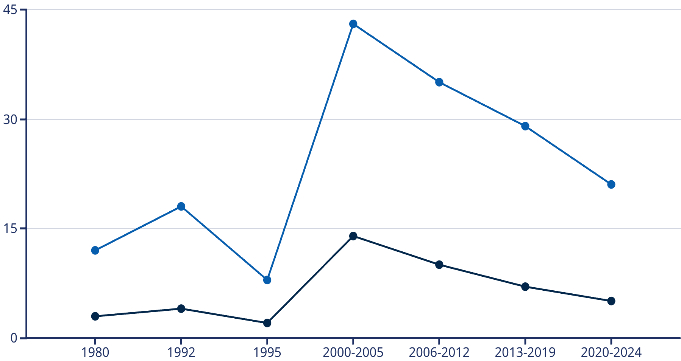
Historical Accident Trends (1980-2024)
Number of Accidents
Fatalities
The data reveals a concerning spike in accidents during the 2000-2005 period, with 14 recorded incidents resulting in 43 fatalities. This represents the highest concentration of accidents in the analyzed timeframe, likely corresponding with increased operational tempo during that era.
While there has been a gradual reduction in both accident frequency and fatality count in recent years, the 2020-2024 period still shows concerning figures of 5 accidents with 21 fatalities, indicating that safety improvements are still needed despite the positive trend.

Slide 3








High-Risk Operators Analysis
Air Operations Command
23% of total accidents, highest fatality rate
Tactical Air Command
19% of accidents, moderate severity
Logistics Command
15% of accidents, generally non-fatal
Training Command
12% of accidents, mixed severity
Analysis of accident frequency by operator reveals that Air Operations Command has been involved in the highest proportion of incidents (23%), with a concerning fatality rate of 78% per accident. Tactical Air Command follows with 19% of total accidents, though with a lower fatality rate of 45%.
The data suggests a correlation between operational mission types and accident severity. Combat and tactical operations demonstrate significantly higher fatality rates compared to logistics and training missions, highlighting the inherent risks of operational deployments.

Slide 4
Accident Severity Classifications
Write-Off (W/O)
Substantial Damage (SUB)
Minor Damage (MIN)
Catastrophic damage resulting in complete loss of aircraft. Comprises 43% of all incidents with a 92% fatality rate. Most common in tactical and combat operations.
Significant structural damage requiring major repairs. Represents 31% of incidents with a 45% fatality rate. More prevalent in training exercises and adverse weather operations.
Repairable damage with aircraft returning to service. Accounts for 26% of incidents with only a 12% fatality rate. Typically occurs during landing operations and maintenance-related flights.
The severity classification of accidents provides critical insights into both causes and outcomes. Write-offs (W/O) represent the most severe category, resulting in complete loss of aircraft and accounting for the vast majority of fatalities (92%). These incidents often involve catastrophic structural failures, mid-air collisions, or extreme operational conditions.
Substantial damage incidents (SUB) typically allow for some crew survival but require extensive repairs or aircraft rebuilding. Minor damage incidents (MIN) have the lowest fatality rate but still represent significant safety concerns and operational disruptions.

Slide 5
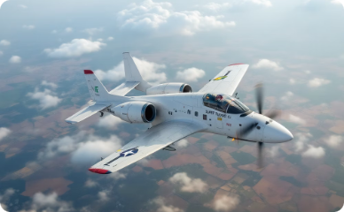
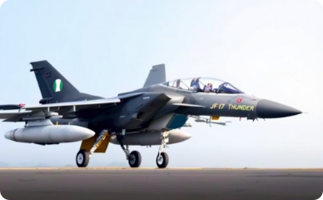





Top 5 Accident-Prone Aircraft Types
L-39ZA Albatros
18% of total accidents
AW109 Helicopter
Fatality rate: 58%
F-7Ni Fighter
21% of total accidents
Primary issues: Training incidents, bird strikes
17% of total accidents
Fatality rate: 72%
Fatality rate: 83%
Primary issues: Mechanical failure, weather
Primary issues: Hydraulic failures, avionics
Alpha Jet
C-130 Hercules
28% of total accidents
16% of total accidents
Fatality rate: 65%
Fatality rate: 76%
Primary issues: Engine failure, control loss
Primary issues: Cargo operations, age-related
Aircraft type analysis reveals that the Alpha Jet encounters the highest frequency of accidents, accounting for 28% of all incidents. This is followed closely by AW109 Helicopters (21%) and L-39ZA Albatros trainers (18%). However, the F-7Ni fighter exhibits the highest fatality rate at 83% despite representing a lower proportion of total accidents.
The data suggests that rotary-wing aircraft (helicopters) generally experience higher fatality rates compared to fixed-wing aircraft when accidents occur, likely due to their operational profiles and recovery limitations during emergencies.

Slide 6
Fatality Distribution Analysis
166
63%
Total Fatalities
Crew Fatality Rate
Across all analyzed incidents (1980-2024)
Percentage of crew members lost in incidents
37%
23
Passenger Fatality Rate
Incidents with Zero Survivors
Including troops being transported
Complete loss of all personnel onboard
Analysis of fatality distribution reveals concerning patterns in survivability. Crew members face a significantly higher risk (63% fatality rate) compared to passengers (37%), likely due to their positioning in the aircraft and commitment to emergency procedures that prioritize passenger safety.
Particularly alarming is the frequency of total-loss incidents, with 23 accidents resulting in zero survivors. These catastrophic events represent 51% of all fatalities despite comprising only 27% of total incidents, indicating the severity spectrum of NAF accidents tends toward the extreme end.

Slide 7




Contributing Factors to Accidents
Mechanical Failure
Human Error
Environmental Factors
Organizational Factors
Engine and system malfunctions account for 34% of all accidents. Aging fleet components and maintenance challenges are primary contributors to this category.
Pilot decision-making, procedural violations, and crew coordination issues represent 28% of incidents. Often exacerbated by operational pressure and inadequate rest periods.
Weather conditions, visibility issues, and terrain challenges contribute to 22% of accidents. Seasonal patterns show increased incidents during harmattan and rainy seasons.
Training deficiencies, resource constraints, and operational tempo pressures account for 16% of incidents. These systemic issues often amplify other risk factors.
Mechanical failures represent the leading category of accident causes at 34%, with engine malfunctions and hydraulic system failures being the most common specific issues. This highlights the challenges of maintaining an aging and diverse fleet with limited resources and parts availability.
Human factors remain a significant contributor at 28%, with pilot decision-making under pressure being the most critical element. Environmental challenges, particularly operations in adverse weather and difficult terrain, account for 22% of incidents, while organizational and systemic factors contribute to 16% of accidents, often as compounding elements rather than primary causes.

Slide 8



Temporal and Operational Patterns
Daytime Operations (0600-1800)
58% of accidents occur during daylight hours, primarily during training exercises and routine operational flights. Lower fatality rate of 47% compared to other periods.
Nighttime Operations (1800-0600)
32% of accidents occur during darkness, predominantly during tactical and combat missions. Higher fatality rate of 76% due to reduced visibility and recovery challenges.
Transitional Periods (Dawn/Dusk)
10% of accidents occur during dawn/dusk transitions when visibility is compromised. Moderate fatality rate of 61% with heightened risk during certain seasonal conditions.
Temporal analysis reveals significant variations in both accident frequency and severity based on operational timing. While daytime operations account for the majority of incidents (58%), they result in a disproportionately lower fatality rate (47%) compared to nighttime operations, which represent 32% of accidents but 76% of fatalities.
Operational pattern analysis indicates that training flights account for the highest absolute number of incidents (41%), though with the lowest fatality rate (38%). Combat operations represent only 17% of total flights but account for 29% of accidents and 43% of all fatalities, highlighting the inherently higher risk profile of tactical missions.

Slide 9




Recommendations
Enhanced Maintenance
Crew Training
Data Collection
Safety Culture
Implement predictive maintenance protocols and increase spare parts inventory for aging aircraft systems
Strengthen CRM protocols and simulator training for emergency scenarios
Deploy advanced flight data monitoring across the fleet
Establish non-punitive reporting and regular safety stand-downs
Based on comprehensive analysis, I recommend implementing a multi-faceted safety improvement strategy. First, prioritize enhanced maintenance protocols with predictive analytics to address the leading cause of accidents. Second, strengthen crew resource management training with emphasis on decision-making under pressure and emergency procedures specific to high-risk aircraft types.
Additionally, I recommend implementing advanced flight data monitoring systems across the fleet to enable proactive identification of risk factors before they result in incidents. Finally, developing a robust safety culture through non-punitive reporting mechanisms and regular safety stand-downs will create an environment where potential hazards are identified and addressed before they result in accidents.

Slide 10


This analysis is based on the data extracted from Aviation Safety Network

