Slide 1
SOLCARE
EFFICIENT RENEWABLE ENERGY SYSTEMS

Slide 2
Content
Introduction
Project Overview
System components
Expected outcomes
Issues faced
Future Work and applications
Conclusions

Slide 3
INTRODUCTION
Renewable Energy: A sustainable solution to power generation
Solar power - very promising due to abundant sunlight and reduction of carbon emissions
Challenges – partial capture of sunlight
Varying environmental factors
Inconsistent power generation, discouraging users
Pushes them back to carbon-emitting energy sources

Slide 4
SOLCARE IS A SOLUTION
Integrates panel alignment and monitoring of environmental conditions to enhance solar panels

Slide 5
Project Overview
Objective: To design and implement a solar panel system that maximizes energy output by tracking sunlight and monitoring environmental factors (voltage, temperature, humidity) that impact solar efficiency.

Slide 6
Project Overview (cont.)
Goals:
Increase energy production through effective sunlight tracking.
Understand how environmental conditions affect solar panel performance.
Improve sustainability through optimized use of renewable resources.

Slide 7
System Components and their functions
Solar Panel: Primary energy source, converting sunlight to electricity.
Arduino Uno & ESP32: Microcontrollers to handle sensor data collection, storage, processing and sending to an IoT monitoring application
Sensors: - Light Dependent Resistor (LDR): Tracks sunlight intensity to adjust panel alignment. Voltage Sensor: Monitors voltage output to assess energy production.

Slide 8
System Components and their functions (cont.)
Temperature Sensor (DHT11): Measures panel temperature, which can affect efficiency as well as Humidity Sensor: Monitors ambient humidity, which can impact the panel's performance
Actuators: - Servo Motor: Adjusts panel alignment based on sunlight tracking.

Slide 9
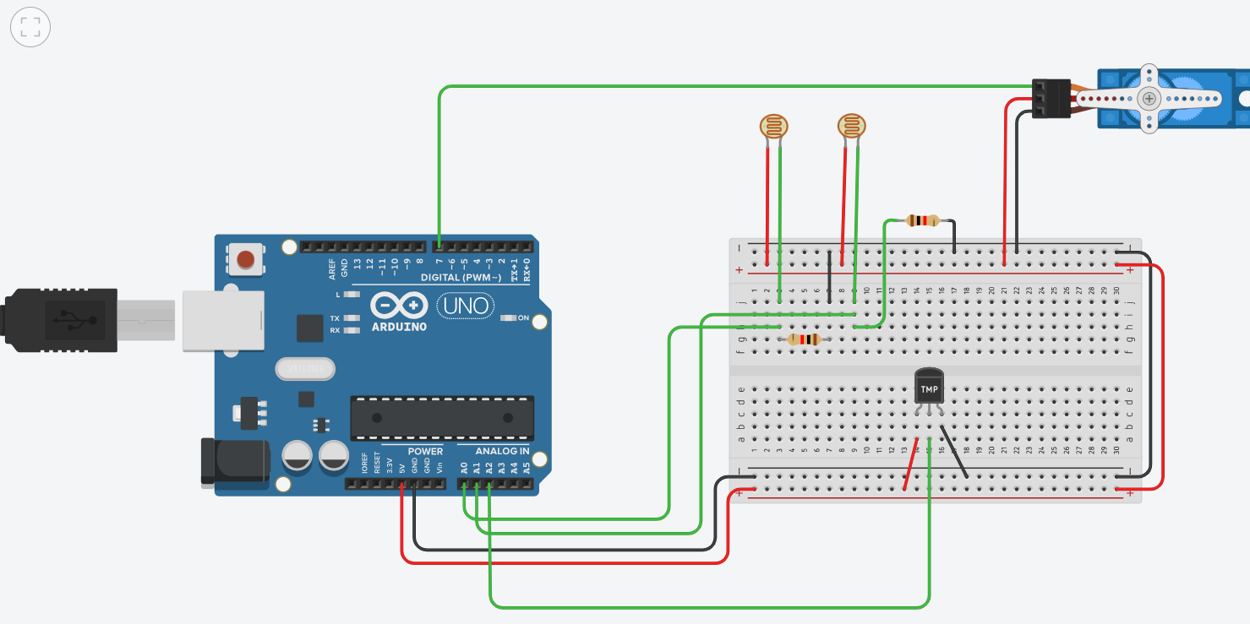
Hardware Setup

Slide 10
Circuit in real time

Slide 11
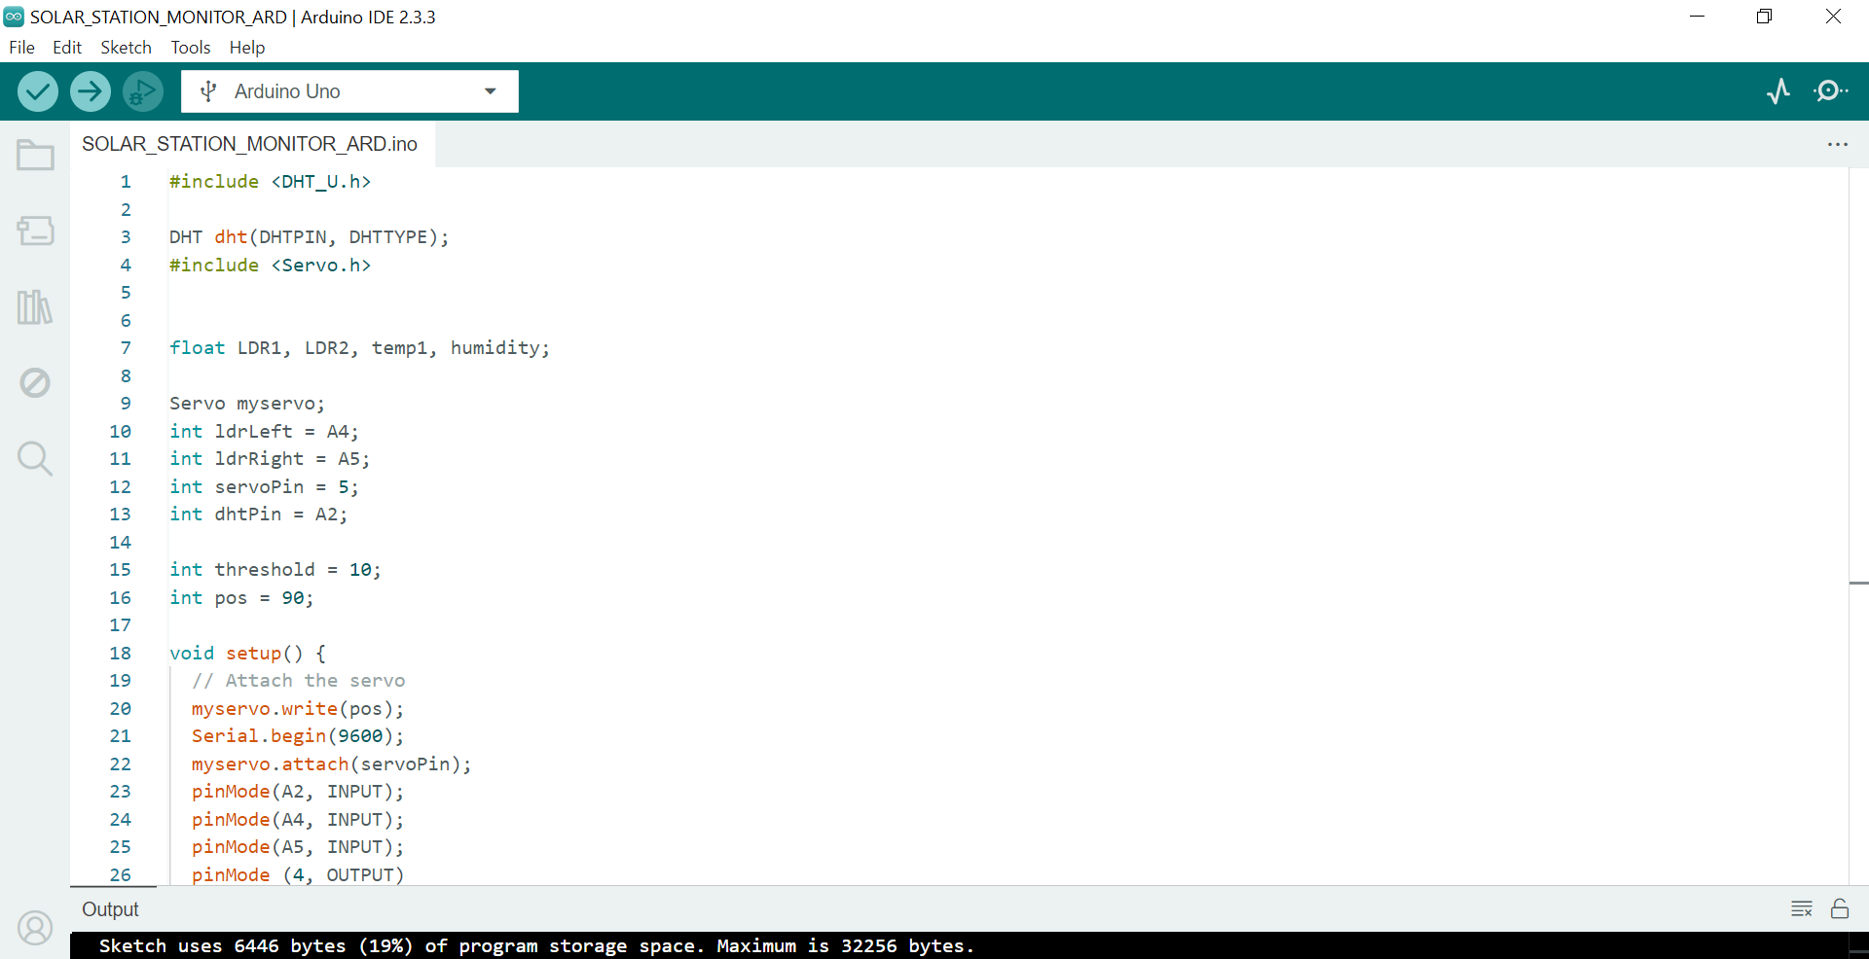
Software sketch

Slide 12
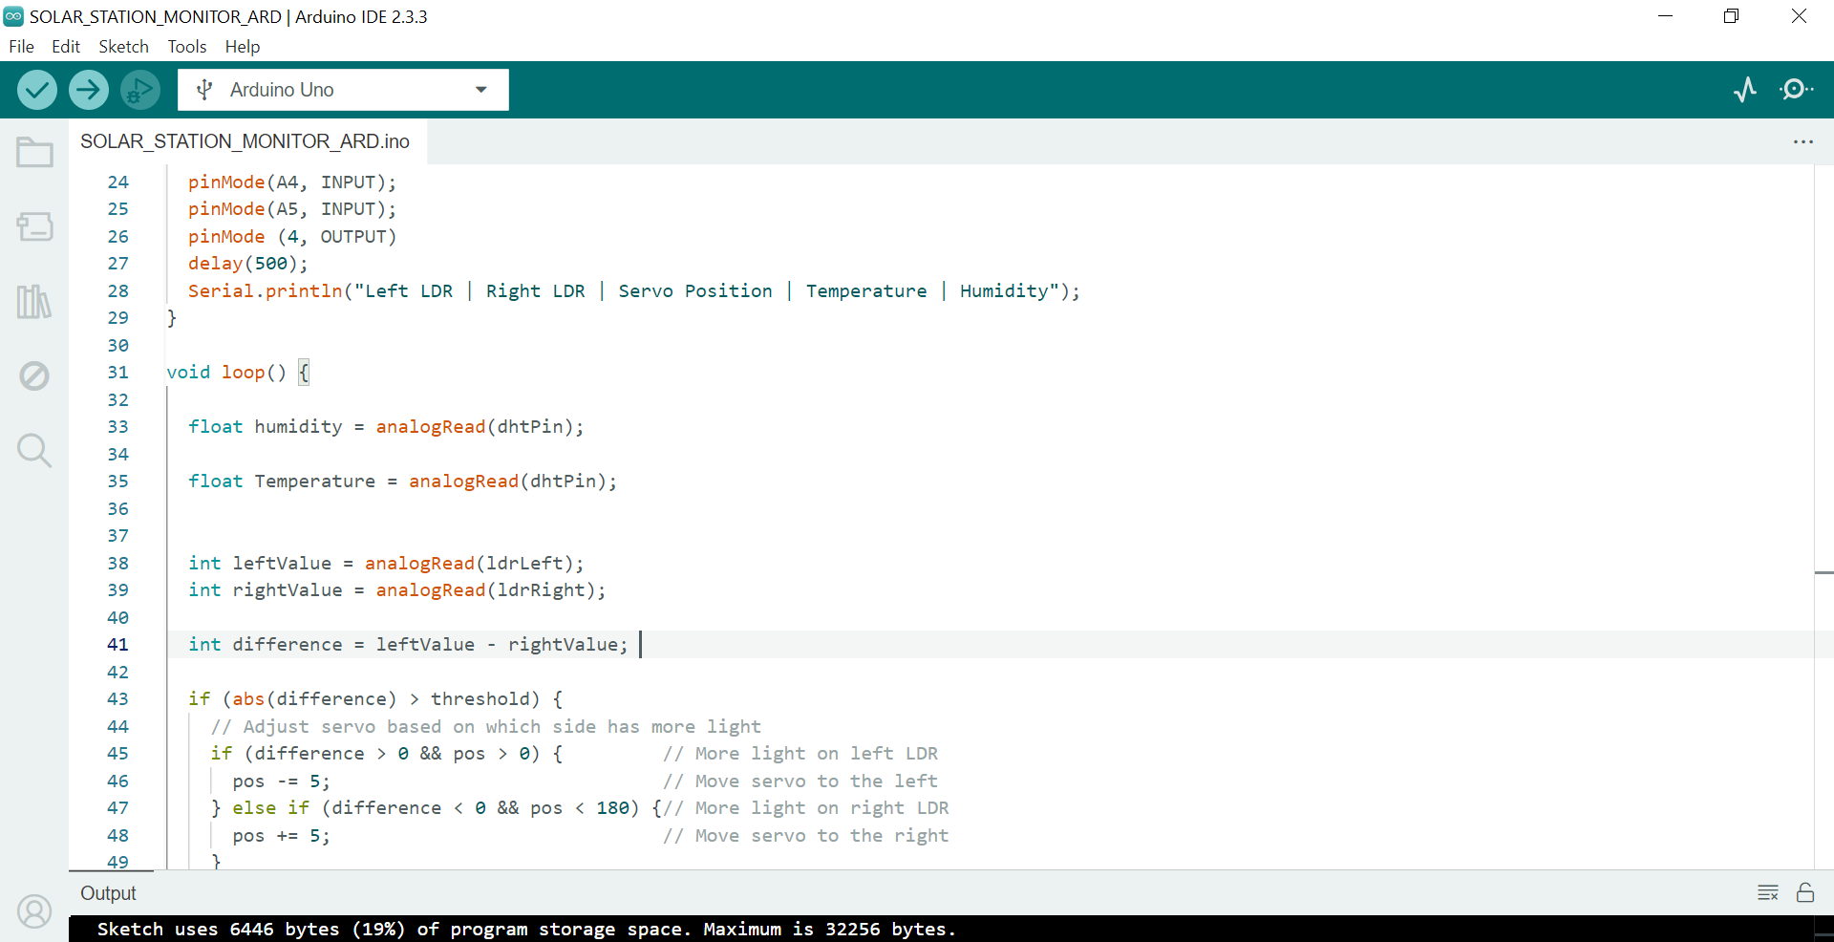
Software sketch

Slide 13
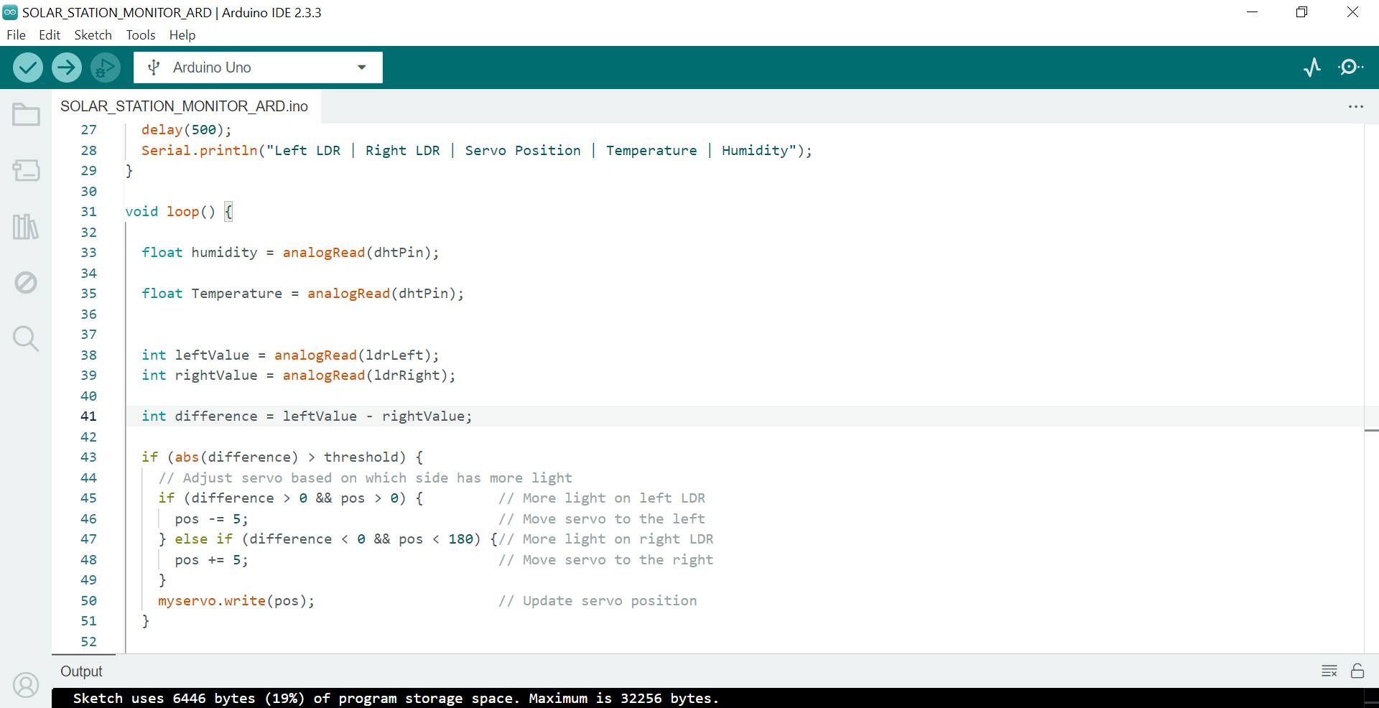
Software sketch

Slide 14
Expected Outcomes
Improved energy production through dynamic sunlight tracking.
Insights into the effects of temperature and humidity on solar panel efficiency.
Enhanced sustainability through data-driven adjustments.

Slide 15
ISSUES FACED
Problem with updating ESP 32 USB driver
So, Arduino Uno was employed for the main time

Slide 16
Future Work
Blynk IoT and replacing Arduino Uno with Esp32
Temperature and Humidity monitoring

Slide 17
Future Applications
Extend the project to larger solar installations.
Implement machine learning to predict optimal panel adjustments based on historical data.
Explore integration with innovative grid systems.

Slide 18
Conclusion
This system monitors and maximizes solar energy efficiency by:
ensuring optimal panel alignment and;
environmental tracking
through user-friendly, real-time app monitoring.
These encourage sustainable habits and promote the use of clean, renewable energy

