Slide 1
VQA Visual Question Answering Computer Vision & NLP
Junyi Ma

Slide 2
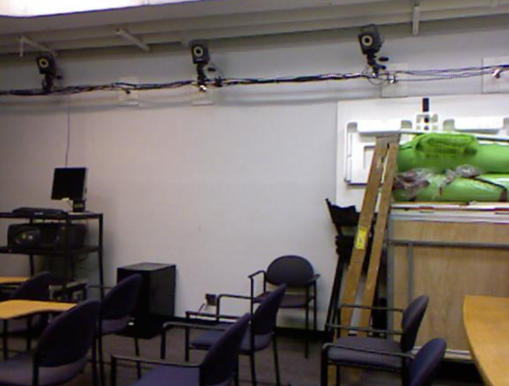
Understanding Visual Question Answering (VQA)
Definition of VQA:
Visual Question Answering is an AI domain that combines the fields of Computer Vision and Natural Language Processing (NLP).
The task involves providing a natural language answer to a question related to the contents of a given image.
how many dark blue armchairs are in this picture?
8
what is in front of the monitor?
keyboard
Image6

Slide 3
Understanding Visual Question Answering (VQA)
The Challenge:
VQA is challenging as it requires the AI to not only recognize elements within an image but also understand the question's context and deliver accurate, relevant answers.
It necessitates the model to correctly interpret various object attributes, spatial relationships, and actions depicted in the image.

Slide 4

Deep Dive into the Dataset
Data sources:
DAQUAR: DAtaset for QUestion Answering on Real-world images
Question and Answer Pairs:
The questions span across various complexities, testing object recognition, numerical counting, and contextual comprehension, while the answers range from single objects to lists and descriptive phrases.

Slide 5
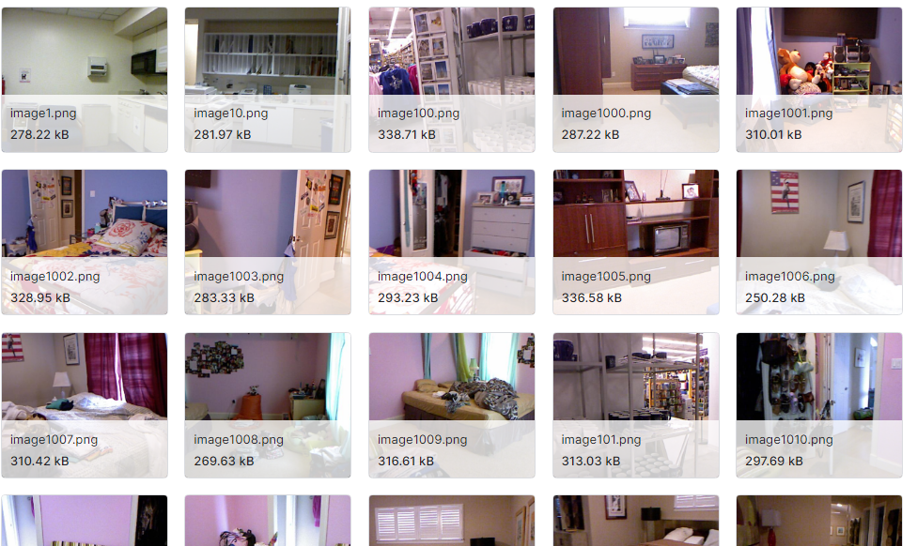
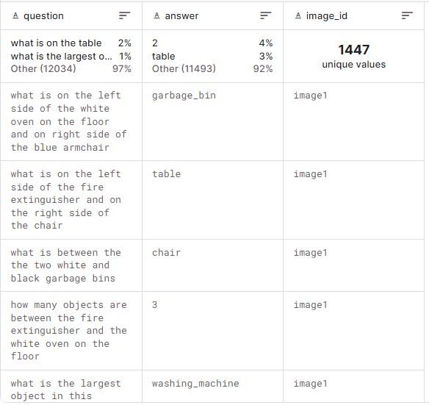
Dataset
1449 Images
12469 Question and Answer Pairs

Slide 6
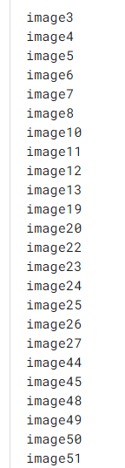
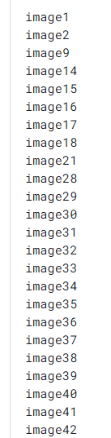
Dataset
test_images_list.txt
train_images_list.txt

Slide 7
Building the VQA Model
Data Processing and Preparation:
A thorough dataset comprising image-question-answer triples was collected and preprocessed.
Question texts were tokenized and padded to create uniform input sequences.
Answers were encoded using a Label Encoder, facilitating a multi-class classification approach.
Feature Extraction:
Utilized the VGG16 model pre-trained on ImageNet to extract intricate features from the images.
Feature vectors were stored for efficient training and evaluation.
Model Architecture:
The VQA model integrates LSTM to handle sequential question data and Dense layers for image features.
I applied Concatenate to merge textual and visual representations, enabling the model to predict answers based on a combined understanding of the question and the image.
Training and Evaluation:
The model underwent extensive training over 100 epochs, optimizing accuracy and minimizing categorical cross-entropy loss.
A meticulous evaluation process provided insight into the model's performance.
Model Storage and Accessibility:
The trained model was saved in the Keras for persistence and future inference.

Slide 8
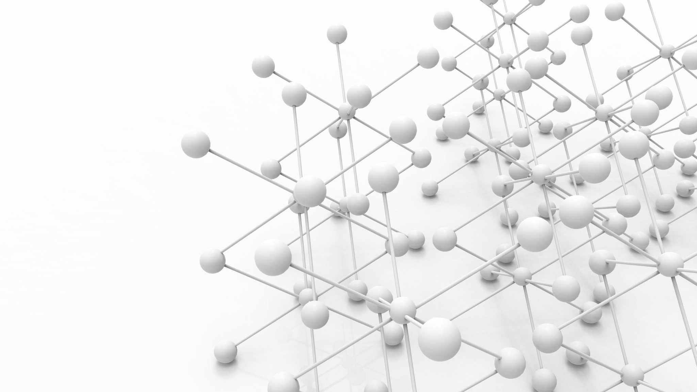


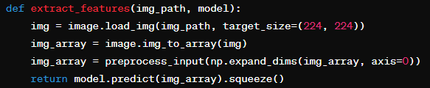

Training Process
Goal:
Enable AI to understand and correctly answer questions about the visual content.
Architecture:
Combines CNN for feature extraction from images with LSTM for sequential language processing.
Process:
Conversion of images into feature vectors and tokenization and sequencing of questions.

Slide 9
Training Process
Combination:
Merging visual and textual features to understand context and content
Optimization:
Fine-tuning the model with loss functions and optimizers.
Progress:
Monitored through the loss and accuracy metrics during the training epochs.

Slide 10

Model Evaluation and Results
Evaluation Methodology:
Assessing model performance on unseen data to ensure reliability.
Performance:
Interpreting Results: While the accuracy may seem modest, it highlights the complexity of VQA tasks and the need for further optimizations.
Potential Issues: Discrepancies in training vs. validation accuracy suggest overfitting. Complex questions may require deeper contextual understanding or advanced models.
Analysis: Further investigation into incorrect predictions to understand the model's weaknesses and improve future iterations.

Slide 11
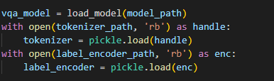
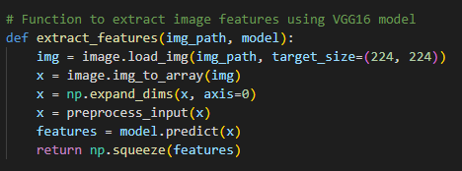
Model Testing & Demonstration
Loading Necessary Components:
For testing, the model is loaded along with the tokenizer and label encoder, crucial for preparing the questions and interpreting the model's predictions.
Extracting Image Features:
A function is defined to process the images and extract features compatible with the VQA model, leveraging the VGG16 architecture.

Slide 12

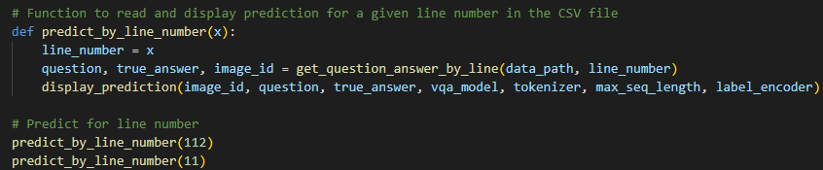
Model Testing & Demonstration
Visualizing Predictions:
The display_prediction function showcases how the model works in real-time, by outputting the question, true answer, and the model's prediction side by side.
Demo Predictions:
To test the model, predict_by_line_number function is used, which takes a line number from the dataset to retrieve the question-answer pair and the associated image.
It provides a hands-on demonstration of the model's ability to answer questions based on image content.

Slide 13
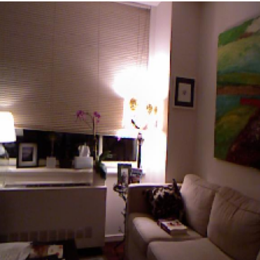

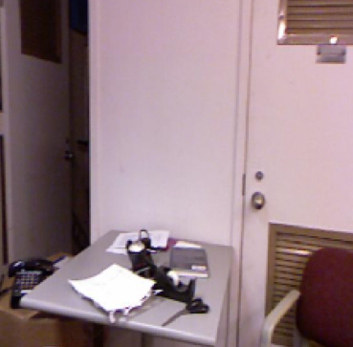

Model Testing & Demonstration
Row 112
Row 11

Slide 14
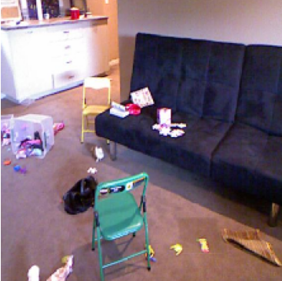
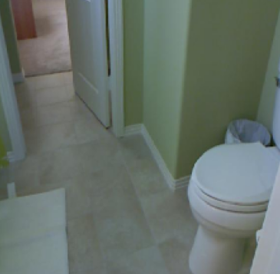
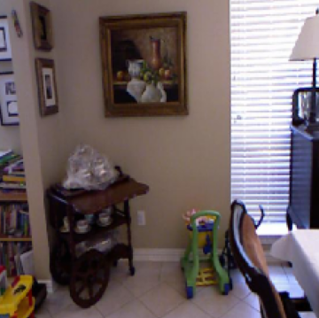



Model Testing & Demonstration
Row 3456
Row 567
Row 12297

Slide 15
Conclusion
The use of models is complicated.
Insufficient amount of data
Model selection
Parameter tuning

Slide 16
Thank you

