Slide 1
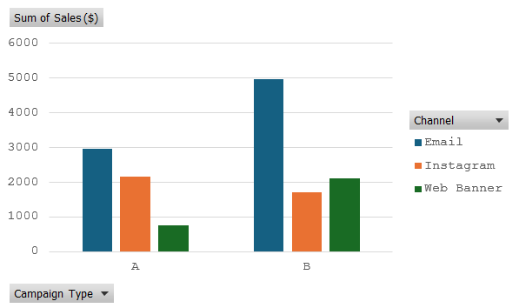
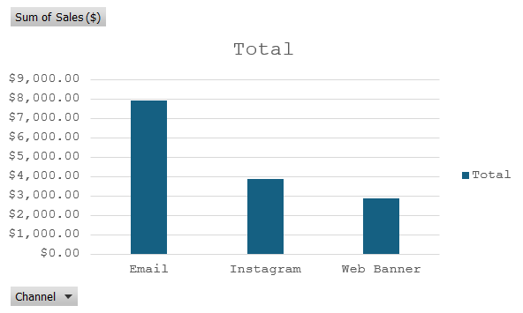
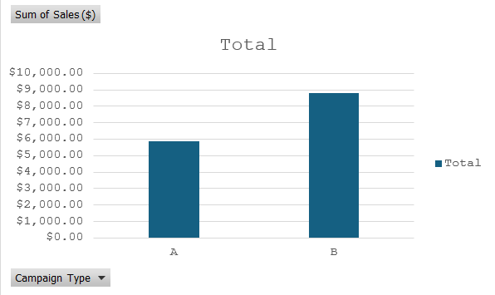
Marketing Campaign Performance Analysis & Recommendation
New Customer Sales by Campaign & Channel
New Customer Sales by Marketing Channel
New Customer Sales by Campaign
Recommendation: Based on the analysis, Campaign B through the Email channel generated the highest new customer sales. We recommend increasing investment in this campaign-channel combination while continuing to optimize Instagram and Web Banner campaigns to improve overall customer acquisition.

