Slide 1
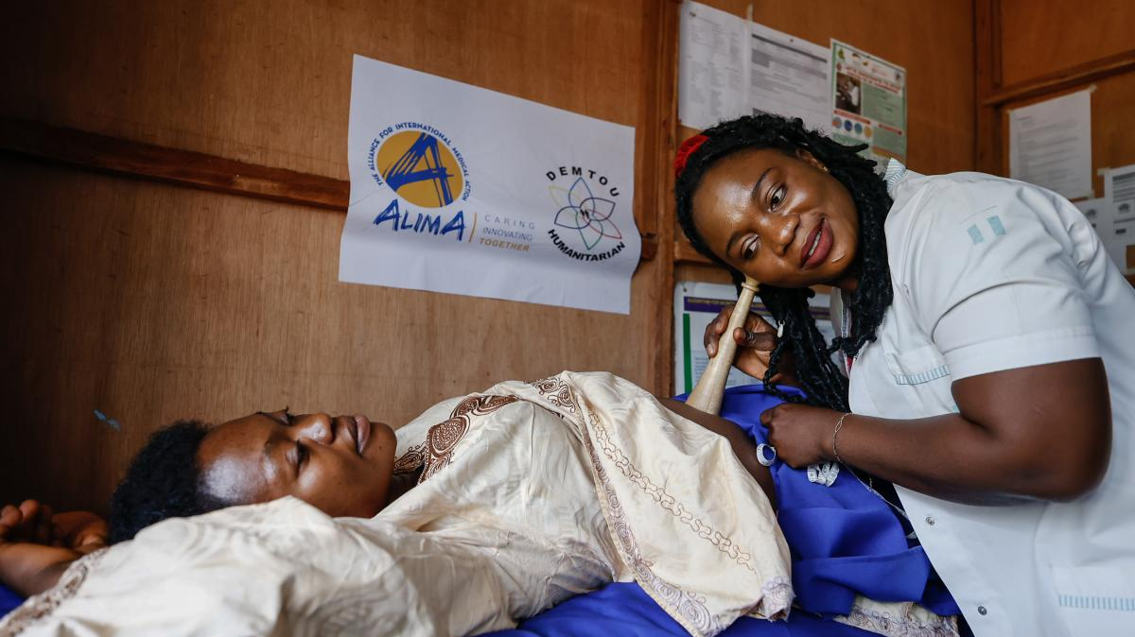
Research Presentation
Factors Associated with Women's Decisional Autonomy in Family Planning Among Women in Cameroon
A Multinomial Analysis of the 2018 Demographic and Health Survey

Slide 2
Navigation
Presentation Overview
01
Background & Context
02
Research Objectives
03
Methodology
Women's reproductive autonomy in Sub-Saharan Africa and the Cameroonian context
Three specific objectives guiding this investigation
Data source, study design, and analytical approach
04
Sample Characteristics
05
Decisional Autonomy Distribution
06
Factors: Husband-Only
Sociodemographic profile of 6,546 married women
Who decides on family planning in Cameroonian households?
Determinants of male-dominated decision-making
07
Factors: Joint Decision
08
Discussion & Implications
09
Conclusions & Recommendations
What promotes shared reproductive agency?
Key insights from the multinomial analysis
Policy implications for reproductive health programmes

Slide 3

Context
Women's Reproductive Autonomy in Sub-Saharan Africa
The Maternal Health Crisis
The Cameroonian Context
Sub-Saharan Africa accounts for 66% of global maternal deaths , with an estimated 546 maternal deaths per 100,000 live births . Unplanned pregnancies and short inter-pregnancy intervals remain leading contributors to maternal and child mortality in the region.
53%
of married women
lack household decision-making autonomy—higher than the sub-Saharan African average of 44%
Family planning services are recognized as a cornerstone of interventional efforts, contributing to the reduction of maternal and infant morbidity and mortality, prevention of unintended pregnancies, and improvements in household living standards.
Partner approval and intra-couple discussion are the two most significant factors associated with contraceptive use and unmet need in both urban and rural Cameroon
Decision-Making Power
A woman's capacity to make autonomous decisions about contraceptive use is fundamentally linked to her broader sense of empowerment and agency within the household and society. Women who experience limited decision-making power are less likely to initiate or maintain contraceptive use , even when they desire to do so.
The interpersonal dimension—particularly partner influence—plays a critical role in determining whether women can freely decide on family planning methods.
Women accessing reproductive health services in Cameroon

Slide 4

Study Purpose
Research Objectives
Research Gap
01
Descriptive Analysis
While existing research has examined binary outcomes—whether a woman has decision-making power or not— fewer studies have examined the full spectrum of who makes family planning decisions.
To describe the sociodemographic characteristics of married women in Cameroon and the distribution of family planning decisional autonomy across the population
Understanding these distinctions is critical for designing targeted interventions, as joint decision-making and woman-alone decision-making represent fundamentally different autonomy profiles.
02
Bivariate Associations
To examine the bivariate associations between candidate independent variables and family planning decisional autonomy using Chi-square tests and Cramér's V
This study addresses this gap by examining the factors associated with each category of decisional autonomy in family planning among married women in Cameroon.
03
Multivariate Analysis
To identify the independent factors associated with husband-only and joint decision-making compared to woman-alone decision-making, using multinomial logistic regression
Empowering women through education and agency

Slide 5
Study Design
Methodology
Data Source & Sample
UNFPA Framework
Survey
Sampling Design
Independent variables selected based on the UNFPA SDG Indicator 5.6.1 four-level determinants framework:
2018 Cameroon Demographic and Health Survey (DHS-7)
Stratified two-stage cluster sampling
1
Socio-demographic
Total Sample
Analytical Sample
Age, residence, education, wealth, religion, union type
14,677 women aged 15–49
6,546 married, non-pregnant women
2
Individual
Occupation, FP knowledge, fertility preference, parity, unmet need
3
Interpersonal
Outcome Variable
Husband's occupation, husband's desired children
4
Institutional
Family planning decisional autonomy was constructed by combining two DHS-7 variables:
ANC visits, FP info at facility, FP media exposure
v632
v632a
Who decided to use contraception (current users)
Who decided not to use contraception (non-users)
Statistical Analysis
1. Descriptive statistics (weighted frequencies)
Four-Category Outcome Variable
2. Bivariate analysis (Chi-square, Cramér's V)
1
2
3
6
3. Lasso regularization for variable selection
4. Multinomial logistic regression (RRR, 95% CI)
Woman Alone
Husband Alone
Joint
Other
Reference
Compared
Compared
Compared
Survey weights (v005) applied throughout

Slide 6
Descriptive Statistics
Sample Characteristics
Sociodemographic and reproductive profile of 6,546 married, non-pregnant women
Demographics
Wealth & Employment
Reproductive History
Age 25–29
20.7%
Poorest quintile
17.4%
No children
6.8%
Urban residence
47.7%
Poorer
21.0%
1–2 children
33.0%
Rural residence
52.3%
Middle
23.3%
3–4 children
31.1%
Monogamous union
78.5%
Richer
20.1%
5+ children
29.2%
Polygynous union
20.9%
Richest
18.2%
Women working
69.9%
Family Planning
Education
Husbands working
95.6%
Ever used FP
39.5%
No education
25.1%
Unmet need
26.7%
Primary
32.8%
Religion
FP info at facility
35.9%
Secondary
36.9%
Catholic
34.4%
FP media exposure
23.5%
Higher
5.2%
Protestant
26.7%
Traditional
27.9%
Mean age: 25–34 years | Largest group: 25–29 (20.7%)
Muslim
7.3%

Slide 7
Key Finding
Distribution of Family Planning Decisional Autonomy
Who decides on contraceptive use or non-use among married women in Cameroon?
Decision-Making Patterns (N = 6,546)
Joint Decision
41.3%
2,704 women make decisions jointly with their husbands. This is the most common pattern, reflecting the culturally negotiated nature of contraceptive use where male partner involvement is normatively expected.
Husband Alone
24.0%
1,571 women report their husband as the sole decision-maker. This represents male-dominated decision-making with limited female agency.
Woman Alone
33.0%
Other
1.6%
Key Insight: Over 65% of decisions involve husband input or control, highlighting the persistence of patriarchal household structures in Cameroon.
2,160 women — highest autonomy
105 women — extended family

Slide 8
Multinomial Regression Results
Factors Associated with Husband-Only Decision-Making
Comparing husband-alone vs. woman-alone decision-making (Reference: Woman decides alone)
Protective Factors (Reduced Likelihood of Husband-Only Decisions)
Key Interpretation
41%
Formally Married (vs. Cohabiting)
Higher education is consistently associated with reduced relative risk of husband-only decision-making. Education enhances women's negotiating position within the household.
RRR = 0.595 (95% CI: 0.486–0.729), p<0.001
STRONGEST
29%
Polygynous Marriage (vs. Monogamous)
Wealthier women and working women show reduced likelihood of husband-only decisions, suggesting that economic independence is an enabling factor for women's reproductive agency.
RRR = 0.711 (95% CI: 0.593–0.852), p<0.001
26%
Secondary Education
RRR = 0.737 (95% CI: 0.563–0.966), p=0.027
Current contraceptive use is the strongest single predictor—women using modern methods are 33% less likely to be in the husband-alone category.
29%
Partner Don’t Know (Desired Children)
Health facility contact is associated with reduced husband-only decision-making, highlighting the importance of FP counselling in empowering women within the household context.
RRR = 0.717 (95% CI: 0.584–0.880), p=0.002
22%
Fieldworker Did Not Visit
RRR = 0.781 (95% CI: 0.649–0.939), p=0.009
33%
Women Working
RRR = 0.671 (95% CI: 0.568–0.792), p<0.001
Risk Factor
+57%
Husband Desires More Children
RRR = 1.569 (95% CI: 1.318–1.868), p<0.001
When fertility preferences diverge, husbands exert stronger control over FP decisions
Family planning counselling at health facilities empowers women

Slide 9

Multinomial Regression Results
Factors Associated with Joint Decision-Making
Comparing joint vs. woman-alone decision-making (Reference: Woman decides alone)
Factors Positively Associated with Joint Decision-Making
Key Insight: Contraception and Autonomy
+81%
Current Modern Contraceptive Use
Modern contraceptive use is the strongest predictor of joint decision-making (RRR=1.808). This likely reflects a bidirectional relationship: joint decisions lead to contraceptive uptake, and contraceptive use facilitates couple communication.
RRR = 1.808 (95% CI: 1.478–2.211), p<0.001
STRONGEST
+26%
Working women are 20% less likely to be in joint decision arrangements (RRR=0.804), suggesting that economic independence enables women to decide independently rather than share decision-making power with partners.
Poorer Wealth Quintile (vs. Poorest)
RRR = 1.262 (95% CI: 1.017–1.566), p=0.035
Note: education variables were not significant for joint decision-making in the final model after controlling for all other variables.
+76%
Traditional Contraceptive Use
RRR = 1.758 (95% CI: 1.285–2.405), p<0.001
-16%
Modern contraceptive use is strongly associated with joint decision-making (RRR=1.808), consistent with the interpretation that joint decisions more readily lead to actual contraceptive uptake.
2–3 Children (vs. 0–1)
RRR = 0.838 (95% CI: 0.719–0.976), p=0.024
-24%
Woman Wants Fewer Children
RRR = 0.756 (95% CI: 0.646–0.886), p<0.001
-20%
Women Working
RRR = 0.804 (95% CI: 0.696–0.929), p=0.003
Key Risk Factor (Reduces Joint Decision)
-49%
Husband Desires More Children
RRR = 0.515 (95% CI: 0.445–0.597), p<0.001
When husbands want more children, women are 49% less likely to be in joint decisions — decisions shift toward male dominance instead
Education empowers women and promotes shared decision-making

Slide 10
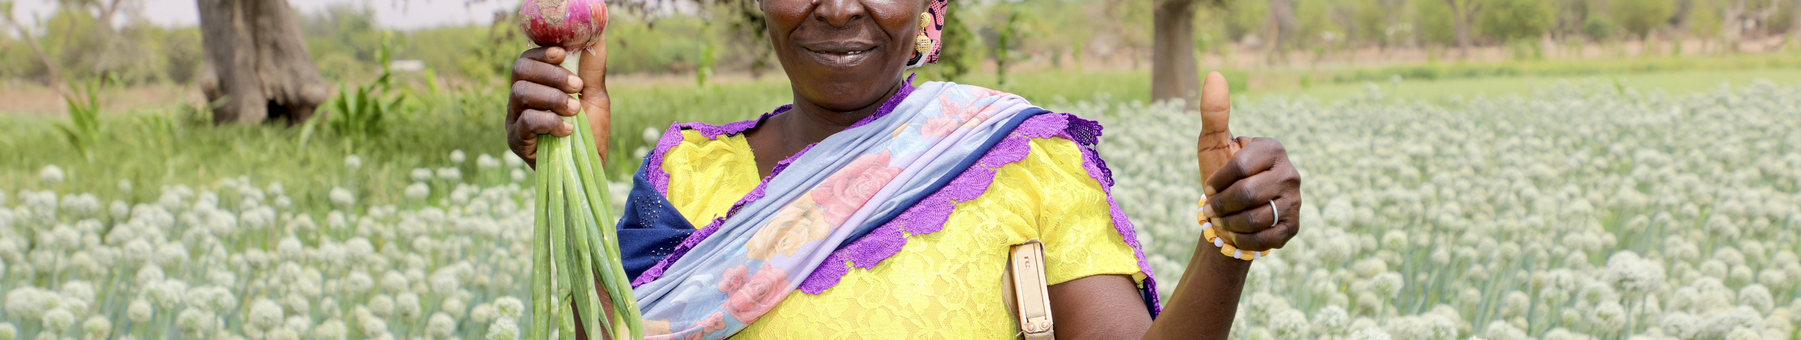
Synthesis
Discussion: Key Insights and Implications
The Prevalence of Joint Decision-Making
Health Facility Contact as an Enabler
The finding that 41.3% of women engage in joint decision-making may reflect the culturally negotiated nature of contraceptive use in Cameroon, where male partner involvement is normatively expected.
Health facility contact—specifically staff discussing family planning—was associated with both reduced husband-only decision-making and increased joint decision-making.
Research in urban and rural Cameroon has consistently identified health facility-based family planning counselling as a key enabler of contraceptive uptake. The current findings extend this by demonstrating that facility-based FP information is also associated with the locus of reproductive decision-making.
This pattern aligns with the broader documentation in sub-Saharan Africa and is particularly noteworthy in the Cameroonian context, where patriarchal household structures remain prevalent.
Education's Dual Effect
Study Limitations
The negative association between education and husband-only decision-making is consistent with extensive literature demonstrating that education improves women's control over their reproductive choices by increasing their position within the household.
1. Cross-sectional design precludes causal inference—associations reflect correlations that must be interpreted cautiously
2. Domestic violence module could not be included due to high missingness, potentially omitting an important determinant of reproductive coercion
Education also appears to facilitate couple communication, as evidenced by the positive association between higher education and joint decision-making.
3. Household decision-making variables were not included as independent variables given their conceptual proximity to the outcome
Partner Influence on Fertility Preferences
4. Cluster-level variables that might justify multilevel modelling were not explored
The strong positive association between husband's desire for more children and husband-alone decision-making (RRR=1.569) is consistent with research in Mozambique and Honduras showing that husbands' pronatalist preferences substantially constrain women's ability to decide on contraceptive use independently.
Women's empowerment through economic independence

Slide 11
Policy Implications
Conclusions and Recommendations
Key Conclusions
3
Health Facility-Based Counselling
Women's family planning decisional autonomy in Cameroon is shaped by an interplay of socioeconomic, individual, interpersonal, and institutional factors.
Health facilities should systematically provide family planning counselling to all women of reproductive age who present for any service, not only those seeking contraceptives. FP information at facilities is associated with both reduced husband-only and increased joint decision-making.
Education, wealth, employment, and modern contraceptive use are independently associated with reduced male-dominated decision-making
Access to family planning information at health facilities promotes both joint and woman-alone decision-making
Partner pronatalism remains a significant barrier to women's reproductive agency
4
Male Partner Engagement
Male partner engagement strategies should be incorporated into family planning programmes to address the influence of husband's fertility preferences on women's decisional autonomy. When husbands desire more children, women are 57% more likely to be in husband-only decision scenarios.
1
Educational Interventions
Interventions aimed at improving women's educational attainment, particularly secondary and higher education, are likely to yield significant benefits for reproductive autonomy. Education simultaneously reduces male-dominated decisions and promotes shared reproductive agency.
Future Research Directions
• Examine the mediating role of intra-couple communication on the relationship between socioeconomic factors and decisional autonomy
2
Economic Empowerment
Economic empowerment programmes targeting married women of reproductive age can complement educational investments by increasing women's negotiating power within the household. Working women show both reduced husband-only and increased joint decision-making.
• Consider multilevel modelling approaches accounting for community-level variation in gender norms
• Conduct longitudinal studies tracking changes in autonomy following educational or economic interventions

Slide 12

Thank You
This study contributes to the growing evidence base on women's reproductive autonomy in Central Africa, providing actionable insights for policy and programme design.
Future research should examine the mediating role of intra-couple communication and consider multilevel modelling approaches accounting for community-level variation in gender norms.
Longitudinal studies tracking changes in autonomy following educational or economic interventions would also be valuable.

