Slide 1
App Identity,
Visual Design &
Frontend Implementation
CarDiag
SMART CAR FAULT DIAGNOSIS
A cross-platform mobile application for car fault diagnosis built with React Native
CEF 440 Internet and Mobile Programming
Group 12 | Supervisor: Dr. Valery Nkemeni
University of Buea | 2025/2026
Slide 1 of 8
CarDiag | Group 12 | CEF 440

Slide 2
App Identity
Colour Palette
App Name
CarDiag
Electric Blue #1E88E5
Package Name
com.group12.cardiag
Primary
Version
1.0.0 (build 1)
Deep Navy #070E1C
Background
Framework
React Native CLI
Warning Orange #FF6D00
Accent / Fault
Android
min SDK 26 (Android 8.0)
Success Green #4CAF50
Normal status
iOS
min iOS 8
Error Red #D32F2F
Critical fault
Slide 3 of 8
CarDiag | Group 12 | CEF 440

Slide 3

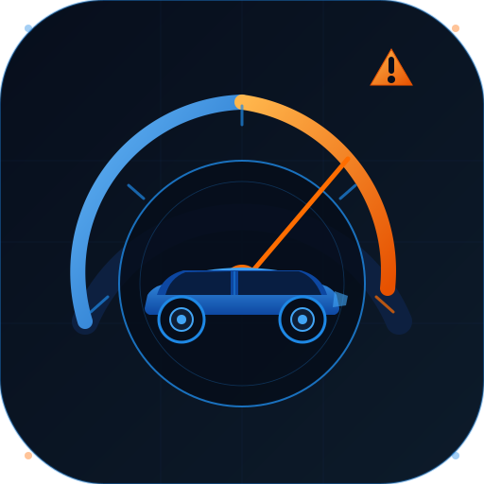
Icon
logo

Slide 4
Visual Design
Design Principles
Typography
Simplicity
Inter Bold 700
One task per screen. All features reachable from bottom nav in one tap.
Headings and screen titles • 24 to 32sp
Roboto Regular 400
Consistency
Body text, labels, buttons • 14 to 16sp
Shared components: buttons, cards, badges, inputs across all screens.
Roboto Mono 500
Accessibility
Fault codes, version badges • 11 to 12sp
High contrast, large touch targets, readable font sizes on all devices.
Navigation (Bottom Tab Bar)
Feedback
Home
Scan
History
Tutorials
Profile
Live waveform, scan line, severity badges confirm every user action.
Slide 4 of 8
CarDiag | Group 12 | CEF 440

Slide 5
Screen Wireframes
10 screens were wireframed before design. Each screen follows a single-task layout with the bottom navigation bar always visible.
01
Splash Screen
06
Engine Sound Recording
Logo, tagline, loading bar
Waveform, timer, stop button
02
Login Screen
07
Diagnosis Results
Email, password, Google login
Fault code, severity badge, causes, action
03
Register Screen
08
Repair Tutorials
Full name, email, password, T&C
Category filters, tutorial cards
04
Dashboard
09
History
Vehicle status, quick actions, recent diagnoses
Filter pills, records with severity badges
05
Warning Light Scanner
10
Profile
Camera viewfinder, scan frame, controls
User info, vehicle card, settings list
Slide 5 of 8
CarDiag | Group 12 | CEF 440

Slide 6
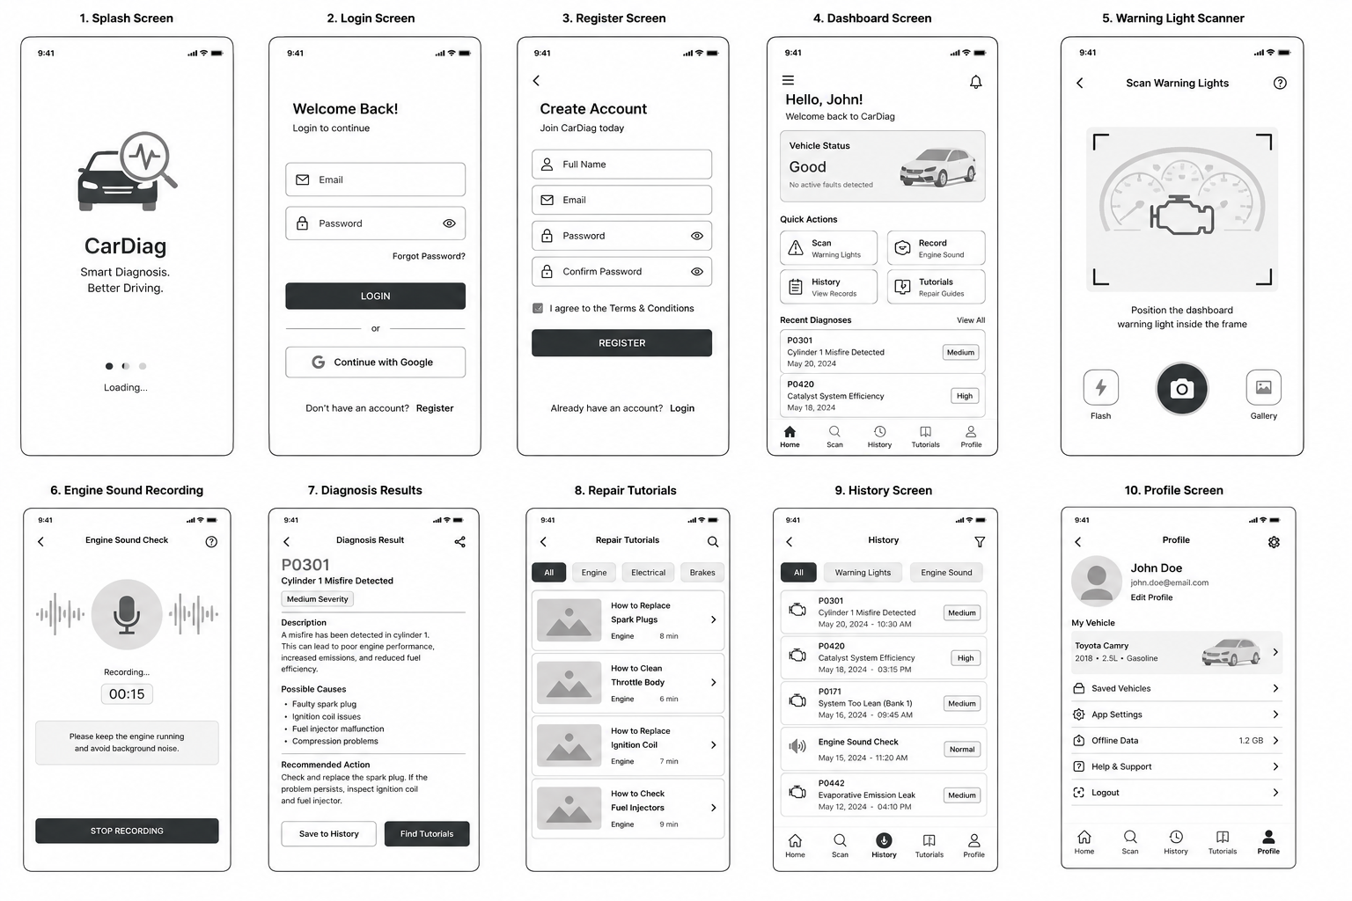

Slide 7
Mockup Design
The high-fidelity mockups represent the final visual appearance of the CarDiag mobile application . They were created to demonstrate how users will interact with the system before the development phase is completed.

Slide 8
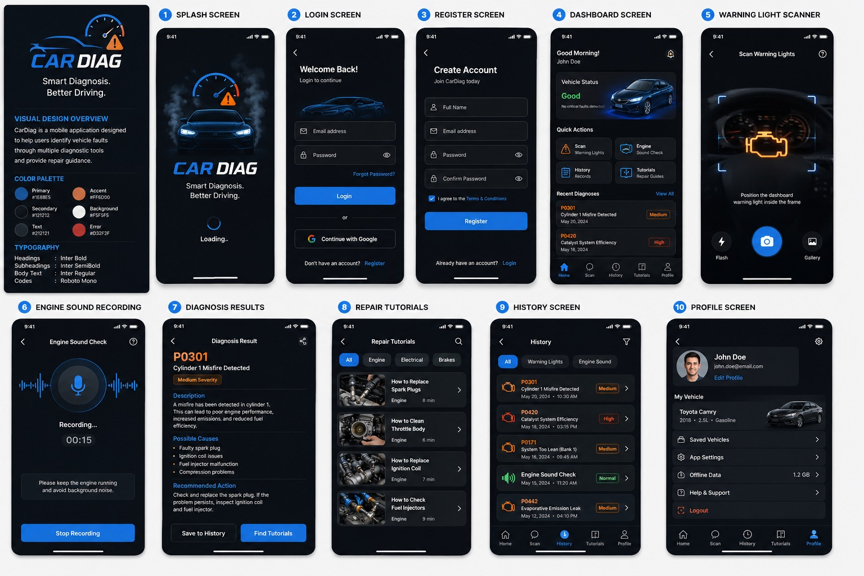

Slide 9
Frontend Implementation
Project Setup
Project Structure
Framework
React Native CLI with TypeScript
CarDiag/
Init command
npx react-native init CarDiag
├── android/ iOS/
├── src/
Navigation
@react-navigation/native + bottom-tabs
│ ├── screens/ (10 screens)
State
Zustand
│ ├── components/ (reusable UI)
│ ├── navigation/ (stack + tabs)
HTTP
Axios
│ ├── services/ (API calls)
Storage
@react-native-async-storage
│ ├── store/ (Zustand state)
│ └── theme/ (colors, fonts)
Camera
react-native-vision-camera
├── App.tsx
Sound
react-native-audio-recorder-player
└── package.json
Slide 7 of 8
CarDiag | Group 12 | CEF 440

Slide 10
What We Delivered
01
02
03
App Identity
Visual Design
Frontend Implementation
• Package name and SDK targets
• 4 design principles
• React Native CLI + TypeScript
• Colour palette and typography
• 10 screen wireframes
• Feature-based folder structure
• Logo and icon design
• 10 high-fidelity mockups
• Full dependency list
Group 12 | CEF 440 | University of Buea | Supervisor: Dr. Valery Nkemeni | 2025/2026

