Slide 1
PayPal AI Hackathon 2026
ASTERION
Intent. Evidence. Payment.
Agent commerce with a customer-approved spending mandate
La Palma, Canary Islands. Verified private AI + PayPal Sandbox prototype.
01 / 10
Notes:
“Book an extraordinary night under the stars. Coordinate the guide, telescope and transport. Stay within my budget, and complete payment only when the evidence satisfies the conditions I approve.”
That request is ASTERION's starting point. The product combines agent proposals with an explicit financial mandate and an inspectable execution policy. We have verified a private three-supplier Gemini negotiation followed by autonomous PayPal Sandbox settlement of the same agreement. Sandbox uses fictitious funds. We have also verified a separate cloudy-condition authorization void.
The public application provides a reproducible demonstration with simulated payments. We keep these environments visible because a credible financial agent must make its authority and evidence clear.
Sources: integrated AI and Sandbox evidence: https://github.com/Enrickq/asterion-commerce/blob/main/docs/evidence/ai-sandbox-run.json, baseline PayPal outcomes: https://github.com/Enrickq/asterion-commerce/blob/main/docs/evidence/paypal-sandbox.json, public verification: https://github.com/Enrickq/asterion-commerce/blob/main/docs/VERIFICATION.es.md, official hackathon announcement: https://developer.paypal.com/community/blog/PayPal_AI_Hackathon/.

Slide 2
The mandate as the unit of commerce
The customer specifies the outcome.
Agents coordinate its components.
The purchase today
The ASTERION agreement
The customer reconciles offers, schedules and cancellation terms across suppliers.
One approved price, supplier allocation and evidence policy. The server enforces the spending limit.
The model proposes terms. Customer consent defines its financial authority.
02 / 10
Notes:
The customer wants an experience that can happen under acceptable conditions. Coordinating three separate suppliers creates work before checkout and uncertainty afterward. Our product thesis is that agents can negotiate the components while an application enforces one common mandate.
This changes the interaction from selecting individual line items to approving a proposed outcome. The user still approves the agreement and the PayPal order. The model cannot increase the budget, rewrite the approved conditions or invoke payment tools.
This is a product hypothesis, not a claim that every purchase should become autonomous. The first useful markets are coordinated purchases whose conditions can be expressed and verified.
Source: architecture and trust boundaries: https://github.com/Enrickq/asterion-commerce/blob/main/docs/ARCHITECTURE.md.

Slide 3
A verified La Palma agreement
CUSTOMER CEILING
GEMINI AGREEMENT
€1,700
€1,650
Allocation | Amount
Private astronomy guide | €425
Telescope and observation equipment | €620
Private transport | €425
Organizer coordination | €180
Total | €1,650
3 actual Gemini requests. Recorded 23 Oct 2026. Simulated inventory and weather.
03 / 10
Notes:
On October 23, Canary Islands time, three isolated `gemini-3.1-flash-lite` supplier requests returned valid quotes. The backend validated whole-cent amounts against each supplier's limits and persisted this €1,650 agreement within the €1,700 mandate. Inference took about 55 seconds in that run.
These prices came from a simulated service catalog. They are not quotations from actual La Palma operators. The €180 organizer allocation is a gross remainder before fees, taxes and other costs, not demonstrated profit.
The proposed nighttime experience would use a permitted nearby observation site and a provider's own equipment. Public visits to the observatory's research telescopes take place during the day. We do not imply an IAC partnership, nighttime access to scientific telescopes or a completed reservation.
Sources: Gemini request metadata and allocations: https://github.com/Enrickq/asterion-commerce/blob/main/docs/evidence/gemini-verification.json, same-agreement settlement evidence: https://github.com/Enrickq/asterion-commerce/blob/main/docs/evidence/ai-sandbox-run.json, IAC visitor guidance: https://iac.es/es/observatorios-de-canarias/observatorio-del-roque-de-los-muchachos/visitas.

Slide 4
Models propose. The server controls payment.
Layer | Authority
Buyer and supplier agents | Propose quotes within validated limits
Approved agreement | Bind allocations and policy to the approved hash
Evidence policy | Check completeness, freshness and thresholds
Payment engine | Authorize, capture or void. Reconcile uncertainty.
SQLite and Autopilot | Persist operations and resume eligible jobs
The model receives a quote tool. Payment tools and secrets stay on the server.
Node.js 24 + React + AG Grid. Restart recovery requires the database to survive.
04 / 10
Notes:
The current application runs one Node.js 24 process with SQLite. React and Vite power the interface. AG Grid Community exposes supplier allocations and operational states.
In the Gemini path, each supplier receives a separate context containing its own price limits. Its only declared function is `quote`. Returned arguments are data that the backend validates. The model receives no payment tools, provider credentials or authority to reserve real inventory.
After buyer approval and authorization, arming Autopilot persists a job before acknowledging it. A server worker evaluates evidence and follows the capture or void path without another financial command from the browser. The application saves operation identifiers before provider requests and treats uncertain results as unresolved until reconciliation. This supports recovery when the database survives a restart.
The free public Render service uses ephemeral storage. Local restart recovery tests do not make that hosted filesystem durable. Scaling beyond one process requires transactional shared storage and durable work orchestration.
Sources: architecture: https://github.com/Enrickq/asterion-commerce/blob/main/docs/ARCHITECTURE.md, Gemini implementation and validation: https://github.com/Enrickq/asterion-commerce/blob/main/docs/INTEGRATIONS.md#optional-google-gemini-negotiation.

Slide 5
Sponsor integrations with evidence
Technology | Concrete use | Evidence status
AG Grid Community | Supplier allocations and states | Running in the app
Render | Host the Node application | Public service verified
APIMatic Context Plugin | PayPal context during development | Installed and consulted
Kernel | Configured supplier browser session | External run pending
Astropods | Independent supplier agents | Proposed extension
Elastic / Channel3 | Search and expanded catalog | Proposed extensions
Render Web Service. AG Grid Community. APIMatic supports development review.
05 / 10
Notes:
We show the status of each integration because sponsor use must be meaningful and demonstrable. AG Grid Community is part of the working React interface. We do not claim AG Studio or Enterprise functionality.
Render hosts the free Frankfurt web service. Hosted clear and cloudy Autopilot flows and receipt integrity have been verified. This deployment is a web service, not Render Workflows usage.
APIMatic's PayPal Context Plugin was installed and consulted during implementation review, including uncertain capture responses and reconciliation. It is a development aid. This application uses direct PayPal REST calls and does not claim a generated APIMatic SDK or runtime payment processing by APIMatic.
Kernel has an implemented session adapter but no recorded external run. It does not currently scrape terms, reserve inventory or certify weather. Astropods, Elastic and Channel3 remain proposed extensions. Using or listing three sponsors does not itself establish eligibility for any sponsor award.
Sources: integration matrix: https://github.com/Enrickq/asterion-commerce/blob/main/docs/INTEGRATIONS.md, APIMatic evidence: https://github.com/Enrickq/asterion-commerce/blob/main/docs/APIMATIC-CONTEXT.md, public deployment verification: https://github.com/Enrickq/asterion-commerce/blob/main/docs/VERIFICATION.es.md, official partner announcement: https://developer.paypal.com/community/blog/PayPal_AI_Hackathon/.

Slide 6
The demonstration in 2:50
Time | Visible action | What it proves
0:00–0:30 | Public mandate and negotiation | €1,500 ceiling. €1,480 bundle.
0:30–1:15 | Consent and clear-fixture Autopilot | Server execution and supplier states
1:15–1:40 | Separate public cloudy agreement | Failed conditions prevent capture
1:40–2:18 | Recorded Gemini + Sandbox evidence | €1,650 capture. Three Payouts succeed.
2:18–2:38 | Receipt and read-only forecast | Inspectable decisions and oracle boundary
2:38–2:50 | Next milestone and product vision | Real operators and local observations
Public payments are simulated. Historical private evidence uses Sandbox test funds.
06 / 10
Notes:
Recording plan. Use docs/VIDEO-RECORDING.en.md and docs/DEMO.en.md. Record the working public application in simulation mode with a €1,500 ceiling and its €1,480 deterministic agreement. Show customer consent, clear-fixture Autopilot, then a visibly separate cloudy agreement. Switch to the public Verified runs view and label the €1,650 Gemini/PayPal outcome as recorded private evidence from 23 October 2026, rather than footage of a new run. It includes actual Gemini requests and actual PayPal Sandbox API operations using fictitious funds. All supplier inventory and settlement weather remain fixtures. Label edited waits. If a future fresh private run is recorded, revise every amount and claim to match it.
Sources: https://github.com/Enrickq/asterion-commerce/blob/main/docs/DEMO.en.md
https://github.com/Enrickq/asterion-commerce/blob/main/docs/VIDEO-RECORDING.en.md
https://asterion-mj13.onrender.com/#verified-runs

Slide 7
The PayPal Edge
An approved mandate controls when
the server may complete payment.
Evidence decision | Financial action
Approved conditions pass | Capture, then separate supplier Payouts
Conditions fail or evidence is incomplete | Void the authorization. Record the reason.
Provider result is uncertain | Keep unresolved and reconcile with PayPal
One organizer sells the bundle. Supplier Payouts use separate operations and available balance.
07 / 10
Notes:
Our product contribution connects an approved agreement, evidence and a traceable execution decision. PayPal already provides the underlying authorization and capture capabilities.
The adapter creates one Orders v2 purchase unit with `intent: AUTHORIZE`. After official buyer approval, it authorizes the order. Payments v2 then captures or voids the resulting authorization. The implementation retains order, authorization and capture identifiers separately.
An authorization is subject to PayPal and funding-source rules. PayPal documents a 29-day authorization window and recommends capture within its initial three-day honor period. Capture remains subject to risk and availability. ASTERION does not provide escrow or install a smart contract inside PayPal. Voiding an authorization is different from refunding a captured payment.
Payouts uses the organizer's available balance and requires the relevant PayPal access. Capture and supplier disbursements are not an atomic split. The application checks each supplier item's amount, currency, references and status. It does not relabel a pending batch as completed. Webhook handling exists, but actual webhook delivery remains unverified.
Sources: PayPal authorization guidance: https://developer.paypal.com/docs/checkout/standard/customize/authorization/, Orders v2: https://developer.paypal.com/api/orders/v2, Payouts overview: https://developer.paypal.com/docs/payouts/standard/, webhook documentation: https://developer.paypal.com/api/rest/webhooks/, implementation and reconciliation: https://github.com/Enrickq/asterion-commerce/blob/main/docs/INTEGRATIONS.md#paypal-sandbox-validation.

Slide 8
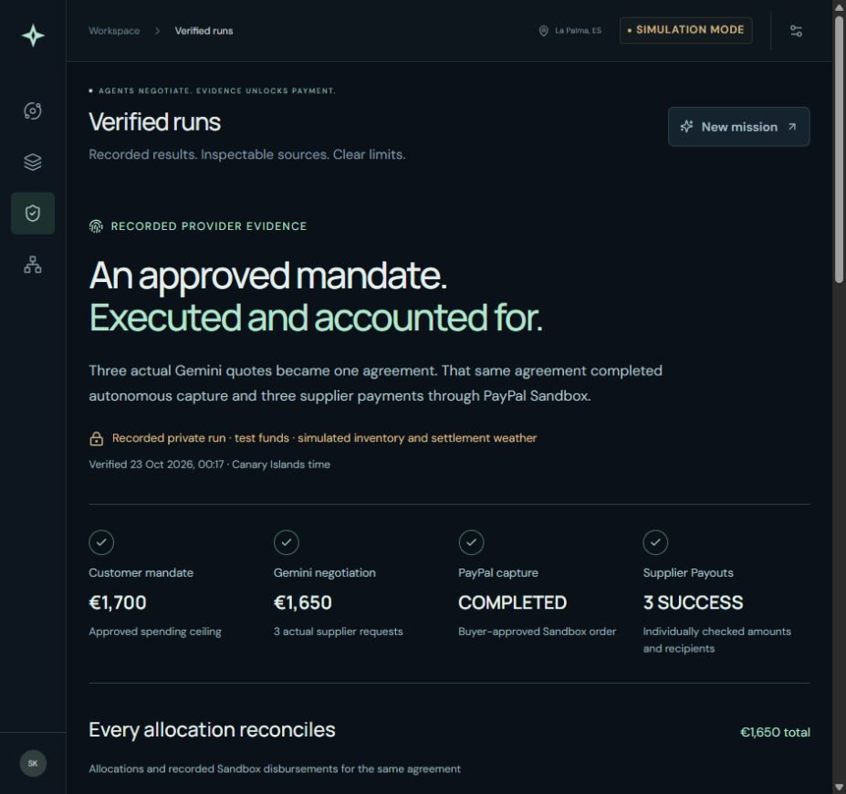
Verified outcomes, visible limits
142
automated tests at deployed revision
RECORDED PRIVATE RUN
3 Gemini quotes
€1,650 Sandbox capture
3 supplier items confirmed SUCCESS
MET Norway forecast preview is read-only. Complete local settlement observations remain pending.
Current app: c4428e9. Provider proof: historical baselines. Inventory and settlement weather: fixtures.
08 / 10
Notes:
The deployed application revision is commit `c4428e9e1342ad4ad64b6198a7233da6ccebaf2a`. Its verification record reports 142 automated tests, preflight, a frontend build and system smoke checks locally and in CI, including offline receipt verification. Public clear and cloudy Autopilot flows were checked on this revision. The historical private model and payment runs retain their own baselines; they are not represented as new transactions performed by this release.
Automated connector tests use mocks. Real-provider claims come from separate private runs followed by authenticated provider queries. The sanitized records retain transaction references and status metadata without credentials. They are local evidence summaries, not digitally signed attestations by PayPal or Google.
The integrated agreement completed three real Gemini quote requests and subsequently settled through PayPal Sandbox using fictitious funds. The separate cloudy agreement demonstrates an authorization void. Both weather scenarios used fixtures. Earlier Gemini errors stopped without creating an agreement or payment, and the successful run does not imply guaranteed model availability.
The public demo is available at asterion-mj13.onrender.com: https://asterion-mj13.onrender.com/. Its free service has cold starts and ephemeral SQLite/session storage. It blocks Sandbox payments and Kernel launches for public visitors.
The separate **Read forecast** view retrieves a MET Norway model forecast with attribution, original model update time and forecast validity. It does not change an agreement or authorize capture. New policy checks reject renamed duplicate sources and incomplete or non-local actual observations. Declared source lineage is not a field-validated proof of independence.
Sources: verification record and CI reference: https://github.com/Enrickq/asterion-commerce/blob/main/docs/VERIFICATION.es.md, integrated provider evidence: https://github.com/Enrickq/asterion-commerce/blob/main/docs/evidence/ai-sandbox-run.json, Gemini request metadata: https://github.com/Enrickq/asterion-commerce/blob/main/docs/evidence/gemini-verification.json, baseline PayPal outcomes: https://github.com/Enrickq/asterion-commerce/blob/main/docs/evidence/paypal-sandbox.json, public repository: https://github.com/Enrickq/asterion-commerce.
Source image: actual public application screenshot, 25 October 2026, docs/assets/asterion-verified-runs.png. Public recorded proof: https://asterion-mj13.onrender.com/#verified-runs. The screenshot preserves the public SIMULATION MODE label, and its recorded-private-run notice explicitly identifies Sandbox test funds. Offline receipt verification checks consistency and hashes, not provider authenticity. Refund and payout uncertainty retain explicit review states.

Slide 9
The first customer is the organizer
PROPOSED PILOT
PRICING HYPOTHESIS
One experience operator
Three coordinated suppliers
Twenty supervised reservations
€149 / month
+ 1% of a settled reservation
Pilot measures: willingness to pay, coordination time
and payment disputes per reservation.
Proposed assumptions. No paying customers, live reservations or revenue established.
09 / 10
Notes:
This is a commercial proposal, not traction. We have not established a paying customer, a live booking pilot or product revenue. The operator would buy the software and remain the merchant for the coordinated experience.
Twenty supervised reservations is an initial pilot design. The proposed €149 monthly fee and 1% settlement fee are illustrative pricing hypotheses to test through customer interviews and an authorized pilot. They are separate from the €180 organizer coordination allocation in the demonstration. They do not represent validated unit economics, margin or a charge currently implemented in the application.
The pilot should establish whether the operator saves coordination time and whether customers understand conditional authorization. It should also record cancellations, blocked captures and disputes. A useful advantage would emerge from trusted supplier integrations, accepted sector policies and evidence that explains settlement decisions. Access to a foundation model alone does not establish that advantage.
Context: current prototype scope and next steps: https://github.com/Enrickq/asterion-commerce/blob/main/docs/SUBMISSION.md#whats-next, architecture requirements before financial use: https://github.com/Enrickq/asterion-commerce/blob/main/docs/ARCHITECTURE.md#work-required-before-public-financial-use. Pilot size and pricing are explicitly proposed assumptions.

Slide 10
A global platform through verified stages
Stage | Evidence required to advance
Verified prototype | Working public demo and private AI / Sandbox outcomes
La Palma pilot | Actual operator, permitted site and complete local evidence
Commercial operation | Verified identities, durable storage and provider approvals
B2C expansion | Coordinated travel and events with fulfillment conditions
B2B expansion | Supplier milestones with independently verifiable evidence
Every complex purchase can have a mandate
an agent can execute and explain.
asterion-mj13.onrender.com github.com/Enrickq/asterion-commerce
10 / 10
Notes:
The prototype establishes a technical starting point. The next milestone is a real oracle and actual operator integration, followed by a supervised pilot at a permitted location. A station observation or municipality forecast cannot silently replace the complete evidence required for a specific observation site.
Commercial operation needs verified authentication, operator authorization, durable orchestration and storage, an appropriate merchant arrangement, PayPal approvals where required and support for disputes and recovery. The current single-process SQLite deployment is not a high-availability architecture.
The reusable component is the mandate and policy boundary. Other purchases need their own evidence and contractual conditions. Coordinated travel, events and B2B delivery milestones are expansion hypotheses, not existing customers or integrations.
The hackathon requires meaningful use of PayPal and AI. Submission materials need English or an English translation. The current delivery checklist records a cutoff of November 12, 2026 at 12:00 PST, or 20:00 Canary Islands time. Registration, personal eligibility and final submission still require completion. A final public YouTube demonstration under three minutes remains pending. This presentation does not submit the project or guarantee an award.
Sources: current submission draft: https://github.com/Enrickq/asterion-commerce/blob/main/docs/SUBMISSION.md, architecture and field requirements: https://github.com/Enrickq/asterion-commerce/blob/main/docs/ARCHITECTURE.md, official hackathon rules: https://paypalaihackathon.devpost.com/rules, official event announcement: https://developer.paypal.com/community/blog/PayPal_AI_Hackathon/.
## Presentation files
The English PowerPoint: https://github.com/Enrickq/asterion-commerce/blob/main/docs/presentation/ASTERION-Pitch.en.pptx contains editable text and native tables, source references and presenter notes. This manuscript retains longer explanations for rehearsal. Keep the public/private scene transition, allocation arithmetic and environment disclosures intact when adapting it for a live pitch.

