Slide 1
MASTER'S THESIS · FINAL EXAMINATION
Wind Speed Modelling
for Derivatives Pricing
Candidate: Enrico Butali Supervisor: Prof.ssa Silvia Romagnoli
Second Cycle Degree in Greening Energy Market and Finance (LM-16 R)
Department of Statistical Sciences “Paolo Fortunati” · University of Bologna
Notes:
~20 s. Title, candidate, supervisor.

Slide 2
CH. 1 · MOTIVATION
Wind is free to generate — and impossible to store
Two legs of exposure for a wind producer
Volumetric — calm days cut generation directly; the shortfall is autocorrelated and seasonally heteroskedastic, not diversified away.
Price (merit order) — high wind output depresses the day-ahead clearing price; storm passages can push it to zero or below.
A weak, asymmetric natural hedge
ρ(generation, price) = −0.16 over 2015–2024 — real, but too weak and one-sided to substitute for a dedicated instrument. It cuts the upside without a floor under the downside.
ILLUSTRATIVE SCALE
100 MW
farm, 25.7% capacity factor → ≈225,100 MWh / yr
≈ €16.1m
annual revenue at the 2015–2024 mean SMARD price (€71.38/MWh) — gross, illustrative, not a project valuation.
Wind Speed Modelling for Derivatives Pricing — Final Defence
2
Notes:
~1 min. Two legs of exposure: volume and price. The merit-order correlation is only −0.16 (−0.476 / −0.275 within the two price regimes), so the natural hedge is weak and one-sided. The residual volumetric risk is what the thesis prices. €16.1m = 225,100 MWh × €71.38.

Slide 3
CH. 1 · AIM AND SCOPE
What the thesis sets out to do
THE QUESTION
Can a continuous-time wind-speed model price a German onshore producer’s volumetric risk — and how much does that price depend on calibrating it on the right wind data?
SCOPE
1
PRICE
Starting point. After the weak merit-order hedge (ρ = −0.16) a producer keeps a volumetric risk, priced here on German onshore wind generation (SMARD, 2015–2024).
Method. One pipeline — Box–Cox and Fourier deseasonalisation, AR(4), GARCH(1,1), CAR(4) — yields a closed-form variance-swap fair strike.
Design. The identical pipeline runs on a misaligned proxy (Bologna, 10 m) and an aligned reference (Nordfriesland, 100 m): the gap between the two prices is the Value of Information.
θ = 0 is adopted as a benchmark assumption in the absence of EEX option-implied data; all strikes are physical-measure expectations.
A synthetic variance swap on wind generation — can it be priced in closed form?
2
HEDGE
A CAWS instrument for the calm years a variance swap cannot see.
3
DATA · VALUE OF INFORMATION
What does the wrong wind data cost — before and after a height correction?
Wind Speed Modelling for Derivatives Pricing — Final Defence
3
Notes:
~1 min 15 s. This replaces the three separate questions with the one question they serve. Read the question in the dark card, then the scope: we price the volume risk that the merit-order hedge leaves behind, with one model, on two datasets. The three strands on the right are RQ1 (price), RQ3 (hedge) and RQ2 (data / Value of Information) of the thesis, in the order the talk takes them. Say the theta = 0 sentence exactly as written.

Slide 4
CH. 1 · DATA
Two datasets, one identical pipeline
 | Dataset A — Proxy | Dataset B — Reference
Location | Bologna, Italy (44.29°N, 11.20°E) | Nordfriesland, Germany (54.77°N, 8.85°E)
Height | 10 m | 100 m (hub height)
Source | OpenWeatherMap API | Open-Meteo · ERA5 reanalysis
Period | 2015–2018 (4 yr) | 2015–2024 (10 yr)
Observations | 1,462 daily | 3,653 daily
Mean wind speed | 2.47 m/s | 8.07 m/s
Role | Build & validate the methodology | Carries all headline empirical claims
Why this pairing: the same five-stage pipeline, identical in functional form, is applied to both sites, so a difference in the resulting price is attributable to the data. One caveat, taken up in Ch. 3: the Box–Cox λ is set per dataset (0.1 vs 0.5), so raw strikes sit on different measurement scales.
Wind Speed Modelling for Derivatives Pricing — Final Defence
4
Notes:
~45 s. A = proxy used to build and validate; B = aligned reference carrying the headline claims. Mention lambda = 0.1 / 0.5 now so the common-scale point in the Value-of-Information section is not a surprise.

Slide 5
CH. 2 · METHODOLOGY AND PRICING INPUTS
One pipeline, five stages — two numbers carry the price
1
2
3
4
5
Deseasonalise
AR(4)
GARCH(1,1)
CAR(4)
Stochastic vol.
Box–Cox + Fourier
conditional mean
conditional variance
continuous-time embedding
Heston / CIR, theoretical
→ W̃(t), C₀
→ β₁ … β₄
→ h(t₀)
→ A, exp(Aτ)
→ Feller check
C₀
8.85× gap
h(t₀)
1.82× gap
Fourier seasonal-variance mean (stage 1)
GARCH conditional-variance state (stage 3)
Dataset A 0.13138 Dataset B 1.16277
Dataset A 0.4137 Dataset B 0.7511
Fair strike K_{var} = h(t₀) × C₀ piecewise-constant h (Tol 1997), θ = 0 benchmark
0.05435 (Dataset A) vs 0.87336 (Dataset B)
Wind Speed Modelling for Derivatives Pricing — Final Defence
5
Notes:
~1 min. Keep it brisk: one pipeline, applied identically to both datasets. Only two outputs enter the price: C0, the mean level of the Fourier seasonal variance, and h(t0), the GARCH state on the pricing date. K = h(t0) x C0 under the piecewise-constant convention of Tol (1997). The CAR(4) embedding (Benth & Saltyte Benth 2009) is what allows pricing off the daily grid. One sentence on validation: every fitted specification beats persistence (DM 8.27 and 16.76) and they are identical on point forecasts by construction (backup B3-B4). Estimates in B6, Feller in B1. Then move to the instrument.

Slide 6
CH. 3 · VARIANCE SWAP — THE MARKET STRIKE
The instrument: a variance swap on German wind generation
THE CONTRACT
ANNUAL PAYOFF OF A LONG UNIT-NOTIONAL SWAP STRUCK AT K = 113.1
Π = RV[t,T] − K
RV = (252 / N) · Σ rₛ²
rₛ: daily log-return of SMARD German onshore wind generation.
The long side receives realised variance; the producer (long volume, short its stability) sells it and receives K − RV.
Linear in RV: no gamma, no path-dependent convexity.
TRACK A — EMPIRICAL FAIR STRIKE
113.1
252× rolling mean realised variance, 2015–2024. A realised quantity — nothing is backed out of a traded price.
95.5 – 132.0
+2.34
−14.8
annual realised variance, 2019 – 2024
mean payoff: the strike was close to fair
5th-percentile year, ≈13% of strike
Wind Speed Modelling for Derivatives Pricing — Final Defence
6
Notes:
~1 min 15 s. The underlying is generation, not wind speed at a point: generation is what sets revenue and it has a ten-year market series. Payoff: realised variance minus strike. The producer is long volume and short its stability, so it sells variance. Track A, 113.1, is the empirical fair strike: 252 times the rolling mean of squared daily log-returns of SMARD generation. It is large because German wind output routinely halves or doubles from one day to the next (daily s.d. about 67%). The chart is the decade at that strike: annual realised variance ranges from 95.5 (2019) to 132.0 (2024), mean payoff +2.34, so the strike was close to fair; worst year about -15, roughly 13% of the strike. Source: thesis §3.1.1-3.1.3, §3.1.8, Table 22 (Dataset B sample).

Slide 7
CH. 3 · VARIANCE SWAP — THE MODEL STRIKE
Reconciled, model and market strikes share an order of magnitude
DATASET B — FROM h(t₀)·C₀ TO TRACK A UNITS (LOG SCALE)
TRACK B — MODEL-IMPLIED
K = h(t₀) × C₀ = 0.873
0.7511 × 1.16277 · piecewise-constant h (Tol 1997) · θ = 0 benchmark
RAW GAP ≈ 130×
A units artefact, not model error: Track B is un-annualised, in Box–Cox units, and measures a wind innovation — not a generation log-return.
RECONCILED: 328.8 vs 113.1
Model ≈ 2.9× above the market — expected when one grid point stands in for a spatially averaged national fleet.
Each step is a first-order delta-method factor (thesis Table 20): an arithmetic reconciliation, not a frozen phase output.
Wind Speed Modelling for Derivatives Pricing — Final Defence
7
Notes:
~1 min 15 s. Track B is the model-implied strike, h(t0) times C0 = 0.873 for Nordfriesland, under the piecewise-constant-h convention of Tol (1997) and the theta = 0 benchmark. Raw, it is about 130 times below Track A, and that gap is a units artefact, not model error: Track B is not annualised, it is in Box-Cox units, and it is the variance of a wind innovation rather than of a generation log-return. The chart applies the four conventions in sequence on a log scale: Box-Cox scale (W-bar^2(1-lambda) = 8.068), innovation to first difference (1.339), the cubic power curve (9/W-bar^2 = 0.138), annualisation (x252). Result 328.8 against 113.1: same order of magnitude, model about 2.9x above the market - what one grid point against a spatially averaged national fleet should give. If asked about Track B sensitivity: dK/dh = C0; winter 0.859, summer 0.891, h = 1 gives 1.163. Full chain for both datasets in backup B2.

Slide 8
CH. 3 · RISK MANAGEMENT — CAWS
CAWS: the left-tail complement — it pays in the calm years
ANNUAL PAYOFF Π = K − CAWS, % OF STRIKE (NON-OVERLAPPING YEARS)
READ THE RIGHT TAIL
 | A · Bologna | B · Nordfr.
Strike K | 2.4644 m/s | 8.0531 m/s
Calmest year | +6.70% (2017) | +4.99% (2021)
Windiest = CVaR₅% | −4.91% (2018) | −6.33% (2015)
Annual obs. | 4 | 10
CVaR₅% is the premium leg, and on 4 and 10 points a sample minimum: descriptive, not inferential.
CALM-YEAR TRANSLATION · 2021, ILLUSTRATIVE
≈ €2.3m
4.99% less wind → ≈14% less generation → ≈32,000 MWh on the 100 MW farm at €71.38/MWh. Not a 2021 P&L: that year’s price spike may have more than offset it.
Above zero: a calm year — the protection leg pays. Below zero: a windy year — the producer pays the premium.
Wind Speed Modelling for Derivatives Pricing — Final Defence
8
Notes:
~1 min. The variance swap is blind to direction: a long calm spell is low variance, not a loss. CAWS, the rolling annual mean wind speed, struck at its full-sample mean, pays K minus CAWS, so the bars above zero are calm years: 2017 for Bologna (+6.70% of strike), 2021 for Nordfriesland (+4.99%). Bars below zero are windy years in which the producer pays the premium - that is what the negative CVaR5% is (2018 and 2015), not a loss, and with 4 and 10 observations it is just the sample minimum. Calm-year translation: 4.99% less wind is about 14% less generation through the cubic power curve, about 32,000 MWh on the 100 MW farm, about EUR 2.3m at the full-sample price. Not a 2021 P&L: the price spike that year means the producer might well have earned more (§3.4.3). If asked about the cross-dataset 4.2x in m/s: mostly a height/units ratio; normalised by the strike the gap is about 30%.

Slide 9
CH. 3 · VALUE OF INFORMATION — THE HEADLINE
Proxy strike: 94% short — still 88% after height correction
MODEL-IMPLIED FAIR STRIKE K = h(t₀)·C₀
SHORTFALL vs WIND-PROFILE EXPONENT α
Open water → very rough terrain. Closing the full 16.07× would need α = 0.60.
WHERE THE 16.07× STRIKE RATIO SITS (LOG SCALE)
≈ four-fifths of the gap is C₀. But C₀ is measured on two different Box–Cox scales — next slide.
8.85× C₀ — seasonal-variance level
1.82× h(t₀)
Wind Speed Modelling for Derivatives Pricing — Final Defence
9
Notes:
~1 min 15 s. Same model, same instrument, two datasets. Priced on Bologna, the strike is 0.0544 against 0.8734 for Nordfriesland: 93.8% short. The 1.931 height correction, (100/10)^(2/7) from Peterson and Hennessey (1978), applied only here, lifts it to 0.1049 and leaves 88.0%. The right chart: whatever profile exponent you choose, from open water (1/10) to very rough terrain (0.25), the shortfall stays above 80%; closing the whole 16.07x would need alpha = 0.60, four times the 1/7 value. So height is not the explanation. The bar at the bottom splits the 16.07x on a log scale: 8.85x from C0, 1.82x from h(t0). Hand over: before calling the C0 part 'climatology', look at the scale it is measured on.

Slide 10
CH. 3 · VALUE OF INFORMATION — ON A COMMON SCALE
On a common scale, the two sites look alike
STRIKE RATIO B / A
RECONCILED MODEL STRIKE ÷ MARKET STRIKE
1.0× = market
TWO MEASUREMENT SCALES
TWO PRICING DATES
SAME RELATIVE VARIABILITY
C₀ is a variance in Box–Cox units: λ = 0.1 (A) vs λ = 0.5 (B).
h(t₀) on 31 Dec 2018 vs 31 Dec 2024: the 1.82× compares dates, not sites.
Coefficient of variation 0.384 (Bologna) vs 0.401 (Nordfriesland).
Wind Speed Modelling for Derivatives Pricing — Final Defence
10
Notes:
~1 min 15 s. State the qualification yourself, before the committee does. Left: the 16.07x ratio is between two variances on different Box-Cox scales (lambda 0.1 vs 0.5) and two pricing dates six years apart. Map both strikes onto the common axis of generation log-return variance (the reconciliation of the variance-swap slide, now for both datasets) and the ratio falls to about 2.5x; switch off the GARCH state (h = 1) and the climatological part is about 1.36x. Coefficients of variation 0.384 and 0.401 say the same: relative variability is nearly identical. Right: reconciled, the proxy is even closer to the market (1.17x) than the reference (2.91x), and the same holds at h = 1 (2.82x vs 3.87x). So the proxy's problem is not the level it quotes. Hand over: what it gets wrong is information. Source: §3.1.5, §3.3.2, Table 20.

Slide 11
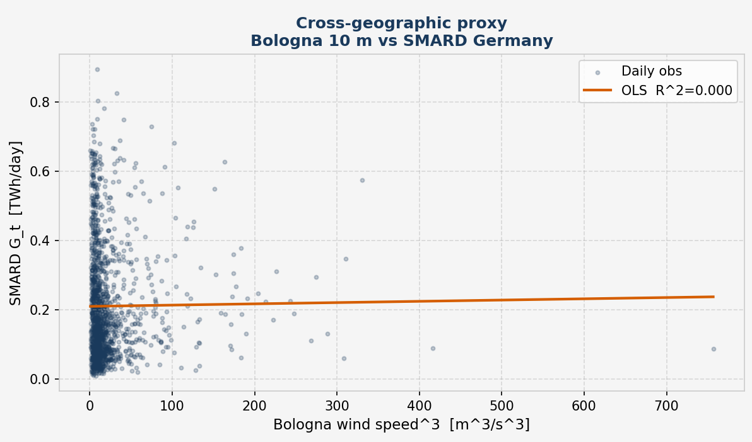
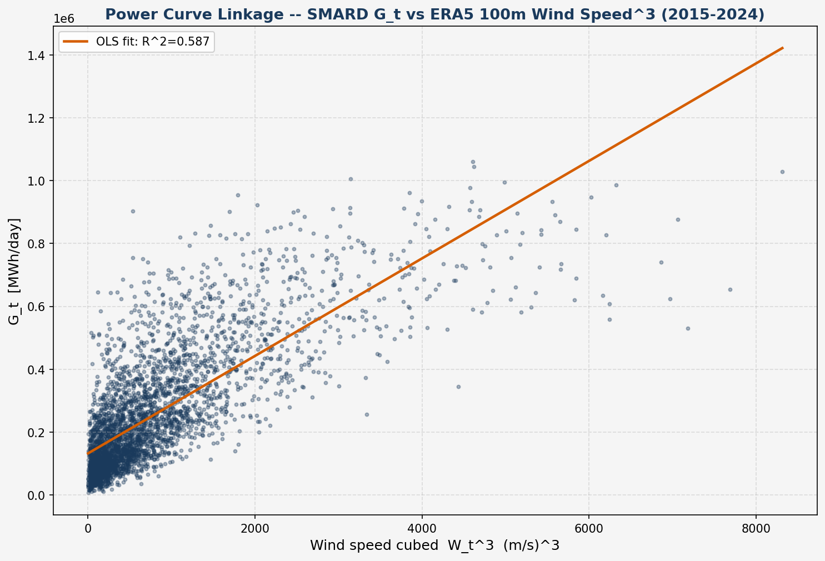
CH. 3 · VALUE OF INFORMATION — WHERE IT REALLY SITS
The proxy carries no information about what it would hedge
GENERATION EXPLAINED
58.7%
Nordfriesland 100 m
0.01%
Bologna 10 m
SMARD Gₜ = c·Wₜ³ + b, daily OLS
A — Bologna 10 m: R² = 0.0001, slope p = 0.723
B — Nordfriesland 100 m: R² = 0.587, p < 0.001
One grid point cannot reach R² = 1 against a national fleet: compare 0.587 with 0.0001, not with 1. It costs one OLS fit — screen wind series on it before pricing.
A proxy that quotes a plausible number while carrying no information is more dangerous than an obviously wrong one — only the second announces itself.
Wind Speed Modelling for Derivatives Pricing — Final Defence
11
Notes:
~1 min 15 s. The sharpest single result of the thesis. Regress daily SMARD generation on the cube of daily wind speed. Nordfriesland 100 m explains 58.7% of the daily variation in national onshore generation; Bologna 10 m explains 0.01%, with a slope not distinguishable from zero (p = 0.723). One grid point cannot reach R-squared = 1 against a national fleet, so compare 0.587 with 0.0001, not with 1. This is where the Value of Information really sits: not in the level of the strike - the previous slide showed the proxy can land close to the market by coincidence - but in whether the wind series explains the cash flow being hedged. And it costs one OLS fit: screen candidate wind series on this R-squared before pricing. Close on the quotation.

Slide 12
SUMMARY
The question, answered
1
PRICE
2
HEDGE
3
DATA
Yes — in closed form
CAWS covers the left tail
Alignment is decisive
K = h(t₀)·C₀ under θ = 0. Reconciled to market units, the Nordfriesland strike is the market’s order of magnitude (328.8 vs 113.1). It prices a variance swap, not an option on variance.
It pays in the calm years that depress revenue — 2021: +4.99% of strike, ≈ €2.3m on 100 MW, illustrative. Tail statistics are descriptive (n = 4, 10).
On the proxy the strike falls 94% short (88% height-corrected), yet on a common scale the sites look alike. The decisive evidence is the power curve: R² = 58.7% vs 0.01%.
“Data alignment is not a refinement to be added once the model works — it is a precondition for the model meaning anything.”
Wind Speed Modelling for Derivatives Pricing — Final Defence
12
Notes:
~1 min. One sentence per strand, then close on the quotation. Price: yes, in closed form, and once units are reconciled the model is the market's order of magnitude. Hedge: CAWS pays in the calm years. Data: the headline 94% / 88% is real but not scale-free; the decisive evidence is R-squared 58.7% vs 0.01%. Mapping to the thesis: Price = RQ1, Hedge = RQ3, Data = RQ2.

Slide 13
LOOKING AHEAD
Limitations, stated — and the work they motivate
LIMITATIONS
FUTURE WORK
θ = 0 is a benchmark in the absence of EEX option-implied data — not a claim the risk premium is zero.
Cross-dataset strikes sit on two Box–Cox scales and two pricing dates: the headline VoI is not scale-free.
One grid point vs a national fleet: spatial averaging caps R² and explains the 3–4× variance overstatement.
Daily data leave the SV parameters unidentified; Feller holds for B, estimator-dependent for A (backup).
4 and 10 annual CAWS observations: tail statistics are descriptive, not inferential.
Option-implied θ from EEX power options — needs a joint price–generation model; Carr–Lee as scaffolding.
Hourly ERA5 at the same coordinates (24 observations per day instead of one) to identify ξ separately from κᵥ.
A capacity-weighted, spatially aggregated wind input across the German fleet.
Screen candidate wind series on power-curve R² before pricing — one OLS fit.
Wind Speed Modelling for Derivatives Pricing — Final Defence
13
Notes:
~40 s. Limitations in the thesis's order (§3.5.2); future work maps one-to-one onto them (§3.5.3). Do not read them all - name theta = 0 and the single grid point, then stop.

Slide 14
THANK YOU
Questions and discussion
Enrico Butali · Wind Speed Modelling for Derivatives Pricing

Slide 15
BACKUP
Supporting detail, on request
B1 Feller condition — robust for B, estimator-dependent for A
B2 Reconciling Track B into Track A units, both datasets
B3 Model validation — four specifications, one conditional mean
B4 The Diebold–Mariano test in Chapters 2 and 3 — why the signs differ
B5 Height correction: sensitivity to the profile exponent α
B6 Model estimates at a glance — AR(4), GARCH(1,1), CAR(4), NIG

Slide 16
BACKUP B1 · CH. 2 §2.5.3 — FELLER CONDITION
The Feller condition depends on which estimator you trust
DATASET B — REFERENCE
DATASET A — PROXY
Holds, robustly
Estimator-dependent
2κᵥv̄ = 0.0270 vs ξ² = 0.000959 → margin 28.1×, on every estimator considered.
Full-sample estimator (same one used for B): margin 0.8× — violated.
30-day rolling estimators: margins ≈5.1× and 3.6× — holds, but on a different estimator than B's.
The finding is the sensitivity itself: ξ (vol-of-vol) is the least identified of the four CIR parameters at daily frequency — it also reverses an earlier project anchor of 27.9×, which is not reproducible under any estimator tested.
Wind Speed Modelling for Derivatives Pricing — Final Defence
16
Notes:
This is the chapter's most uncomfortable, and most interesting, result, and it is stated rather than smoothed over. The Feller condition asks whether the CIR variance process stays strictly positive almost surely. For Dataset B it holds comfortably, at a margin of 28.1 times, on every estimator considered. For Dataset A, the full-sample estimator — the same one used for B — gives a margin of only 0.8, meaning the condition is violated; but 30-day rolling estimators give margins of 3.6 to 5.1, meaning it holds. The verdict flips depending on which estimator you trust. That sensitivity is itself the finding: xi, the volatility-of-volatility parameter, is the least identified of the four CIR parameters at daily sampling frequency. It also means an earlier project record of a 27.9-times margin is not reproducible under any estimator tested and needed correcting.

Slide 17
BACKUP B2 · CH. 3 §3.1.5 — THE FOUR CONVENTIONS
Reconciling Track B into Track A units, step by step
Factor | Formula | Dataset A | Dataset B
K_var = h(t₀) × C₀ (as recorded) | — | 0.05435 | 0.87336
× Box–Cox scale | W̄^(2(1−λ)) | 5.088 | 8.068
× innovation → first difference | (RMSE pers. / RMSE AR(4))² | 1.292 | 1.339
× power curve | 9 / W̄² | 1.4764 | 0.13826
× annualisation | 252 | 252 | 252
Reconciled model strike (Track A units) |  | 132.9 | 328.8
Track A strike, same sample |  | 113.999 | 113.145
Ratio model / market (at h = 1) |  | 1.17 (2.82) | 2.91 (3.87)
Arithmetic reconciliation, not a frozen phase output. Each step is a first-order delta-method approximation at the sample mean, so the figures are order-of-magnitude statements. Both models overstate the market — the expected effect of calibrating on one grid point against a spatially averaged national fleet.
Wind Speed Modelling for Derivatives Pricing — Final Defence
17

Slide 18
BACKUP B3 · CH. 2–3 — MODEL VALIDATION
Four specifications, one conditional mean
AR(4) • AR(4)+GARCH • CAR(4)+Gaussian • CAR(4)+NIG
share one conditional mean by construction → indistinguishable on one-day-ahead forecast accuracy. They separate only on pricing and hedging criteria — which is why Chapter 3 does not rank them by RMSE alone.
ALL FOUR STILL REJECT PERSISTENCE, DECISIVELY
Diebold–Mariano statistic vs. persistence
Diebold–Mariano statistic vs. persistence
+8.27
+16.76
Dataset A — RMSE 0.8868 → 0.7802 (12.0% better than persistence)
Dataset B — RMSE 1.0046 → 0.8681 (13.6% better than persistence)
Full standardised series, dₜ = e²(persistence) − e²(model), §3.2. Chapter 2's held-out split reports −3.681 / −7.019 under the reversed sign convention — same test, same conclusion (B4).
Wind Speed Modelling for Derivatives Pricing — Final Defence
18
Notes:
Backup. All four fitted specifications share the AR(4) conditional mean, so they are identical on one-step RMSE by construction and separable only on pricing and hedging criteria (or a proper scoring rule such as CRPS). All beat persistence decisively.

Slide 19
BACKUP B4 · CH. 2 §2.2.4 & CH. 3 §3.2.1 — DIEBOLD–MARIANO
The same test, twice — why the signs differ
 | Chapter 2, §2.2.4 | Chapter 3, §3.2.1
Loss differential | dₜ = e²AR(4) − e²persistence | dₜ = e²persistence − e²model
A winning model gives | a negative statistic | a positive statistic
Evaluation sample | held-out partition (220 / 548 obs.) | full series (1,461 / 3,652 errors)
DM statistic (A / B) | −3.681 / −7.019 | +8.265 / +16.758
RMSE persistence (A / B) | 0.6856 / 0.9955 | 0.8868 / 1.0046
RMSE AR(4) (A / B) | 0.6017 / 0.8580 | 0.7802 / 0.8681
Improvement (A / B) | 12.2% / 13.8% | 12.0% / 13.6%
The sign is a convention, not a result. Same test, same conclusion: every fitted specification rejects equal accuracy with persistence at any conventional level, on either convention and either sample. Magnitudes scale with √n.
Why A's RMSEs move by 23%, B's by under 1%. A's hold-out ends in a calm spell: √(0.4137/0.608) = 0.825 vs an observed 0.773. B's h(t₀) = 0.7511 sits at its unconditional 0.7522, predicting one vs an observed 0.991.
Wind Speed Modelling for Derivatives Pricing — Final Defence
19

Slide 20
BACKUP B5 · CH. 3 §3.3.1 — HEIGHT CORRECTION
No admissible profile exponent turns the gap into a height effect
Profile exponent α | Factor 10^(2α) | Corrected K, A | Mispricing
1/10 (open water) | 1.585 | 0.0861 | 90.1%
1/7 (adopted) | 1.931 | 0.1049 | 88.0%
0.168 (ERA5 coastal, lower bound) | 2.166 | 0.1177 | 86.5%
0.20 (rough inland) | 2.512 | 0.1365 | 84.4%
0.25 (very rough terrain) | 3.162 | 0.1719 | 80.3%
TO CLOSE 16.07×
α = 0.60
four times the Hellmann value, outside any surface in Peterson & Hennessey (1978).
Only the 1/7 row is a frozen phase output; the other four are an arithmetic sensitivity computed for Chapter 3.
0.168 is measured at Nordfriesland (ERA5 10 m vs 100 m means, 5.4825 vs 8.0682 m/s) and is a lower bound for Bologna's sheltered Po-Valley site. A larger α means a smaller residual, so 88.0% is an upper bound on the share attributable to geography — the operative result is the 80.3% floor.
Wind Speed Modelling for Derivatives Pricing — Final Defence
20

Slide 21
BACKUP B6 · CH. 2 — MODEL ESTIMATES
The pipeline’s fitted parameters, both datasets
Quantity | Dataset A — Bologna 10 m | Dataset B — Nordfriesland 100 m
Box–Cox λ (optimum → adopted, 1/λ ∈ ℤ⁺) | −0.450 → 0.1 | 0.404 → 0.5
AR(4) β₁, β₂, β₃, β₄ | 0.6299, −0.1443, 0.0926, 0.0310 | 0.5324, −0.0763, 0.0324, −0.0074
AIC advantage of AR(3) over AR(4) | 0.59 | 1.8
GARCH ω, α, β | 0.01004, 0.03105, 0.95242 | 0.01348, 0.00590, 0.97618
Persistence α + β · volatility half-life | 0.9835 · 41.6 days | 0.9821 · 38.3 days
CAR(4) α₁, α₂, α₃, α₄ | 3.3701, 4.2546, 2.3063, 0.3908 | 3.4676, 4.4789, 2.5228, 0.5188
Eigenvalues of A | −0.9358 ± 0.4653i, −1.2004, −0.2980 | −1.0730 ± 0.2550i, −0.7614, −0.5602
Oscillatory period · mean-reversion half-life | 13.5 days · 2.33 days | 24.6 days · 1.24 days
NIG α̂ · KS p (NIG / Gaussian) | 4.374 · 0.120 / 0.079 | 2,649.57 · 0.0275 / 0.0269
GARCH standardised residuals | all diagnostics pass | z² lag 5 p = 0.0167; ARCH-LM p = 0.0185
Frozen phase outputs (thesis Tables 5, 7, 10, 13, 14, 16, 24). AR(4) is retained on structural grounds: CAR(4) needs a four-dimensional companion matrix.
Wind Speed Modelling for Derivatives Pricing — Final Defence
21
Notes:
Backup. AR(4) kept over the AIC-preferred AR(3) (gaps 0.59 and 1.8 units, inside the 2-point band) because the CAR(4) embedding needs a 4-dimensional companion matrix. All eigenvalues in the open left half-plane: stationary. The complex pair makes the kernel peak at about 3.6 days in both datasets, breaking the monotone Samuelson effect (Benth & Saltyte Benth 2009). NIG buys little: KS p 0.079 to 0.120 for A, none for B (alpha about 2,650). Dataset B's GARCH leaves short-lag structure (z^2 lag 5 p = 0.0167, ARCH-LM p = 0.0185): a GARCH(2,1) or two-component model would be the remedy; pricing uses only h(t0) and the unconditional level.

