Slide 1
MASTER'S THESIS · FINAL EXAMINATION
Wind Speed Modelling
for Derivatives Pricing
Candidate: Enrico Butali Supervisor: Prof.ssa Silvia Romagnoli
Second Cycle Degree in Greening Energy Market and Finance (LM-16 R)
Department of Statistical Sciences “Paolo Fortunati” · University of Bologna
Notes:
~20 s. Title, candidate, supervisor.

Slide 2
CH. 1 · MOTIVATION
Wind is free to generate — and impossible to store
Two legs of exposure for a wind producer
Volumetric — calm days cut generation directly; the shortfall is autocorrelated and seasonally heteroskedastic, not diversified away.
Price (merit order) — high wind output depresses the day-ahead clearing price; storm passages can push it to zero or below.
A weak, asymmetric natural hedge
ρ(generation, price) = −0.16 over 2015–2024 — real, but too weak and one-sided to substitute for a dedicated instrument. It cuts the upside without a floor under the downside.
ILLUSTRATIVE SCALE
100 MW
farm, 25.7% capacity factor → ≈225,100 MWh / yr
≈ €16.1m
annual revenue at the 2015–2024 mean SMARD price (€71.38/MWh) — gross, illustrative, not a project valuation.
Wind Speed Modelling for Derivatives Pricing — Final Defence
2
Notes:
~1 min. Two legs of exposure: volume and price. The merit-order correlation is only −0.16 (−0.476 / −0.275 within the two price regimes), so the natural hedge is weak and one-sided. The residual volumetric risk is what the thesis prices. €16.1m = 225,100 MWh × €71.38.

Slide 3
CH. 1 · DATA
Two datasets, one identical pipeline
 | Dataset A — Proxy | Dataset B — Reference
Location | Bologna, Italy (44.29°N, 11.20°E) | Nordfriesland, Germany (54.77°N, 8.85°E)
Height | 10 m | 100 m (hub height)
Source | OpenWeatherMap API | Open-Meteo · ERA5 reanalysis
Period | 2015–2018 (4 yr) | 2015–2024 (10 yr)
Observations | 1,462 daily | 3,653 daily
Mean wind speed | 2.47 m/s | 8.07 m/s
Role | Build & validate the methodology | Carries all headline empirical claims
Why this pairing: the same five-stage pipeline, identical in functional form, is applied to both sites, so a difference in the resulting price is attributable to the data. One caveat, taken up in Ch. 3: the Box–Cox λ is set per dataset (0.1 vs 0.5), so raw strikes sit on different measurement scales.
Wind Speed Modelling for Derivatives Pricing — Final Defence
3
Notes:
~1 min. A = proxy used to build and validate; B = aligned reference carrying the headline claims. Mention λ = 0.1 / 0.5 now so the commensurability point in Ch. 3 is not a surprise.

Slide 4
CH. 1 · RESEARCH QUESTIONS
Three questions, one pipeline
1
2
3
FEASIBILITY
VALUE OF INFORMATION
RISK MANAGEMENT
Can CAR(4)+GARCH(1,1), calibrated on wind speed aligned in geography and height with the generation being hedged, price a synthetic wind variance swap in closed form?
What is the pricing cost — the Value of Information — of using a geographic proxy instead of an aligned reference, before and after a wind-profile height correction?
How does a Cumulative Accumulated Wind Speed (CAWS) instrument behave as a left-tail complement to the variance swap?
Wind Speed Modelling for Derivatives Pricing — Final Defence
4
Notes:
~40 s. Read the three questions; they structure the rest of the talk.

Slide 5
CH. 2 · METHODOLOGY AND PRICING INPUTS
One pipeline, five stages — two numbers carry the price
1
2
3
4
5
Deseasonalise
AR(4)
GARCH(1,1)
CAR(4)
Stochastic vol.
Box–Cox + Fourier
conditional mean
conditional variance
continuous-time embedding
Heston / CIR, theoretical
→ W̃(t), C₀
→ β₁ … β₄
→ h(t₀)
→ A, exp(Aτ)
→ Feller check
C₀
8.85× gap
h(t₀)
1.82× gap
Fourier seasonal-variance mean (stage 1)
GARCH conditional-variance state (stage 3)
Dataset A 0.13138 Dataset B 1.16277
Dataset A 0.4137 Dataset B 0.7511
Fair strike K_{var} = h(t₀) × C₀ piecewise-constant h (Tol 1997), θ = 0 benchmark
0.05435 (Dataset A) vs 0.87336 (Dataset B)
Wind Speed Modelling for Derivatives Pricing — Final Defence
5
Notes:
~1.5 min. Walk the pipeline quickly: each stage is applied identically to both datasets. Only two outputs enter the price: C₀ from the seasonal-variance fit and h(t₀) from GARCH. AR(4) is retained over the AIC-preferred AR(3) because CAR(4) needs a 4-dimensional companion matrix. Precedents: Tol (1997) for seasonal variance × GARCH; Benth & Šaltytė Benth (2009) for the AR(4)↔CAR(4) Euler map. Feller: holds for B (28.1×), estimator-dependent for A — backup.

Slide 6
CH. 2–3 · MODEL VALIDATION
Four specifications, one conditional mean
AR(4) • AR(4)+GARCH • CAR(4)+Gaussian • CAR(4)+NIG
share one conditional mean by construction → indistinguishable on one-day-ahead forecast accuracy. They separate only on pricing and hedging criteria — which is why Chapter 3 does not rank them by RMSE alone.
ALL FOUR STILL REJECT PERSISTENCE, DECISIVELY
Diebold–Mariano statistic vs. persistence
Diebold–Mariano statistic vs. persistence
+8.27
+16.76
Dataset A — RMSE 0.8868 → 0.7802 (12.0% better than persistence)
Dataset B — RMSE 1.0046 → 0.8681 (13.6% better than persistence)
Full standardised series, dₜ = e²(persistence) − e²(model), §3.2. Chapter 2's held-out split reports −3.681 / −7.019 under the reversed sign convention — same test, same conclusion (backup).
Wind Speed Modelling for Derivatives Pricing — Final Defence
6
Notes:
~1 min. All four fitted specifications share the AR(4) conditional mean, so they are identical on one-step RMSE by construction — separable only on pricing and hedging criteria. All beat persistence decisively. If asked about the Ch. 2 figures: sign convention and sample differ (backup).

Slide 7
CH. 3 · §3.1.5 — COMMENSURABILITY
Four conventions separate model from market
TRACK A — EMPIRICAL
TRACK B — MODEL
252×-annualised realised variance of SMARD generation log-returns — the market benchmark, 113.999 / 113.145 on the two samples.
h(t₀) × C₀ — the daily variance of a Box–Cox wind anomaly, not annualised. The raw gap to Track A (130× to 2,100×) is a units artefact, not model error.
RECONCILIATION CHAIN — TRACK B INTO TRACK A UNITS
h(t₀)×C₀
× Box–Cox scale
× innovation ratio²
× power curve
× 252 annualise
= reconciled
132.9 (A, 1.17× market) 328.8 (B, 2.91× market) — once reconciled, the same order of magnitude.
Note the proxy lands closer to the market. A coincidence of level, not of information — the power curve shows why.
Wind Speed Modelling for Derivatives Pricing — Final Defence
7
Notes:
~1.5 min. Track A ≈ 114, Track B ≈ 0.05–0.87: not comparable raw. Four conventions: power curve (9/W̄²), annualisation (×252), Box–Cox scale (W̄^{2(1−λ)}), innovation vs first difference. Reconciled: 132.9 and 328.8 vs ≈113. Both overstate the market — consistent with a single grid point vs a national fleet (spatial averaging). Full chain in backup.

Slide 8
CH. 3 · VALUE OF INFORMATION
Pricing on the proxy understates the strike by 88–94%
RAW MISPRICING
AFTER 1.931× HEIGHT CORRECTION
STRIKE RATIO B / A
93.8%
88.0%
16.07×
pricing on the Bologna proxy as-is
(100/10)^(2/7), Peterson & Hennessey 1978. Stays above 80% for every exponent α from 1/10 to 0.25.
8.85× from C₀ × 1.82× from h(t₀)
Height is not the explanation — and the headline is not scale-free.
Of the 16.07× ratio, 8.85× sits in C₀ and 1.82× in h(t₀). But the two C₀ are variances on different Box–Cox scales (λ = 0.1 vs 0.5), and the two h(t₀) are pricing dates six years apart. On a common axis the gap shrinks to ≈2.5×, ≈1.36× of it climatological: the sites' coefficients of variation are 0.384 vs 0.401. The case for the aligned dataset rests elsewhere.
Wind Speed Modelling for Derivatives Pricing — Final Defence
8
Notes:
~1.5 min. Headline: 93.8% raw, 88.0% after the 1.931× height correction. Robust to the profile exponent (backup table: 90.1% to 80.3%). Then state the qualification yourself before the committee does: different Box–Cox scales and pricing dates. This hands over to the power-curve slide.

Slide 9
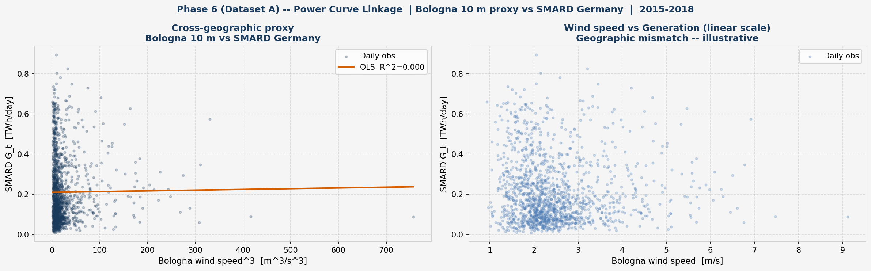
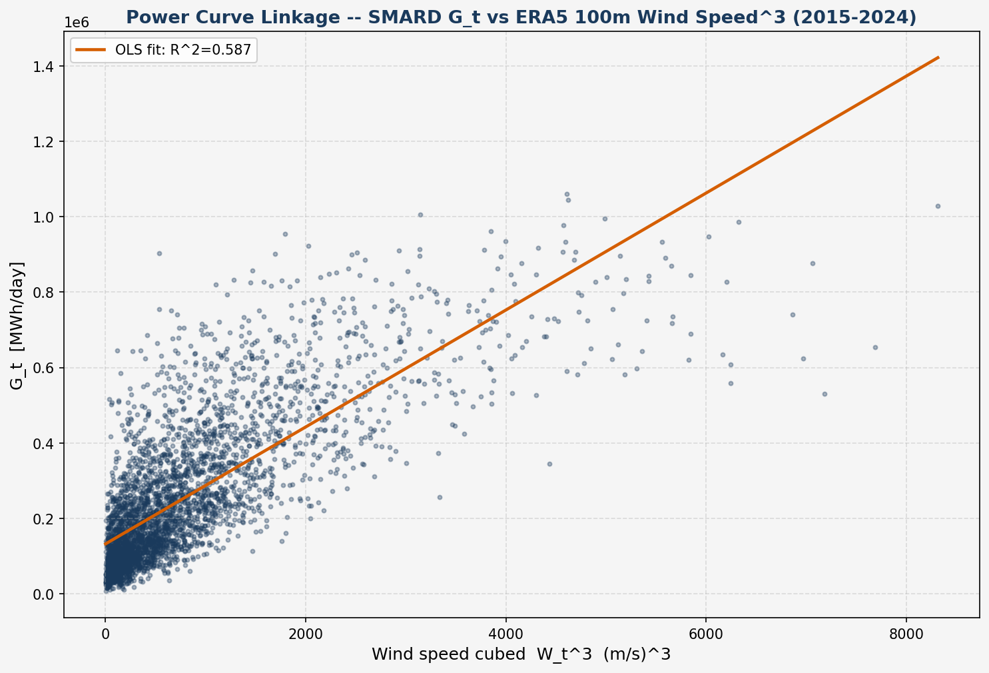
CH. 3 · §3.1.6 — THE REAL VALUE OF INFORMATION
The proxy carries no information about what it would hedge
SMARD Gₜ = c·Wₜ³ + b | A — Bologna 10 m | B — Nordfr. 100 m
Overlap window | 2015–2018 | 2015–2024
Paired daily obs. | 1,461 | 3,649
Slope c | 36.43 | 155.12
R² | 0.0001 | 0.5871
p-value on slope | 0.723 | < 0.001
SHARE OF DAILY GENERATION EXPLAINED
58.7% vs 0.01%
Nordfriesland 100 m vs Bologna 10 m. One grid point cannot reach R² = 1 against a national fleet: compare 0.587 with 0.0001, not with 1.
A proxy that quotes a plausible number while carrying no information is more dangerous than an obviously wrong one — only the second announces itself.
A — structureless cloud, slope indistinguishable from zero
B — clear cubic relation
Wind Speed Modelling for Derivatives Pricing — Final Defence
9
Notes:
~1.5 min. The sharpest single result. Regress SMARD generation on cubed wind speed: Nordfriesland explains 58.7%, Bologna 0.01% with p = 0.723 — no measurable information. This is where the Value of Information really sits, and it costs one OLS fit: screen candidate wind series on R² before pricing. Correction to the record: the Phase 6 write-up reported p < 0.0001 for A; the executed notebook gives 0.723.

Slide 10
CH. 3 · RISK MANAGEMENT
CAWS — a left-tail complement to the variance swap
 | Dataset A (n = 4 yr) | Dataset B (n = 10 yr)
Strike K (full-sample mean CAWS) | 2.4644 m/s | 8.0531 m/s
Protection leg — calmest year, % of K | +6.70% (2017) | +4.99% (2021)
Premium leg — windiest year (CVaR₅%) | −4.91% (2018) | −6.33% (2015)
Read the right tail. Π = N × (K − CAWS) pays in calm years, when generation revenue is depressed. The negative CVaR₅% is the premium paid in a windy year, not a loss; with 4 and 10 non-overlapping annual observations it is a sample minimum, so tail statistics are descriptive.
Calm-year translation (2021, illustrative): a 4.99% wind shortfall ≈ 14% generation shortfall ≈ 32,000 MWh ≈ €2.3m at €71.38/MWh. An order of magnitude, not a 2021 P&L: the price crisis would have partly offset that year's shortfall (§3.4.3).
Wind Speed Modelling for Derivatives Pricing — Final Defence
10
Notes:
~1.5 min. The variance swap is blind to direction; CAWS pays when the wind resource falls short. Emphasise the protection leg (2017 for A, 2021 for B). Pre-empt the misreading: the negative CVaR is the windy year paying the premium. Cross-dataset: 4.2× in m/s is mostly a height/units ratio; normalised the gap is ≈30%.

Slide 11
SUMMARY
Three research questions, answered
1
2
3
FEASIBILITY — YES
VOI — LOCATED
CAWS — BUILT & STRESS-TESTED
Yes, in closed form: K = h(t₀) × C₀. It prices a variance swap but not an option on variance, for which the Heston characteristic function (§2.5.5) would have to be evaluated, not merely written down.
The proxy understates the fair strike by 94%, 88% after height correction. The decisive evidence is the power curve: R² = 58.7% vs 0.01%.
Pays in exactly the calm years that depress revenue — 2021 would have paid 4.99% of strike. Tail statistics are descriptive on 4 and 10 annual observations.
“Data alignment is not a refinement to be added once the model works — it is a precondition for the model meaning anything.”
Wind Speed Modelling for Derivatives Pricing — Final Defence
11
Notes:
~1 min. One sentence per research question, then close on the quotation.

Slide 12
LOOKING AHEAD
Limitations, stated — and the work they motivate
LIMITATIONS
FUTURE WORK
θ = 0 is a benchmark in the absence of EEX option-implied data — not a claim the risk premium is zero.
Cross-dataset strikes sit on two Box–Cox scales and two pricing dates: the headline VoI is not scale-free.
One grid point vs a national fleet: spatial averaging caps R² and explains the 3–4× variance overstatement.
Daily data leave the SV parameters unidentified; Feller holds for B, estimator-dependent for A (backup).
4 and 10 annual CAWS observations: tail statistics are descriptive, not inferential.
Option-implied θ from EEX power options — needs a joint price–generation model; Carr–Lee as scaffolding.
Hourly ERA5 at the same coordinates (24 observations per day instead of one) to identify ξ separately from κᵥ.
A capacity-weighted, spatially aggregated wind input across the German fleet.
Screen candidate wind series on power-curve R² before pricing — one OLS fit.
Wind Speed Modelling for Derivatives Pricing — Final Defence
12
Notes:
~40 s. Limitations in the thesis's order (§3.5.2); future work maps one-to-one onto them (§3.5.3).

Slide 13
THANK YOU
Questions and discussion
Enrico Butali · Wind Speed Modelling for Derivatives Pricing

Slide 14
BACKUP
Supporting detail, on request
B1 Feller condition — robust for B, estimator-dependent for A
B2 Reconciling Track B into Track A units, factor by factor
B3 The Diebold–Mariano test in Chapters 2 and 3 — why the signs differ
B4 Height correction: sensitivity to the profile exponent α

Slide 15
BACKUP B1 · CH. 2 §2.5.3 — FELLER CONDITION
The Feller condition depends on which estimator you trust
DATASET B — REFERENCE
DATASET A — PROXY
Holds, robustly
Estimator-dependent
2κᵥv̄ = 0.0270 vs ξ² = 0.000959 → margin 28.1×, on every estimator considered.
Full-sample estimator (same one used for B): margin 0.8× — violated.
30-day rolling estimators: margins ≈5.1× and 3.6× — holds, but on a different estimator than B's.
The finding is the sensitivity itself: ξ (vol-of-vol) is the least identified of the four CIR parameters at daily frequency — it also reverses an earlier project anchor of 27.9×, which is not reproducible under any estimator tested.
Wind Speed Modelling for Derivatives Pricing — Final Defence
15
Notes:
This is the chapter's most uncomfortable, and most interesting, result, and it is stated rather than smoothed over. The Feller condition asks whether the CIR variance process stays strictly positive almost surely. For Dataset B it holds comfortably, at a margin of 28.1 times, on every estimator considered. For Dataset A, the full-sample estimator — the same one used for B — gives a margin of only 0.8, meaning the condition is violated; but 30-day rolling estimators give margins of 3.6 to 5.1, meaning it holds. The verdict flips depending on which estimator you trust. That sensitivity is itself the finding: xi, the volatility-of-volatility parameter, is the least identified of the four CIR parameters at daily sampling frequency. It also means an earlier project record of a 27.9-times margin is not reproducible under any estimator tested and needed correcting.

Slide 16
BACKUP B2 · CH. 3 §3.1.5 — THE FOUR CONVENTIONS
Reconciling Track B into Track A units, step by step
Factor | Formula | Dataset A | Dataset B
K_var = h(t₀) × C₀ (as recorded) | — | 0.05435 | 0.87336
× Box–Cox scale | W̄^(2(1−λ)) | 5.088 | 8.068
× innovation → first difference | (RMSE pers. / RMSE AR(4))² | 1.292 | 1.339
× power curve | 9 / W̄² | 1.4764 | 0.13826
× annualisation | 252 | 252 | 252
Reconciled model strike (Track A units) |  | 132.9 | 328.8
Track A strike, same sample |  | 113.999 | 113.145
Ratio model / market (at h = 1) |  | 1.17 (2.82) | 2.91 (3.87)
Arithmetic reconciliation, not a frozen phase output. Each step is a first-order delta-method approximation at the sample mean, so the figures are order-of-magnitude statements. Both models overstate the market — the expected effect of calibrating on one grid point against a spatially averaged national fleet.
Wind Speed Modelling for Derivatives Pricing — Final Defence
16

Slide 17
BACKUP B3 · CH. 2 §2.2.4 & CH. 3 §3.2.1 — DIEBOLD–MARIANO
The same test, twice — why the signs differ
 | Chapter 2, §2.2.4 | Chapter 3, §3.2.1
Loss differential | dₜ = e²AR(4) − e²persistence | dₜ = e²persistence − e²model
A winning model gives | a negative statistic | a positive statistic
Evaluation sample | held-out partition (220 / 548 obs.) | full series (1,461 / 3,652 errors)
DM statistic (A / B) | −3.681 / −7.019 | +8.265 / +16.758
RMSE persistence (A / B) | 0.6856 / 0.9955 | 0.8868 / 1.0046
RMSE AR(4) (A / B) | 0.6017 / 0.8580 | 0.7802 / 0.8681
Improvement (A / B) | 12.2% / 13.8% | 12.0% / 13.6%
The sign is a convention, not a result. Same test, same conclusion: every fitted specification rejects equal accuracy with persistence at any conventional level, on either convention and either sample. Magnitudes scale with √n.
Why A's RMSEs move by 23%, B's by under 1%. A's hold-out ends in a calm spell: √(0.4137/0.608) = 0.825 vs an observed 0.773. B's h(t₀) = 0.7511 sits at its unconditional 0.7522, predicting one vs an observed 0.991.
Wind Speed Modelling for Derivatives Pricing — Final Defence
17

Slide 18
BACKUP B4 · CH. 3 §3.3.1 — HEIGHT CORRECTION
No admissible profile exponent turns the gap into a height effect
Profile exponent α | Factor 10^(2α) | Corrected K, A | Mispricing
1/10 (open water) | 1.585 | 0.0861 | 90.1%
1/7 (adopted) | 1.931 | 0.1049 | 88.0%
0.168 (ERA5 coastal, lower bound) | 2.166 | 0.1177 | 86.5%
0.20 (rough inland) | 2.512 | 0.1365 | 84.4%
0.25 (very rough terrain) | 3.162 | 0.1719 | 80.3%
TO CLOSE 16.07×
α = 0.60
four times the Hellmann value, outside any surface in Peterson & Hennessey (1978).
Only the 1/7 row is a frozen phase output; the other four are an arithmetic sensitivity computed for Chapter 3.
0.168 is measured at Nordfriesland (ERA5 10 m vs 100 m means, 5.4825 vs 8.0682 m/s) and is a lower bound for Bologna's sheltered Po-Valley site. A larger α means a smaller residual, so 88.0% is an upper bound on the share attributable to geography — the operative result is the 80.3% floor.
Wind Speed Modelling for Derivatives Pricing — Final Defence
18

