Slide 1
MASTER'S THESIS · FINAL EXAMINATION
Wind Speed Modelling
for Derivatives Pricing
Candidate: Enrico Butali Supervisor: Prof.ssa Silvia Romagnoli
Second Cycle Degree in Greening Energy Market and Finance (LM-16 R)
Department of Statistical Sciences “Paolo Fortunati” · University of Bologna
Notes:
Good morning members of the Committee. The thesis I present today, entitled Wind Speed Modelling for Derivatives Pricing, belongs to the context of the energy transition. It addresses a central problem in the risk management of renewable producers: how to price hedging instruments written on an underlying that cannot be traded, namely the wind.

Slide 2
CH. 1 · MOTIVATION
Wind is free to generate — and impossible to store
Two legs of exposure for a wind producer
Volumetric — calm days cut generation directly; the shortfall is autocorrelated and seasonally heteroskedastic, not diversified away.
Price (merit order) — high wind output depresses the day-ahead clearing price; storm passages can push it to zero or below.
A weak, asymmetric natural hedge
ρ(generation, price) = −0.16 over 2015–2024 — real, but too weak and one-sided to substitute for a dedicated instrument. It cuts the upside without a floor under the downside.
ILLUSTRATIVE SCALE
100 MW
farm, 25.7% capacity factor → ≈225,100 MWh / yr
≈ €16.1m
annual revenue at the 2015–2024 mean SMARD price (€71.38/MWh) — gross, illustrative, not a project valuation.
Wind Speed Modelling for Derivatives Pricing — Final Defence
2
Notes:
Wind can be neither stored nor traded. A German onshore producer is therefore exposed on two legs. The first is volumetric: prolonged calms cut generation directly, and because wind is autocorrelated, they are not diversified away. The second is price: through the merit-order effect, strong wind depresses the day-ahead price exactly when the producer generates most. This negative correlation dampens revenue variance, but it is weak, minus 0.16 over 2015 to 2024, and asymmetric: it cuts the upside without a floor under a prolonged calm. As an order of magnitude, a 100-megawatt farm at a 25.7 per cent capacity factor generates about 225,000 megawatt-hours a year, roughly 16 million euros of gross revenue at the mean price.

Slide 3
CH. 1 · AIM AND SCOPE
What the thesis sets out to do
THE QUESTION
Can a continuous-time wind-speed model price a German onshore producer’s volumetric risk — and how much does that price depend on calibrating it on the right wind data?
SCOPE
1
PRICE
Starting point. After the weak merit-order hedge (ρ = −0.16), a German onshore producer keeps a volumetric risk.
Method. One continuous-time pipeline yields a closed-form variance-swap fair strike.
Design. The same pipeline runs on a misaligned proxy and an aligned reference: the gap between the two prices is the Value of Information.
θ = 0 is adopted as a benchmark assumption in the absence of EEX option-implied data.
A synthetic variance swap on wind generation — can it be priced in closed form?
2
HEDGE
A CAWS instrument for the calm years a variance swap cannot see.
3
DATA · VALUE OF INFORMATION
What does the wrong wind data cost — before and after a height correction?
Wind Speed Modelling for Derivatives Pricing — Final Defence
3
Notes:
The thesis answers three research questions. First: can a continuous-time wind model deliver a closed-form fair strike for a synthetic variance swap on German onshore wind generation? Second: how can we cover the left tail, the prolonged calms to which a variance swap is blind, with a CAWS contract, the Cumulative Accumulated Wind Speed? Third, and most relevant: what is the Value of Information, that is, the pricing cost of calibrating the same model on an imperfect proxy rather than on data aligned in height and geography? One framing point from the outset: θ = 0 is adopted throughout as a benchmark assumption, in the absence of option-implied data from EEX. Every strike is therefore a physical-measure expectation.

Slide 4
CH. 1 · DATA
Two datasets, one identical pipeline
 | Dataset A — Proxy | Dataset B — Reference
Location | Bologna, Italy (44.29°N, 11.20°E) | Nordfriesland, Germany (54.77°N, 8.85°E)
Height | 10 m | 100 m (hub height)
Source | OpenWeatherMap API | Open-Meteo · ERA5 reanalysis
Period | 2015–2018 (4 yr) | 2015–2024 (10 yr)
Observations | 1,462 daily | 3,653 daily
Mean wind speed | 2.47 m/s | 8.07 m/s
Role | Build & validate the methodology | Carries all headline empirical claims
Why this pairing: the same pipeline, identical in functional form, runs on both sites, so a difference in the resulting price points to the data.
Wind Speed Modelling for Derivatives Pricing — Final Defence
4
Notes:
The study rests on two datasets processed by one identical pipeline. Dataset A is a proxy: ten-metre wind speed for Bologna, four years of daily observations. It is where the methodology was built and validated. Dataset B is the reference: ERA5 reanalysis at 100 metres, the hub height, for Nordfriesland, in Germany’s densest onshore wind corridor, ten years of observations and a much more higher mean 8.07. The derivative itself is written on SMARD generation for 2015 to 2024. Because the functional form is identical, any difference in the resulting price is attributable to the data. One caveat, to which I return in Chapter 3: the Box–Cox parameter is set per dataset, 0.1 and 0.5, so raw strikes sit on different measurement scales.

Slide 5
CH. 2 · METHODOLOGY AND PRICING INPUTS
One pipeline, five stages — two numbers carry the price
1
2
3
4
5
Deseasonalise
AR(4)
GARCH(1,1)
CAR(4)
Stochastic vol.
Box–Cox + Fourier
conditional mean
conditional variance
continuous-time embedding
Heston / CIR, theoretical
→ W̃(t), C₀
→ β₁ … β₄
→ h(t₀)
→ A, exp(Aτ)
→ Feller check
C₀
h(t₀)
Fourier seasonal-variance mean (stage 1)
GARCH conditional-variance state (stage 3)
Dataset A 0.1314 Dataset B 1.1628
Dataset A 0.4137 Dataset B 0.7511
Fair strike K_{var} = h(t₀) × C₀ piecewise-constant h (Tol 1997), θ = 0 benchmark
0.0544 (Dataset A) vs 0.8734 (Dataset B)
Wind Speed Modelling for Derivatives Pricing — Final Defence
5
Notes:
The modelling proceeds in five stages. First, a Box–Cox transformation and a Fourier decomposition remove seasonality in the mean and the variance. Lambda is set to 0.1 and 0.5, rather than to the likelihood optima, so that its inverse is a positive integer, as the closed-form moments require. This stage delivers the standardised series and the seasonal variance level C₀. Second, an AR(4) models the conditional mean and improves on persistence by roughly 12 to 14 per cent in RMSE. Third, a GARCH(1,1) models the conditional variance and delivers the volatility state at the pricing date, h(t₀). Fourth, the CAR(4) embedding moves the model to continuous time, so that a contract can be priced at any maturity. Fifth, Heston–CIR stochastic volatility is purely theoretical: daily data cannot identify its parameters, so it does not enter the price. The whole pricing structure therefore reduces to two numbers. Under a piecewise-constant h, following Tol 1997, and the θ = 0 benchmark, the fair strike is h(t₀) times C₀, because the Fourier harmonics integrate to zero over a year: 0.054 for Bologna, 0.873 for Nordfriesland.

Slide 6
CH. 3 · VARIANCE SWAP — THE MARKET STRIKE
The instrument: a variance swap on German wind generation
THE CONTRACT
ANNUAL PAYOFF OF A LONG UNIT-NOTIONAL SWAP STRUCK AT K = 113.1
Π = RV[t,T] − K
RV = (252 / N) · Σ rₛ²
rₛ: daily log-return of SMARD German onshore wind generation.
The long side receives realised variance; the producer (long volume, short its stability) sells it and receives K − RV.
Linear in RV: no gamma, no path-dependent convexity.
TRACK A — EMPIRICAL FAIR STRIKE
113.1
252× rolling mean realised variance, 2015–2024. A realised quantity — nothing is backed out of a traded price.
95.5 – 132.0
+2.34
−14.8
annual realised variance, 2019 – 2024
mean payoff: the strike was close to fair
5th-percentile year, ≈13% of strike
Wind Speed Modelling for Derivatives Pricing — Final Defence
6
Notes:
Moving to the application, we define a synthetic variance swap on German onshore wind generation from SMARD. The payoff is realised variance minus a fixed strike, with realised variance annualised by 252. The producer, long volume and so short its stability, takes the short side. The payoff is linear in variance: no gamma, no path-dependent convexity. Track A is the empirical fair strike: 252 times the rolling mean of squared daily log-returns of generation, which gives 113.1 over 2015 to 2024. It is a realised quantity: nothing is backed out of a traded price, and no model is involved. The level is high because the underlying is: German output can change by a factor of two from one day to the next, a daily standard deviation of log-returns near 67 per cent. Annual realised variance ranged from 95.5 in 2019 to 132.0 in 2024. A long swap struck at 113.1 would have paid plus 2.34 on average, so the strike was close to fair, with a fifth-percentile year of minus 14.8, about 13 per cent of the strike.

Slide 7
CH. 3 · VARIANCE SWAP — THE MODEL STRIKE
Reconciled, model and market strikes share an order of magnitude
DATASET B — MODEL STRIKE IN MARKET UNITS
TRACK B — MODEL-IMPLIED
K = h(t₀) × C₀ = 0.873
0.7511 × 1.16277 · piecewise-constant h (Tol 1997) · θ = 0 benchmark
RAW GAP ≈ 130×
A units artefact, not model error: Track B is un-annualised, in Box–Cox units, and measures a wind innovation — not a generation log-return.
MODEL ≈ 2.9× THE MARKET
Expected: one grid point stands in for a spatially averaged national fleet, and averaging removes variance.
Four unit conventions convert 0.873 into market units: Box–Cox scale · innovation → first difference · cubic power curve · ×252 annualisation. First-order approximations; step by step in backup B2.
Wind Speed Modelling for Derivatives Pricing — Final Defence
7
Notes:
Track B is the model-implied strike, h(t₀) times C₀. Its raw value for Nordfriesland, 0.87, differs from the market by a factor of about 130. This is not a model error but a units artefact: Track B is un-annualised, expressed in Box–Cox units, and measures the variance of a wind innovation rather than of a generation log-return. Four conventions separate the two tracks: the Box–Cox scale, innovation versus first difference, the cubic power curve, and annualisation. Applying them in sequence, through first-order delta-method approximations, the Nordfriesland strike reconciles to 328.8 against 113.1 for the market: the same order of magnitude, with the model about 2.9 times higher. This is expected, since a single grid point stands in for thousands of turbines across Germany, and spatial averaging removes variance.

Slide 8
CH. 3 · RISK MANAGEMENT — CAWS
CAWS: the left-tail complement — it pays in the calm years
ANNUAL PAYOFF Π = K − CAWS, % OF STRIKE · NORDFRIESLAND 100 m, 2015–2024
HOW THE CONTRACT WORKS
Index: the annual mean wind speed at the site (CAWS).
Strike K = 8.05 m/s, the full-sample mean.
Calm year: index below K → the contract pays.
Windy year: index above K → the producer pays.
REVENUE AT RISK · CALM YEAR 2021, ILLUSTRATIVE
≈ €2.3m
Wind 4.99% below strike → ≈14% less generation on the 100 MW farm. A revenue exposure, not the contract payout.
Above zero: a calm year — the contract pays. Below zero: a windy year — the producer pays the premium.
Wind Speed Modelling for Derivatives Pricing — Final Defence
8
Notes:
Because the variance swap is blind to direction, a prolonged calm registers as low variance, not as a loss. We therefore introduce CAWS, in normalised rolling-annual-mean form, struck at the full-sample mean. The payoff is the strike minus the realised index, so it is positive in calm years. All metrics use non-overlapping calendar years, four for Bologna and ten for Nordfriesland, since consecutive rolling windows share 251 of 252 observations. The cost of that choice is that tail statistics are descriptive, not inferential; the CVaR in the table describes the windy years, where the producer pays the premium leg. Consider the calmest year at Nordfriesland, 2021: wind was 4.99 per cent below the strike, and the contract would have paid 0.40 metres per second per unit of notional. Through the cubic power relation, that deficit means roughly 14 per cent less generation: about 32,000 megawatt-hours, or some 2.3 million euros of gross revenue on the illustrative farm. This sizes the exposure the instrument addresses. It is neither the contract payout nor a 2021 profit and loss: that year’s price spike may well have offset it.

Slide 9
CH. 3 · VALUE OF INFORMATION — THE HEADLINE
Proxy strike: 94% short — still 88% after height correction
MODEL-IMPLIED FAIR STRIKE K = h(t₀)·C₀
PROXY vs ALIGNED REFERENCE
Strike 93.8% too low
0.0544 vs 0.8734 · same model, same θ = 0 benchmark, different wind data
HEIGHT CORRECTION (×1.931)
Scaling Bologna’s 10 m wind to the 100 m hub height (power law, α = 1/7) still leaves 88.0% of the gap.
ANY PLAUSIBLE TERRAIN
From open water to very rough terrain the shortfall stays between 80% and 90% (backup B5). The gap is not a height effect.
Wind Speed Modelling for Derivatives Pricing — Final Defence
9
Notes:
We now reach the central contribution, the Value of Information: the relative gap between the strike quoted by the model calibrated on the proxy and the strike of the aligned model. Pricing on Bologna instead of Nordfriesland understates the fair strike by 93.8 per cent: 0.054 against 0.873, a ratio of 16.07. Is this a measurement-height effect? We apply the power-law profile correction, Hellmann exponent one-seventh, a factor of 1.931 on variance, to Dataset A only and in this comparison only. The proxy strike rises to 0.105 and 88.0 per cent mispricing remains: on a logarithmic scale, the correction closes less than a quarter of the gap. The conclusion does not hinge on the exponent. From one-tenth, open water, to 0.25, very rough terrain, the residual stays between 90.1 and 80.3 per cent, and closing the whole gap would require an exponent of 0.60, four times the Hellmann value. Bologna’s sheltered site probably has a higher exponent than one-seventh, so the operative result is the floor of 80 per cent. Whatever separates the two datasets, it is not measurement height.

Slide 10
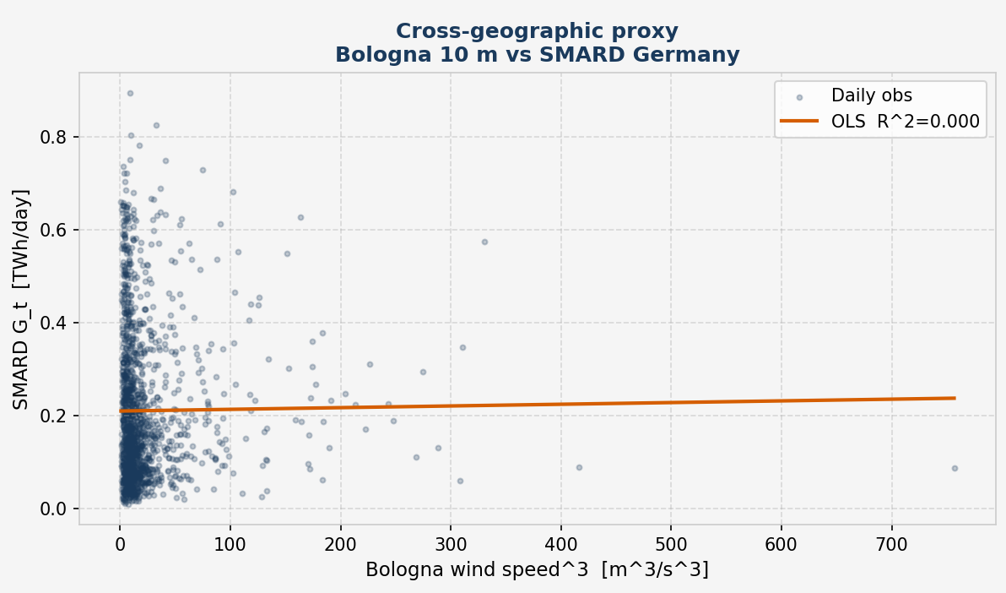
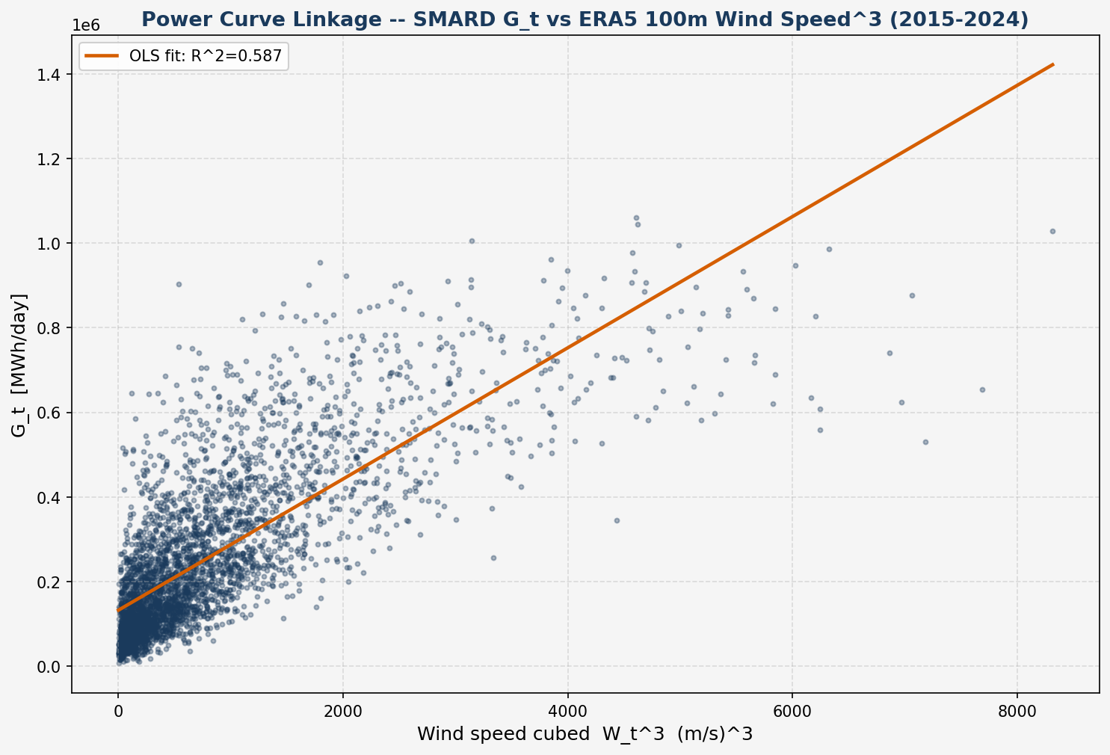
CH. 3 · VALUE OF INFORMATION — WHERE IT REALLY SITS
The proxy carries no information about what it would hedge
GENERATION EXPLAINED
58.7%
Nordfriesland 100 m
0.01%
Bologna 10 m
SMARD Gₜ = c·Wₜ³ + b, daily OLS
A — Bologna 10 m: R² = 0.0001, slope p = 0.723
B — Nordfriesland 100 m: R² = 0.587, p < 0.001
One grid point cannot reach R² = 1 against a national fleet: compare 0.587 with 0.0001, not with 1. It costs one OLS fit — screen wind series on it before pricing.
A proxy that quotes a plausible number while carrying no information is more dangerous than an obviously wrong one — only the second announces itself.
Wind Speed Modelling for Derivatives Pricing — Final Defence
10
Notes:
The decisive evidence is the power curve. We regress daily SMARD generation on the cube of daily wind speed. At Nordfriesland, wind at 100 metres explains 58.7 per cent of the daily variation in German onshore generation. At Bologna, wind at ten metres explains 0.01 per cent: R-squared 0.0001, p-value 0.72, a slope statistically indistinguishable from zero. The right comparison is not with one, which no single grid point can reach against a national fleet, but 0.587 against 0.0001. There is a further warning. In reconciled units, the Bologna strike, 132.9, was closer to the market level than the Nordfriesland one, 328.8. That is a coincidence of level between unrelated series, and a level-based metric would have mistaken it for a successful calibration. A proxy that quotes a plausible number while carrying no information about the cash flow is more dangerous than an obviously wrong one, because only the second announces itself. The test costs a single regression, and it should come before any pricing.

Slide 11
SUMMARY
The question, answered
1
PRICE
2
HEDGE
3
DATA
Yes — in closed form
CAWS covers the left tail
Alignment is decisive
K = h(t₀)·C₀ under θ = 0. Reconciled to market units, the Nordfriesland strike is the market’s order of magnitude (328.8 vs 113.1). It prices a variance swap, not an option on variance.
It pays in the calm years that depress revenue. 2021: wind 4.99% below strike, ≈ €2.3m revenue exposure on 100 MW (illustrative). Tail statistics are descriptive (n = 4, 10).
On the proxy the strike falls 94% short (88% after height correction). The power curve shows why: R² = 58.7% vs 0.01%.
“Data alignment is not a refinement to be added once the model works — it is a precondition for the model meaning anything.”
Wind Speed Modelling for Derivatives Pricing — Final Defence
11
Notes:
In conclusion, the three research questions can be answered. On pricing: yes, in closed form. Under the θ = 0 benchmark the strike is h(t₀) times C₀ and, reconciled to market units, the Nordfriesland strike is of the market’s order of magnitude, 328.8 against 113.1. The framework prices a variance swap, not an option on variance. On hedging: CAWS pays in precisely the calm years that depress revenue, although tail statistics, with four and ten observations, are descriptive. On data: alignment is decisive. The proxy understates the strike by 94 per cent, 88 per cent after height correction, and the evidence is the power curve, 58.7 against 0.01 per cent. Data alignment is not a refinement to be added once the model works; it is a precondition for the model meaning anything.

Slide 12
LOOKING AHEAD
Limitations, stated — and the work they motivate
LIMITATIONS
FUTURE WORK
θ = 0 is adopted as a benchmark assumption in the absence of EEX option-implied data.
Cross-dataset strikes sit on two Box–Cox scales and two pricing dates.
One grid point stands in for a national fleet.
Daily data cannot identify the stochastic-volatility parameters.
CAWS tail statistics rest on 4 and 10 years: descriptive only.
Option-implied θ from EEX power options.
Hourly ERA5 data to identify the volatility of volatility.
A capacity-weighted wind input across the German fleet.
Screen wind series on power-curve R² before pricing.
Wind Speed Modelling for Derivatives Pricing — Final Defence
12
Notes:
Let me state the limitations plainly. First, θ = 0 is a benchmark adopted in the absence of EEX option-implied data; it is not a claim that the risk premium is zero. Second, cross-dataset strikes sit on two Box–Cox scales and two pricing dates. Third, one grid point stands in for a national fleet. Fourth, daily data leave the stochastic-volatility parameters unidentified: the Feller condition holds for Nordfriesland but depends on the estimator for Bologna. Finally, four and ten annual observations make tail statistics descriptive. Future work follows directly: calibrating θ from EEX power options, which requires a joint price–generation model, with Carr and Lee as theoretical scaffolding; hourly ERA5 data, to identify the volatility of volatility; a capacity-weighted, spatially aggregated wind input; and screening any candidate wind series on power-curve R-squared before pricing.

Slide 13
THANK YOU
Questions and discussion
Enrico Butali · Wind Speed Modelling for Derivatives Pricing

Slide 14
BACKUP
Supporting detail, on request
B1 Feller condition — robust for B, estimator-dependent for A
B2 Reconciling Track B into Track A units, both datasets
B3 Model validation — four specifications, one conditional mean
B4 The Diebold–Mariano test in Chapters 2 and 3 — why the signs differ
B5 Height correction: sensitivity to the profile exponent α
B6 Model estimates at a glance — AR(4), GARCH(1,1), CAR(4), NIG
B7 Value of Information on a common scale — strike ratios and reconciliation
B8 CAWS tail statistics on both datasets — calmest, windiest year, CVaR

Slide 15
BACKUP B1 · CH. 2 §2.5.3 — FELLER CONDITION
The Feller condition depends on which estimator you trust
DATASET B — REFERENCE
DATASET A — PROXY
Holds, robustly
Estimator-dependent
2κᵥv̄ = 0.0270 vs ξ² = 0.000959 → margin 28.1×, on every estimator considered.
Full-sample estimator (same one used for B): margin 0.8× — violated.
30-day rolling estimators: margins ≈5.1× and 3.6× — holds, but on a different estimator than B's.
The finding is the sensitivity itself: ξ (vol-of-vol) is the least identified of the four CIR parameters at daily frequency — it also reverses an earlier project anchor of 27.9×, which is not reproducible under any estimator tested.
Wind Speed Modelling for Derivatives Pricing — Final Defence
15
Notes:
This is the chapter's most uncomfortable, and most interesting, result, and it is stated rather than smoothed over. The Feller condition asks whether the CIR variance process stays strictly positive almost surely. For Dataset B it holds comfortably, at a margin of 28.1 times, on every estimator considered. For Dataset A, the full-sample estimator — the same one used for B — gives a margin of only 0.8, meaning the condition is violated; but 30-day rolling estimators give margins of 3.6 to 5.1, meaning it holds. The verdict flips depending on which estimator you trust. That sensitivity is itself the finding: xi, the volatility-of-volatility parameter, is the least identified of the four CIR parameters at daily sampling frequency. It also means an earlier project record of a 27.9-times margin is not reproducible under any estimator tested and needed correcting.

Slide 16
BACKUP B2 · CH. 3 §3.1.5 — THE FOUR CONVENTIONS
Reconciling Track B into Track A units, step by step
Factor | Formula | Dataset A | Dataset B
K_var = h(t₀) × C₀ (as recorded) | — | 0.05435 | 0.87336
× Box–Cox scale | W̄^(2(1−λ)) | 5.088 | 8.068
× innovation → first difference | (RMSE pers. / RMSE AR(4))² | 1.292 | 1.339
× power curve | 9 / W̄² | 1.4764 | 0.13826
× annualisation | 252 | 252 | 252
Reconciled model strike (Track A units) |  | 132.9 | 328.8
Track A strike, same sample |  | 113.999 | 113.145
Ratio model / market (at h = 1) |  | 1.17 (2.82) | 2.91 (3.87)
Arithmetic reconciliation, not a frozen phase output. Each step is a first-order delta-method approximation at the sample mean, so the figures are order-of-magnitude statements. Both models overstate the market — the expected effect of calibrating on one grid point against a spatially averaged national fleet.
Wind Speed Modelling for Derivatives Pricing — Final Defence
16

Slide 17
BACKUP B3 · CH. 2–3 — MODEL VALIDATION
Four specifications, one conditional mean
AR(4) • AR(4)+GARCH • CAR(4)+Gaussian • CAR(4)+NIG
share one conditional mean by construction → indistinguishable on one-day-ahead forecast accuracy. They separate only on pricing and hedging criteria — which is why Chapter 3 does not rank them by RMSE alone.
ALL FOUR STILL REJECT PERSISTENCE, DECISIVELY
Diebold–Mariano statistic vs. persistence
Diebold–Mariano statistic vs. persistence
+8.27
+16.76
Dataset A — RMSE 0.8868 → 0.7802 (12.0% better than persistence)
Dataset B — RMSE 1.0046 → 0.8681 (13.6% better than persistence)
Full standardised series, dₜ = e²(persistence) − e²(model), §3.2. Chapter 2's held-out split reports −3.681 / −7.019 under the reversed sign convention — same test, same conclusion (B4).
Wind Speed Modelling for Derivatives Pricing — Final Defence
17
Notes:
Backup. All four fitted specifications share the AR(4) conditional mean, so they are identical on one-step RMSE by construction and separable only on pricing and hedging criteria (or a proper scoring rule such as CRPS). All beat persistence decisively.

Slide 18
BACKUP B4 · CH. 2 §2.2.4 & CH. 3 §3.2.1 — DIEBOLD–MARIANO
The same test, twice — why the signs differ
 | Chapter 2, §2.2.4 | Chapter 3, §3.2.1
Loss differential | dₜ = e²AR(4) − e²persistence | dₜ = e²persistence − e²model
A winning model gives | a negative statistic | a positive statistic
Evaluation sample | held-out partition (220 / 548 obs.) | full series (1,461 / 3,652 errors)
DM statistic (A / B) | −3.681 / −7.019 | +8.265 / +16.758
RMSE persistence (A / B) | 0.6856 / 0.9955 | 0.8868 / 1.0046
RMSE AR(4) (A / B) | 0.6017 / 0.8580 | 0.7802 / 0.8681
Improvement (A / B) | 12.2% / 13.8% | 12.0% / 13.6%
The sign is a convention, not a result. Same test, same conclusion: every fitted specification rejects equal accuracy with persistence at any conventional level, on either convention and either sample. Magnitudes scale with √n.
Why A's RMSEs move by 23%, B's by under 1%. A's hold-out ends in a calm spell: √(0.4137/0.608) = 0.825 vs an observed 0.773. B's h(t₀) = 0.7511 sits at its unconditional 0.7522, predicting one vs an observed 0.991.
Wind Speed Modelling for Derivatives Pricing — Final Defence
18

Slide 19
BACKUP B5 · CH. 3 §3.3.1 — HEIGHT CORRECTION
No admissible profile exponent turns the gap into a height effect
Profile exponent α | Factor 10^(2α) | Corrected K, A | Mispricing
1/10 (open water) | 1.585 | 0.0861 | 90.1%
1/7 (adopted) | 1.931 | 0.1049 | 88.0%
0.168 (ERA5 coastal, lower bound) | 2.166 | 0.1177 | 86.5%
0.20 (rough inland) | 2.512 | 0.1365 | 84.4%
0.25 (very rough terrain) | 3.162 | 0.1719 | 80.3%
TO CLOSE 16.07×
α = 0.60
four times the Hellmann value, outside any surface in Peterson & Hennessey (1978).
Only the 1/7 row is a frozen phase output; the other four are an arithmetic sensitivity computed for Chapter 3.
0.168 is measured at Nordfriesland (ERA5 10 m vs 100 m means, 5.4825 vs 8.0682 m/s) and is a lower bound for Bologna's sheltered Po-Valley site. A larger α means a smaller residual, so 88.0% is an upper bound on the share attributable to geography — the operative result is the 80.3% floor.
Wind Speed Modelling for Derivatives Pricing — Final Defence
19

Slide 20
BACKUP B6 · CH. 2 — MODEL ESTIMATES
The pipeline’s fitted parameters, both datasets
Quantity | Dataset A — Bologna 10 m | Dataset B — Nordfriesland 100 m
Box–Cox λ (optimum → adopted, 1/λ ∈ ℤ⁺) | −0.450 → 0.1 | 0.404 → 0.5
AR(4) β₁, β₂, β₃, β₄ | 0.6299, −0.1443, 0.0926, 0.0310 | 0.5324, −0.0763, 0.0324, −0.0074
AIC advantage of AR(3) over AR(4) | 0.59 | 1.8
GARCH ω, α, β | 0.01004, 0.03105, 0.95242 | 0.01348, 0.00590, 0.97618
Persistence α + β · volatility half-life | 0.9835 · 41.6 days | 0.9821 · 38.3 days
CAR(4) α₁, α₂, α₃, α₄ | 3.3701, 4.2546, 2.3063, 0.3908 | 3.4676, 4.4789, 2.5228, 0.5188
Eigenvalues of A | −0.9358 ± 0.4653i, −1.2004, −0.2980 | −1.0730 ± 0.2550i, −0.7614, −0.5602
Oscillatory period · mean-reversion half-life | 13.5 days · 2.33 days | 24.6 days · 1.24 days
NIG α̂ · KS p (NIG / Gaussian) | 4.374 · 0.120 / 0.079 | 2,649.57 · 0.0275 / 0.0269
GARCH standardised residuals | all diagnostics pass | z² lag 5 p = 0.0167; ARCH-LM p = 0.0185
Frozen phase outputs (thesis Tables 5, 7, 10, 13, 14, 16, 24). AR(4) is retained on structural grounds: CAR(4) needs a four-dimensional companion matrix.
Wind Speed Modelling for Derivatives Pricing — Final Defence
20
Notes:
Backup. AR(4) kept over the AIC-preferred AR(3) (gaps 0.59 and 1.8 units, inside the 2-point band) because the CAR(4) embedding needs a 4-dimensional companion matrix. All eigenvalues in the open left half-plane: stationary. The complex pair makes the kernel peak at about 3.6 days in both datasets, breaking the monotone Samuelson effect (Benth & Saltyte Benth 2009). NIG buys little: KS p 0.079 to 0.120 for A, none for B (alpha about 2,650). Dataset B's GARCH leaves short-lag structure (z^2 lag 5 p = 0.0167, ARCH-LM p = 0.0185): a GARCH(2,1) or two-component model would be the remedy; pricing uses only h(t0) and the unconditional level.

Slide 21
BACKUP B7 · CH. 3 §3.3 — VALUE OF INFORMATION ON A COMMON SCALE
On a common scale, the two sites look alike
STRIKE RATIO B / A
RECONCILED MODEL STRIKE ÷ MARKET STRIKE
1.0× = market
TWO MEASUREMENT SCALES
TWO PRICING DATES
SAME RELATIVE VARIABILITY
C₀ is a variance in Box–Cox units: λ = 0.1 (A) vs λ = 0.5 (B).
h(t₀) on 31 Dec 2018 vs 31 Dec 2024: the 1.82× compares dates, not sites.
Coefficient of variation 0.384 (Bologna) vs 0.401 (Nordfriesland).
Wind Speed Modelling for Derivatives Pricing — Final Defence
21
Notes:
Decomposing the ratio of 16.07, we find 8.85 from the seasonal variance level C₀ and 1.82 from the GARCH state h(t₀): about four-fifths of the gap, on a logarithmic scale, sits in C₀. Two qualifications are needed. First, C₀ is a variance in Box–Cox units, with lambda 0.1 for Bologna and 0.5 for Nordfriesland, so the two strikes are not strictly the same kind of quantity. Second, the 1.82 compares two pricing dates, December 2018 and December 2024, rather than two sites. Mapped onto a common scale, the variance of generation log-returns, the ratio falls from 16 to about 2.5, and its climatological part to about 1.36. Consistently, the two sites have almost identical coefficients of variation: 0.384 for Bologna and 0.401 for Nordfriesland. Bologna’s problem is therefore not how variable its wind is, in relative terms. The headline figures describe what the two pipelines quote; they are not scale-free, and the evidence for alignment lies elsewhere.

Slide 22
BACKUP B8 · CH. 3 — CAWS TAIL STATISTICS
CAWS on both datasets: calmest year, windiest year, CVaR₅%
 | A · Bologna | B · Nordfr.
Strike K | 2.4644 m/s | 8.0531 m/s
Calmest year | +6.70% (2017) | +4.99% (2021)
Windiest = CVaR₅% | −4.91% (2018) | −6.33% (2015)
Annual obs. | 4 | 10
CVaR₅% is the premium leg, and on 4 and 10 points a sample minimum: descriptive, not inferential.
Wind Speed Modelling for Derivatives Pricing — Final Defence
22

