Slide 1
MASTER'S THESIS · FINAL EXAMINATION
Wind Speed Modelling
for Derivatives Pricing
Candidate: Enrico Butali Supervisor: Prof.ssa Silvia Romagnoli
Second Cycle Degree in Greening Energy Market and Finance (LM-16 R)
Department of Statistical Sciences “Paolo Fortunati” · University of Bologna
Notes:
Good morning members of the Committee. The thesis I present today, entitled Wind Speed Modelling for Derivatives Pricing, belongs to the context of the energy transition. It addresses a central problem in the risk management of renewable producers: how to price hedging instruments written on an underlying that cannot be traded, namely the wind.

Slide 2
Wind is free to generate — and impossible to store
Two legs of exposure for a wind producer
Volumetric — when the wind is weak, the farm produces less.
Price — when it is very windy, all farms produce together and the price falls (merit order effect).
The natural hedge is weak
Output and price move against each other, but only slightly (correlation −0.16). In a calm year the producer simply loses revenue.
ILLUSTRATIVE SCALE
100 MW
farm, 25.7% capacity factor → ≈225,100 MWh / yr
≈ €16.1m
2
Notes:
Let me start with the producer.
A wind farm is exposed on two legs. The first is volumetric: prolonged calms cut generation directly, and because wind is autocorrelated, they are not diversified away. The second is price: through the merit-order effect, strong wind depresses the day-ahead price exactly when the producer generates most.
This negative correlation dampens revenue variance, but it is weak, minus 0.16 over 2015 to 2024, and asymmetric: it cuts the upside without a floor under a prolonged calm. As an order of magnitude, a 100-megawatt farm at a 25.7 per cent capacity factor generates about 225,000 megawatt-hours a year, roughly 16 million euros of gross revenue at the mean price.
So the producer needs a contract written on the wind itself. That is what this thesis builds and prices.

Slide 3
What the thesis sets out to do
THE QUESTION
Can a wind-speed model price a wind producer’s volume risk — and does the price depend on which wind data we use?
1
QUESTION 1 · PRICE
2
QUESTION 2 · HEDGE
3
QUESTION 3 · DATA
Can a wind model give a fair price for a wind derivative — with a closed formula?
Can a second contract protect the producer in calm years?
Does the price change if we use the wrong wind data?
θ = 0 is adopted as a benchmark assumption in the absence of EEX option-implied data.
3
Notes:
The thesis answers three research questions:
One: price. Can a continuous-time wind model deliver a closed-form fair strike for a synthetic variance swap?
Two: hedge. How can we cover the left tail, the prolonged calms to which a variance swap is blind, with a CAWS contract?
Three: data. What is the value of information, that is, the pricing cost of calibrating the same model on an imperfect proxy rather than on data aligned in height and geography?
One assumption holds throughout. θ = 0 is adopted as a benchmark assumption, in the absence of EEX option-implied data. There is no option market to estimate a risk premium from, so every price I show is an expected value.

Slide 4
Two datasets, one identical pipeline
 | Dataset A — Proxy | Dataset B — Reference
Location | Bologna, Italy (44.29°N, 11.20°E) | Nordfriesland, Germany (54.77°N, 8.85°E)
Height | 10 m | 100 m (hub height)
Source | OpenWeatherMap API | Open-Meteo · ERA5 reanalysis
Period | 2015–2018 (4 yr) | 2015–2024 (10 yr)
Observations | 1,462 daily | 3,653 daily
Mean wind speed | 2.47 m/s | 8.07 m/s
Role | Build & validate the methodology | Carries all headline empirical claims
Why this pairing: the same pipeline, identical in functional form, runs on both sites, so a difference in the resulting price points to the data.
4
Notes:
The study rests on two datasets processed by one identical pipeline.
Dataset A is a proxy: wind speed for Bologna, four years of daily observations measured at 10 metres. It is where the methodology was built and validated.
Dataset B is the reference: wind in northern Germany, ten years of daily observations measured at 100 metres, the height of a turbine. I chose Nordfriesland because it is Germany's densest onshore wind corridor.
Because the functional form is identical, any difference in the resulting price is attributable to the data.

Slide 5
One pipeline, five stages — two numbers carry the price
1
2
3
4
5
Deseasonalise
AR(4)
GARCH(1,1)
CAR(4)
Stochastic vol.
Box–Cox + Fourier
conditional mean
conditional variance
continuous-time embedding
Heston / CIR, theoretical
→ W̃(t), C₀
→ β₁ … β₄
→ h(t₀)
→ A, exp(Aτ)
→ theory only, not in the price
C₀
h(t₀)
How variable the wind is over the year
How variable the wind is today
Dataset A 0.1314 Dataset B 1.1628
Dataset A 0.4137 Dataset B 0.7511
Fair strike K_{var} = h(t₀) × C₀ piecewise-constant h (Tol 1997), θ = 0 benchmark
0.0544 (Dataset A) vs 0.8734 (Dataset B)
5
Notes:
The modelling proceeds in five stages.
First, a Box–Cox transformation and a Fourier decomposition remove seasonality in the mean and the variance. This stage delivers the standardised series and the seasonal variance level C₀.
Second an AR(4) models the conditional mean and improves on persistence, capturing memory: a windy day tends to follow a windy day.
Third, a GARCH(1,1) models the conditional variance and delivers the volatility state at the pricing date, h(t₀).
Fourth, the CAR(4) embedding moves the model to continuous time, so that a contract can be priced at any maturity.
Fifth, Heston–CIR stochastic volatility is purely theoretical: daily data cannot identify its parameters, so it does not enter the price.
The whole pricing structure therefore reduces to two numbers. Under a piecewise-constant h, following Tol (1997), and the θ = 0 benchmark, the fair strike is h(t₀) times C₀, because the Fourier harmonics integrate to zero over a year: 0.054 for Bologna, 0.873 for Nordfriesland.

Slide 6
Price: the model lands in the market’s range
FAIR STRIKE · MODEL vs MARKET · GERMANY, 2015–2024
THE CONTRACT
A variance swap
Pays the realised variance of German wind generation minus a fixed strike. The producer sells it.
MARKET BENCHMARK
Average realised variance of German wind generation over ten years. No model involved.
WHY THE MODEL IS HIGHER
One location against a nationwide fleet: averaging over many sites makes output smoother.
Model strike h(t₀) × C₀ converted into market units (conversion in backup B2). θ = 0 benchmark.
6
Notes:
Question one: price.
The contract is a variance swap on German wind generation. It pays the realised variability of wind output, minus a fixed strike. The producer sells it: it receives a fixed amount, and pays when output is unstable.
The market benchmark is simple: the realised variance of German wind generation over ten years it’s 113.1.
The model gives 328.8, once its number is converted into the same units. So the two are in the same range. The model is higher, and we expect that: I model one location, while German output comes from thousands of turbines across the country. Averaging over many places makes output smoother.
So the answer to question one is yes: the model gives a closed-form price, and it lands in the right range.

Slide 7
Hedge: CAWS pays in the calm years
CAWS PAYOFF PER YEAR, % OF STRIKE · GERMAN SITE, 2015–2024
HOW THE CONTRACT WORKS
Written on the average wind speed of the year.
Calm year → the contract pays.
Windy year → the producer pays.
REVENUE AT RISK IN A CALM YEAR
≈ €2.3m
2021: wind about 5% below normal, on a 100 MW farm. Illustrative exposure, not the contract payout.
Above zero: a calm year — the contract pays. Below zero: a windy year — the producer pays the premium.
7
Notes:
Question two: hedge.
A variance swap has a blind spot. It measures how much the wind changes, not whether there is enough of it. A long calm period looks stable, so the swap does not pay.
We therefore introduce CAWS, in normalised rolling-annual-mean form, struck at the full-sample mean. The payoff is the strike minus the realised index, so it is positive in calm years.
The chart shows ten years at the German site. Look at 2021, in orange: the calmest year, with wind about 5 per cent below normal. Power grows with the cube of wind speed, so a small drop in wind is a large drop in output. For a 100-megawatt farm, that deficit means roughly 14 per cent less generation: about 32,000 megawatt-hours, or some 2.3 million euros of gross revenue on the illustrative farm. This is the revenue at risk, not the contract payout.
So the answer to question two is yes: CAWS pays in exactly the years the producer needs it.

Slide 8
Data: on the wrong wind data, the price is 94% too low
FAIR STRIKE · SAME MODEL, DIFFERENT WIND DATA
WRONG DATA
Price 94% too low
Same model, same assumptions — only the wind data changes.
HEIGHT IS NOT THE REASON
Correcting Bologna’s wind from 10 m to 100 m still leaves the price 88% too low — for any realistic terrain (backup B5).
SO WHAT IS?
Next: does the wind series move with German wind generation at all?
8
Notes:
Question three: value of information.
I run the same model on the Bologna data instead of the German data. The price comes out 94 per cent too low. Same model, same assumptions; only the data changed.
The obvious objection is height. Bologna is measured at 10 metres, where wind is weaker. So I correct it to 100 metres with the standard formula. The gap barely moves: the price is still 88 per cent too low. And this holds for any realistic type of terrain.
So height is not the reason. What is?

Slide 9
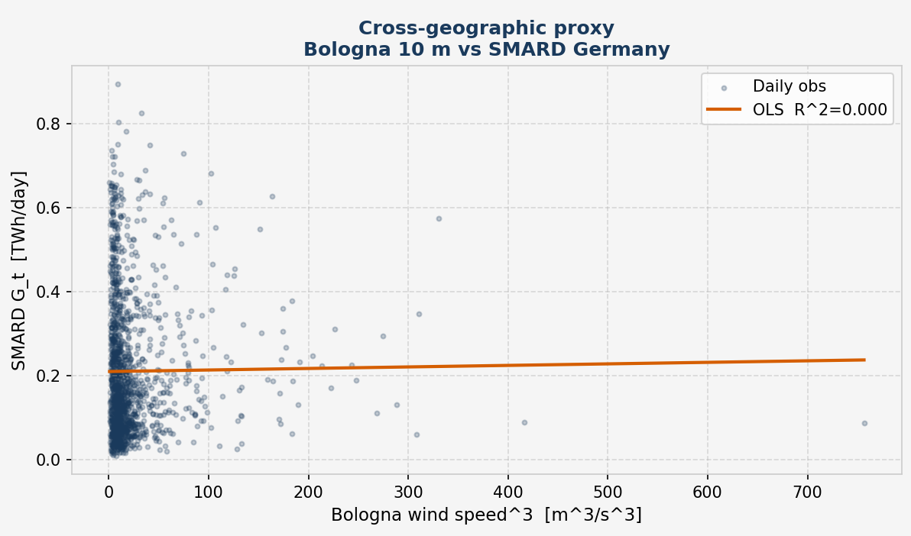
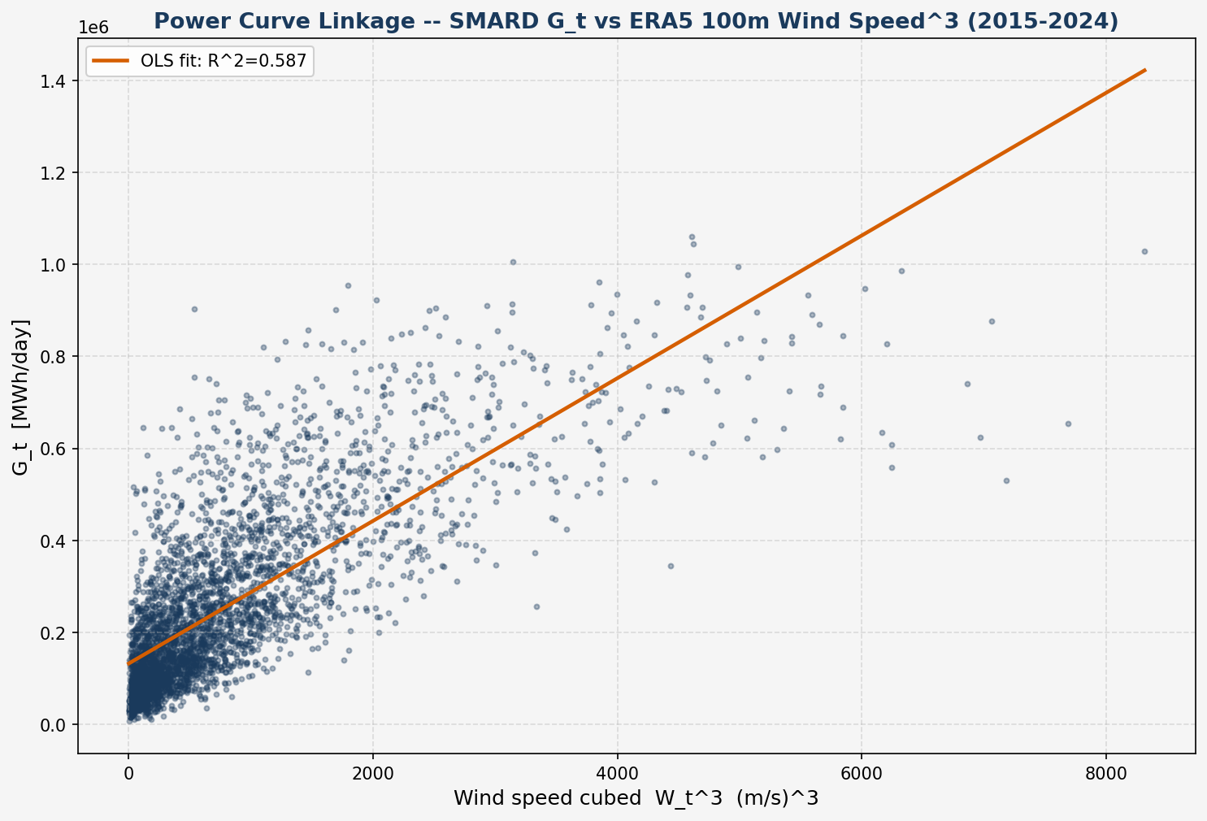
The proxy wind tells us nothing about German generation
GENERATION EXPLAINED
58.7%
German site, 100 m
0.01%
Bologna, 10 m
Daily regression of German wind generation on wind speed cubed
A — Bologna 10 m: R² = 0.0001, slope p = 0.723
B — Nordfriesland 100 m: R² = 0.587, p < 0.001
A simple rule: before pricing, check that the wind data explains the output you hedge. It costs one regression.
A proxy that quotes a plausible number while carrying no information is more dangerous than an obviously wrong one — only the second announces itself.
9
Notes:
The answer is this test. I compare each wind series with actual German wind generation, day by day.
On the right, the German site: its wind explains almost 60 per cent of German generation. On the left, Bologna: it explains practically nothing. The line is flat.
So the Bologna data is not just a little wrong. It has no link with the cash flow we want to hedge.
And here is the danger. Converted into market units, the Bologna price looks reasonable. A quick check on the level would accept it. A wrong number that looks plausible is worse than one that is obviously wrong.
The good news: this test takes one regression, and it should be done before any pricing.

Slide 10
The question, answered
1
PRICE
2
HEDGE
3
DATA
Yes — in closed form
CAWS covers the calm years
The right data comes first
Fair strike = h(t₀) × C₀ under the θ = 0 benchmark. In market units, it is in the market’s range.
It pays when wind — and revenue — fall short: the case a variance swap cannot see.
On the wrong data the price is 94% too low, with no warning. One regression detects it.
“Data alignment is not a refinement to be added once the model works — it is a precondition for the model meaning anything.”
10
Notes:
To sum up, the three answers.
Price: yes. A wind model gives a closed-form price, in the market's range.
Hedge: yes. CAWS covers the calm years that a variance swap cannot see.
Data: this is the key message. With the wrong data, the price is 94 per cent too low, and the model gives no warning. A simple test catches it.
In one sentence: data alignment is not a detail to fix at the end. It is a precondition for the model to mean anything.

Slide 11
Looking ahead
LIMITATIONS
FUTURE WORK
θ = 0 is adopted as a benchmark assumption in the absence of EEX option-implied data.
Cross-dataset strikes sit on two Box–Cox scales and two pricing dates.
One location stands in for a nationwide fleet.
Short samples and daily data: some results are descriptive.
Estimate the risk premium from EEX power options.
Use fleet-wide, hourly wind data.
Test wind data against generation before pricing.
11
Notes:
Finally, the main limits, and what they suggest.
First, θ = 0 is a benchmark assumption. With EEX option data, the next step is to estimate the risk premium.
Second, the two datasets sit on different Box–Cox scales and pricing dates, so the cross-site comparison is not scale-free.
Third, one location stands in for a whole country. Fleet-wide, hourly wind data would improve the fit.
Fourth, the samples are short, so some results are descriptive.
And one practical rule: test the wind data against generation before pricing anything.

Slide 12
Thank you for your attention.
Enrico Butali · Wind Speed Modelling for Derivatives Pricing
Notes:
Thank you for your attention. I am happy to take your questions.

Slide 13
BACKUP
Supporting detail, on request
B1 Feller condition — robust for B, estimator-dependent for A
B2 Reconciling Track B into Track A units, both datasets
B3 Model validation — four specifications, one conditional mean
B4 The Diebold–Mariano test in Chapters 2 and 3 — why the signs differ
B5 Height correction: sensitivity to the profile exponent α
B6 Model estimates at a glance — AR(4), GARCH(1,1), CAR(4), NIG
B7 Value of Information on a common scale — strike ratios and reconciliation
B8 CAWS tail statistics on both datasets — calmest, windiest year, CVaR
B9 Back-test of the market strike, year by year

Slide 14
BACKUP B1 · CH. 2 §2.5.3 — FELLER CONDITION
The Feller condition depends on which estimator you trust
DATASET B — REFERENCE
DATASET A — PROXY
Holds, robustly
Estimator-dependent
2κᵥv̄ = 0.0270 vs ξ² = 0.000959 → margin 28.1×, on every estimator considered.
Full-sample estimator (same one used for B): margin 0.8× — violated.
30-day rolling estimators: margins ≈5.1× and 3.6× — holds, but on a different estimator than B's.
The finding is the sensitivity itself: ξ (vol-of-vol) is the least identified of the four CIR parameters at daily frequency — it also reverses an earlier project anchor of 27.9×, which is not reproducible under any estimator tested.
Wind Speed Modelling for Derivatives Pricing — Final Defence
14
Notes:
This is the chapter's most uncomfortable, and most interesting, result, and it is stated rather than smoothed over. The Feller condition asks whether the CIR variance process stays strictly positive almost surely. For Dataset B it holds comfortably, at a margin of 28.1 times, on every estimator considered. For Dataset A, the full-sample estimator — the same one used for B — gives a margin of only 0.8, meaning the condition is violated; but 30-day rolling estimators give margins of 3.6 to 5.1, meaning it holds. The verdict flips depending on which estimator you trust. That sensitivity is itself the finding: xi, the volatility-of-volatility parameter, is the least identified of the four CIR parameters at daily sampling frequency. It also means an earlier project record of a 27.9-times margin is not reproducible under any estimator tested and needed correcting.

Slide 15
BACKUP B2 · CH. 3 §3.1.5 — THE FOUR CONVENTIONS
Reconciling Track B into Track A units, step by step
Factor | Formula | Dataset A | Dataset B
K_var = h(t₀) × C₀ (as recorded) | — | 0.05435 | 0.87336
× Box–Cox scale | W̄^(2(1−λ)) | 5.088 | 8.068
× innovation → first difference | (RMSE pers. / RMSE AR(4))² | 1.292 | 1.339
× power curve | 9 / W̄² | 1.4764 | 0.13826
× annualisation | 252 | 252 | 252
Reconciled model strike (Track A units) |  | 132.9 | 328.8
Track A strike, same sample |  | 113.999 | 113.145
Ratio model / market (at h = 1) |  | 1.17 (2.82) | 2.91 (3.87)
Arithmetic reconciliation, not a frozen phase output. Each step is a first-order delta-method approximation at the sample mean, so the figures are order-of-magnitude statements. Both models overstate the market — the expected effect of calibrating on one grid point against a spatially averaged national fleet.
Wind Speed Modelling for Derivatives Pricing — Final Defence
15

Slide 16
BACKUP B3 · CH. 2–3 — MODEL VALIDATION
Four specifications, one conditional mean
AR(4) • AR(4)+GARCH • CAR(4)+Gaussian • CAR(4)+NIG
share one conditional mean by construction → indistinguishable on one-day-ahead forecast accuracy. They separate only on pricing and hedging criteria — which is why Chapter 3 does not rank them by RMSE alone.
ALL FOUR STILL REJECT PERSISTENCE, DECISIVELY
Diebold–Mariano statistic vs. persistence
Diebold–Mariano statistic vs. persistence
+8.27
+16.76
Dataset A — RMSE 0.8868 → 0.7802 (12.0% better than persistence)
Dataset B — RMSE 1.0046 → 0.8681 (13.6% better than persistence)
Full standardised series, dₜ = e²(persistence) − e²(model), §3.2. Chapter 2's held-out split reports −3.681 / −7.019 under the reversed sign convention — same test, same conclusion (B4).
Wind Speed Modelling for Derivatives Pricing — Final Defence
16
Notes:
Backup. All four fitted specifications share the AR(4) conditional mean, so they are identical on one-step RMSE by construction and separable only on pricing and hedging criteria (or a proper scoring rule such as CRPS). All beat persistence decisively.

Slide 17
BACKUP B4 · CH. 2 §2.2.4 & CH. 3 §3.2.1 — DIEBOLD–MARIANO
The same test, twice — why the signs differ
 | Chapter 2, §2.2.4 | Chapter 3, §3.2.1
Loss differential | dₜ = e²AR(4) − e²persistence | dₜ = e²persistence − e²model
A winning model gives | a negative statistic | a positive statistic
Evaluation sample | held-out partition (220 / 548 obs.) | full series (1,461 / 3,652 errors)
DM statistic (A / B) | −3.681 / −7.019 | +8.265 / +16.758
RMSE persistence (A / B) | 0.6856 / 0.9955 | 0.8868 / 1.0046
RMSE AR(4) (A / B) | 0.6017 / 0.8580 | 0.7802 / 0.8681
Improvement (A / B) | 12.2% / 13.8% | 12.0% / 13.6%
The sign is a convention, not a result. Same test, same conclusion: every fitted specification rejects equal accuracy with persistence at any conventional level, on either convention and either sample. Magnitudes scale with √n.
Why A's RMSEs move by 23%, B's by under 1%. A's hold-out ends in a calm spell: √(0.4137/0.608) = 0.825 vs an observed 0.773. B's h(t₀) = 0.7511 sits at its unconditional 0.7522, predicting one vs an observed 0.991.
Wind Speed Modelling for Derivatives Pricing — Final Defence
17

Slide 18
BACKUP B5 · CH. 3 §3.3.1 — HEIGHT CORRECTION
No admissible profile exponent turns the gap into a height effect
Profile exponent α | Factor 10^(2α) | Corrected K, A | Mispricing
1/10 (open water) | 1.585 | 0.0861 | 90.1%
1/7 (adopted) | 1.931 | 0.1049 | 88.0%
0.168 (ERA5 coastal, lower bound) | 2.166 | 0.1177 | 86.5%
0.20 (rough inland) | 2.512 | 0.1365 | 84.4%
0.25 (very rough terrain) | 3.162 | 0.1719 | 80.3%
TO CLOSE 16.07×
α = 0.60
four times the Hellmann value, outside any surface in Peterson & Hennessey (1978).
Only the 1/7 row is a frozen phase output; the other four are an arithmetic sensitivity computed for Chapter 3.
0.168 is measured at Nordfriesland (ERA5 10 m vs 100 m means, 5.4825 vs 8.0682 m/s) and is a lower bound for Bologna's sheltered Po-Valley site. A larger α means a smaller residual, so 88.0% is an upper bound on the share attributable to geography — the operative result is the 80.3% floor.
Wind Speed Modelling for Derivatives Pricing — Final Defence
18

Slide 19
BACKUP B6 · CH. 2 — MODEL ESTIMATES
The pipeline’s fitted parameters, both datasets
Quantity | Dataset A — Bologna 10 m | Dataset B — Nordfriesland 100 m
Box–Cox λ (optimum → adopted, 1/λ ∈ ℤ⁺) | −0.450 → 0.1 | 0.404 → 0.5
AR(4) β₁, β₂, β₃, β₄ | 0.6299, −0.1443, 0.0926, 0.0310 | 0.5324, −0.0763, 0.0324, −0.0074
AIC advantage of AR(3) over AR(4) | 0.59 | 1.8
GARCH ω, α, β | 0.01004, 0.03105, 0.95242 | 0.01348, 0.00590, 0.97618
Persistence α + β · volatility half-life | 0.9835 · 41.6 days | 0.9821 · 38.3 days
CAR(4) α₁, α₂, α₃, α₄ | 3.3701, 4.2546, 2.3063, 0.3908 | 3.4676, 4.4789, 2.5228, 0.5188
Eigenvalues of A | −0.9358 ± 0.4653i, −1.2004, −0.2980 | −1.0730 ± 0.2550i, −0.7614, −0.5602
Oscillatory period · mean-reversion half-life | 13.5 days · 2.33 days | 24.6 days · 1.24 days
NIG α̂ · KS p (NIG / Gaussian) | 4.374 · 0.120 / 0.079 | 2,649.57 · 0.0275 / 0.0269
GARCH standardised residuals | all diagnostics pass | z² lag 5 p = 0.0167; ARCH-LM p = 0.0185
Frozen phase outputs (thesis Tables 5, 7, 10, 13, 14, 16, 24). AR(4) is retained on structural grounds: CAR(4) needs a four-dimensional companion matrix.
Wind Speed Modelling for Derivatives Pricing — Final Defence
19
Notes:
Backup. AR(4) kept over the AIC-preferred AR(3) (gaps 0.59 and 1.8 units, inside the 2-point band) because the CAR(4) embedding needs a 4-dimensional companion matrix. All eigenvalues in the open left half-plane: stationary. The complex pair makes the kernel peak at about 3.6 days in both datasets, breaking the monotone Samuelson effect (Benth & Saltyte Benth 2009). NIG buys little: KS p 0.079 to 0.120 for A, none for B (alpha about 2,650). Dataset B's GARCH leaves short-lag structure (z^2 lag 5 p = 0.0167, ARCH-LM p = 0.0185): a GARCH(2,1) or two-component model would be the remedy; pricing uses only h(t0) and the unconditional level.

Slide 20
BACKUP B7 · CH. 3 §3.3 — VALUE OF INFORMATION ON A COMMON SCALE
On a common scale, the two sites look alike
STRIKE RATIO B / A
RECONCILED MODEL STRIKE ÷ MARKET STRIKE
1.0× = market
TWO MEASUREMENT SCALES
TWO PRICING DATES
SAME RELATIVE VARIABILITY
C₀ is a variance in Box–Cox units: λ = 0.1 (A) vs λ = 0.5 (B).
h(t₀) on 31 Dec 2018 vs 31 Dec 2024: the 1.82× compares dates, not sites.
Coefficient of variation 0.384 (Bologna) vs 0.401 (Nordfriesland).
Wind Speed Modelling for Derivatives Pricing — Final Defence
20
Notes:
Decomposing the ratio of 16.07, we find 8.85 from the seasonal variance level C₀ and 1.82 from the GARCH state h(t₀): about four-fifths of the gap, on a logarithmic scale, sits in C₀. Two qualifications are needed. First, C₀ is a variance in Box–Cox units, with lambda 0.1 for Bologna and 0.5 for Nordfriesland, so the two strikes are not strictly the same kind of quantity. Second, the 1.82 compares two pricing dates, December 2018 and December 2024, rather than two sites. Mapped onto a common scale, the variance of generation log-returns, the ratio falls from 16 to about 2.5, and its climatological part to about 1.36. Consistently, the two sites have almost identical coefficients of variation: 0.384 for Bologna and 0.401 for Nordfriesland. Bologna’s problem is therefore not how variable its wind is, in relative terms. The headline figures describe what the two pipelines quote; they are not scale-free, and the evidence for alignment lies elsewhere.

Slide 21
BACKUP B8 · CH. 3 — CAWS TAIL STATISTICS
CAWS on both datasets: calmest year, windiest year, CVaR₅%
 | A · Bologna | B · Nordfr.
Strike K | 2.4644 m/s | 8.0531 m/s
Calmest year | +6.70% (2017) | +4.99% (2021)
Windiest = CVaR₅% | −4.91% (2018) | −6.33% (2015)
Annual obs. | 4 | 10
CVaR₅% is the premium leg, and on 4 and 10 points a sample minimum: descriptive, not inferential.
Wind Speed Modelling for Derivatives Pricing — Final Defence
21

Slide 22
BACKUP B9 · CH. 3 §3.1 — BACK-TEST OF THE MARKET STRIKE
The instrument: a variance swap on German wind generation
THE CONTRACT
ANNUAL PAYOFF OF A LONG UNIT-NOTIONAL SWAP STRUCK AT K = 113.1
Π = RV[t,T] − K
RV = (252 / N) · Σ rₛ²
rₛ: daily log-return of SMARD German onshore wind generation.
The long side receives realised variance; the producer (long volume, short its stability) sells it and receives K − RV.
Linear in RV: no gamma, no path-dependent convexity.
TRACK A — EMPIRICAL FAIR STRIKE
113.1
252× rolling mean realised variance, 2015–2024. A realised quantity — nothing is backed out of a traded price.
95.5 – 132.0
+2.34
−14.8
annual realised variance, 2019 – 2024
mean payoff: the strike was close to fair
5th-percentile year, ≈13% of strike
Wind Speed Modelling for Derivatives Pricing — Final Defence
22
Notes:
Backup. Year-by-year payoff of a long swap struck at the Track A strike, 113.1. Mean payoff +2.34: the strike was close to fair. 5th-percentile year −14.8, about 13% of the strike. Annual realised variance ranged from 95.5 (2019) to 132.0 (2024).

