Slide 1
Superstore Sales Analysis
By Enrico Carrer

Slide 2
Project Goals
Review the company's overall sales and profitability in the period 2014 - 2017.
Outline findings and insights.
Pinpoint the main areas that need to be improved.
Suggest ways to increase sales where they aren't doing well.

Slide 3
Findings & Insights

Slide 4
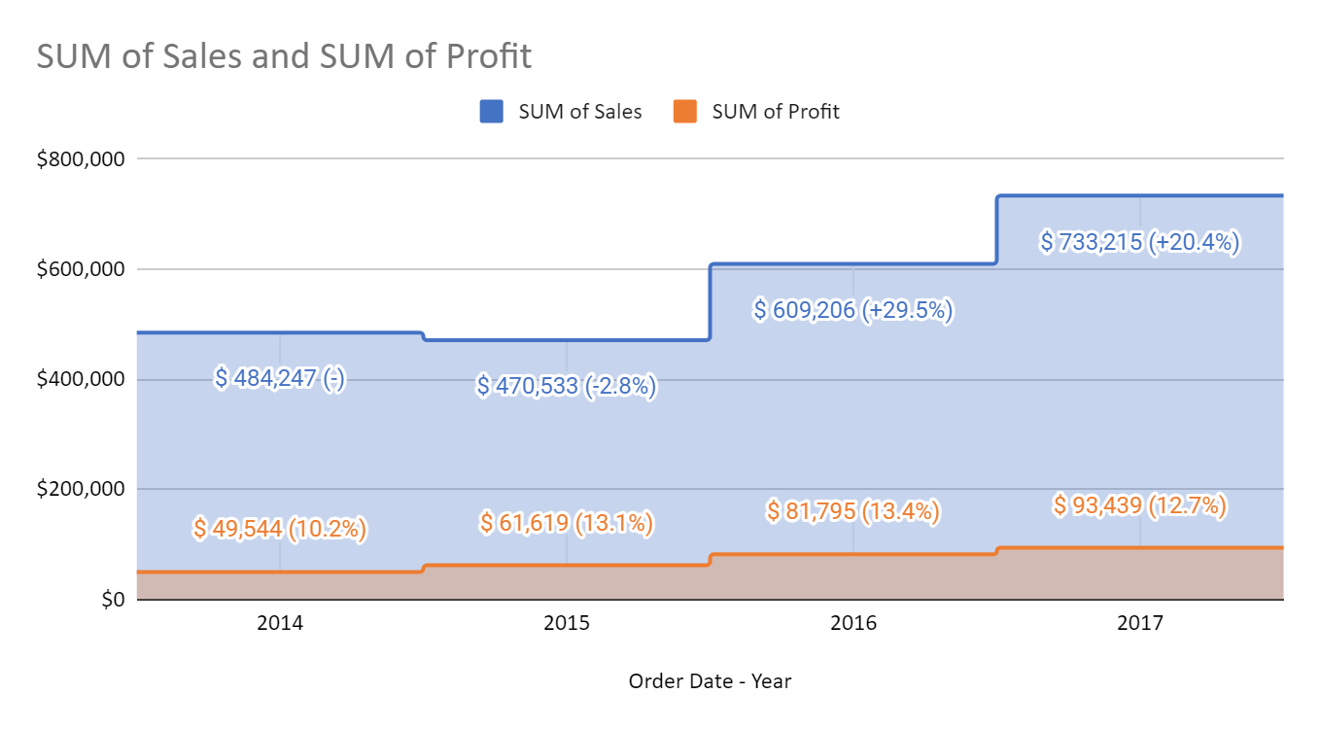
Sales & Profit trend by year
Sales:
2015 showed a small decrease in sales compared with 2014.
however, 2016 and 2017 showed a steady and consistent growth.
Profits:
Steady growth YOY

Slide 5
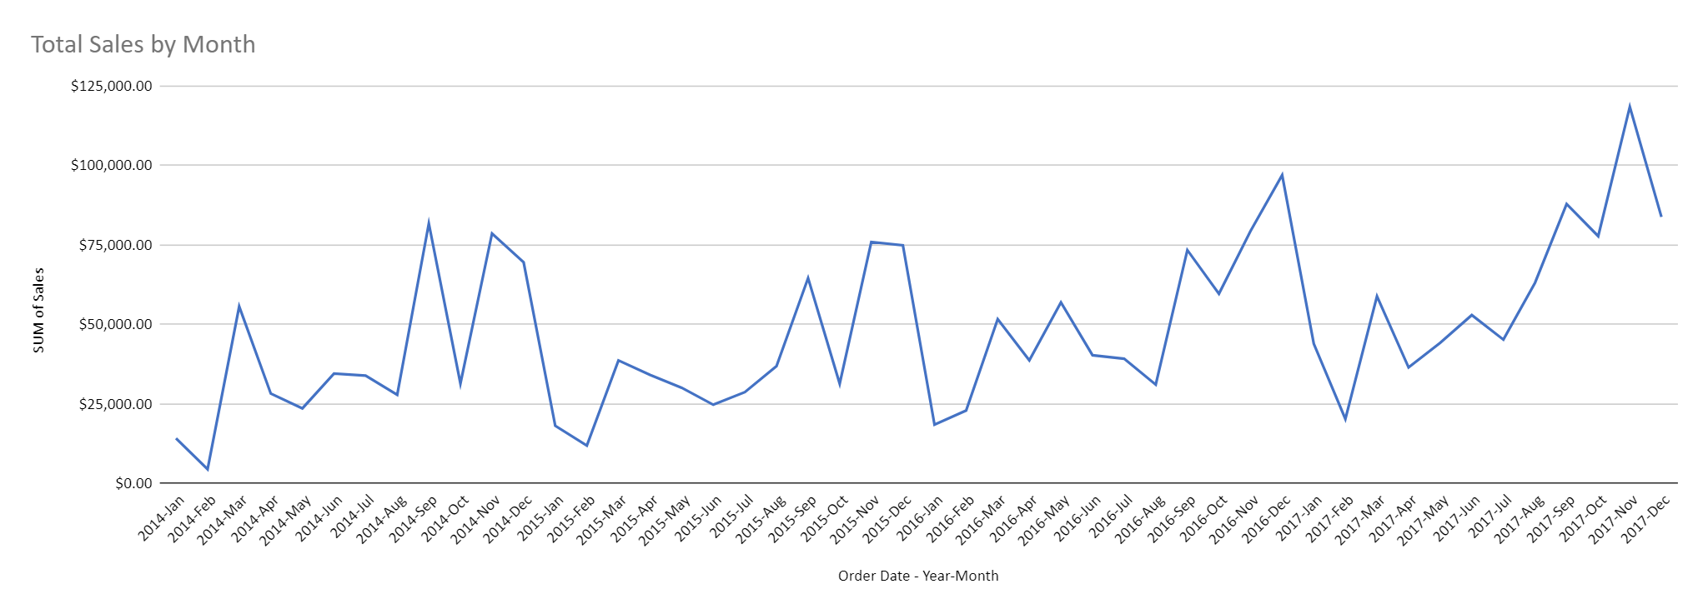
Sales & Profit trend by months
peaks every year in Sept and December
troughs every year in Jan-Feb
Consistent sales trend overall

Slide 6
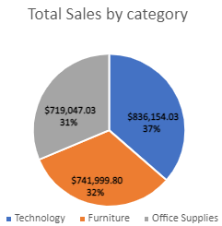
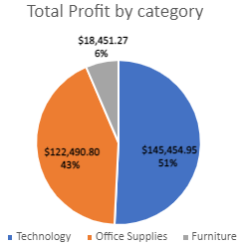
Overall Sales and Profitability
We can see that the total sales is quite evenly split between Technology, Furniture and And Office Supplies.
However, when we look at the profit, we notice that the Furniture is the worst performing. This might suggest a poorer margin in the furniture products or another issue and it should be investigated.

Slide 7
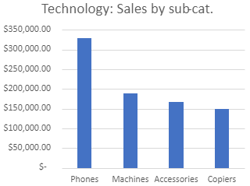
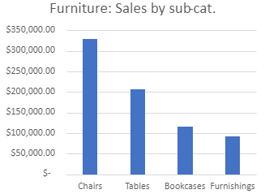
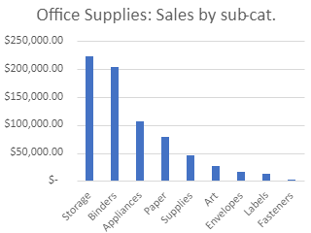
Overall Sales by Sub-category
Phones dominate the technology sales rank, Chairs dominate the furniture category and Storage leads in the Furniture category.
On the other hand, among the worst performers, we have copiers in technology, furnishings in furniture and Fasteners in Office supplies.

Slide 8
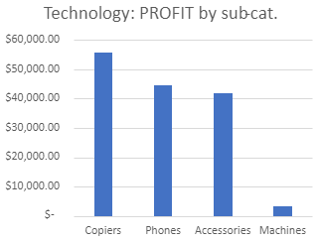
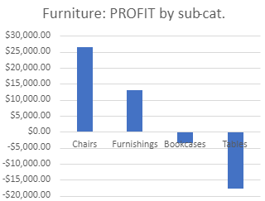
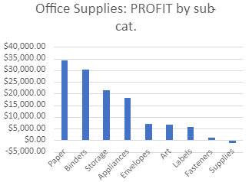
Overall Profit by Sub-category
In Technology, Copiers are the most profitable sub-category. Machines seems to be much less profitable than any other group. It might be interesting to look into the cost structure. Chairs are the most profitable group within Furniture and Paper leads within Office Supplies
In Furniture and Office Supplies, there are some sub-categories that totaled a negative figure. This could be due to discounts but must be definitely investigated (more details later on).

Slide 9
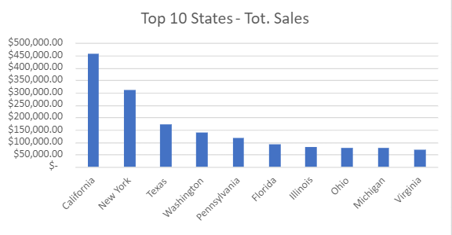
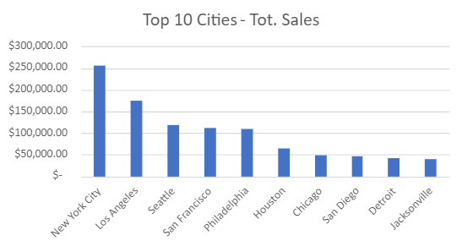
Best SALES performers by State and city
California and New York are the Best seller States by far.
Texas in 3rd place, followed by Washington.
NYC and Los Angeles lead the city rank.
The sales figures are clearly determined by the wealth concentration in the above metropolitan areas.

Slide 10
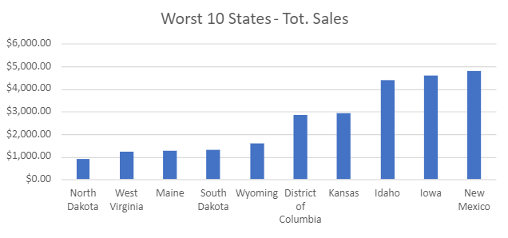
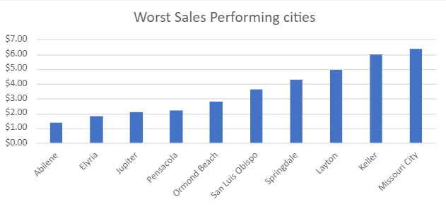
Worst SALES performers by States and city
North Dakota tops the worst-performing states rank
A fairly large group off cities have minimal sales figures (close to zero)

Slide 11
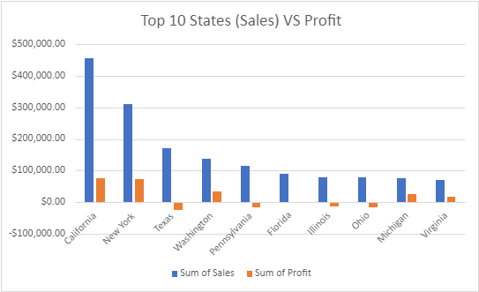
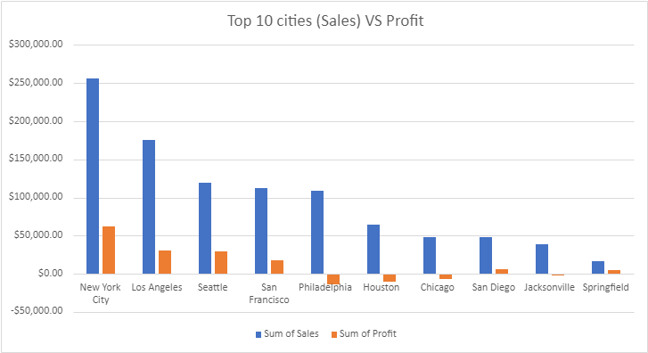
Profit by States and cities
Among the best performing states and cities, there some negative profits
States: Texas, Pennsylvania, Florida, Illinois, Ohio
Cities: Philadelphia, Houston, Chicago, Jacksonville

Slide 12
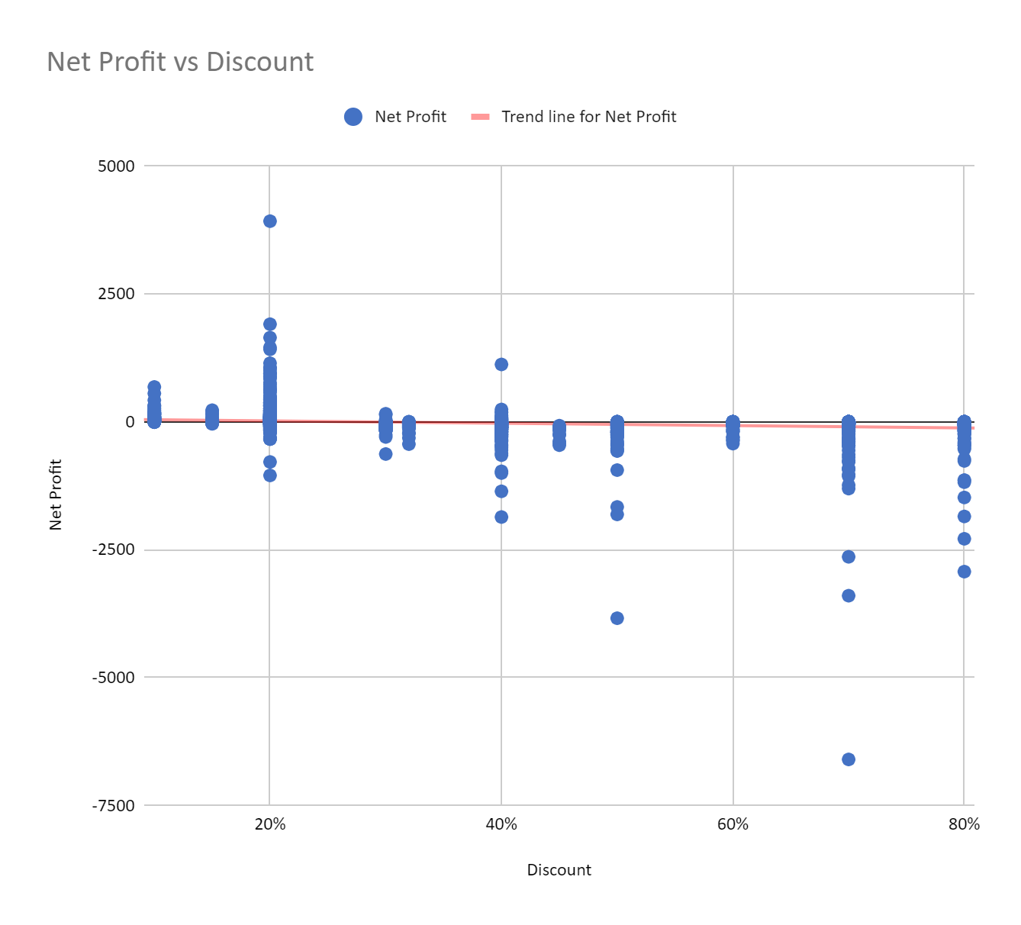
Discounts and Negative Profits
After looking into some of the cities with negative profits, I can confirm there is a correlation between discounts and profits.
On the left side of the scatter chart (zero or small discount), most profit values are positive.
Viceversa on the right side of the chart, most values are negative

Slide 13
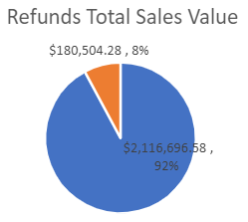
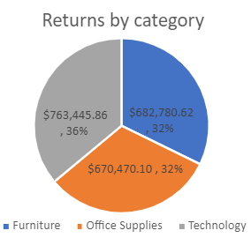
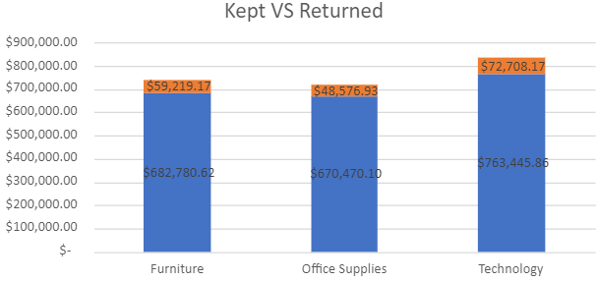
Returns overview
8% of returned goods
Even distributions of returns across categories

Slide 14
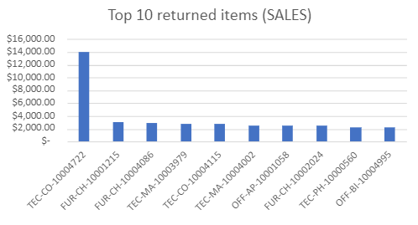
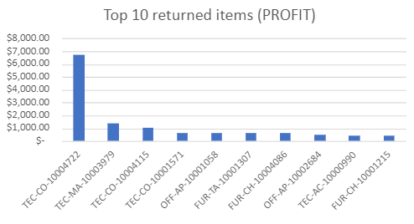
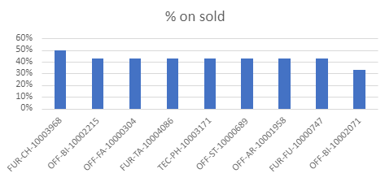
Returns
Copier TEC-CO-10004722 is a high value item and leads the rank of Sales and Profits
However, as a percentage of items returned based on item sold (among the items that sold more than 5 units) the following items are above 40%: Novimex Turbo Task Chair, Wilson Jones Hanging View Binder White 1", Advantus Push Pins, KI Adjustable-Height Table, Plantronics Encore H101 Dual Earpieces Headset, Fellowes Strictly Business Drawer File, Letter/Legal Size, Stanley Bostitch Contemporary Electric Pencil Sharpeners, Tenex B1-RE Series Chair Mats for Low Pile Carpets

Slide 15
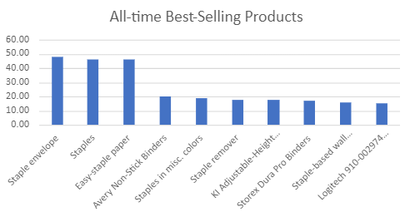
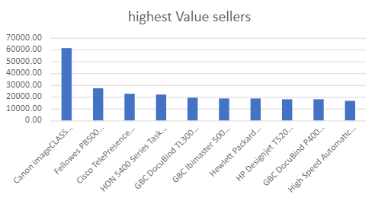
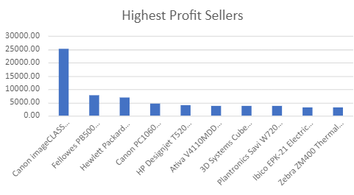
Best-sellers
Top 3 all-time best sellers: Staple envelope, Easy-staple paper, Staples
However, the product that generates the highest Sales and Profit value is Canon imageCLASS 2200 Advanced Copier

Slide 16
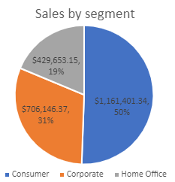
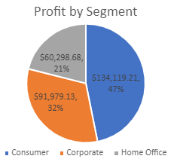
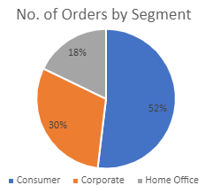
Segments
The consumer segment accounts for 50% of the total sale value, 47% of the total profit value and 52% of the number of orders.
On the other hand the Home Office segment accounts for 19% of sales, 21% of profit and 18% of orders’ number.
The corporate segments sits in the middle

Slide 17
Conclusions

Slide 18
Summary and Recommendations
Sales Trends:
promotions during the trough periods (Jan-Feb).
Try new/alternative products during the trough periods (example: if gift items sell well before xmas, research “non-gift” items/services that tend to sell well after xmas such as gym equipment).
Worst performers areas (North Dakota, West Virginia, Maine, etc.): explore partnerships or collaborations to expand the customer base in these low-performing areas.
Returns: look into reviews/feedback and investigate reasons for most returned items (Novimex Turbo Task Chair, Wilson Jones Hanging View Binder White 1", etc.).
Launch campaigns to promote top-performing products and capitalize on their success (copiers, phones, etc.).
Segments: provide incentives or personalized offers for the Home Office segment.

