Slide 1

Creative Programming and Computing – a.y. 2023/2024
Emma Coletta
Enrico Dalla Mora
Federico Ferreri
Lorenzo Previati
(Charmolypi)

Slide 2
INSPIRATION AND CONCEPT
beauty of closeness in human connections
Relationships → expression of the choice to risk losing something to share it, in exchange of making space for something enriching
distance understood as solitude → individuals are self-contained beings when apart
getting closer: gradual exchange and boundary opening
The intention behind this installation is to explore and abstractly represent what humans possess and share of themselves.

Slide 4
PURPOSE AND ACHIEVEMENT
Enhance the value of the enriching effect closeness in relationships has on the individual
Promote and encourage sharing and openness
Highlight the feeling of joy in choosing community over solitude
How do we achieve this?
The installation exploits human-to-human interaction
Both visual and audio dynamically evolve contributing to make the users perceive closeness and connection as something valuable and energising
Notes:
ABSTRACT REPRESENTATION OF THE ENRICHING EFFECT CLOSENESS IN RELATIONSHIP HAS ON THE INDIVIDUAL

Slide 6





FLOWCHART
osc
osc
osc
VISUAL
AUDIO
OUTPUT
OUTPUT

Slide 7
INTERACTION AND VISUAL
INTERACTION TECHNOLOGY: Kinect
VISUAL SOFTWARE: Touchdesigner
The Users’ position detected and mapped from the spinal cord
Geometries instantiate point-cloud like figures, affected by turbulent forces to create more interesting shapes and movements
Each user is assigned to a spherical
3-D geometry, which position in space is translated from the user’s real life one, as well as the relative distance between one another
The distance between users is mapped to control a 3-D noise applied to the boundaries of the each sphere, resulting in a progressively more shuttering effect of said boundaries
Notes:
The distance between users is mapped to control a 3-D noise applied to the boundaries of the each sphere, resulting in a progressively more shuttering effect of said boundaries

Slide 8
FLOWCHART
osc
osc
osc
VISUAL
AUDIO
OUTPUT
OUTPUT

Slide 9
AUDIO – evolution in time
Music sequence composition:
python
External midi dataset:
https://magenta.tensorflow.org/datasets/maestro - v300
GENERATION OF SOUNDS:
MARKOV CHAIN (variable order)→ computation of a generative chord progression after evaluating probabilities of a given dataset
CLOSENESS between users → sets the markov chain order and influences overall loudness, Shimmer volume and dry-wet reverb level
MUSIC COMPOSITION EVOLUTION → real time data from the kinect
PYTHON SCRIPT
midi velocity, tempo and duration values extraction
Values range manipulation to make the generation of notes sequences less deterministic

Slide 10
AUDIO – synthesis
SOUND SYNTHESIS METHODS:
subtractive
Granular & fft processing
SOUND SYNTHESIS SOFTWARE: Supercollider
GENERATION OF SOUNDS:
Paulstretch Algorithm → generates pads by hugely slowing a given sample.
‘clean’ synth → cleaner sound through reverb, high and low pass filtering
‘Shimmerwet’ synth → adds complex shimmering wet effect through layers of distortion, reverb and filtering effects

Slide 11
FLOWCHART
osc
osc
osc
VISUAL
AUDIO
OUTPUT
OUTPUT

Slide 13
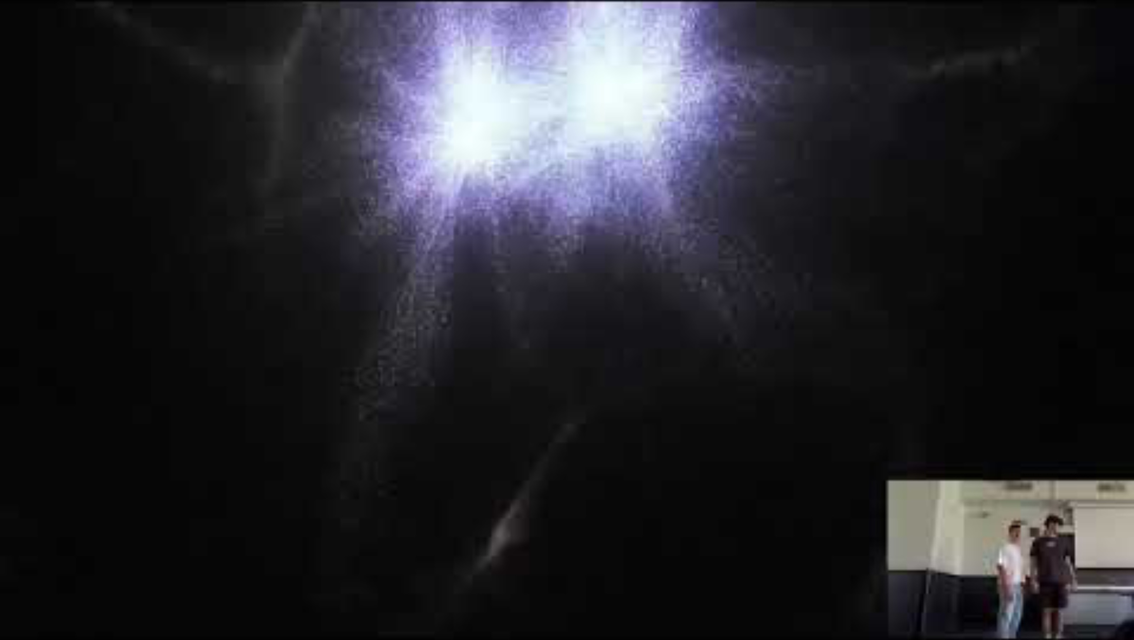
VIDEO DEMO
Notes:
https://youtu.be/q8xytoQ--RE?feature=shared

Slide 15
Known issues – future possibilities
ISSUES:
Deprecated Kinect SDK (continuity issues)
Deterministic component of the sequence generation using the Variable Length Markov Chain [solved]
People on the background interfere with overall functioning of the sensor
FUTURE POSSIBILITIES:
- Include extra features to further model the system developement in time (e.g. use of the twitter's API in order to evaluate density of specific words to affect the probabilities used in music sequence generation)

Slide 16
(Charmolypi)

Slide 17
(Charmolypi)

Slide 18
INSPIRATION AND CONCEPT
beauty of closeness in human connections
relationships: expression of the choice to risk losing something in exchange of making space for something enriching
distance understood as solitude: individuals are self-contained beings when apart
getting closer: gradual exchange and boundary opening
The intention behind this installation is to explore and abstractly represent what humans possess and share of themselves.

Slide 19
INSPIRATION AND CONCEPT
The installation aims to enhance the beauty of closeness between human beings. The loss of social connection often leads to feeling lonely and pained.
Relationships are the expression of the choice to risk start losing something personal and make space for something enriching. Distance is understood as solitude.
Two individuals far from each other are single entities, keeping their entire being within themselves. When the two choose to start getting closer one another, an exchange gradually happens, then translating into an opening of their respective boundaries, sharing parts of themselves and receiving something valuable in exchange.
The intention behind this installation is to explore and abstractly represent what humans possess and share of themselves.
Notes:
The installation aims to enhance the beauty of closeness between human beings. The loss of social connection often leads to feeling lonely and pained.
Relationships are the expression of the choice to risk start losing something personal and make space for something enriching. Distance is understood as solitude.
Two individuals far from each other are single entities, keeping their entire being within themselves. When the two choose to start getting closer one another, an exchange gradually happens, then translating into an opening of their respective boundaries, sharing parts of themselves and receiving something valuable in exchange.

Slide 20
FLOWCHART
osc
osc
osc
VISUAL
OUTPUT
AUDIO
OUTPUT

