Slide 1
Coupling with variable torsional stiffness
Barban Alberto, Behmanesh Ashkan, Bonato Matteo, Bonetto Matteo, Fabozzi Valerio, Turrin Tommaso.

Slide 2
What is a coupling?
What are torsional vibrations?
A coupling is a device used to mechanically connect two shafts in order to transmit torque. The coupling stiffness must be high enough to allow efficient torque transmission, but also the device has to be able to operate under conditions like misalignment which require flexibility. The torsional stiffness of the coupling affects the natural frequencies of the shaft line and it needs to be considered when selecting a coupling.
Torsional vibrations are present in almost every rotating system and some machines are inherently prone to them. These vibrations produce cyclic stresses, which can make the machine elements susceptible to fatigue damage. The vibrations can manifest heavily due to resonance if the excitation frequency of the system coincides with torsional natural frequencies of the system.

Slide 3
What are natural frequencies?
What is resonance?
free vibrations of a an elastic body are called natural vibrations and occur at a frequency called natural frequency.
if the frequency of an applied force (forced frequency) is equal to the natural frequency, the vibration amplitude increases manyfold. This phenomena is called resonance.

Slide 4

Goals
Have a joint which connects rotary components.
Stay away from resonance: different stiffness cause different natural frequency.
Unlimited rotation range in order to allow continuous motions. Or limited rotation range to be defined in accordance to the motor used.
Allow a changing in joint stiffness during working conditions.

Slide 5
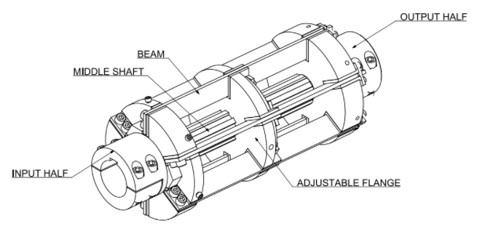
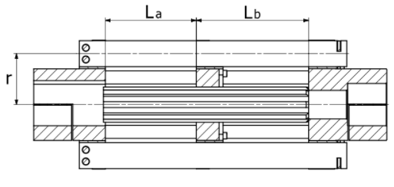
Starting concept to be improved
We started from a variable stiffness coupling which change stiffness in a static way: we must stop the mechanism to change it.

Slide 6
Issue of previous concept
The machine must be stopped and some components substituted by others more or less stiff depending on the new frequency range I want.
In our work we want to improve this operation by allowing the system to adapt the natural frequency of the system by changing the stiffness without stopping the machine.

Slide 7
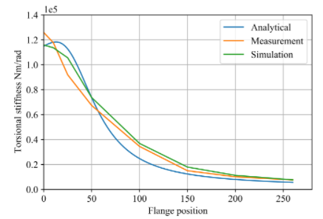
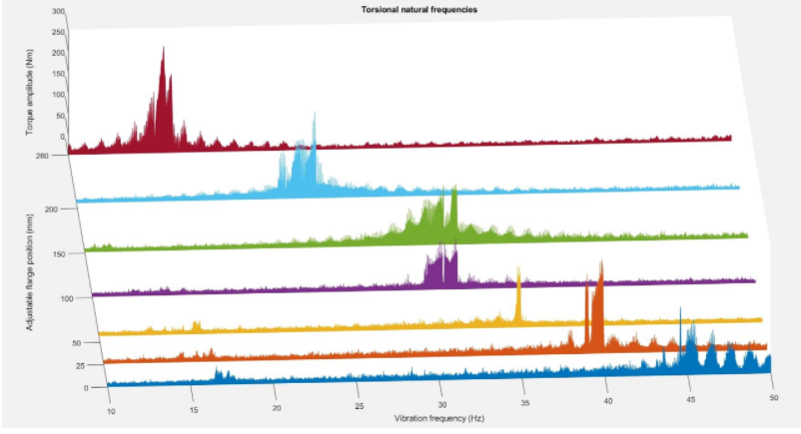
How it works
Natural frequency of the system change with the stiffness of the mechanism.
Stiffness depends on the geometry of the system → change position of the flange.
Issues: flange difficult to move because of friction, no automatic change of stiffness.

Slide 8
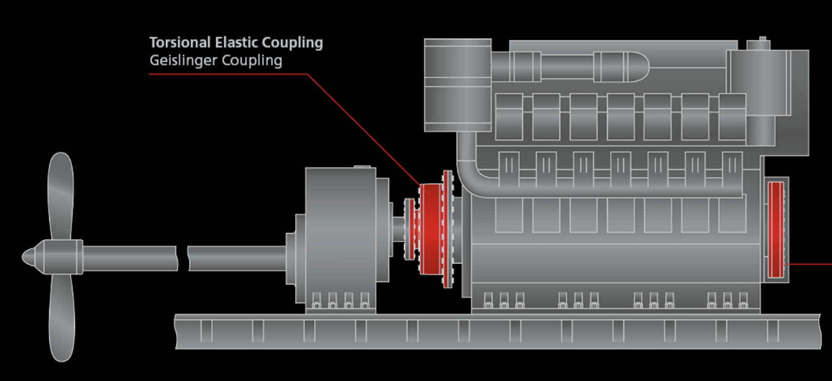
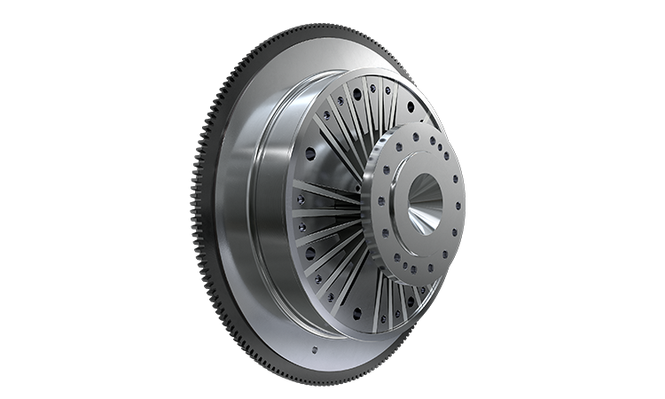
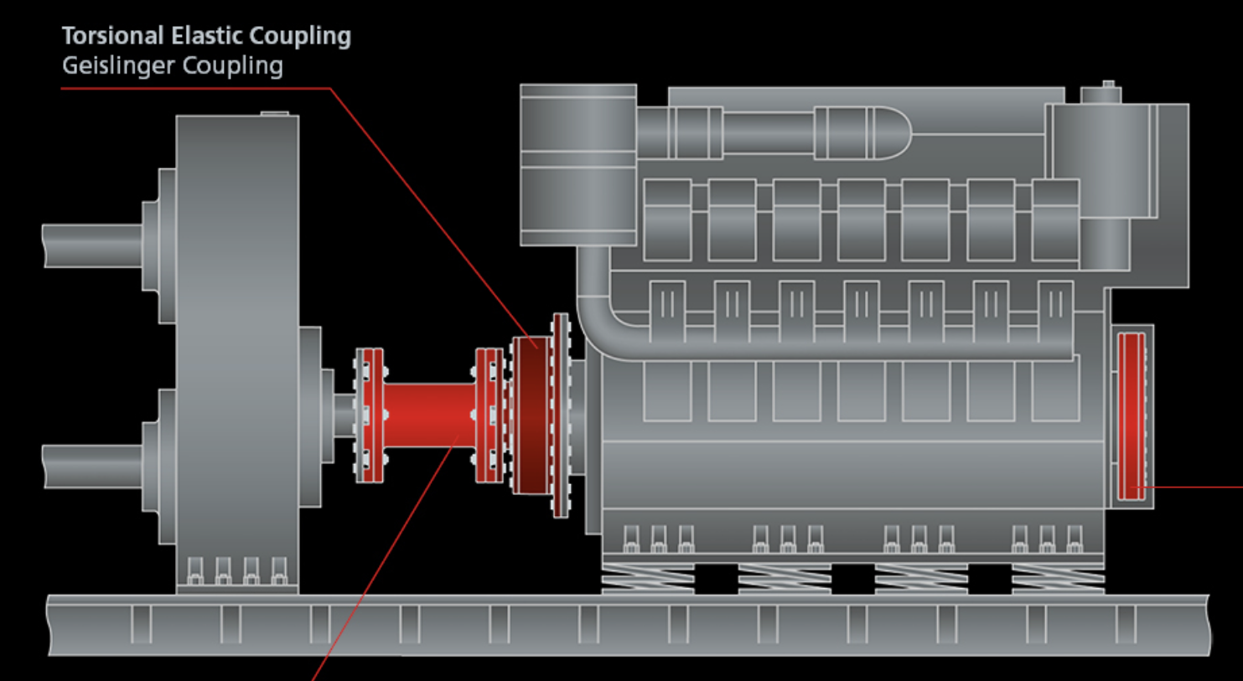
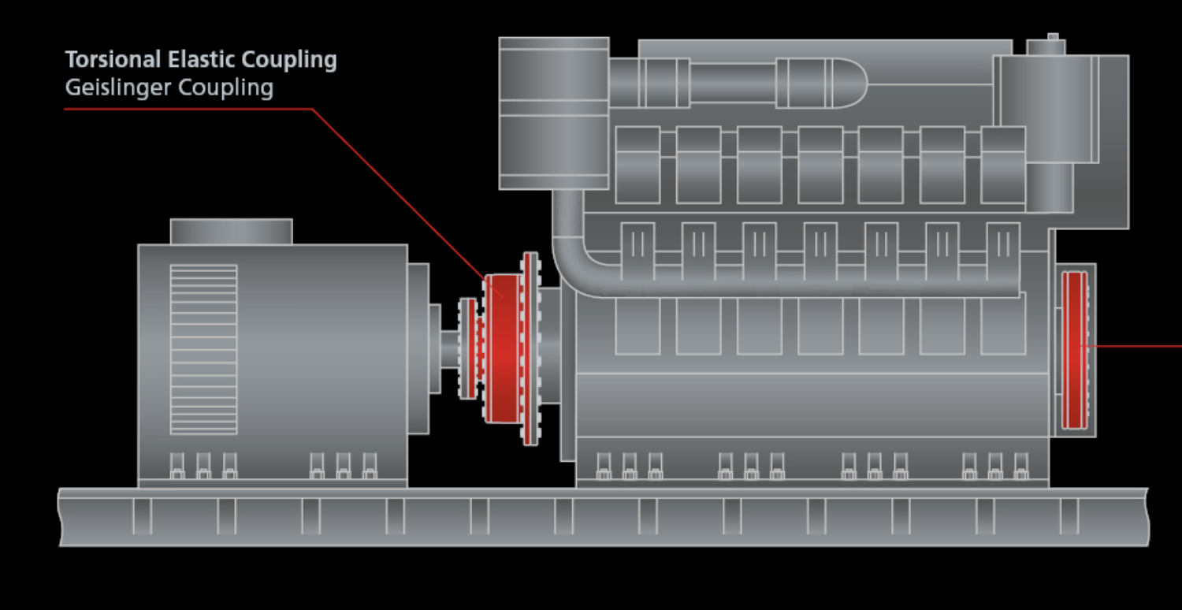
Applications
Marine
Power applications
Off-highway
Wind power
Many more…

Slide 9
Possible concepts
Pistons which move a flange that is linked to the rotary beam through some rollers or another way. Stiffness changes if the flange position is changed.
Elastic components which give different stiffness with radial locking.
Pressure system: oleodynamic system which gives different pressure to the coupling and this changes the whole stiffness.
System to change the shape of internal configuration of metal dust.

Slide 10
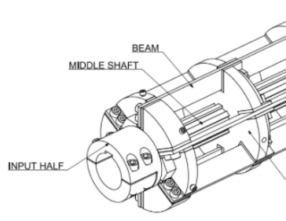

Concept 1: pistons with movable flange
It’s based on the starting concept of movable flange.
It uses a piston which shifts the position of the flange. This displacement is facilitated by the use of rollers which act as roller guides. Roller or ball bearings are used to avoid the problem of high friction.
It is needed an automatic system which calculates where to move the flange to obtain the correct stiffness.
Displacement of the flange = variable stiffness.
Notes:
Problema da capire: come risolvere il punto di contatto dei rulli ortogonale allo spostamento assiale

Slide 11
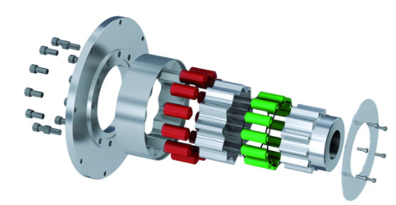
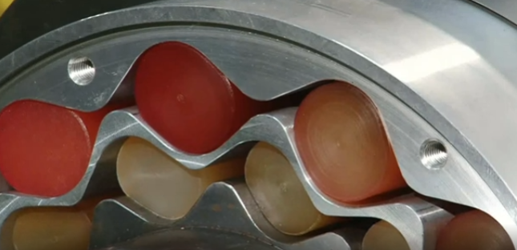
Concept 2: elastic components
Use of elastomers inserted in two rows of inserts.
The different stiffness of the elastic components cause different stiffness of the general system.
Problem: stiffness can be changed only in a limited range for each types of elastomers used. Therefore, we need to stop the machine to change the stiffness range.
https://blog.ringfeder.com/innovative-coupling-design-adjustable-stiffness-easy-replacement
Notes:
https://blog.ringfeder.com/new-coupling-offers-stiffness-adjustments
https://blog.ringfeder.com/innovative-coupling-design-adjustable-stiffness-easy-replacement

Slide 12
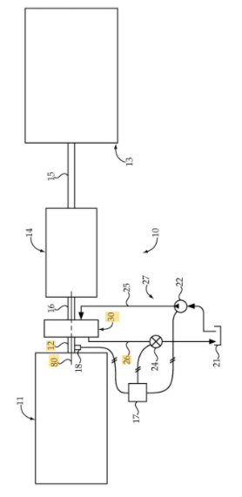
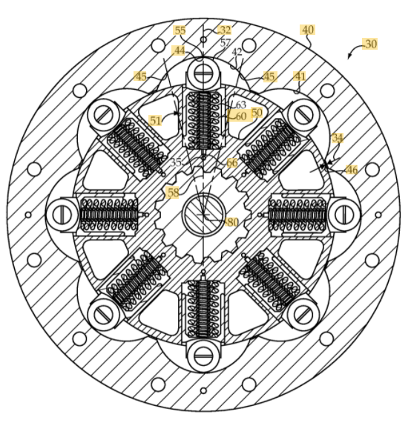
Concept 3: pressure system
There is a oleodynamic system which change the internal pressure of the coupling, in an automatic way.
An increase in the internal pressure cause major contact between the components causing stiffness increasing.

Slide 13
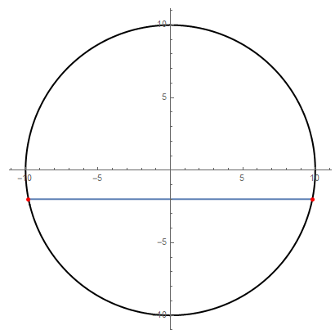
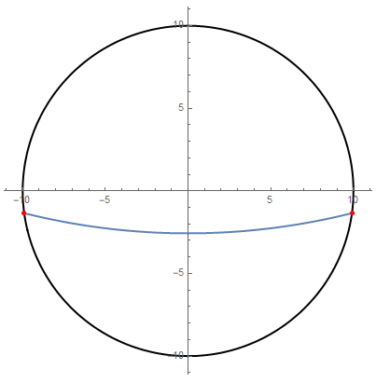
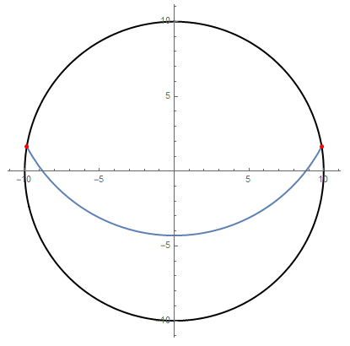
Concept 4: System to change the shape of internal configuration of metal dust
The natural frequencies depends on the shape. In order to design a concept able to avoid resonance, we need a mechanism able to modify its shape in accordance with the angular velocity of the shaft. The first step is to find the parameters that define the concept is to describe the correlation between the shape and the angular velocity
w=0 rad/s
w=1.2 rad/s
w=0.5 rad/s

Slide 14

System to change the shape of internal configuration of metal dust
Now we can describe the Natural frequencies in function of the moment of inertia, precisely, in function of the parameters of the concept (ρ, R, h0, ecc..) and the angular velocity
FreqNat=f(ρ, R, h0, ecc.,w)
we define the function m as the difference between the range of the frequencies that can be covered by the shaft and the natural frequencies
Notes:
https://blog.ringfeder.com/new-coupling-offers-stiffness-adjustments
https://blog.ringfeder.com/innovative-coupling-design-adjustable-stiffness-easy-replacement

Slide 15
System to change the shape of internal configuration of metal dust
Finally we should maximize the function m respect to its parameters
we will find at the end the best parameter’s conditions that allow our system to keep the distance from resonance
Notes:
https://blog.ringfeder.com/new-coupling-offers-stiffness-adjustments
https://blog.ringfeder.com/innovative-coupling-design-adjustable-stiffness-easy-replacement

