Slide 2
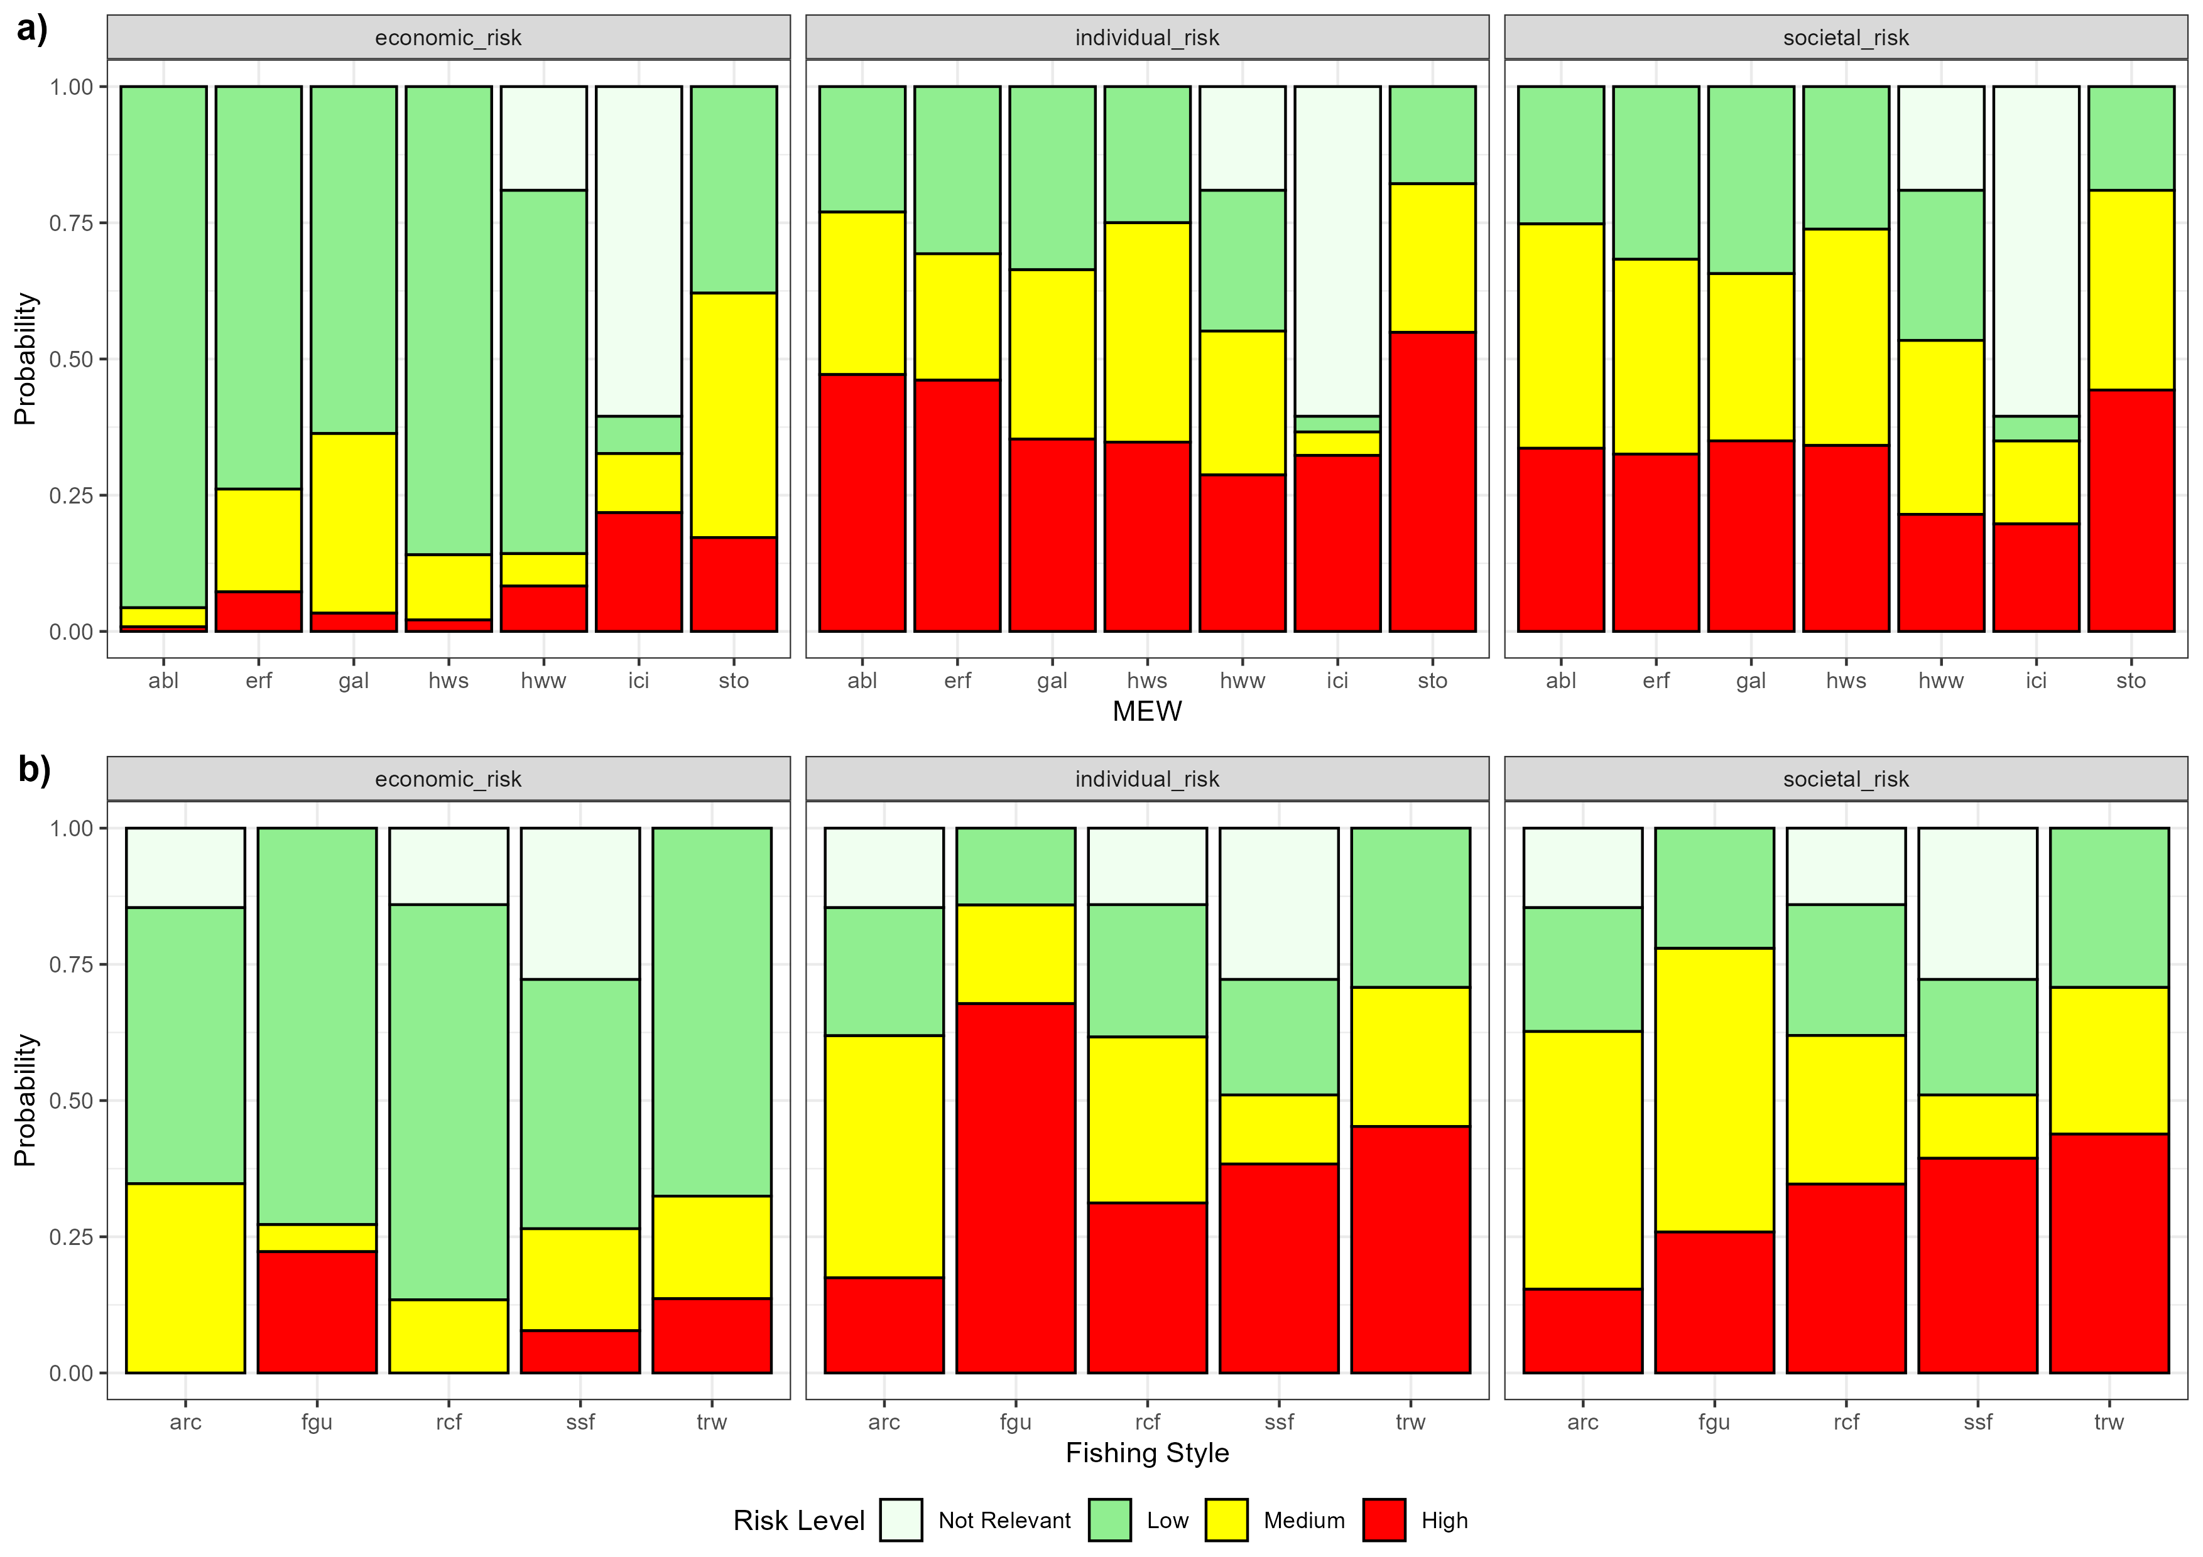

Slide 5
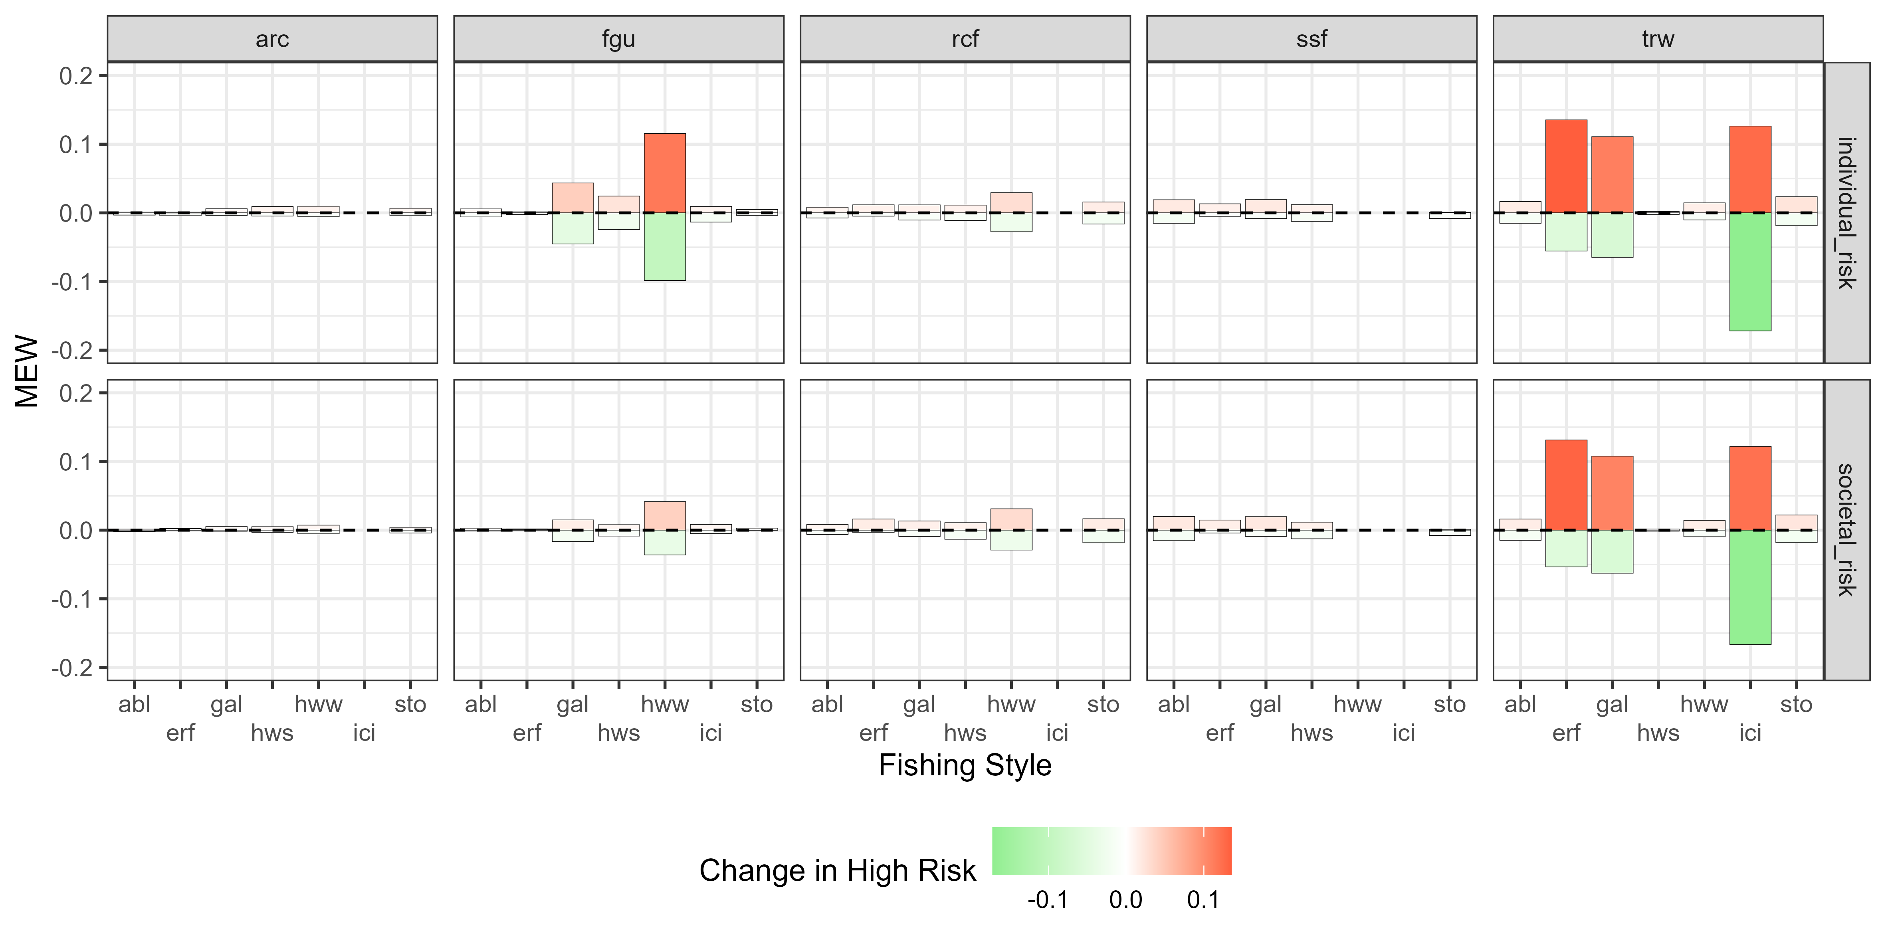

Stock status
worse
better

Slide 6
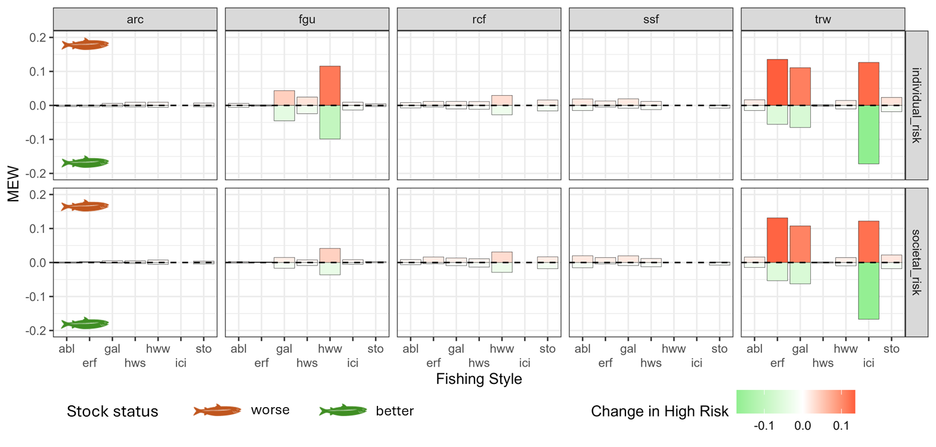

Slide 7
Preparatory work
MEW: 6 events
Operational: long list of detailed variabled
Socio economic: 2 borad categories
Cycle 1
MEW: confirmed
Operational: simplified to 6
Socio economic: expanded to 12
Cycle 2
Legend
MEW: confirmed and validated as mutually exclusive
Operational: revised to accommodate gear, target species and strategies
Socio economic: confirmed
List of variables
Cycle 3
Revision from scientist team
Interview with fishers

Slide 8
