Slide 1



Slide 2

Landers, R. N., & Behrend, T. S. (2024). Research methods for industrial and organizational psychology: Science and practice. Routledge.

Slide 3
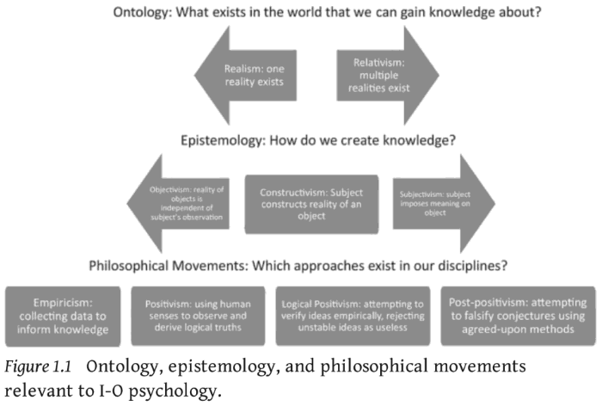

Slide 4
WOP
Theory-driven
(deductive)
Data-driven
(inductive)
Hybrid
(abductive??)
Psychometrics
Data Science

Slide 5
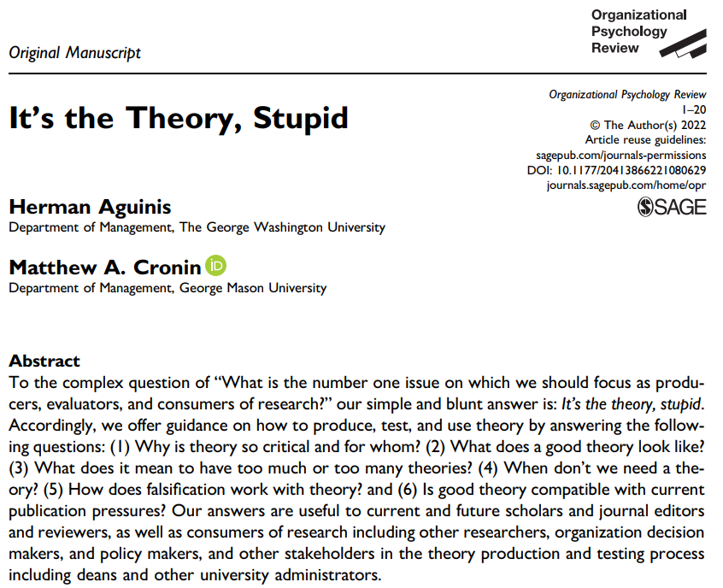

Slide 6


Slide 7
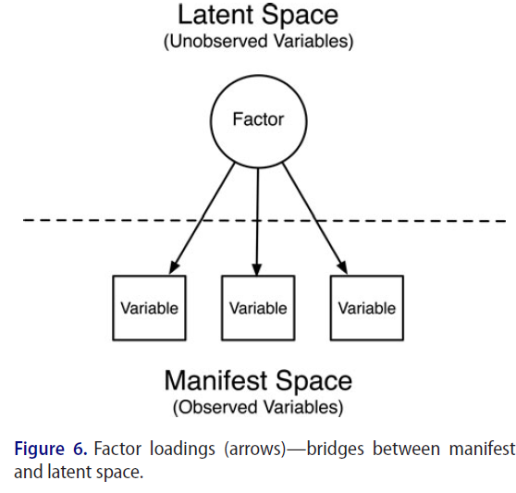

Slide 8
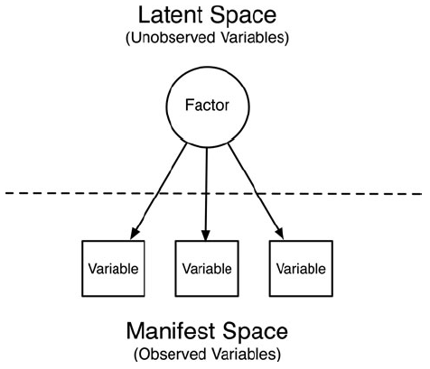
Construct
Instrument
Indicators
Variables

Slide 9
Work Engagement
Work engagement
UWES-3
UWES-item 1
UWES-item 2
UWES-item 3
Vigor, dedication, and absorption
“At my work, I feel bursting with energy”
“I am enthusiastic about my job”
“I am immersed in my work”

Slide 10
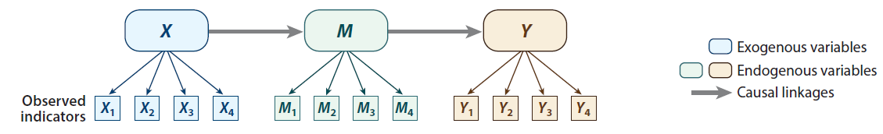

Slide 11
v
Volume
AI
Variety
Velocity
Machine Learning
Big Data
Deep Learning
Veracity
Value
Variability
Shallow Learning
Supervised
Regression
Classification
Unsupervised
Dimension Reduction
Clustering

Slide 12
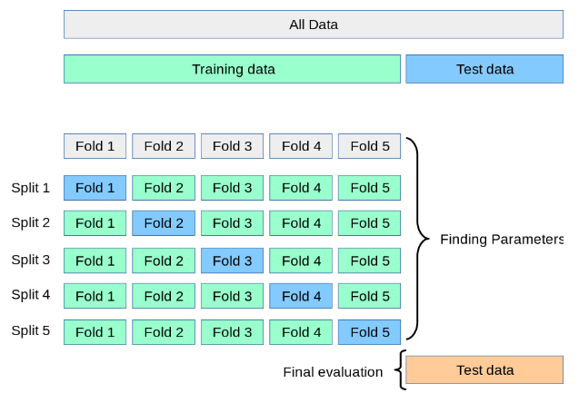
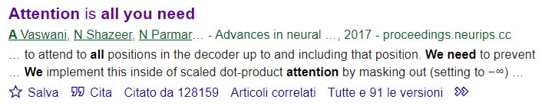
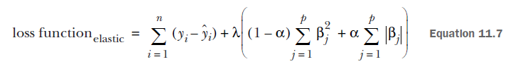
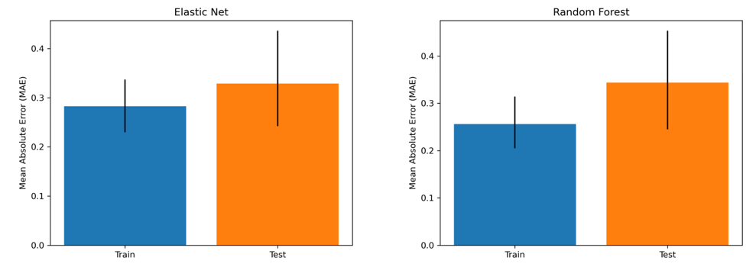
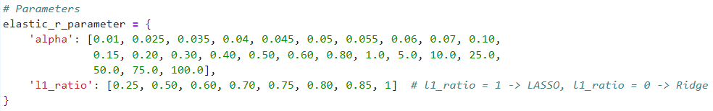
Transformer
New deep learning architecture at the basis of the latest advancements in Large Language Models (e.g., GPT)
Cross-validation
https://scikit-learn.org/stable/modules/cross_validation.html
As of Aug 8, 2024
Regularization and Optimization
Loss function for Elastic Net (Rhys, 2020, p. 262)
Overfitting
(Perinelli, Stella, Bizzego, Pisanu, & Fraccaroli, under review)
Hyperparameter Tuning (Optimization) for Elastic Net in Python

Slide 13
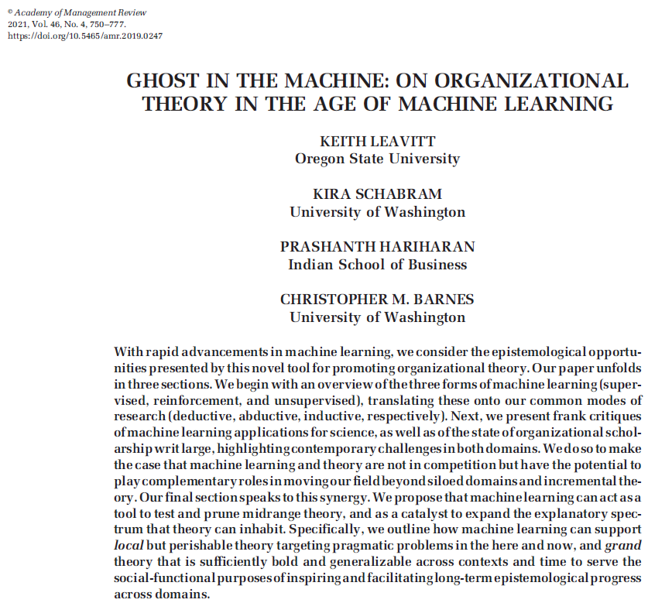

Slide 14
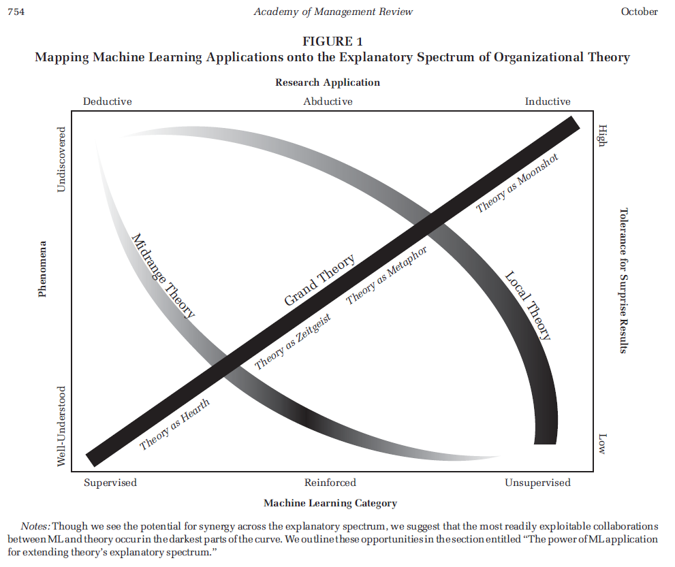

Slide 15
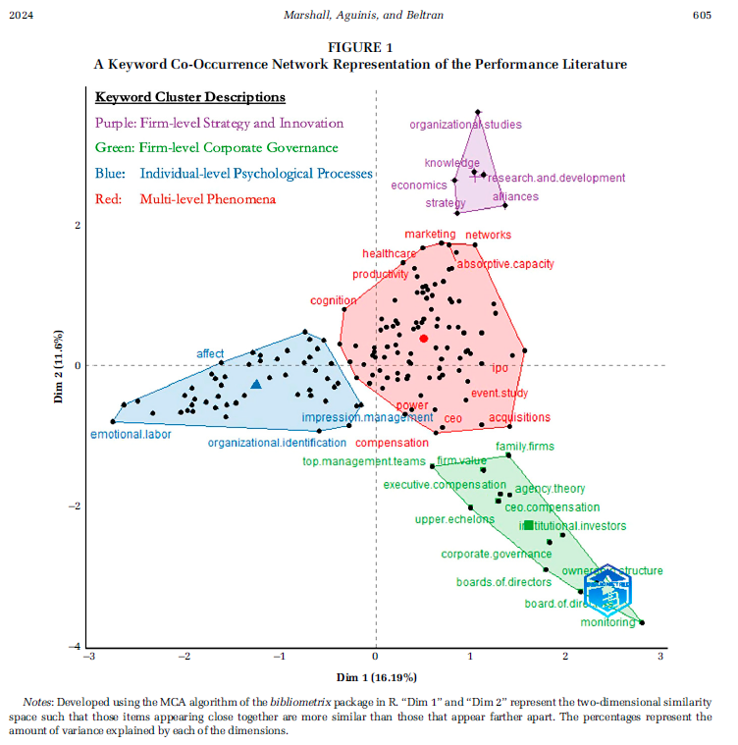
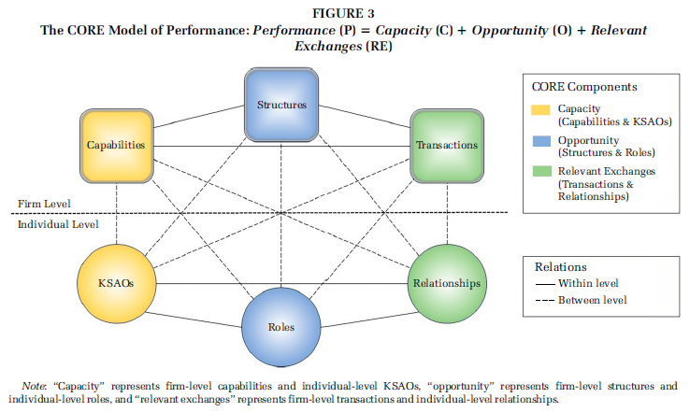

Slide 16
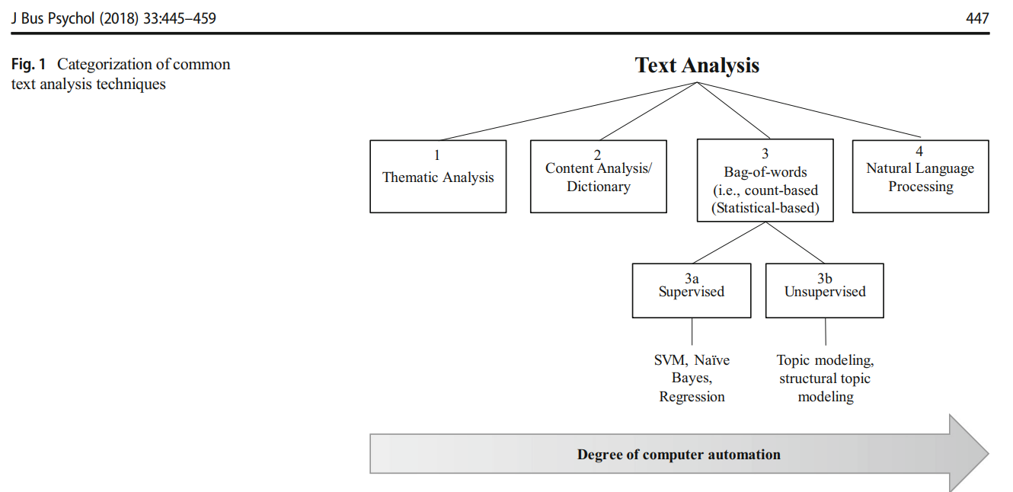

Slide 17
