Slide 1
Model results accompanied by Equations and Figures

Slide 2
Model | Name | Question | Mixed-Effects Equation
1 | Null (intercept only) | Is there substantial between level variability to be explained in my outcome variable? | y_{ij} = γ₀₀ + u_{0j} + r_{ij}
2 | Random intercept - Fixed slope | Does the intercept of my specified regression equation vary across clusters? | y_{ij} = γ₀₀ + γ₁₀x_{ij} + u_{0j} + r_{ij}
3 | Random intercept - Random slope | Does the slope of my specified regression equation vary across clusters? | y_{ij} = γ₀₀ + γ₁₀x_{ij} + u_{1j}x_{ij} + u_{0j} + r_{ij}
4 | Intercept as outcome | Are there between level variables capable to predict the between variability of intercepts? | y_{ij} = γ₀₀ + γ₁₀x_{ij} + γ₀₁w_{j} + u_{1j}x_{ij} + u_{0j} + r_{ij}
5 | Intercept and slope as outcomes | Are there between level variables capable to predict the between variability of intercepts and slopes? | y_{ij} = γ₀₀ + γ₁₀x_{ij} + γ₀₁w_{j} + γ₁₁x_{ij} w_{j} + u_{1j} x_{ij} + u_{0j} + r_{ij}

Slide 3
MODEL 1: Null (intercept only) – Equation and path diagram
Level 1: y_{ij} = β_{0j} + r_{ij}
Level 2: β_{0j} = γ₀₀ + u_{0j}
y_{ij} = γ₀₀ + u_{0j} + r_{ij}
1
γ₀₀
u_{0j}
job_perf
Between (Level 2)
-----------------------------------------------------------------
Within (Level 1)
r_{ij}
job_perf (y_{ij})

Slide 4
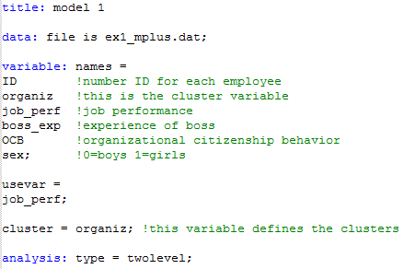
MODEL 1: Null (intercept only) – Mplus input

Slide 5
MODEL 1: Null (intercept only) – Mplus output
The 3 parameters we are computing are:
γ₀₀ = Between mean = 5.308***
Var(u_{0j}) = Between variance = 0.871***
Var(r_{ij}) = Within variance = 0.639***
1
MODEL RESULTS
Two-Tailed
Estimate S.E. Est./S.E. P-Value
Within Level
Variances
JOB_PERF 0.639 0.030 21.312 0.000
Between Level
Means
JOB_PERF 5.308 0.095 55.857 0.000
Variances
JOB_PERF 0.871 0.116 7.516 0.000
0.871***
u_{0j}
5.308***
job_perf
Between
------------------------------------------------------
Within
r_{ij}
job_perf (y_{ij})
0.639***

Slide 6
MODEL 2: Random intercept – Equation and path diagram
Level 1: y_{ij} = β_{0j} + β_{1j} (OCB_{ij}) + r_{ij}
Level 2: β_{0j} = γ₀₀ + u_{0j}
Level 2: β_{1j} = γ₁₀
y_{ij} = γ₀₀ + γ₁₀ (OCB_{ij}) + u_{0j} + r_{ij}
1
γ₀₀
u_{0j}
job_perf
Between (Level 2)
---------------------------------------------------------------------------------
.
Within (Level 1)
r_{ij}
OCB_{ij}
γ₁₀
job_perf (y_{ij})

Slide 7
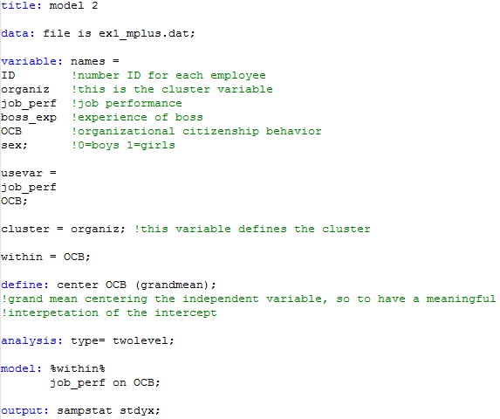
MODEL 2: Random intercept – Mplus input

Slide 8
MODEL 2: Random intercept – Mplus output
The 4 parameters we are computing are:
γ₀₀ = Between mean = 5.307***
Var(u_{0j}) = Between variance = 0.255***
Var(r_{ij}) = Within variance = 0.586***
γ₁₀ = Within slope coefficient = .530***
1
0.255***
MODEL RESULTS
Two-Tailed
Estimate S.E. Est./S.E. P-Value
Within Level
JOB_PERF ON
OCB 0.530 0.048 11.073 0.000
Residual Variances
JOB_PERF 0.586 0.026 22.770 0.000
Between Level
Means
JOB_PERF 5.307 0.053 99.456 0.000
Variances
JOB_PERF 0.255 0.051 4.995 0.000
5.307***
u_{0j}
job_perf
Between
------------------------------------------------------
Within
.
r_{ij}
0.586***
OCB_{ij}
0.530***
job_perf (y_{ij})

Slide 9
MODEL 3: Random slope – Equation and path diagram
Level 1: y_{ij} = β_{0j} + β_{1j} (OCB_{ij}) + r_{ij}
Level 2: β_{0j} = γ₀₀ + u_{0j}
Level 2: β_{1j} = γ₁₀ + u_{1j}
y_{ij} = γ₀₀ + γ₁₀ (OCB_{ij}) + u_{1j} (OCB_{ij}) + u_{0j} + r_{ij}
Random slope
u_{1j}
γ₁₀
1
τ₀₁
γ₀₀
job_perf
u_{0j}
Between (Level 2)
--------------------------------------------------------------------------------
.
.
Within (Level 1)
r_{ij}
OCB_{ij}
job_perf (y_{ij})

Slide 10
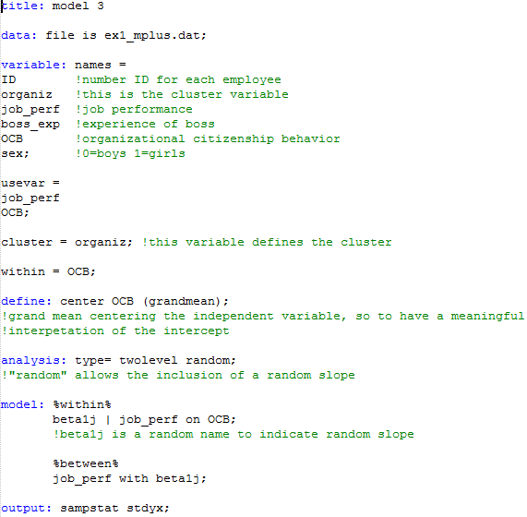
MODEL 3: Random slope – Mplus input

Slide 11
MODEL 3: Random slope – Mplus output
The 6 parameters we are computing are:
γ₀₀ = Between mean = 5.226***
Var(u_{0j}) = Between variance = 0.227***
Var(r_{ij}) = Within variance = 0.567***
γ₁₀ = Between slope mean = 0.535***
Var(u_{1j}) = Between slope variance = 0.054**
τ₀₁ = Between interc/slope covariance = 0.047**
0.054**
MODEL RESULTS
Two-Tailed
Estimate S.E. Est./S.E. P-Value
Within Level
Residual Variances
JOB_PERF 0.567 0.025 22.456 0.000
Between Level
JOB_PERF WITH
BETA1J 0.047 0.016 2.843 0.004
Means
JOB_PERF 5.226 0.057 90.980 0.000
BETA1J 0.535 0.044 12.097 0.000
Variances
JOB_PERF 0.227 0.048 4.704 0.000
BETA1J 0.054 0.018 2.982 0.003
Random slope
u_{1j}
0.535***
1
0.047**
5.226***
job_perf
u_{0j}
Between
0.227***
------------------------------------------------------------------
.
.
Within
r_{ij}
0.567***
OCB_{ij}
job_perf (y_{ij})

Slide 12
MODEL 4: Intercept as outcome – Equation and path diagram
Level 1: y_{ij} = β_{0j} + β_{1j} (OCB_{ij}) + r_{ij}
Level 2: β_{0j} = γ₀₀ + γ₀₁ (boss_exp_{j}) + u_{0j}
Level 2: β_{1j} = γ₁₀ + u_{1j}
y_{ij} = γ₀₀ + γ₁₀ (OCB_{ij}) + γ₀₁ (boss_exp_{j}) + u_{1j} (OCB_{ij}) + u_{0j} + r_{ij}
Random slope
u_{1j}
γ₁₀
1
τ₀₁
γ₀₀
boss_exp_{j}
(Boss experience)
γ₀₁
job_perf
u_{0j}
Between (Level 2)
------------------------------------------------------------------------------------------------------
.
.
Within (Level 1)
r_{ij}
OCB_{ij}
job_perf (y_{ij})

Slide 13
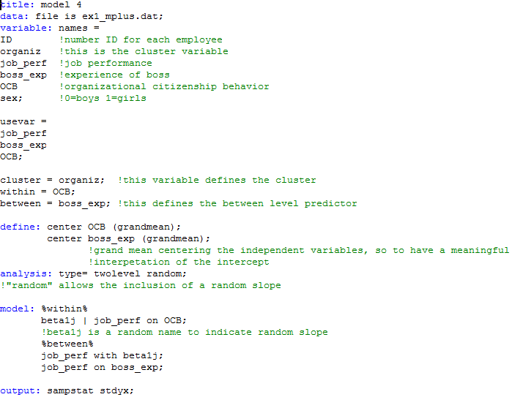
MODEL 4: Intercept as outcome – Mplus input

Slide 14
MODEL 4: Intercept as outcome – Mplus output
The 7 parameters we are computing are:
γ₀₀ = Between mean = 5.248***
Var(u_{0j}) = Between variance = .124***
Var(r_{ij}) = Within variance = 0.569***
γ₁₀ = Between slope mean = 0.523***
Var(u_{1j}) = Between slope variance = .038*
τ₀₁ = Between interc/slope covariance = 0.032*
γ₀₁ = Between slope coefficient (job_perf) = 0.051***
0.038*
Two-Tailed
Estimate S.E. Est./S.E. P-Value
Within Level
Residual Variances
JOB_PERF 0.569 0.025 22.492 0.000
Between Level
JOB_PERF ON
BOSS_EXP 0.051 0.007 7.467 0.000
JOB_PERF WITH
BETA1J 0.032 0.014 2.267 0.023
Means
BETA1J 0.523 0.043 12.160 0.000
Intercepts
JOB_PERF 5.248 0.047 111.106 0.000
Variances
BETA1J 0.038 0.016 2.366 0.018
Residual Variances
JOB_PERF 0.124 0.028 4.444 0.000
Random slope
u_{1j}
0.523***
1
0.032*
5.248***
Boss_exp_{j}
0.051***
job_perf
u_{0j}
Between
0.124***
.
.
------------------------------------------------------------------
Within
r_{ij}
0.569***
OCB_{ij}
job_perf (Y_{ij})

Slide 15
MODEL 5: Intercept and slope as outcomes – Equation and path diagram
Level 1: y_{ij} = β_{0j} + β_{1j} (OCB_{ij}) + r_{ij}
Level 2: β_{0j} = γ₀₀ + γ₀₁ (boss_exp_{j}) + u_{0j}
Level 2: β_{1j} = γ₁₀ + γ₁₁ (boss_exp_{j}) + u_{1j}
y_{ij} = γ₀₀ + γ₁₀ (OCB_{ij}) + γ₀₁ (boss_exp_{j}) + γ₁₁ (OCB_{ij} * boss_exp_{j}) + u_{1j} (OCB_{ij}) + u_{0j} + r_{ij}
Random slope
u_{1j}
γ₁₁
γ₁₀
1
τ₀₁
γ₀₀
boss_exp_{j}
(Boss experience)
γ₀₁
job_perf
u_{0j}
Between (Level 2)
------------------------------------------------------------------------------------------------------
.
.
Within (Level 1)
r_{ij}
OCB_{ij}
job_perf (y_{ij})

Slide 16
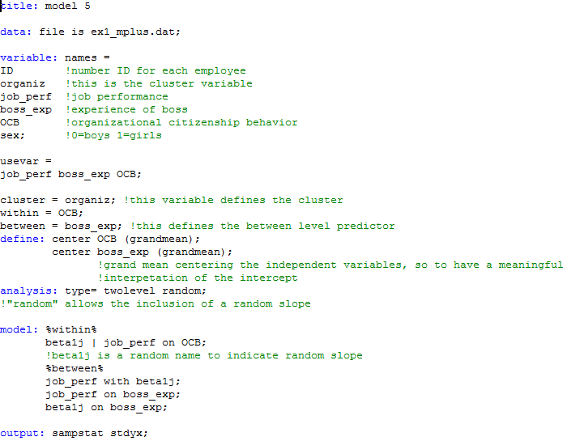
MODEL 5: Intercept and slope as outcome – Mplus input

Slide 17
MODEL 5: Intercept and slope as outcome – Mplus output
The 8 parameters we are computing are:
γ₀₀ = Between mean = 5.238***
Var(u_{0j}) = Between variance = 0.120***
Var(r_{ij}) = Within variance = 0.569***
γ₁₀ = Between slope mean = 0.526***
Var(u_{1j}) = Between slope variance = 0.037*
τ₀₁ = Between interc/slope covariance = .030*
γ₀₁ = Between slope coefficient ( → job_perf) = 0.053***
γ₁₁ = Between slope coefficient (→ random slope) = 0.006^{n.s.}
0.037*
Two-Tailed
Estimate S.E. Est./S.E. P-Value
Within Level
Residual Variances
JOB_PERF 0.569 0.025 22.463 0.000
Between Level
BETA1J ON
BOSS_EXP 0.006 0.004 1.341 0.180
JOB_PERF ON
BOSS_EXP 0.053 0.007 7.409 0.000
JOB_PERF WITH
BETA1J 0.030 0.015 2.038 0.042
Intercepts
JOB_PERF 5.238 0.047 112.465 0.000
BETA1J 0.526 0.043 12.185 0.000
Residual Variances
JOB_PERF 0.120 0.028 4.355 0.000
BETA1J 0.037 0.016 2.281 0.023
Random slope
u_{1j}
0.006^{n.s.}
0.526***
1
.030*
5.238***
boss_exp_{j}
0.053***
job_perf
u_{0j}
Between
0.120***
.
.
----------------------------------------------------------------
Within
r_{ij}
0.569***
OCB_{ij}
job_perf (y_{ij})

