Slide 1
Ordinary Differential Equations & 1 D models Kjell Kåre Fjelde - 2024

Slide 2
Theory-based Models
Here we will focus on models that are based on scientific knowledge (not data science models that only uses data)
We use knowlegde from physics, biology or chemistry to try to put up a model for the process of interest
The model is described with mathematics, for instance an ordinary differential equation.

Slide 3
What kind of problems are often modelled using ordinary differential equations?
Mechanical problems (e.g pendulum, ballistic motion, free fall, spring-mass)
Population models (e.g. logistic growth)
Radioactive decay
Predator – Prey
Continuous stirred tank reactor ( a tank with fluid and some chemical compound distributed evenly all over)
Electrical circuits
+ much much more
They describe something that vary either in time or space. While a partial differential equation describes both. Hence, a weather forecast model where the weather depends on both location and time is not described by ordinary differential equations.

Slide 4
The modelling process
First try to formulate the physical, biological or chemical phenomena with mathematics
E.g formulate a differential equation for populations growth by using the fact that the growth rate must be proportional to the number of people DN/dt = kxN
Leads often to some differential equations
Try to solve the problem either analytically or by a numerical method
Test the simulation model
If possible, try to verify the model with real data (important)
Use the simulation model to simulate various scenarios by varying input parameters to get insight into the dynamics of the system and how sensitive it is to various changes.
Use results for engineering studies to support various decision making processes
Sometimes simulation models calibrated with real data can be used as digital twins which represent some kind of real process. The digital twin is important if we loose contact with the real process and still want to have an idea of what is going on. Example, a drilling simulator can still predict downhole pressures even if some downhole sencors fails

Slide 5
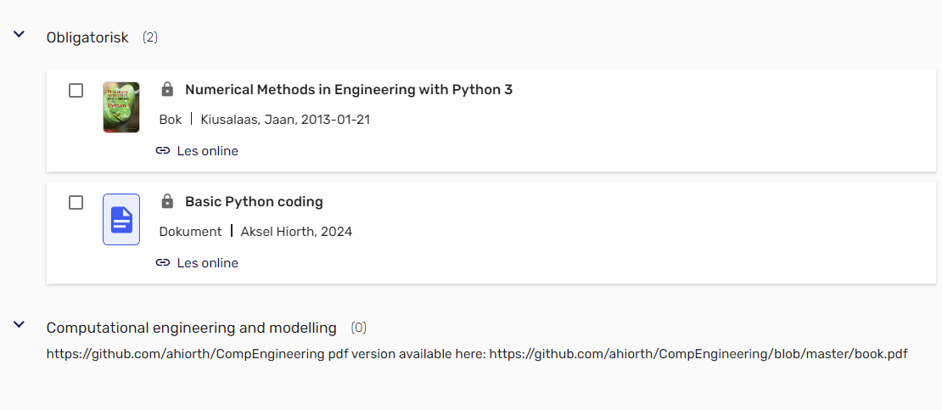
Reading List:
The theory related to ordinary differential equations can be found in Chapter 7 in the book: Numerical Methods in Engineering with Python 3 (page 246-263)+ Chapter 7 in the Compendium: Computational engineering and modelling.
The theory related to control engineering has been taken from the book: Reguleringsteknikk, Finn Aakre Haugen
All programming examples and exercises will be performed in Jupyter Notebook. Also the project to be delivered shall use Jupyter Notebook.

Slide 6
Note:
Bring your laptops charged to the classes with Jupyter Notebook so that we can do programming more interactively (reproduce codes that are presented on the projector or modify codes that you download)
We will use blackboard in combination with showing code examples using the projector
Codes will be posted on Canvas. Important to study these and get familar with programming (this is a practical oriented course)
What we will go through the different weeks depends on how fast we progress. So the plan shown is tentative.
Some of the theory we go through is strongly linked to the project that you shall work with on this topic.

Slide 7
Project
The project will deal with:
Logistic growth model to study a fish population and the effect of harvesting
We will study the dynamics of the model by varying different parameters and we will see that simulations can be used to give us deeper insight into how different systems behave.
The numerical methods that will be used are the first order Euler method and the fourth order Runge Kutta method. So the codes we go through in the course are highly relevant.

Slide 8
Week 36
Start with looking at a couple of examples of first order ordinary differential equations (initial value problems ) and how to derive exact solutions
(Example 7.1 page 250) in Jan Kiusalaas book + radioactive decay example
Get familiar with the terms: order of differential equation, linear vs nonlinear
Taylor series expansion and its relation to deriving numerical methods
First order Euler method
4 th order Runge Kutta method
Apply the two methods on the two examples (4 codes provided on Canvas). We will work through these codes.
Discuss terms like convergence, truncation error, accumulated error and study the impact of reducing the step size in the numerical methods.

Slide 9
Week 37
Study how we can rewrite a second or higher order differential equation as a system of first order equations.
Study the numerical code framework provided in Jan Kiusalaas book for solving systems of equations (it is very flexible). Example 7.2 and Example 7.4 in book are relevant. Codes will be provided
Present the logistic growth model used for population dynamics (e.g fish stock)
Discuss how we derive such an equation (the modelling part)
How can we analyse the model without having the exact solution?
Present the exact solution (just note that not all problems have an exact solution)

Slide 10
Week 38
Continue with what remains regarding the logistic growth model
Present the water tank model and how to derive it
Short introduction to control engineering

Slide 11
Week 39
Ballistic motion with air drag.
Show how we derive two second order ordinary differential equations from Newtons laws to describe the motion (nonlinear equations due to air drag)
Show how we can rewrite these as a system of 4 first order differential equations
See how we can apply the numerical framework provided in the book to produce simulations of the projectile movement
The reason why we go through this is that it is relevant for the last part of the course that addresses machine learning (we are actually using these simulations to provide data that one can work with for machine learning). We will use randomization to produce different simulation results.

