Slide 1


ttalkR

Slide 2
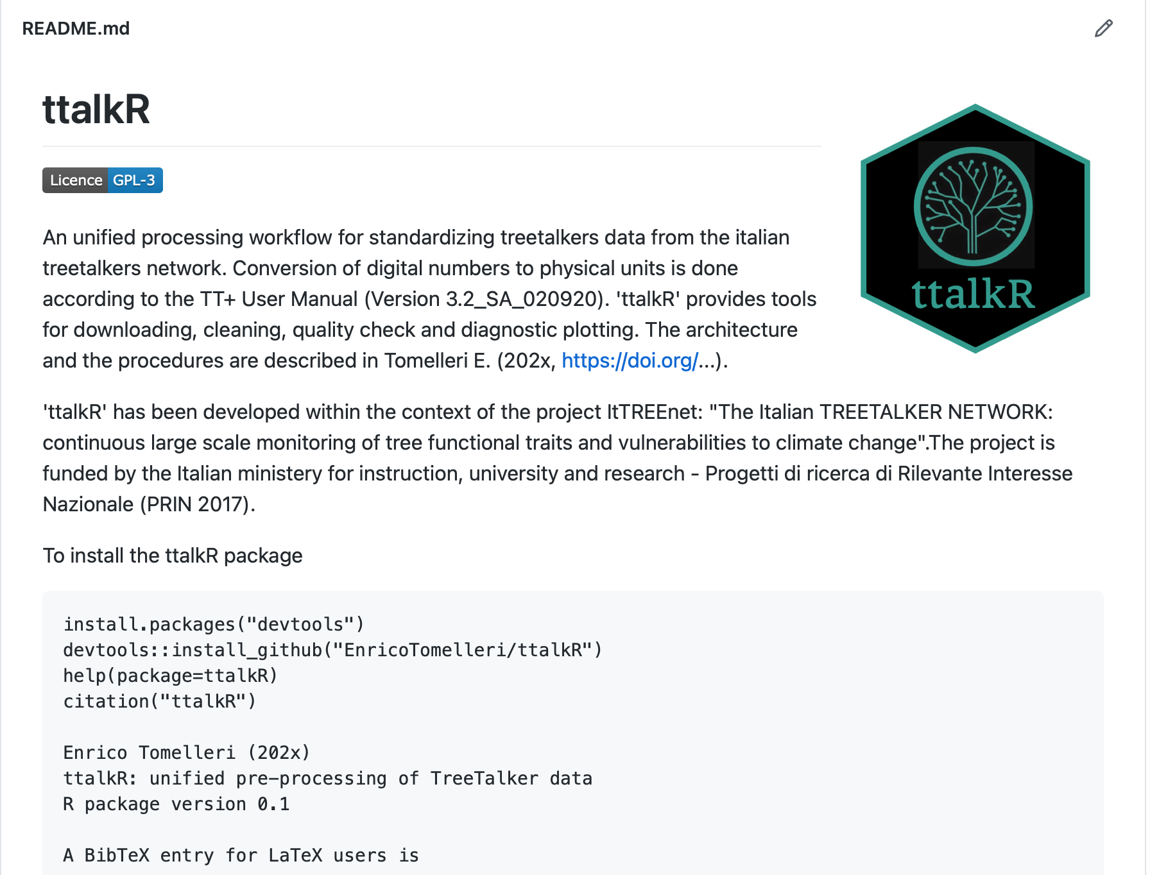

Slide 3

An unified processing workflow
ttlight()
ttbattery()
Done!
Almost ready
Action needed
ttscrape()
ttgranier()
Missing: plotting utility
ttmeteo()
Missing: plotting utility
ttgrowth()
Missing: data filtering, plotting utility
ttacc()
Missing: to be started

