Slide 1
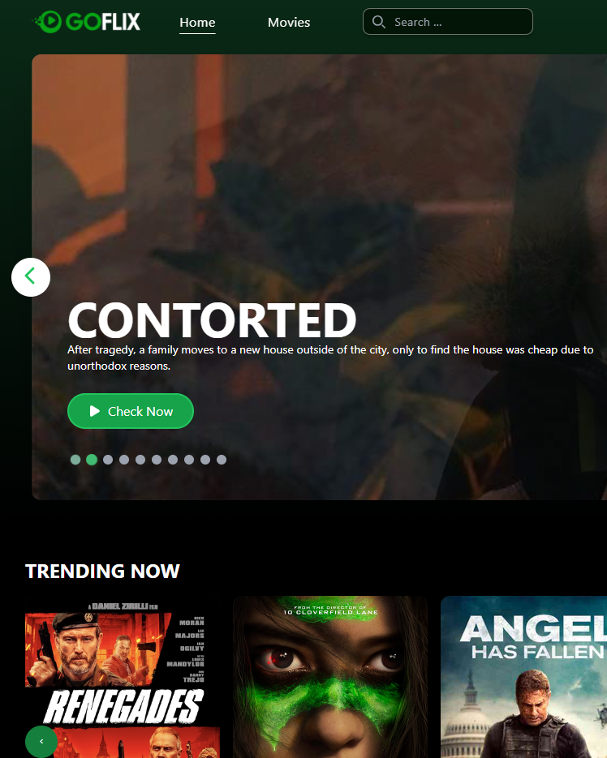
Goflix
STREAMING PLATFORM
The admin dashboard behind the catalog, the plans, and who may watch what
Enrico Saputra · Backend developer, Laravel dashboard
Client code and data are private. The demo rebuilds the Laravel dashboard on the real data model, with made-up data.
Notes:
Framing: Goflix has three parts. I built the Laravel dashboard. The demo rebuilds that dashboard with made-up data because the real code is under NDA.

Slide 2
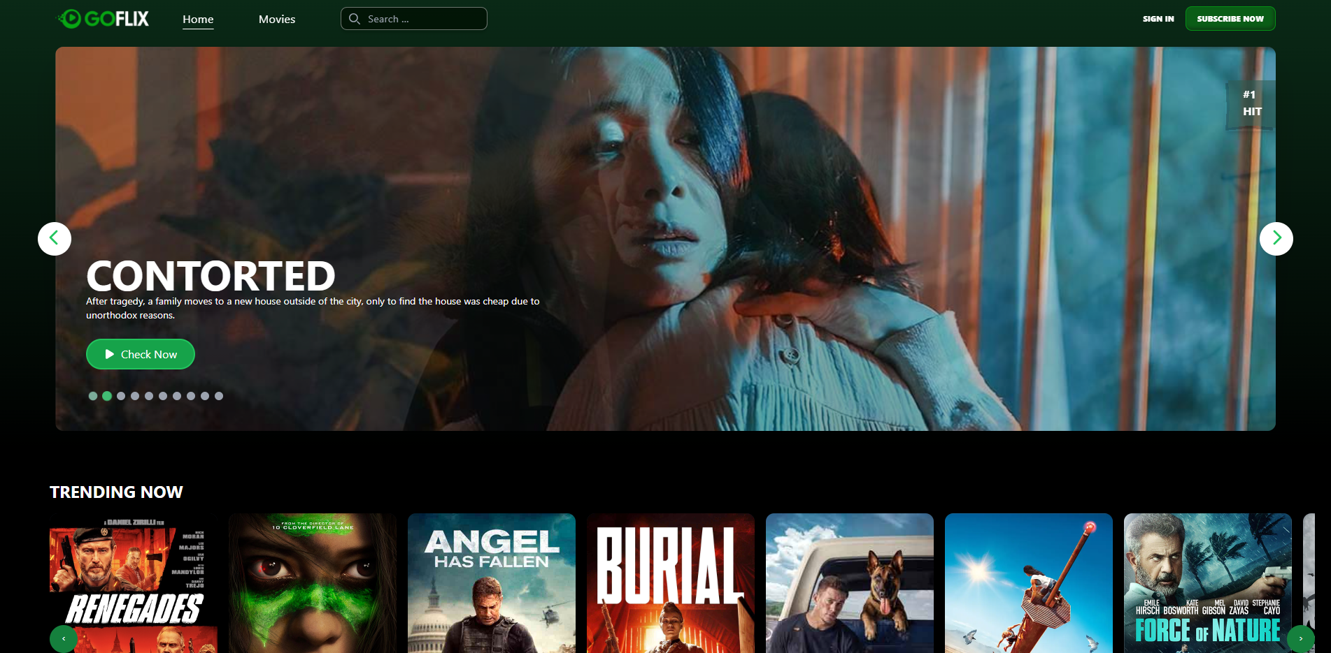
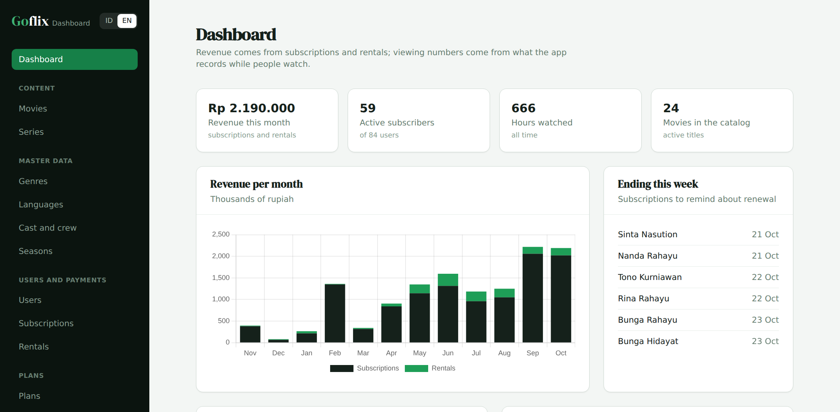
Viewers see this; the team works here
01
Viewer app · Vue + Go
Dashboard · Laravel · my part
The content team adds movies and episodes, the business team sets plans and coupons, and support answers "why can't I watch this?"
Notes:
Left is the viewer app (Vue and Go), not my part. Right is the dashboard I built, in its demo form.

Slide 3



Three ways to watch
02
Free
Plan
Rental
Free titles play for anyone with an active account.
A monthly or yearly plan opens every premium title.
One premium movie, for a few days, without a plan.
My part: the catalog, plans and coupons, users and payments, and the reports on them.
Notes:
Every rule in this deck turns on these three ways in. Point out that an episode can be premium on its own or through its series.

Slide 4
Three parts, one database
03
Vue.js web
Go API
PostgreSQL
Laravel dashboard
Mobile app
Payment gateway
Two writers
The server decides
No API in the dashboard
The API writes activity and in-app payments; the dashboard writes the catalog, plans and corrections.
The app never decides access on its own. The dashboard shows support the same rule.
Everything the apps need goes through the Go API.
Notes:
Go for heavy playback traffic, Laravel for the internal team's forms and CRUD. Both write to the same PostgreSQL.

Slide 5



The data model in three groups
04
Catalog
Users and money
Activity
movies
shows
users
packages
watch_history
bookmarks
episodes
seasons
package_features
subscriptions
Written by the apps while people watch. The dashboard only reads it, for reports and continue watching.
genres
languages
rentals
coupons
people
users.subscription_ends_on is the source of truth for a fast access check; only SubscriptionService may change it.
Notes:
Production has about 40 tables, including games, music, radio and banners. The demo keeps the tables that carry the dashboard rules.

Slide 6
Relations: from text to pivot tables
05
Production
Demo
video
id: 12
category_id: '6,12,19'
cast_id: '1,108,109,110'
genre_movie
(movie_id 12, genre_id 6)
(movie_id 12, genre_id 12)
(movie_id 12, genre_id 19)
Cannot be joined or indexed; deleted ids stay behind.
Foreign keys, normal joins, and the genre report is one query.
Gradual migration: add the pivot, fill it from the old column, move readers one by one, then drop the old column.
Notes:
This is the strongest design point to discuss: why the old pattern hurts and how to fix it without downtime.

Slide 7
Renewing without losing paid days
06
Active until 20 Mar, buys 12 months on 10 Mar
old: until 20 Mar
new: 21 Mar to 20 Mar next year
Ended 31 Jan, buys 1 month on 10 Mar
lapsed
10 Mar to 9 Apr
One place
One transaction
A row lock
Only SubscriptionService moves users.subscription_ends_on.
The payment and the end date are saved together, or neither is.
lockForUpdate makes a second payment wait and count from the new date.
Notes:
Show it in the demo: add a plan for a user who is still subscribed and watch the end date move out.

Slide 8
Who may watch what
07
Account and title active?
Premium?
Active plan?
Movie rented?
no: refused
no: free
yes: allowed
yes: allowed until it expires
Refused: needs a plan, or a rental if the movie has a rent price
An episode is premium on its own or through its series. One AccessService is used everywhere, and the dashboard shows it per user so support can answer complaints.
Notes:
This is the rule the Go API runs before playback. The dashboard has a Check button on the user page.

Slide 9


Rentals and coupons
08
Renting one movie
Coupons
Only premium movies with a rent price
Lasts rent_days days from payment
Active subscribers cannot rent: it is already included
The same movie cannot be rented twice at once
Fixed amount or percentage
Only valid between its start and end dates
Never takes a price below zero
A single-use coupon works once per user
Example: an active subscriber tries to rent a premium movie → refused, because the plan already includes it. Nobody pays twice, and refund requests drop.
Notes:
The subscribers-cannot-rent rule stops people paying twice and cuts refund requests.

Slide 10
Decisions worth talking about
09
1
End date on users
2
Payments cannot be edited
Deliberate duplication: one indexed column beats finding the latest subscription on every play.
Subscriptions and rentals are financial records. A correction is a new entry.
3
Deactivate, not delete
4
Episodes updated in place
A genre, plan, coupon or user in use can only be deactivated.
The same rows are kept, so viewing history stays attached.
Notes:
Have the reason and the risk ready for each. For example, the duplicate end date can drift, so only one service may change it.

Slide 11
Tech stack and why
10
Laravel 10
PostgreSQL
Go
Vue.js
Admin dashboard: forms, validation, CRUD. The part I built.
One database for the API and the dashboard, with transactions and row locks.
The apps' API: heavy playback traffic, low latency.
The viewer web app.
Demo: Laravel 10, Blade, Tailwind, Chart.js and PostgreSQL, like production. The green one is my part.
Notes:
The demo also uses Blade, Tailwind and Chart.js, and runs on PostgreSQL like production.

Slide 12
Keeping the code easy to read
11
Rules in services
return DB::transaction(function () use (...) {
$user = User::lockForUpdate()
->findOrFail($user->id);
$startsOn = $user->subscription_ends_on
?->gte($today)
? $user->subscription_ends_on->addDay()
: $today;
$endsOn = $startsOn->copy()
->addMonthsNoOverflow($months)->subDay();
$user->subscriptions()->create([...]);
$user->update(['subscription_ends_on' => $endsOn]);
});
Thin controllers; plans, rentals, coupons and access are plain classes.
Enums, not numbers
Sign-in, role and coupon type are typed.
Tests on the rules
33 feature tests.
Notes:
This is app/Services/SubscriptionService.php in the demo repo.

Slide 13
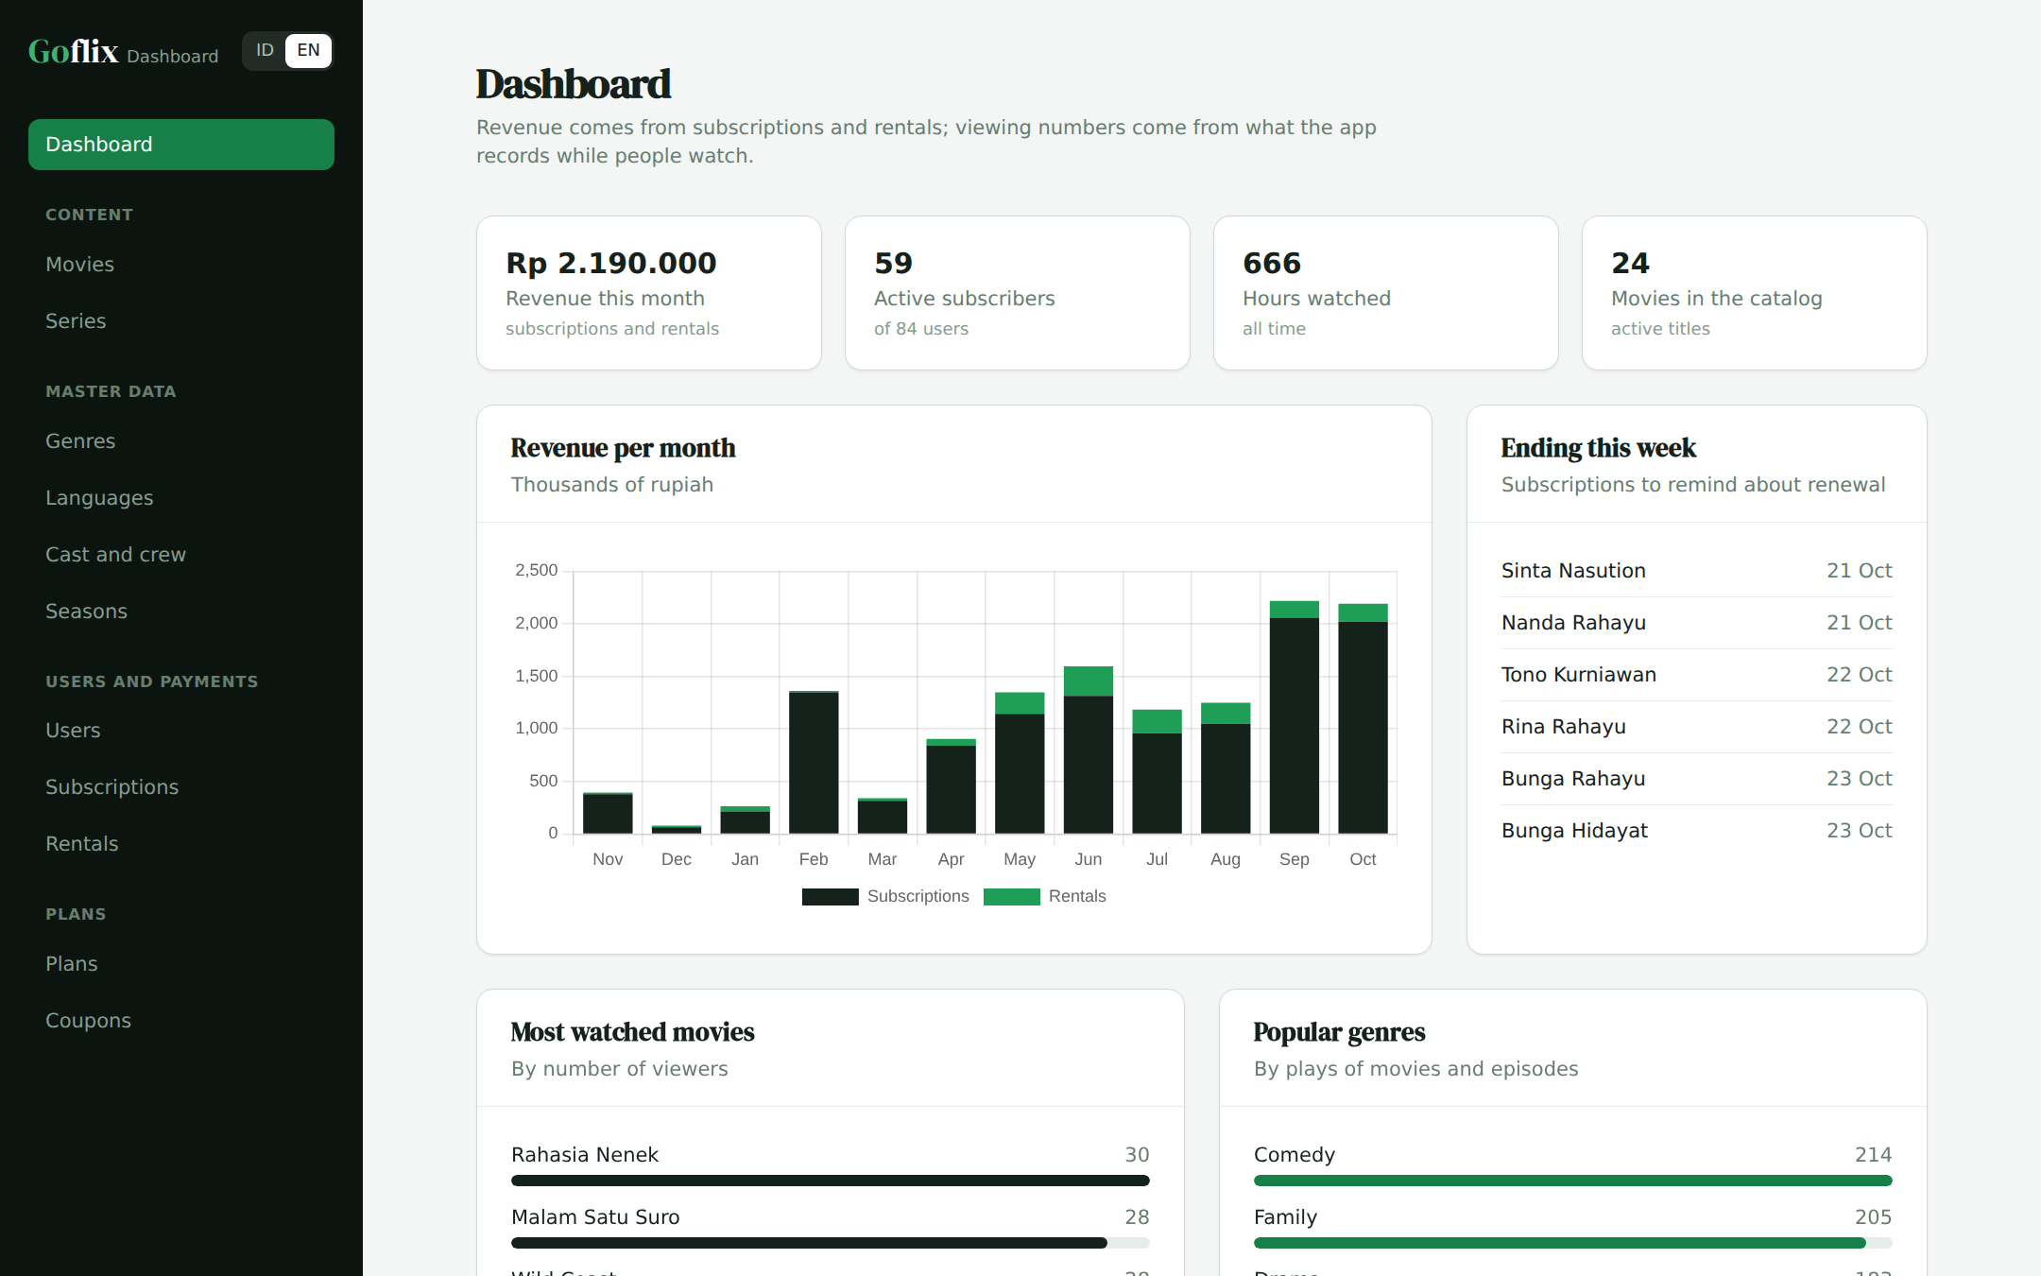
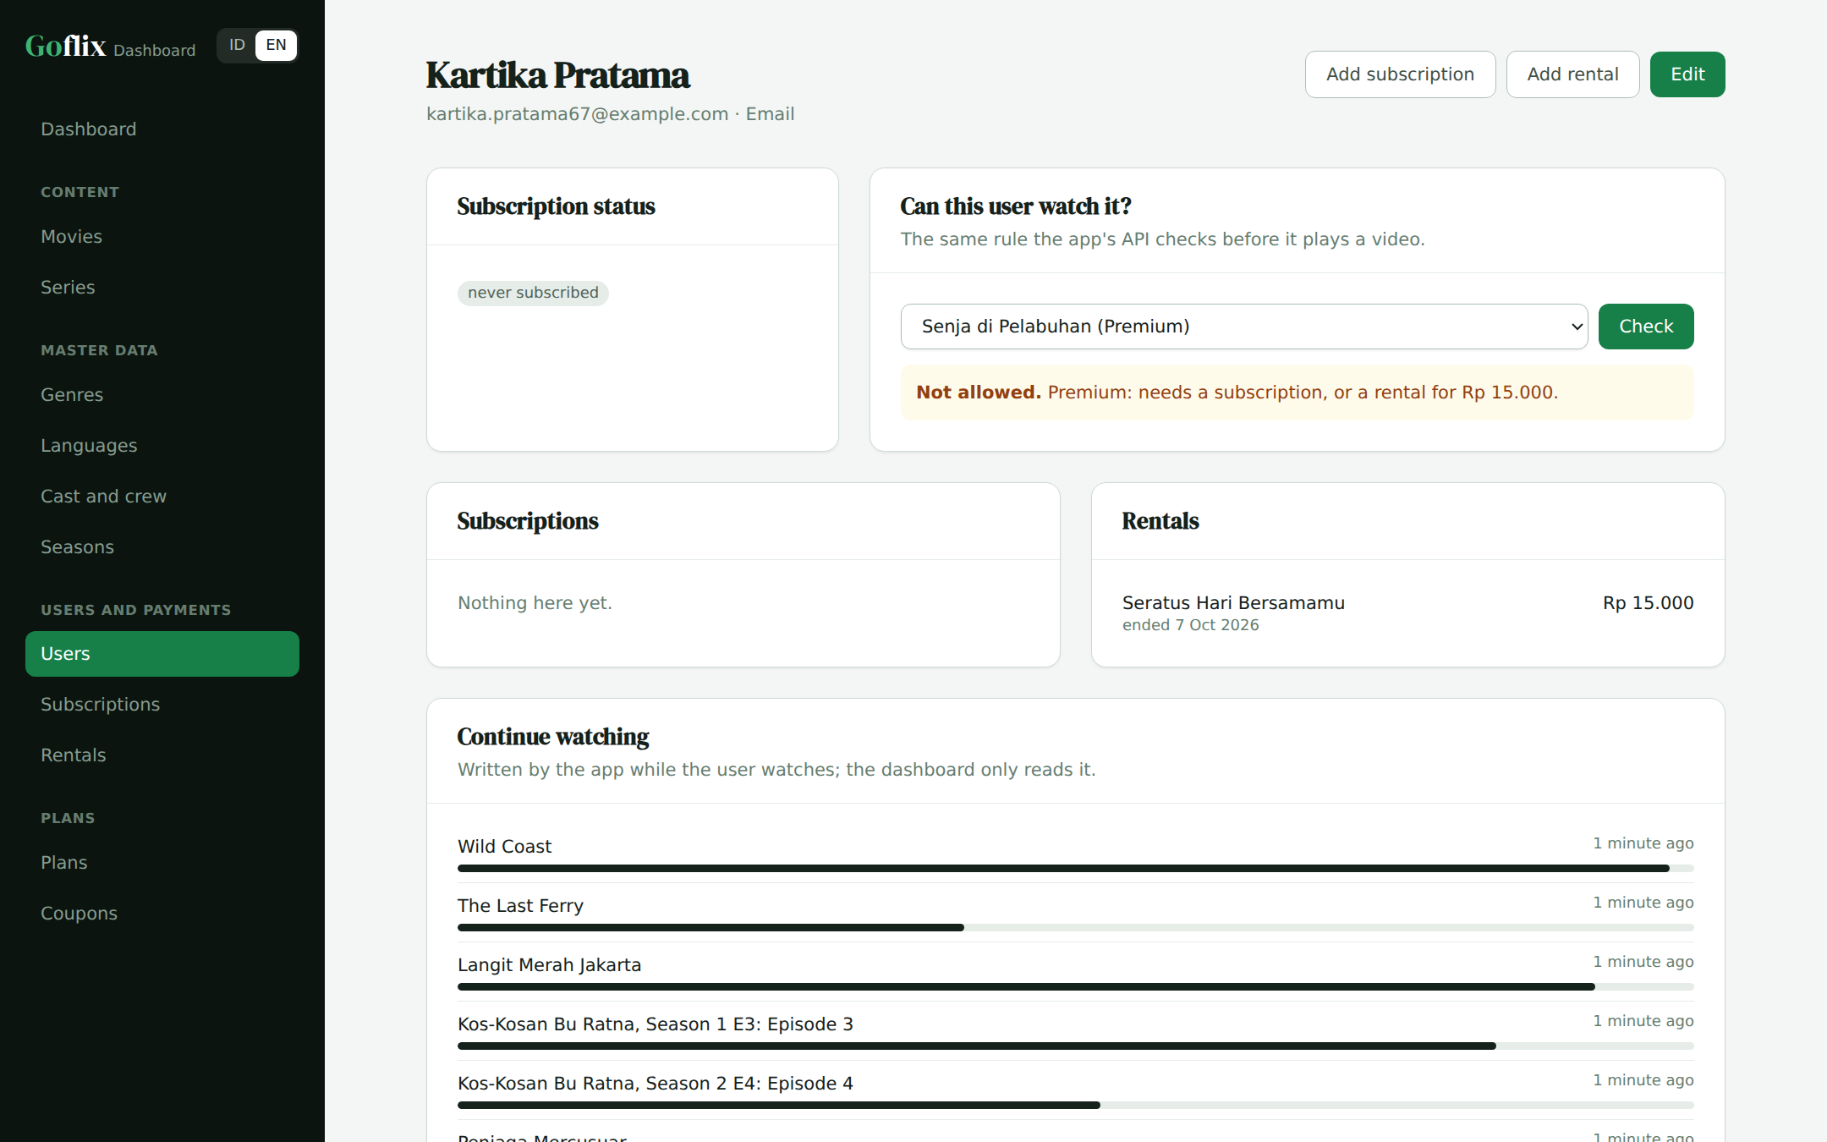
The demo app
12
Dashboard: plan and rental revenue per month
User page: status, payments and the access check
Notes:
Live demo: check a premium movie for a user without a plan, add a rental, then check again.

Slide 14

What I would improve
13
Move to pivot tables
Replace the comma-separated ids step by step, with no downtime.
One shared rule contract
The access rule lives in Go and Laravel; one shared set of test cases keeps them in step.
Large viewing history
Partition watch_history by month, report from a daily summary table.
Constraints and indexes
Foreign keys and indexes on the access-check and report columns.
Notes:
Pick one or two you are most ready to discuss.

Slide 15
Try it yourself
Live demo
https://goflix-dashboard-demo.vercel.app
Slides (PDF)
https://goflix-dashboard-demo.vercel.app/goflix-walkthrough.pdf
Slides (PPTX)
https://goflix-dashboard-demo.vercel.app/goflix-walkthrough.pptx
The demo code is in a private GitHub repo; access is given during the interview. The dashboard speaks Bahasa Indonesia and English; demo data is restored every 3 hours.
Notes:
Close with the links and offer to open the demo or the code.

