Slide 1
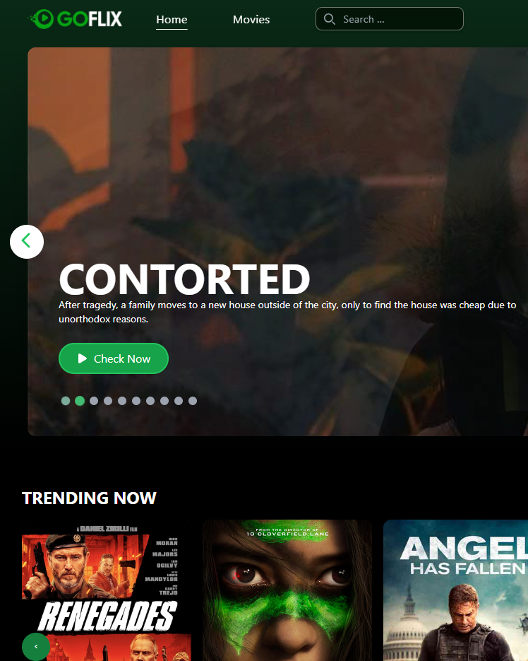
Goflix
STREAMING PLATFORM
The admin dashboard behind the catalog, the plans, and who may watch what
Enrico Saputra · Backend developer, Laravel dashboard
Client code and data are private. The demo rebuilds the Laravel dashboard on the real data model, with made-up data.
Notes:
Framing: Goflix has three parts. I built the Laravel dashboard. The demo rebuilds that dashboard with made-up data because the real code is under NDA.

Slide 2
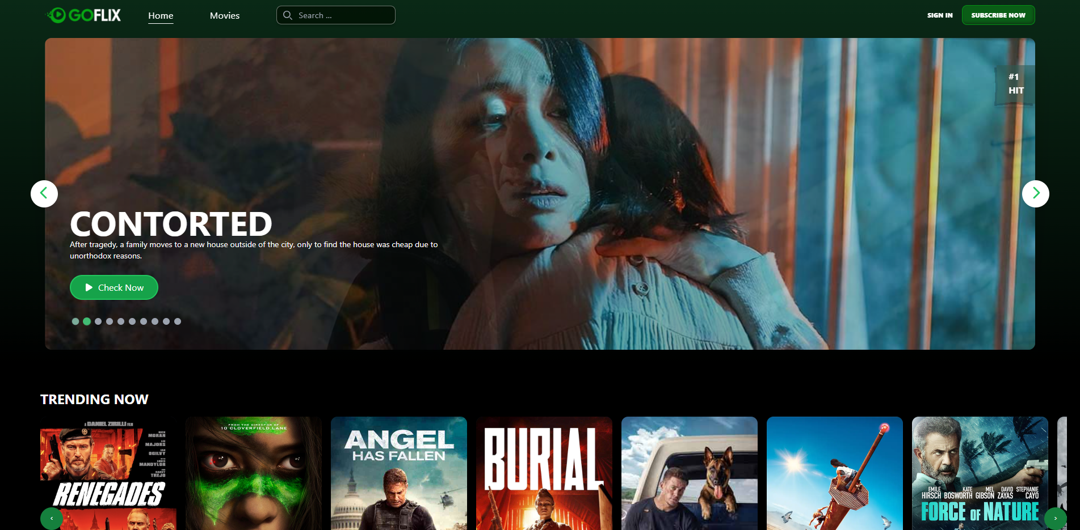
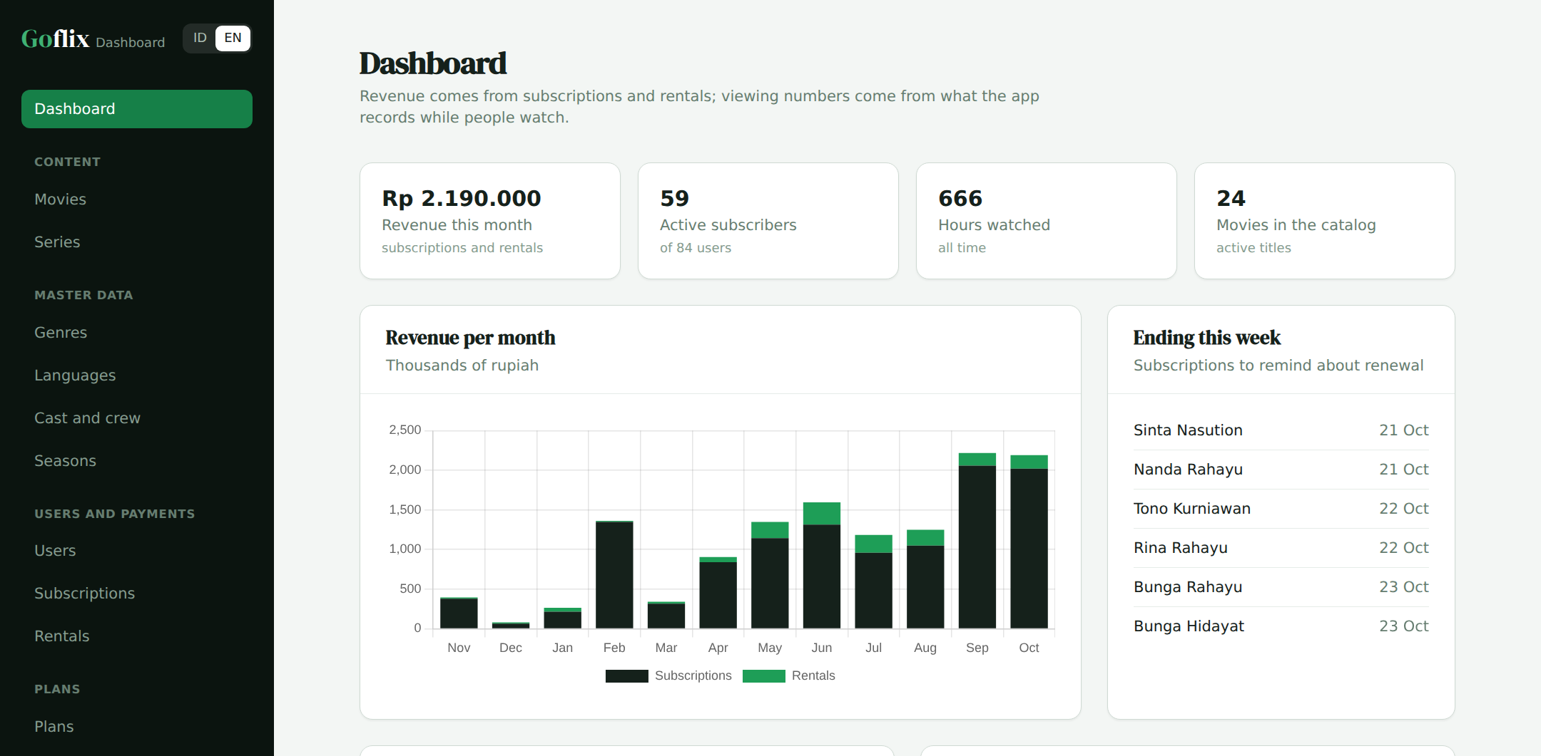
Viewers see this; the team works here
01
Viewer app · Vue + Go
Dashboard · Laravel · my part
The content team adds movies and episodes, the business team sets plans and coupons, and support answers "why can't I watch this?"
Notes:
Left is the viewer app (Vue and Go), not my part. Right is the dashboard I built, in its demo form.

Slide 3



Three ways to watch
02
Free
Plan
Rental
Free titles play for anyone with an active account.
A monthly or yearly plan opens every premium title.
One premium movie, for a few days, without a plan.
My part: the catalog, plans and coupons, users and payments, and the reports on them.
Notes:
Every rule in this deck turns on these three ways in. Point out that an episode can be premium on its own or through its series.

Slide 4
About the app
03
Goflix is a streaming platform for local and international movies and series, on the web (Vue.js) and on mobile. Some titles are free; premium titles open with a monthly or yearly plan, or by renting a single movie.
User journey
1
A viewer signs in on the web or mobile app.
2
They browse movies and series by genre.
Who uses it
Viewers
3
Free titles play right away; premium titles ask for a plan or a rental.
Watch, save titles and continue where they stopped.
Content and business team
4
They pay for a plan or rental through the payment gateway and get access.
Manage the catalog, plans, prices and coupons in the dashboard.
Support team
5
Viewing history is saved, so they can continue from where they stopped.
Check why a user can or cannot watch something.
Notes:
Start from the viewer's point of view. The dashboard I built is the team's tool behind these screens.

Slide 5
What the dashboard contains
04
Menu | What it does | Data
Dashboard | Revenue per month, active subscribers, hours watched, top movies and genres, plans sold, sign-in methods | subscriptions, rentals, watch_history
Movies, Series | The catalog: movies, series with episodes per season, free or premium, rent price | movies, shows, episodes
Genres, Languages, Cast, Seasons | Master data for the catalog | genres, languages, people, seasons
Users | Subscription status, payments, continue watching and an access check per title | users, watch_history
Subscriptions, Rentals | Payment records; can be added, never edited | subscriptions, rentals
Plans, Coupons | Plan price and length, plan-card lines, discount coupons | packages, coupons
Notes:
These are the demo dashboard menus, the same as the part of the production dashboard I worked on.

Slide 6
Three parts, one database
05
Vue.js web
Go API
PostgreSQL
Laravel dashboard
Mobile app
Payment gateway
Two writers
The server decides
No API in the dashboard
The API writes activity and in-app payments; the dashboard writes the catalog, plans and corrections.
The app never decides access on its own. The dashboard shows support the same rule.
Everything the apps need goes through the Go API.
Notes:
Go for heavy playback traffic, Laravel for the internal team's forms and CRUD. Both write to the same PostgreSQL.

Slide 7



The data model in three groups
06
Catalog
Users and money
Activity
movies
shows
users
packages
watch_history
bookmarks
episodes
seasons
package_features
subscriptions
Written by the apps while people watch. The dashboard only reads it, for reports and continue watching.
genres
languages
rentals
coupons
people
users.subscription_ends_on is the source of truth for a fast access check; only SubscriptionService may change it.
Notes:
Production has about 40 tables, including games, music, radio and banners. The demo keeps the tables that carry the dashboard rules.

Slide 8
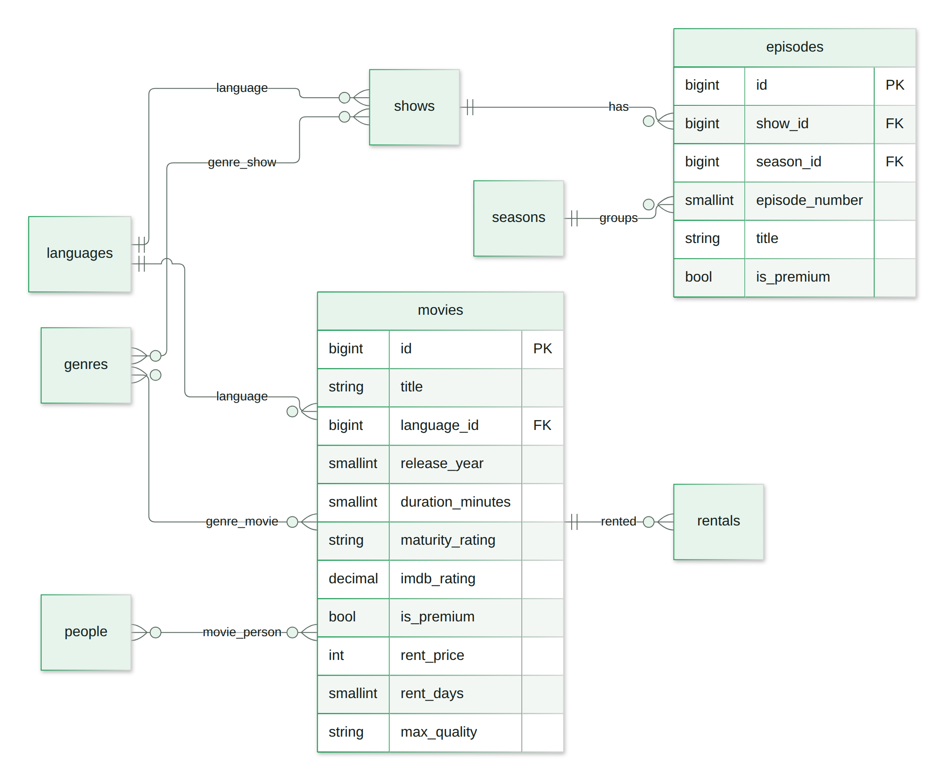
Database 1/2: the catalog
07
Movies, series, episodes and seasons, with pivot tables for genres, languages and cast. Boxes without columns are tables from the other part.
Notes:
Movies, series, episodes and seasons, with pivot tables for genres, languages and cast.

Slide 9
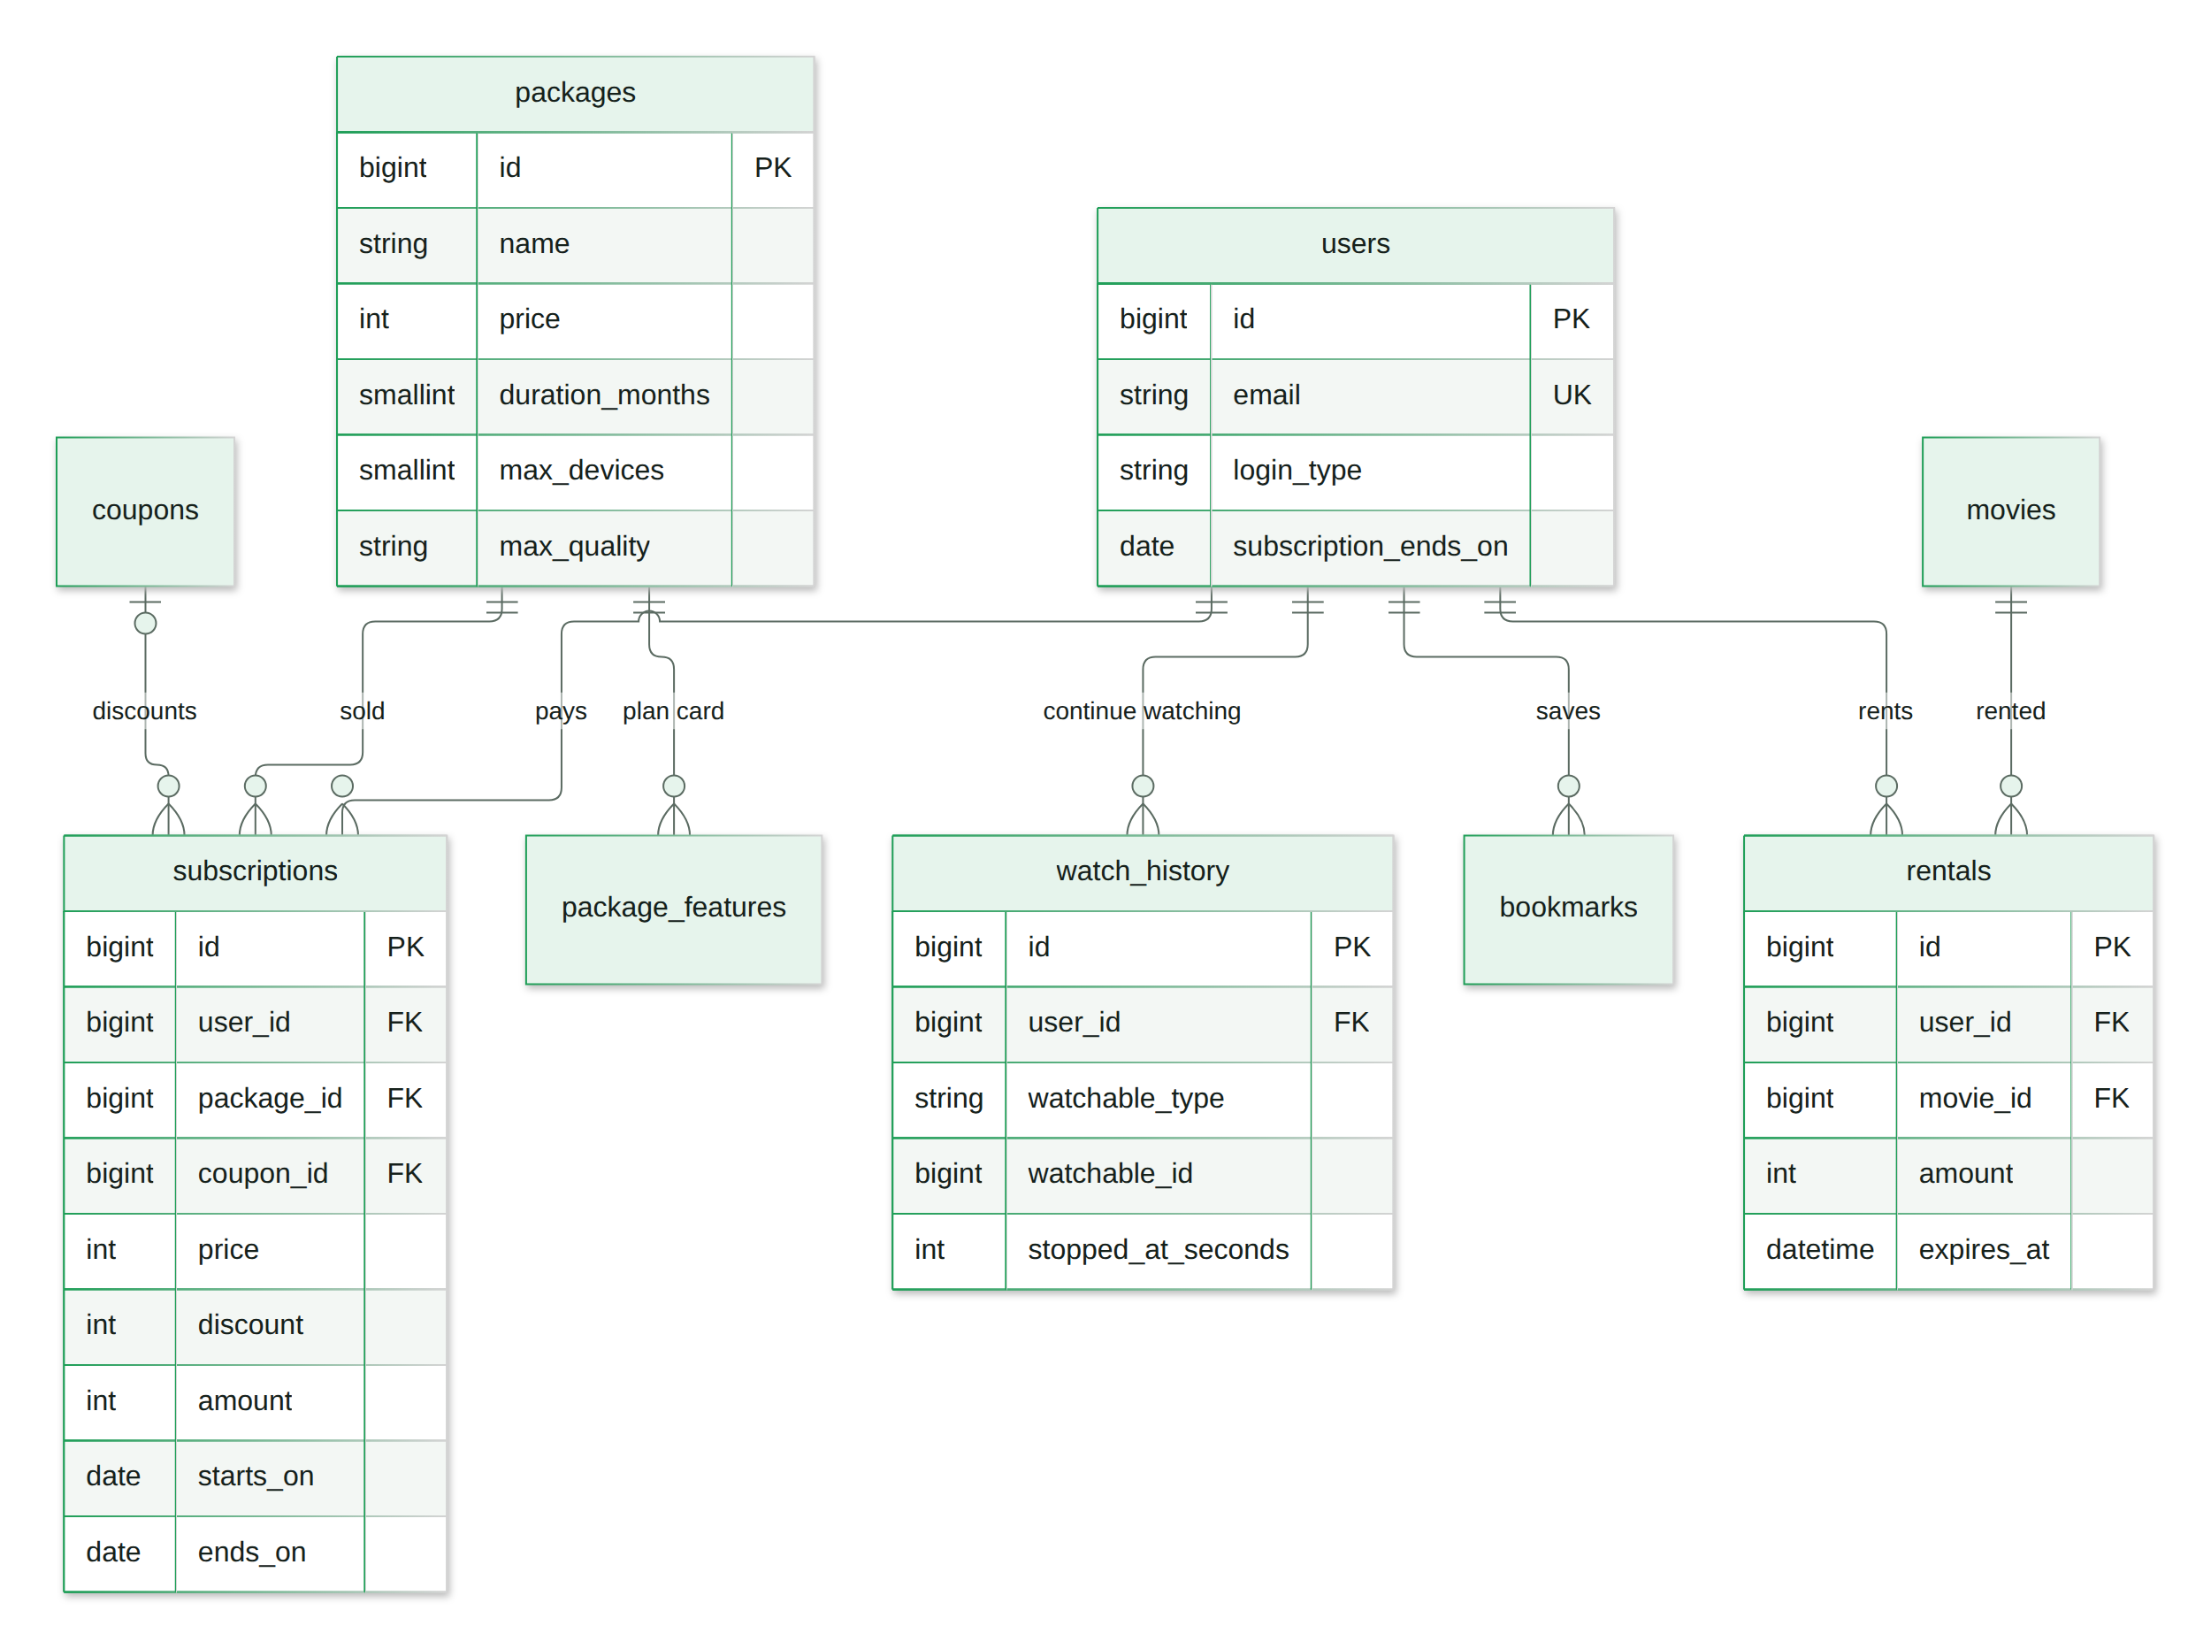
Database 2/2: users and payments
08
Plans, subscriptions, rentals and coupons. users.subscription_ends_on serves the fast access check. Boxes without columns are tables from the other part.
Notes:
Plans, subscriptions, rentals and coupons. users.subscription_ends_on serves the fast access check.

Slide 10
Relations: from text to pivot tables
09
Production
Demo
video
id: 12
category_id: '6,12,19'
cast_id: '1,108,109,110'
genre_movie
(movie_id 12, genre_id 6)
(movie_id 12, genre_id 12)
(movie_id 12, genre_id 19)
Cannot be joined or indexed; deleted ids stay behind.
Foreign keys, normal joins, and the genre report is one query.
Gradual migration: add the pivot, fill it from the old column, move readers one by one, then drop the old column.
Notes:
This is the strongest design point to discuss: why the old pattern hurts and how to fix it without downtime.

Slide 11
Renewing without losing paid days
10
Active until 20 Mar, buys 12 months on 10 Mar
old: until 20 Mar
new: 21 Mar to 20 Mar next year
Ended 31 Jan, buys 1 month on 10 Mar
lapsed
10 Mar to 9 Apr
One place
One transaction
A row lock
Only SubscriptionService moves users.subscription_ends_on.
The payment and the end date are saved together, or neither is.
lockForUpdate makes a second payment wait and count from the new date.
Notes:
Show it in the demo: add a plan for a user who is still subscribed and watch the end date move out.

Slide 12
Who may watch what
11
Account and title active?
Premium?
Active plan?
Movie rented?
no: refused
no: free
yes: allowed
yes: allowed until it expires
Refused: needs a plan, or a rental if the movie has a rent price
An episode is premium on its own or through its series. One AccessService is used everywhere, and the dashboard shows it per user so support can answer complaints.
Notes:
This is the rule the Go API runs before playback. The dashboard has a Check button on the user page.

Slide 13


Rentals and coupons
12
Renting one movie
Coupons
Only premium movies with a rent price
Lasts rent_days days from payment
Active subscribers cannot rent: it is already included
The same movie cannot be rented twice at once
Fixed amount or percentage
Only valid between its start and end dates
Never takes a price below zero
A single-use coupon works once per user
Example: an active subscriber tries to rent a premium movie → refused, because the plan already includes it. Nobody pays twice, and refund requests drop.
Notes:
The subscribers-cannot-rent rule stops people paying twice and cuts refund requests.

Slide 14
Why this stack
13
Choice | Why
Laravel 10 | The dashboard: forms, validation, CRUD. My part
PostgreSQL | Shared with the Go API; transactions and row locks
Go | The apps' API: heavy playback traffic
Blade + Chart.js | An internal admin needs no SPA; one chart needs only Chart.js
Notes:
For each row, have one example from this project ready.

Slide 15
A renewal is one transaction
14
Rules in services
return DB::transaction(function () use (...) {
$user = User::lockForUpdate()
->findOrFail($user->id);
$startsOn = $user->subscription_ends_on
?->gte($today)
? $user->subscription_ends_on->addDay()
: $today;
$endsOn = $startsOn->copy()
->addMonthsNoOverflow($months)->subDay();
$user->subscriptions()->create([...]);
$user->update(['subscription_ends_on' => $endsOn]);
});
Thin controllers; plans, rentals, coupons and access are plain classes.
Enums, not numbers
Sign-in, role and coupon type are typed.
Tests on the rules
33 feature tests.
Notes:
This is app/Services/SubscriptionService.php in the demo repo.

Slide 16
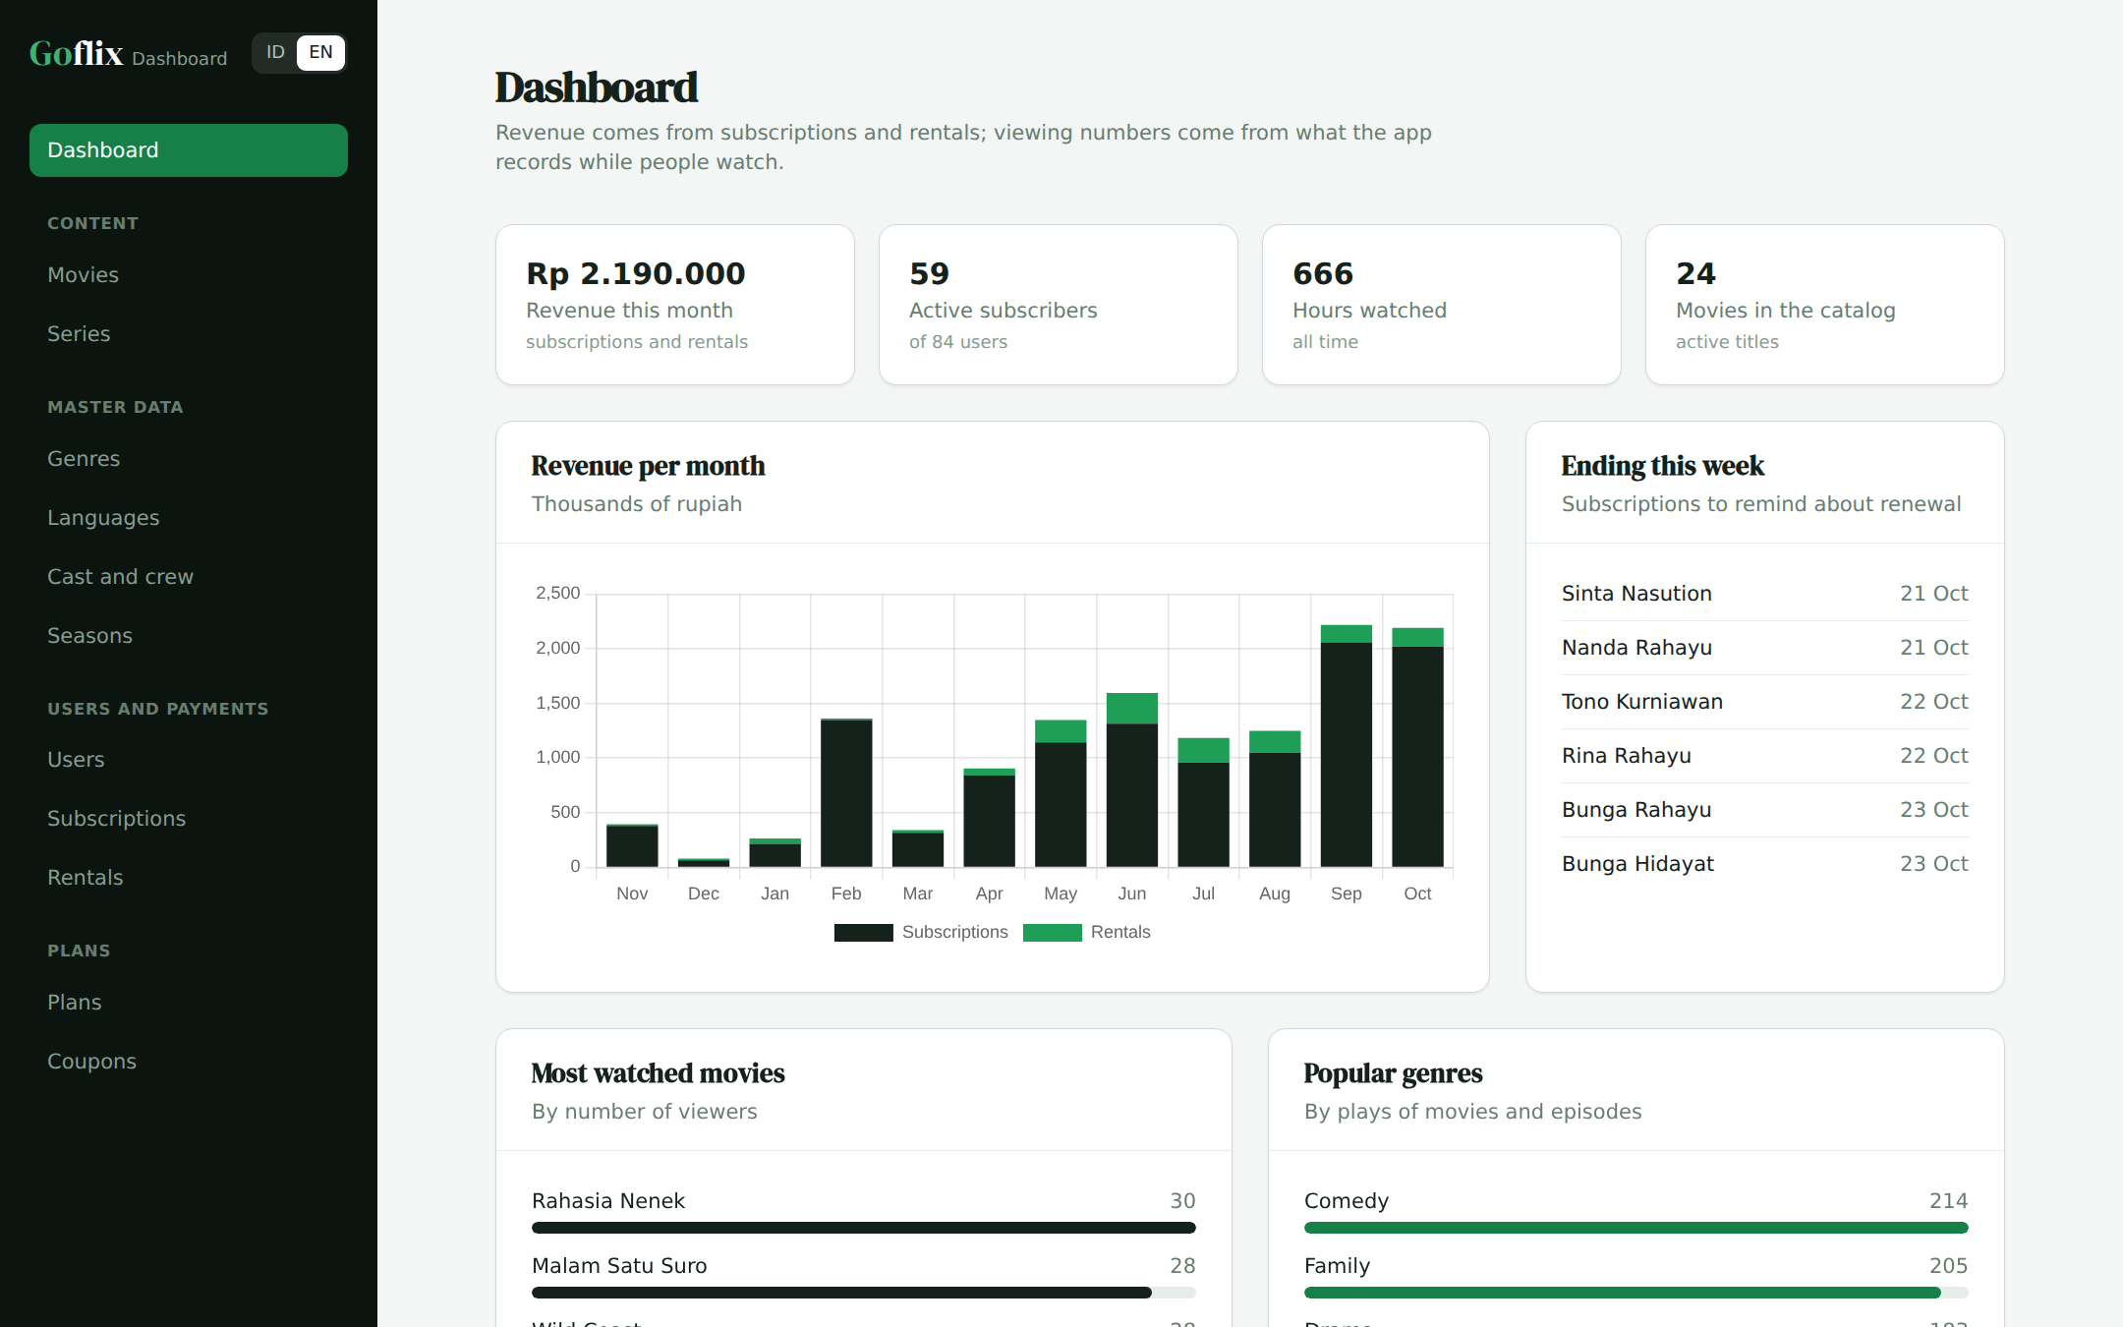
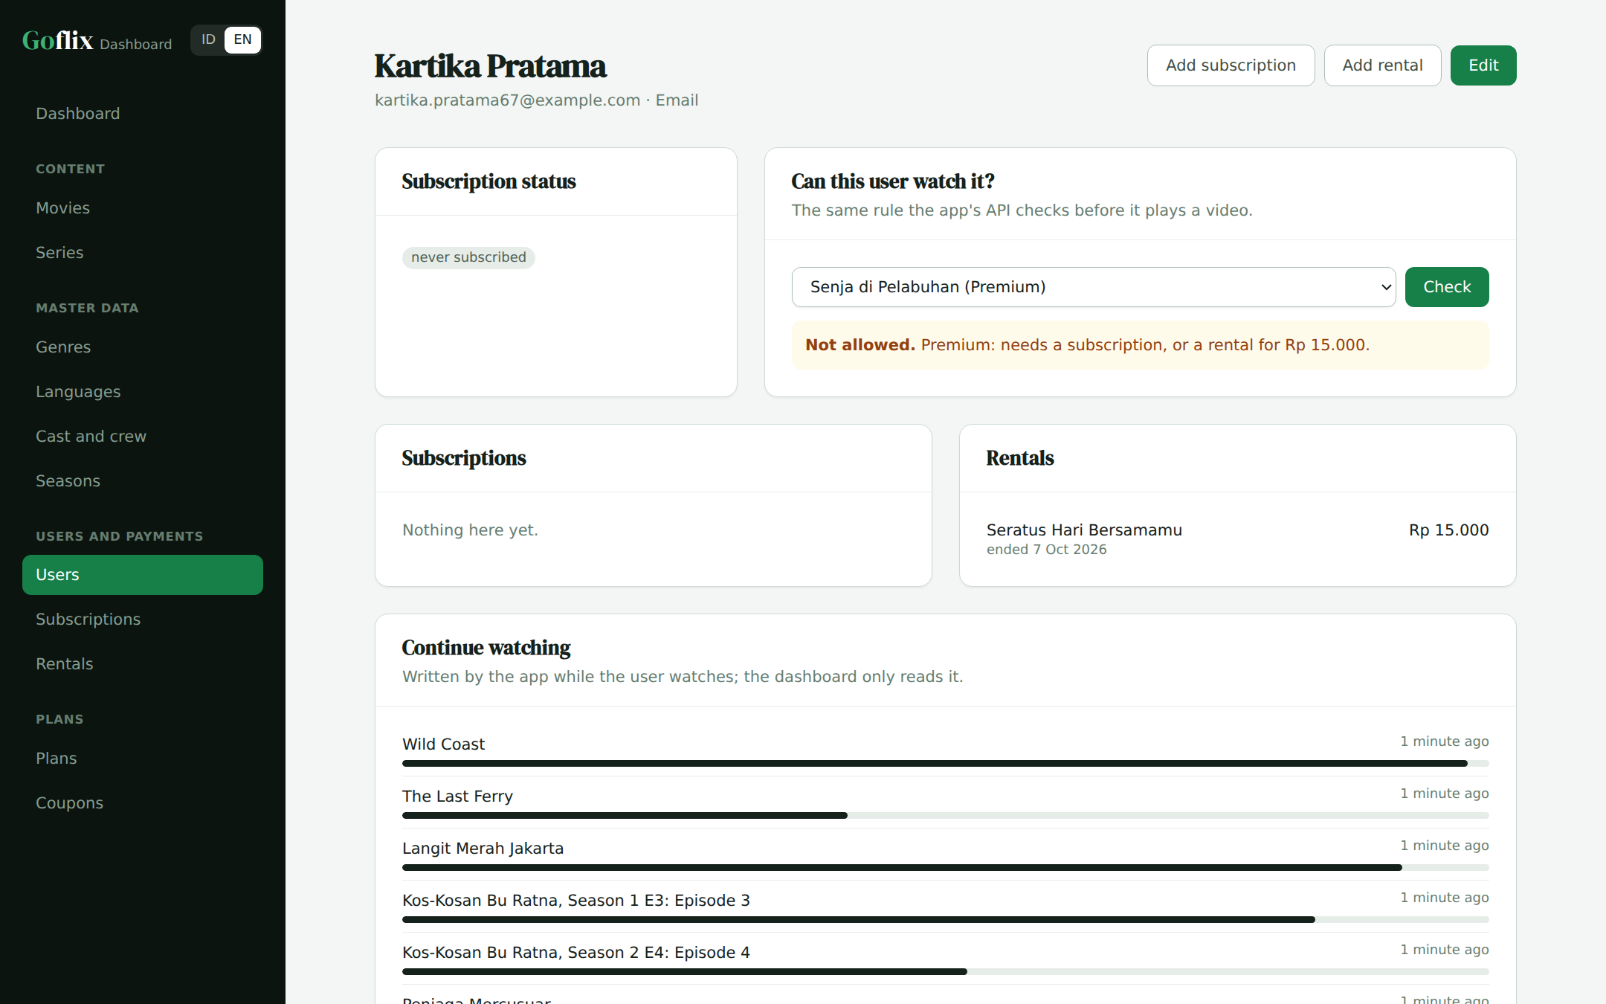
Demo: revenue, then a user's access check
15
Dashboard: plan and rental revenue per month
User page: status, payments and the access check
Notes:
Live demo: check a premium movie for a user without a plan, add a rental, then check again.

Slide 17
Demo and slides
Live demo
https://goflix-dashboard-demo.vercel.app
Slides (PDF)
https://goflix-dashboard-demo.vercel.app/goflix-walkthrough.pdf
Slides (PPTX)
https://goflix-dashboard-demo.vercel.app/goflix-walkthrough.pptx
The demo code is in a private GitHub repo; access is given during the interview. The dashboard speaks Bahasa Indonesia and English; demo data is restored every 3 hours.
Notes:
Close with the links and offer to open the demo or the code.

