Slide 1
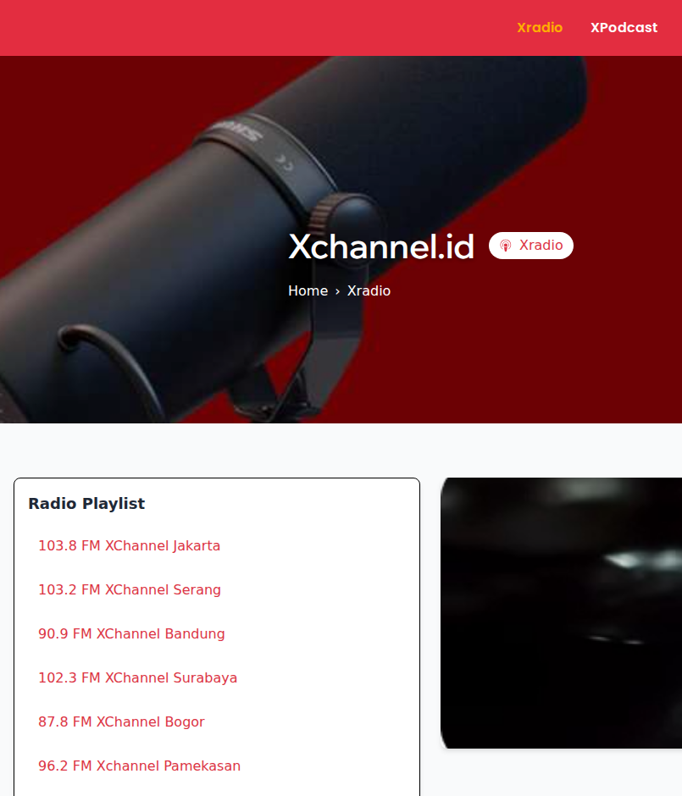
XChannel
XRADIO · DASHBOARD
The broadcast schedule for local radio in several cities, and the system behind it
Enrico Saputra · Backend developer, Laravel dashboard
Client code and data are private. The demo rebuilds the radio part of the dashboard on the real data model, with made-up data.
Notes:
Opening: XChannel is local radio in several cities. I worked on its Laravel dashboard. The real code is under NDA, so I rebuilt the radio part with made-up data.

Slide 2
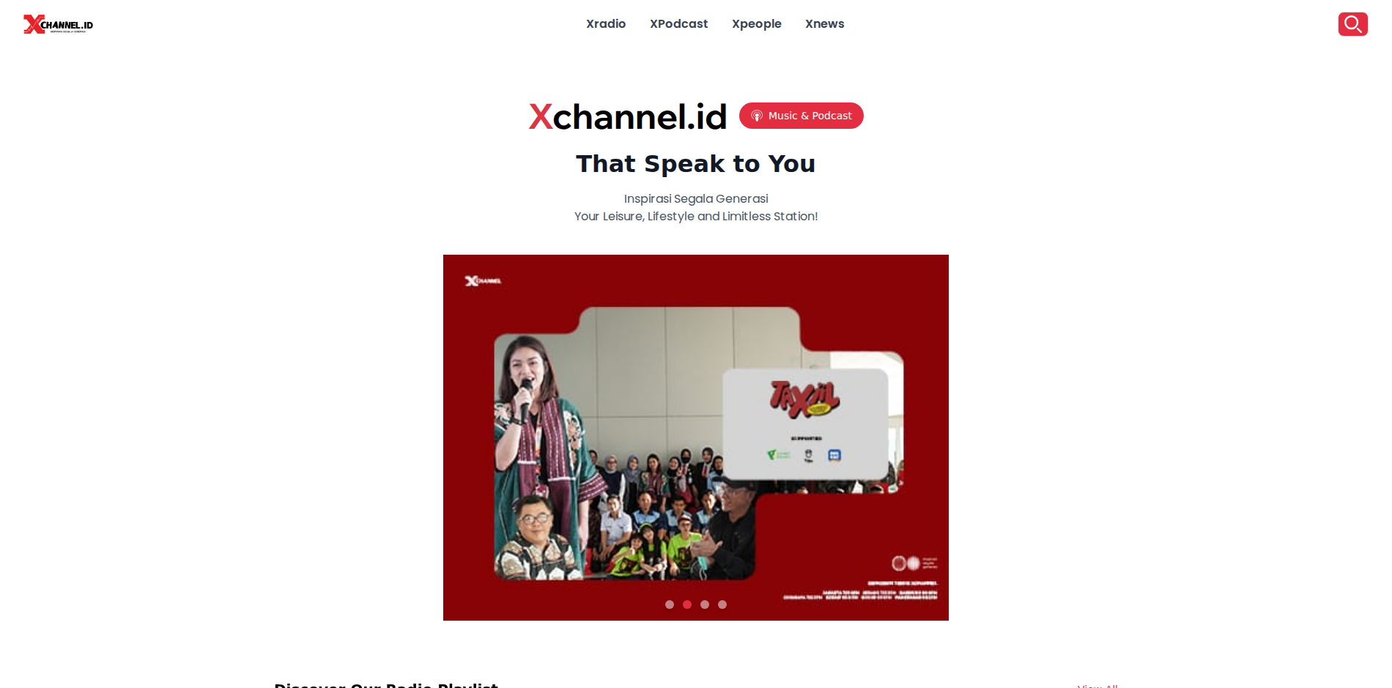
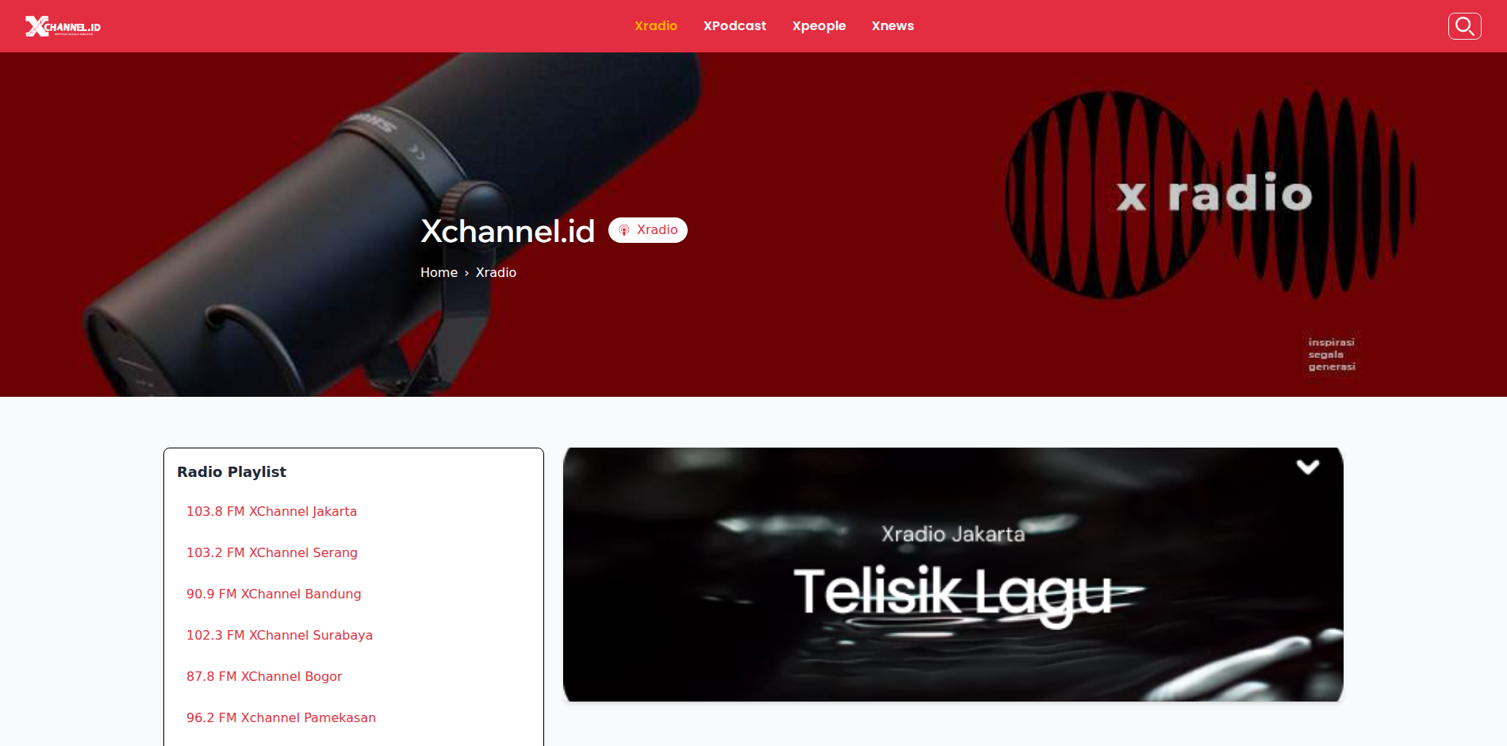
xchannel.id, the side listeners see
Home: radio, podcasts, people and news
Xradio: stations per city and the show that is playing
The stations, shows, hosts and schedule on the Xradio page are managed in the Laravel dashboard. That is the part this demo rebuilds.
Screenshots of xchannel.id, October 2026
Notes:
Point at the Xradio page: the station list and the show that is playing. All of it comes from data managed in the dashboard.

Slide 3
What I built at XChannel
The XChannel app plays each station's stream and shows what is on air. The broadcast team runs all of it from the dashboard.
8
stations on xchannel.id today
What I built
7 → 1
per-city schedule tables become one
Stations: city, frequency, stream URL and status
Shows and hosts
Each station's weekly schedule, which the app reads
Podcasts, chart, video, news: same dashboard, outside this demo
24/7
empty hours play automated music
Notes:
Make clear the dashboard is the broadcast team's tool, not the listener app. The 7 to 1 number is the heart of the design story.

Slide 4
One database, two readers
XChannel app
API
MY PART
MySQL
Laravel dashboard
Radio streams
The dashboard writes
The app reads
Rules on save
Stations, shows, hosts and the schedule.
"What is on air now?" through its API.
An overlapping schedule never reaches a listener.
Notes:
The dashboard writes, the app reads through its API. That is why the schedule rules are enforced on save, not on read.

Slide 5
Four tables and one pivot
stations
schedule_slots
shows
name, city
frequency
stream_url
stream_status
is_active
station_id → stations
show_id → shows
day_of_week 1..7
starts_at 0..1440
ends_at 0..1440
title
description
is_active
A show still on the schedule cannot be deleted, only made inactive (restrict on delete).
hosts
host_show
name, bio
is_active
show_id → shows
host_id → hosts
Notes:
schedule_slots is the centre. The index on (station_id, day_of_week, starts_at) serves both the overlap check and the on-air query.

Slide 6
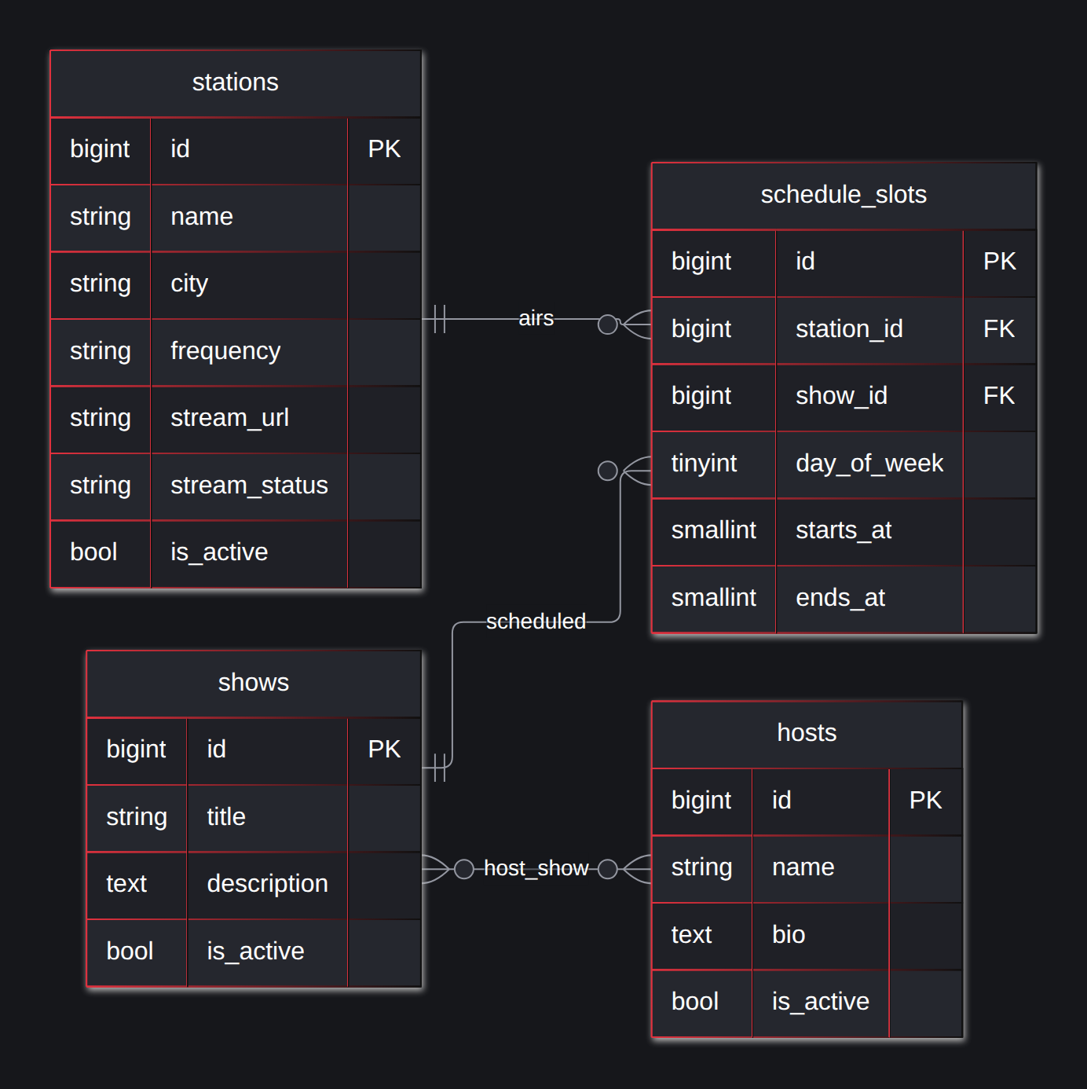
Database structure (ERD)
schedule_slots
One row = one show, one day, one station.
starts_at, ends_at
Minutes since 00:00, from 0 to 1440.
host_show
Many-to-many between shows and hosts.
Foreign key
All restrict on delete: anything in use cannot be deleted.
Notes:
Walk it left to right: master data, then documents, then records.

Slide 7
From a table per city to one table
Production
7 TABLES
Demo
1 TABLE
radio.api_jadwal = 'jadwal_radio_woman'
jdwl_radio_bandung
jdwl_radio_surabaya
jdwl_radio_suramadu ...
judul_siaran, hari_siaran,
waktu_siaran, penyiar (text)
schedule_slots
station_id -> stations
show_id -> shows
day_of_week, starts_at, ends_at
host_show (show_id, host_id)
A new station means a new table. One name in api_jadwal does not match the real table.
A new station is one row. Foreign keys keep it consistent.
No-downtime migration: fill the new table from the old ones, keep a view per city for the old API, move readers one by one.
Notes:
This is the strongest design point. The columns are identical; only the station differs. That is data, not schema.

Slide 8
Time as numbers, not text
In production
In the demo
senin-jumat
Senin- Jumat
450
1440
Monday-Friday
6:00 AM - 10:00 AM
minutes = 07:30
minutes = 24:00
08.00-09.00
20:00-24:00
day_of_week 1-7 (ISO), one row per day. The form takes HH:MM only.
Two slots overlap when each starts before the other ends
starts_at < :end AND ends_at > :start
Touching (10:00 then 10:00) is fine.
Notes:
Every example on the left really is in the production data. A TIME column is not used because 24:00 is not valid in it.

Slide 9



The overlap rule on save
00:00
06:00
12:00
18:00
24:00
Monday, Jakarta
Pagi Jakarta
Jam Makan Siang
New 09:00-11:00
Ngobrol
Refused: clashes with "Pagi Jakarta" (06:00 - 10:00)
New 13:00-14:00
OK
Allowed: starts exactly when the previous show ends
A clear message
All days or none
Past midnight
Day, time and the show in the way.
Monday to Friday in one transaction.
Two slots: until 24:00, then from 00:00.
Notes:
Demo it live: Jakarta, Monday to Wednesday 09:00-11:00. Refused with the name of the show in the way, and no day is saved.

Slide 10



On air, up next, and empty hours
00:00
06:00
12:00
18:00
24:00
Pagi Banten
Jalan Pulang
XChannel Banten, Monday 08:30. Red line = now; grey = automated music.
On air
Up next
Empty hours
Today's slot with start <= now < end. One indexed query.
The first slot after now, rolling into the next days for up to a week.
Worked out from the schedule, not stored. Airtime per station out of 168 hours.
Notes:
The dashboard has a day and time picker. Pick Friday 21:00: Banten is playing automated music.

Slide 11
Why this stack
Choice | Why
Laravel 10 | Same as production; forms and validation are quick
MySQL | The production database. The same code runs on SQLite (tests) and PostgreSQL (online demo)
Blade + Tailwind | The timelines are plain HTML and CSS
PHPUnit | 19 feature tests on the schedule rules
Notes:
For each row, have one example from this project ready.

Slide 12
The overlap check is one query
Rules in one service
public function clash(int $stationId, Day $day,
int $start, int $end, ?int $ignoreId = null)
{
// Two ranges overlap when each one starts
// before the other ends. Touching is fine.
return ScheduleSlot::with('show')
->where('station_id', $stationId)
->where('day_of_week', $day->value)
->where('starts_at', '<', $end)
->where('ends_at', '>', $start)
->when($ignoreId, fn ($q) =>
$q->whereKeyNot($ignoreId))
->first();
}
Clash, schedule, move, on air, up next, gaps.
Enums, not numbers
Day (ISO 1-7), StreamStatus.
Thin controllers
FormRequests validate, Clock parses times.
Notes:
This is app/Services/ScheduleService.php in the demo repo. Open it on screen if they want to see it.

Slide 13
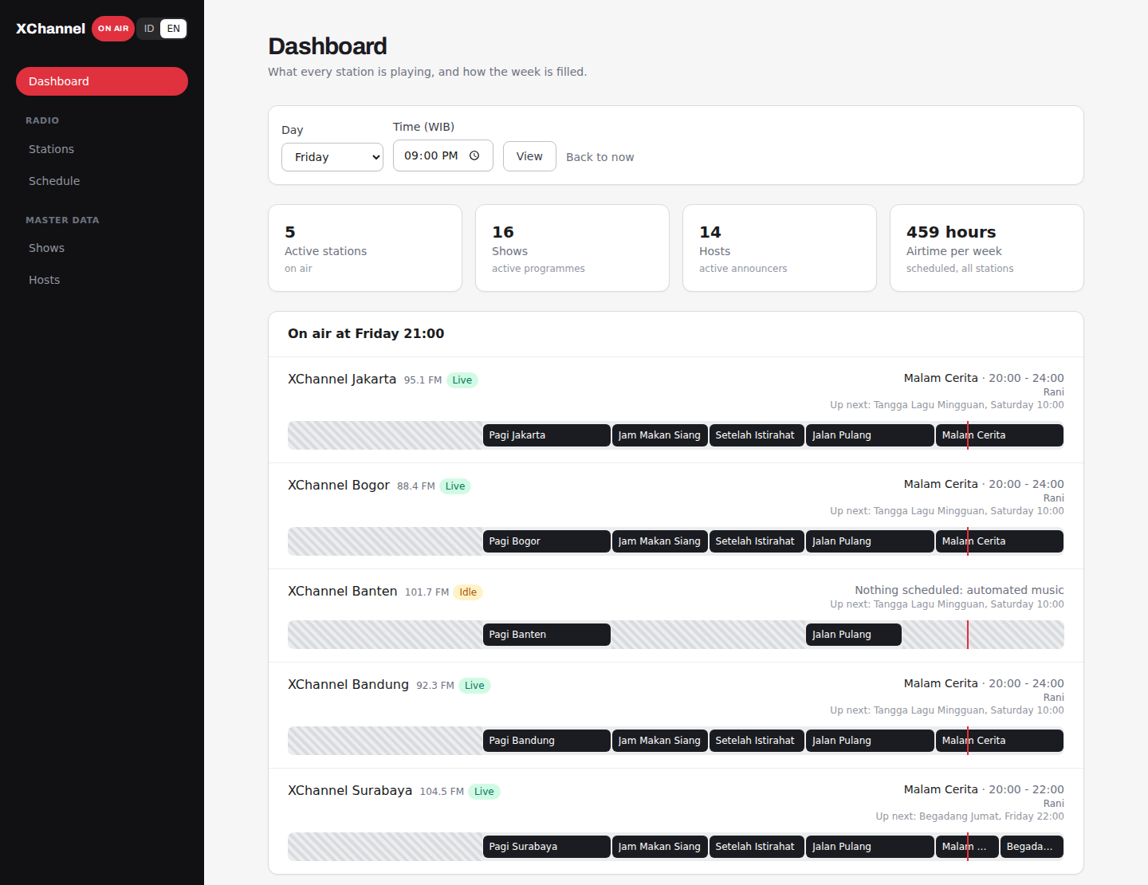
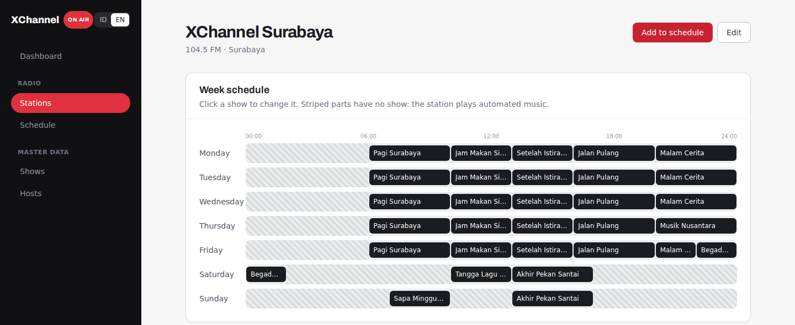
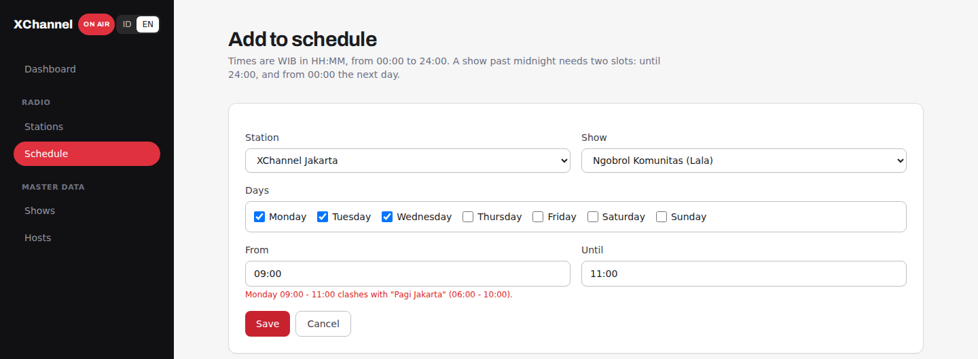
Demo: dashboard, schedule, a refused slot
Dashboard: on air and airtime
Notes:
Demo order: the dashboard on Friday 21:00, then Surabaya's week, then try adding an overlapping slot.

Slide 14
Demo, slides and the real product
Live demo
https://xchannel-dashboard-demo.vercel.app
Slides (PDF)
https://xchannel-dashboard-demo.vercel.app/xchannel-walkthrough.pdf
Slides (PPTX)
https://xchannel-dashboard-demo.vercel.app/xchannel-walkthrough.pptx
Real product
https://xchannel.id/radio
The demo code is in a private GitHub repo; access is given during the interview. The dashboard speaks Bahasa Indonesia and English, and its data is restored every 3 hours.
Notes:
Close with the links. Offer to open the demo or the code on screen.

