Slide 1


Slide 2
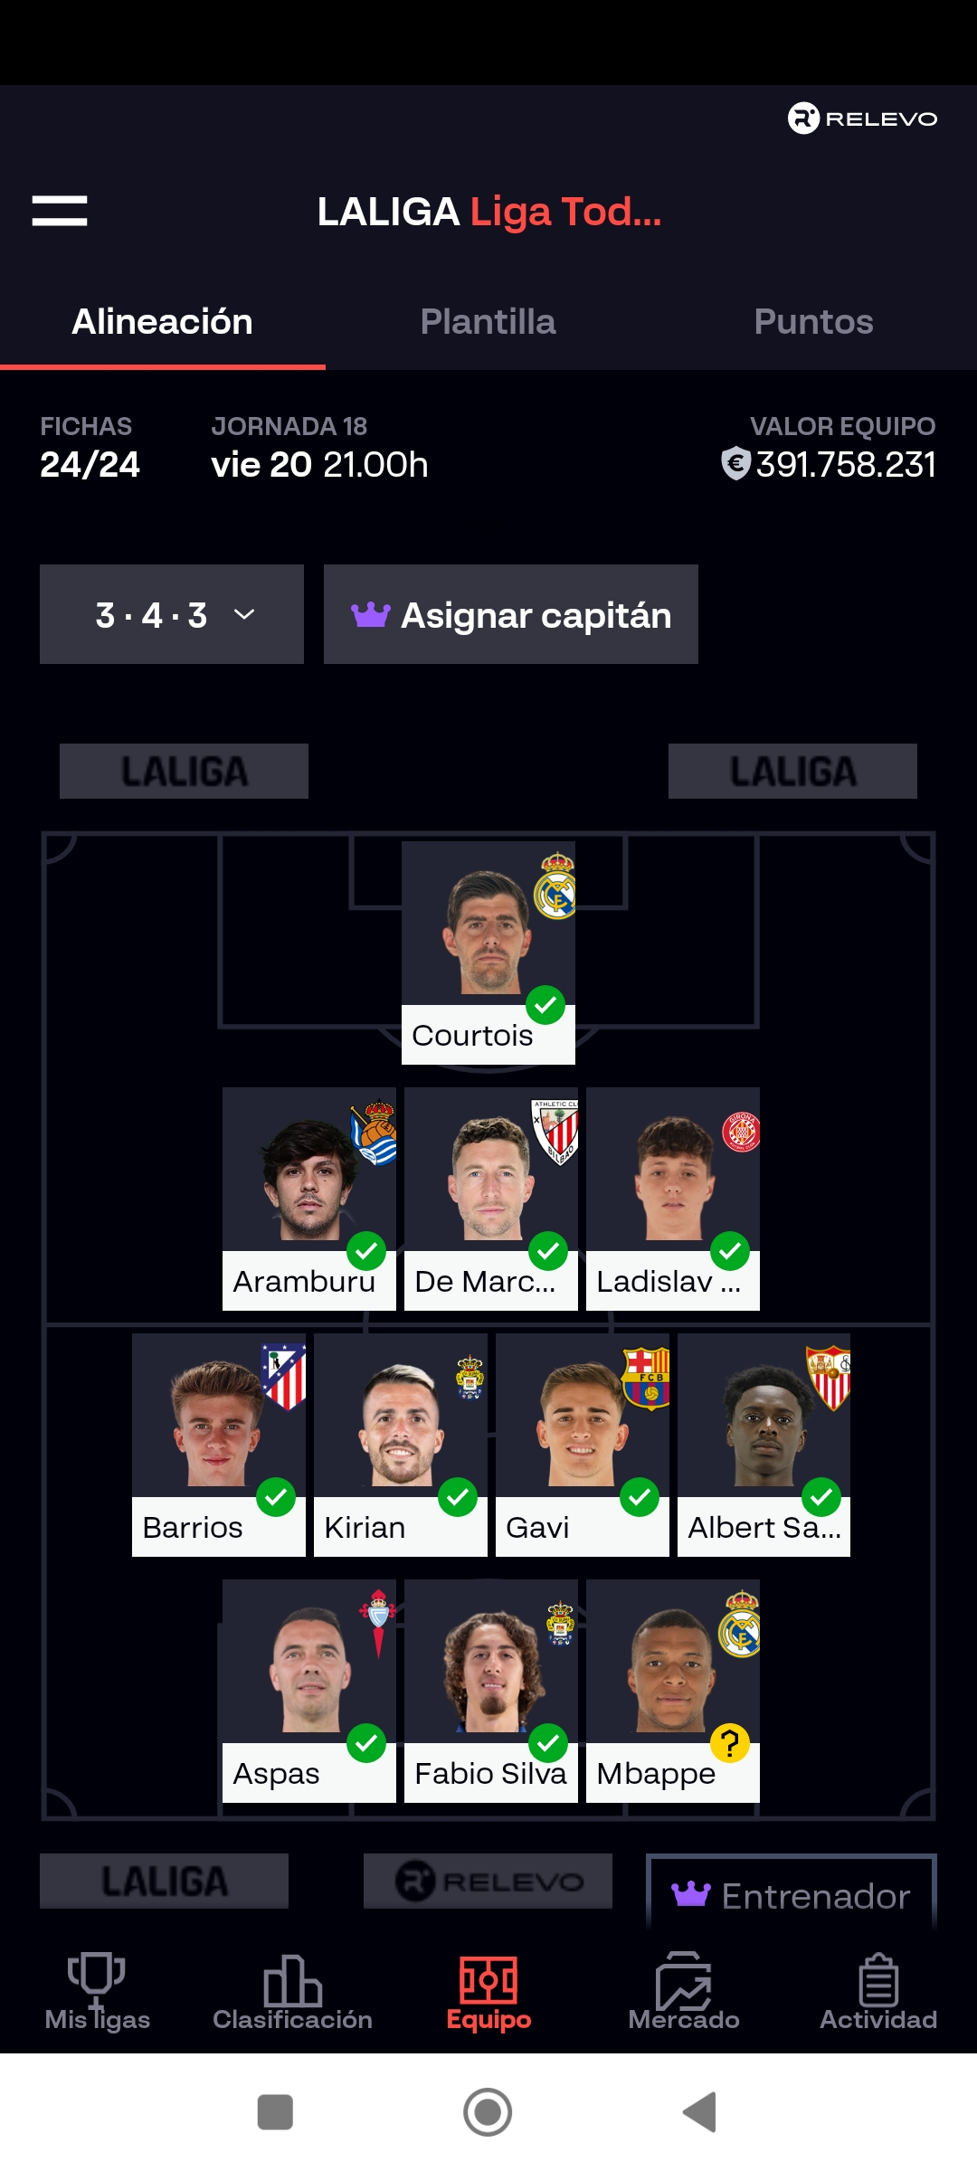
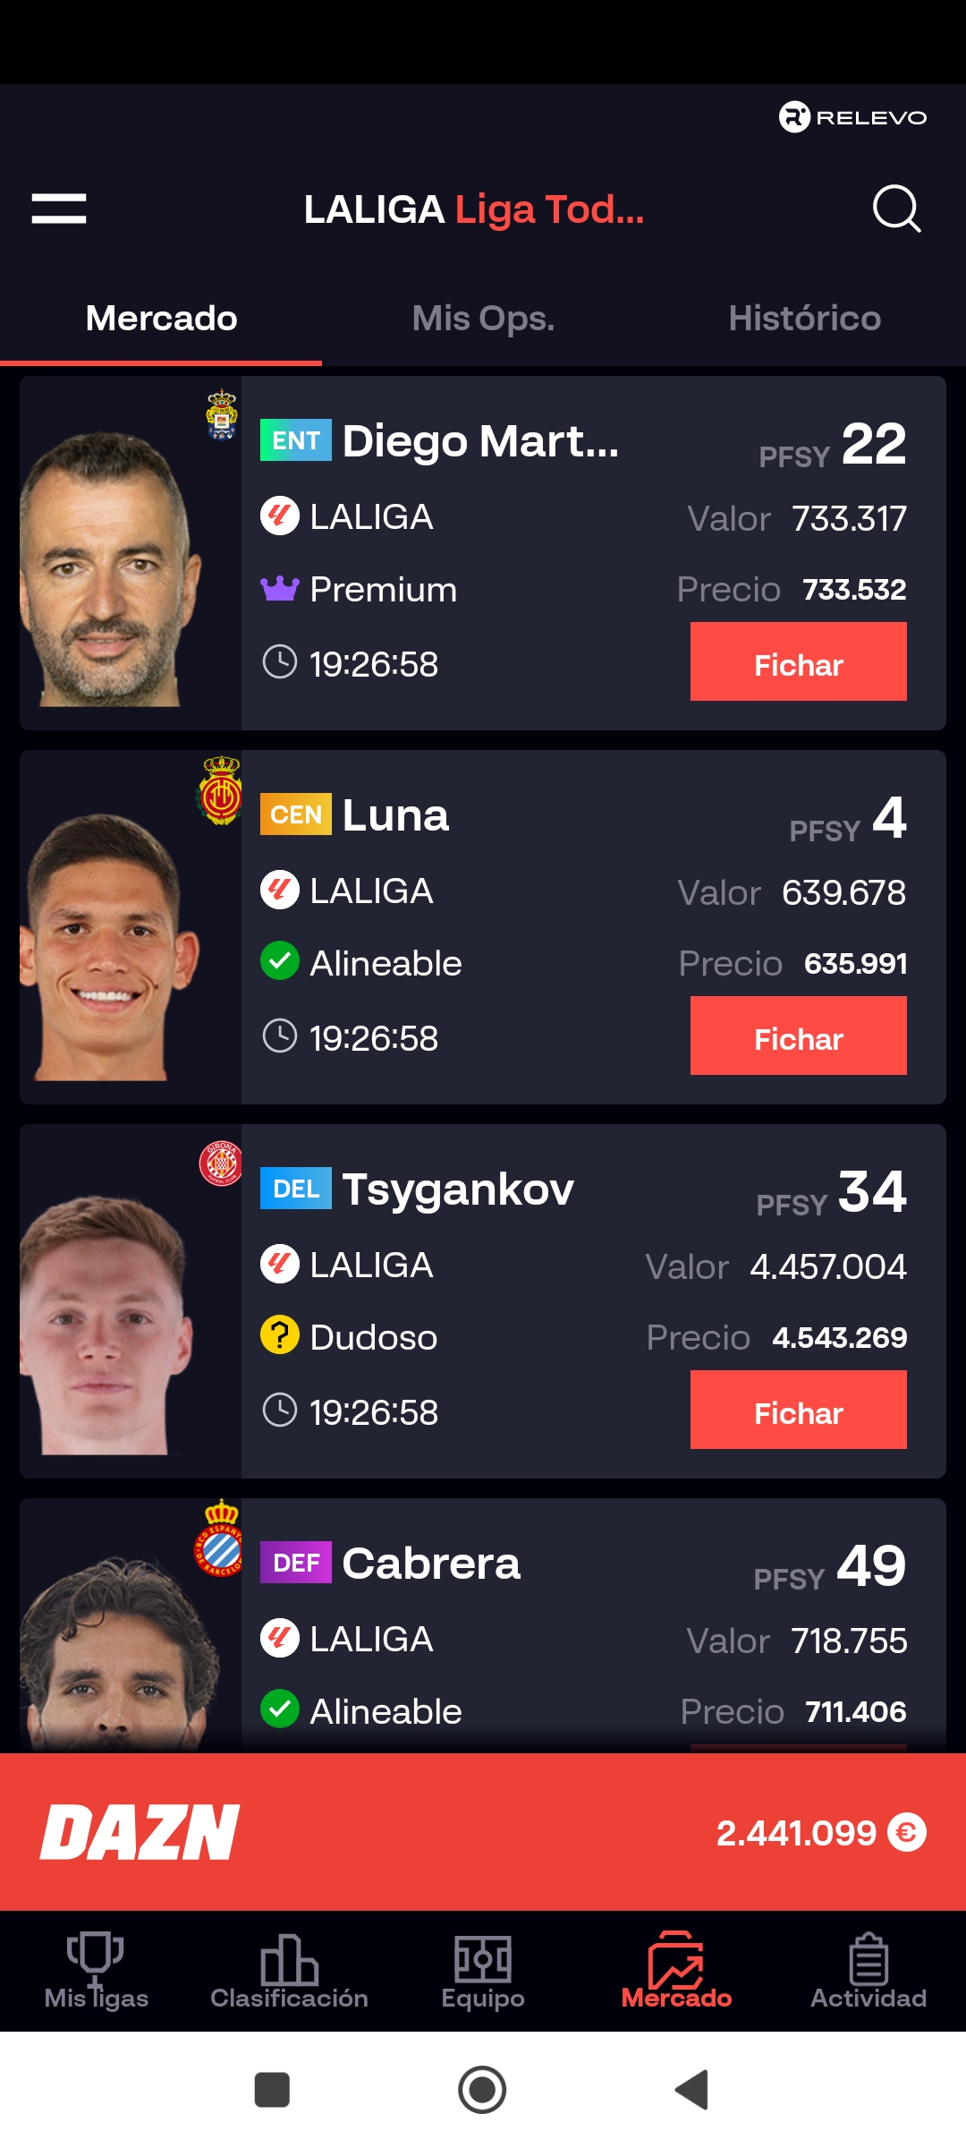
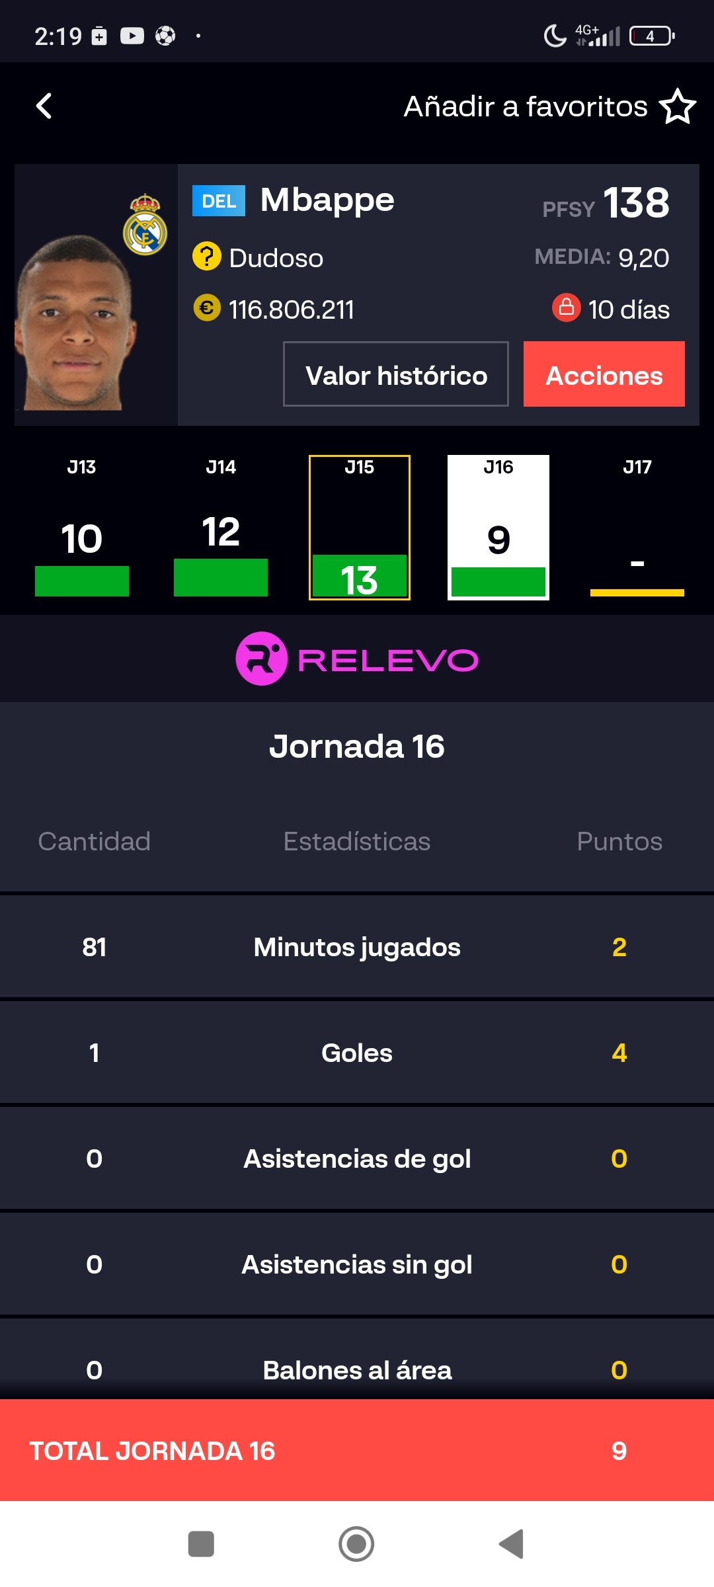
uy

Slide 3
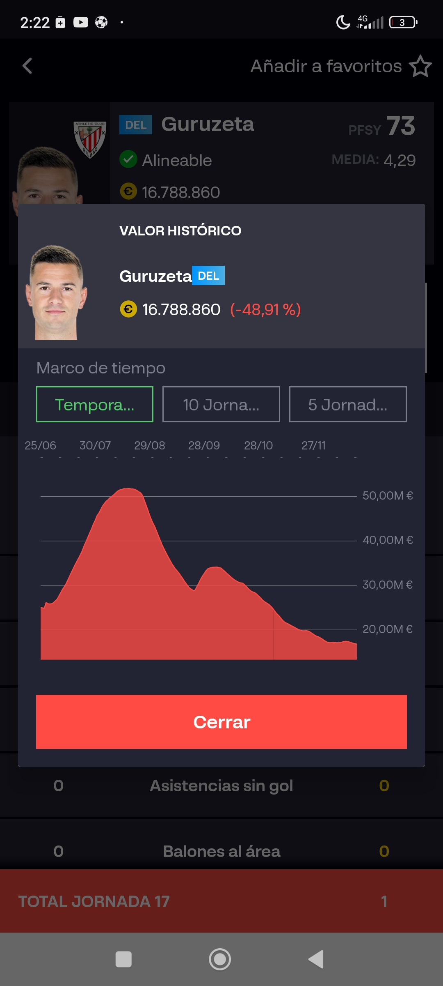
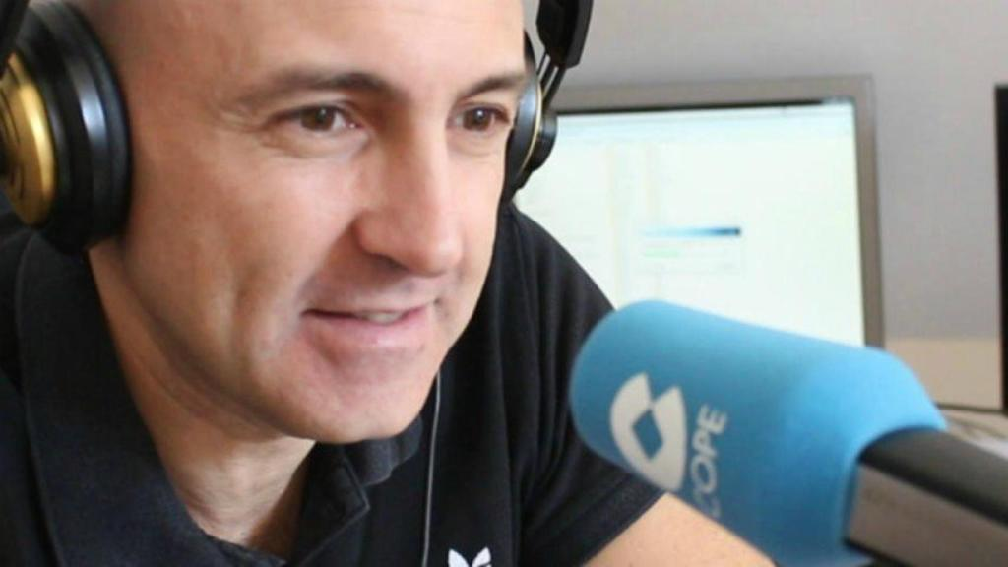
Foto caída mercado un jugador
This player is underrated

Slide 4

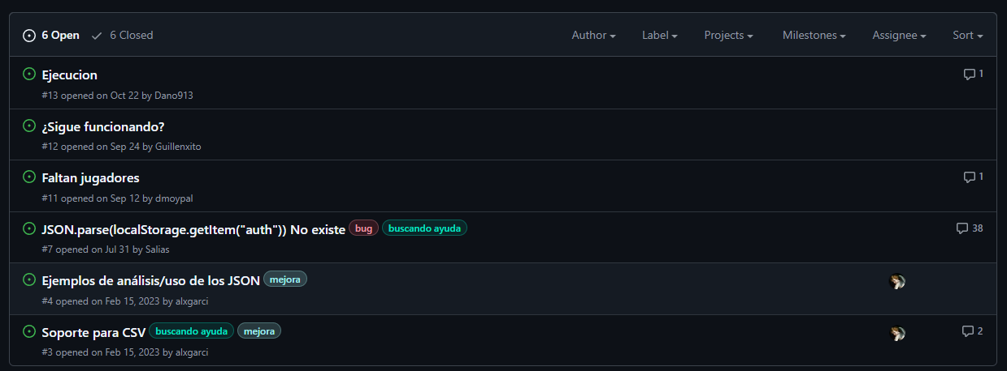
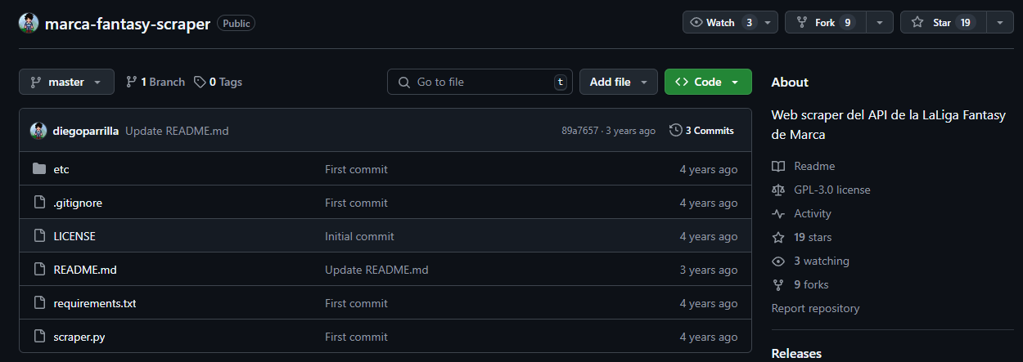
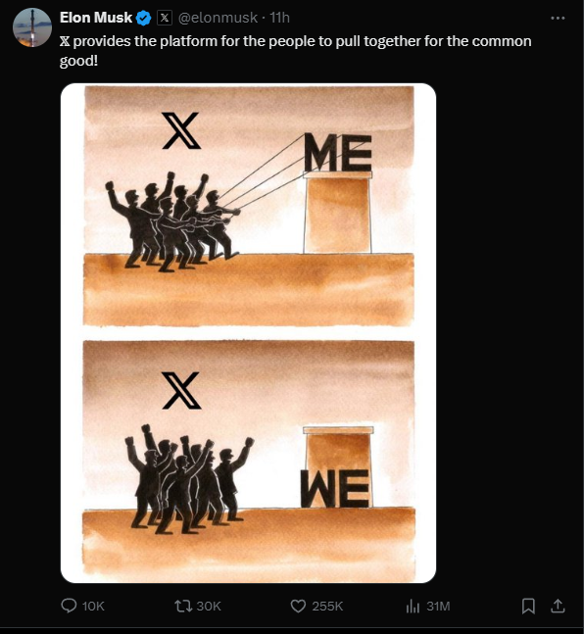
#alxgarci
#diegoparrilla

Slide 5
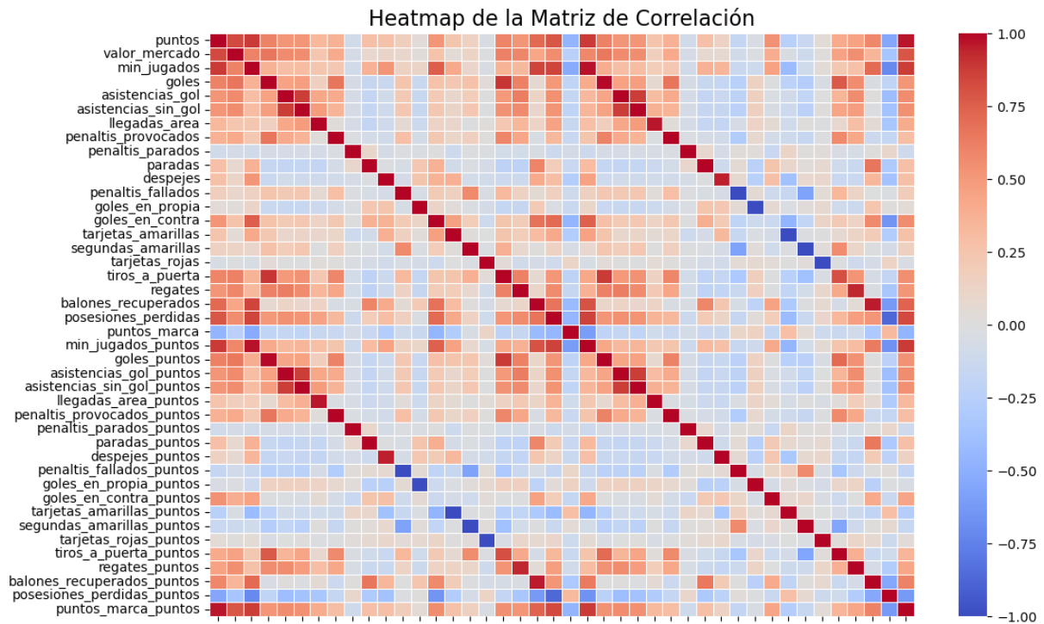

Slide 6
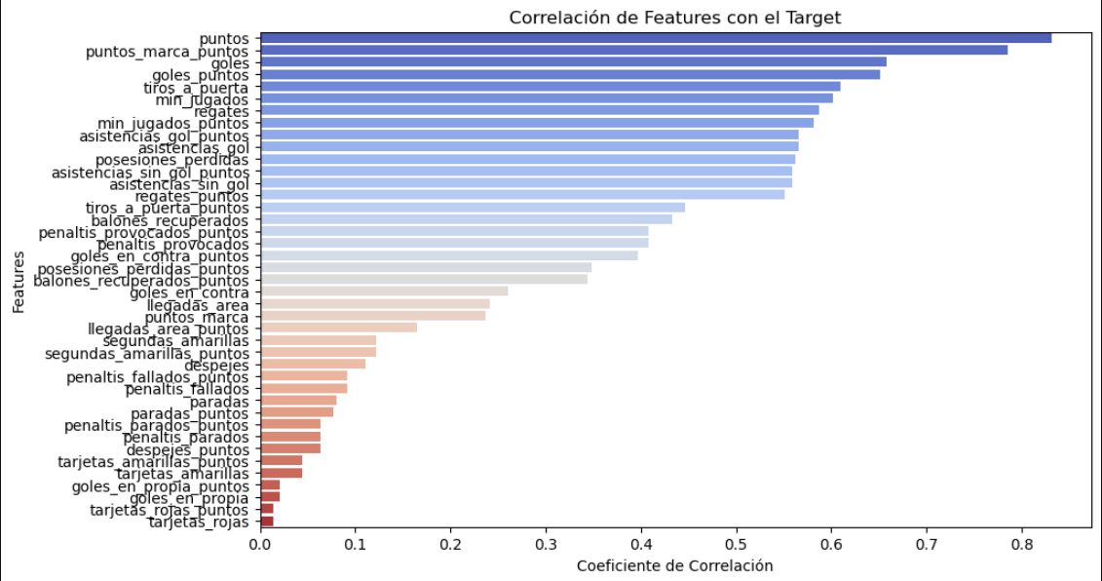
Features´ correlations with Target

Slide 7
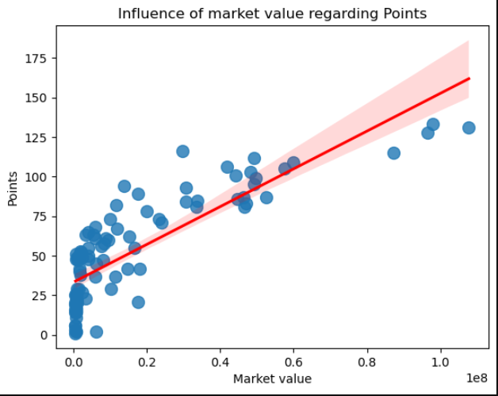
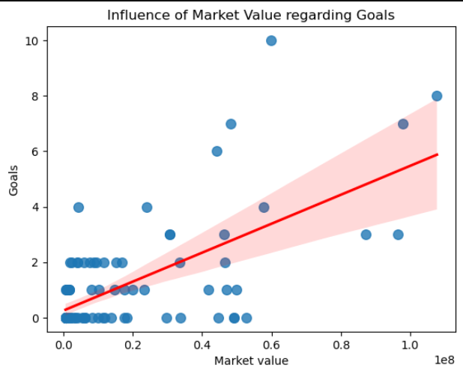

Slide 8
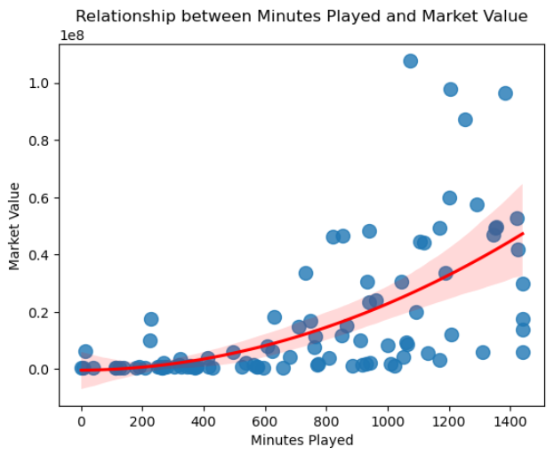
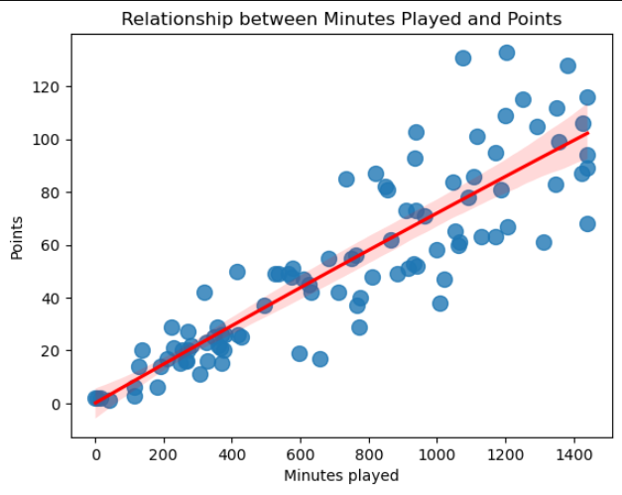

Slide 9
 | Real Value | Edu | Me | XGBoost | Rain Forest
Luka Sucic | 29.000.000€ | 28.000.000€ | 22.000.000€ | 25,463,806€ | 22,299,751€
Mbappe | 129.000.000€ | 120.000.000€ | 120.000.000€ | 62,260,868€ | 73,405,221€
Sancet | 58.000.000€ | 40.000.000€ | 52.000.000€ | 52,361,576€ | 51,011,480€
Johnny | 3.000.000€ | 7.000.000€ | 10.000.000€ | 8,928,820€ | 16,736,896€
Aramburu | 10.000.000€ | 15.000.000€ | 20.000.000€ | 24,739,476€ | 19,263,086€
Unai Simón | 5.500.000€ | 20.000.000€ | 10.000.000€ | 5,913,875€ | 3,417,477€

Slide 10
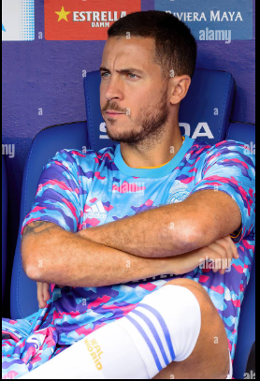
how do we include Hazard?
- Mood
- Personality
- Training
- Pressure
- Hierarchy
- Punctuations of Good players, experts, my own one…

