Slide 1

Analysis of the economical activity for a convenience store

Slide 2


Consultancy
“I´d like to organize my products”
“The space is a problem in my store”
“ I cannot afford to have products that pass out very quickly, apart from my own products like fruits or vegetables that I grow myself”
“Profits are not what I expected”
“I´d like to find the ideal product”
“I want to know which products are worthy to have”
“I am considering of moving my store elsewhere, on the same area I am right now”

Slide 3
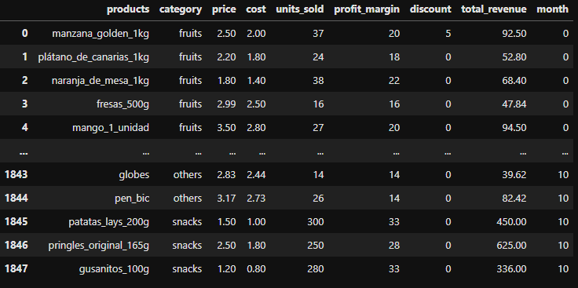

1848 rows
9 columns
numpy.random.uniform
random.triangular(left, mode, right, size=None)
Total Revenue

Slide 4
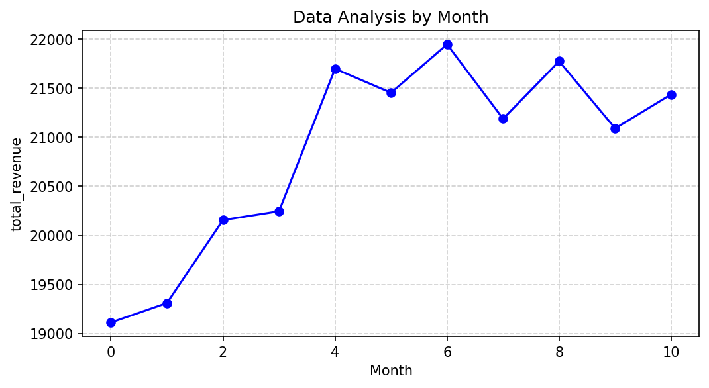
Performance of the store before consultancy

Slide 5
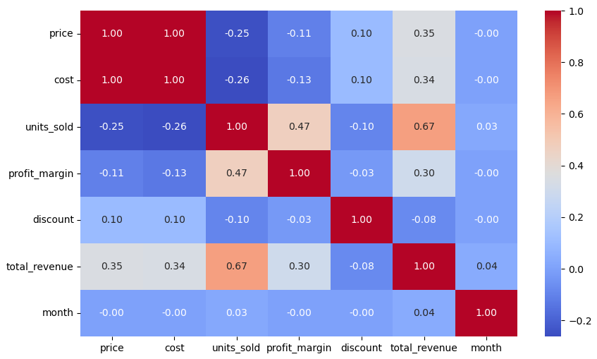

Slide 6

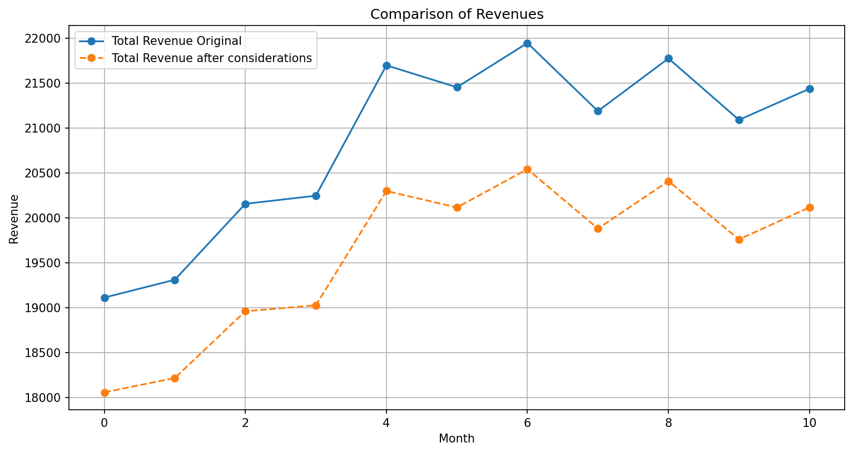
Impact of new feature (space)
MAE = 2.80
MSE = 123.78
RMSE = 11.13

Slide 7
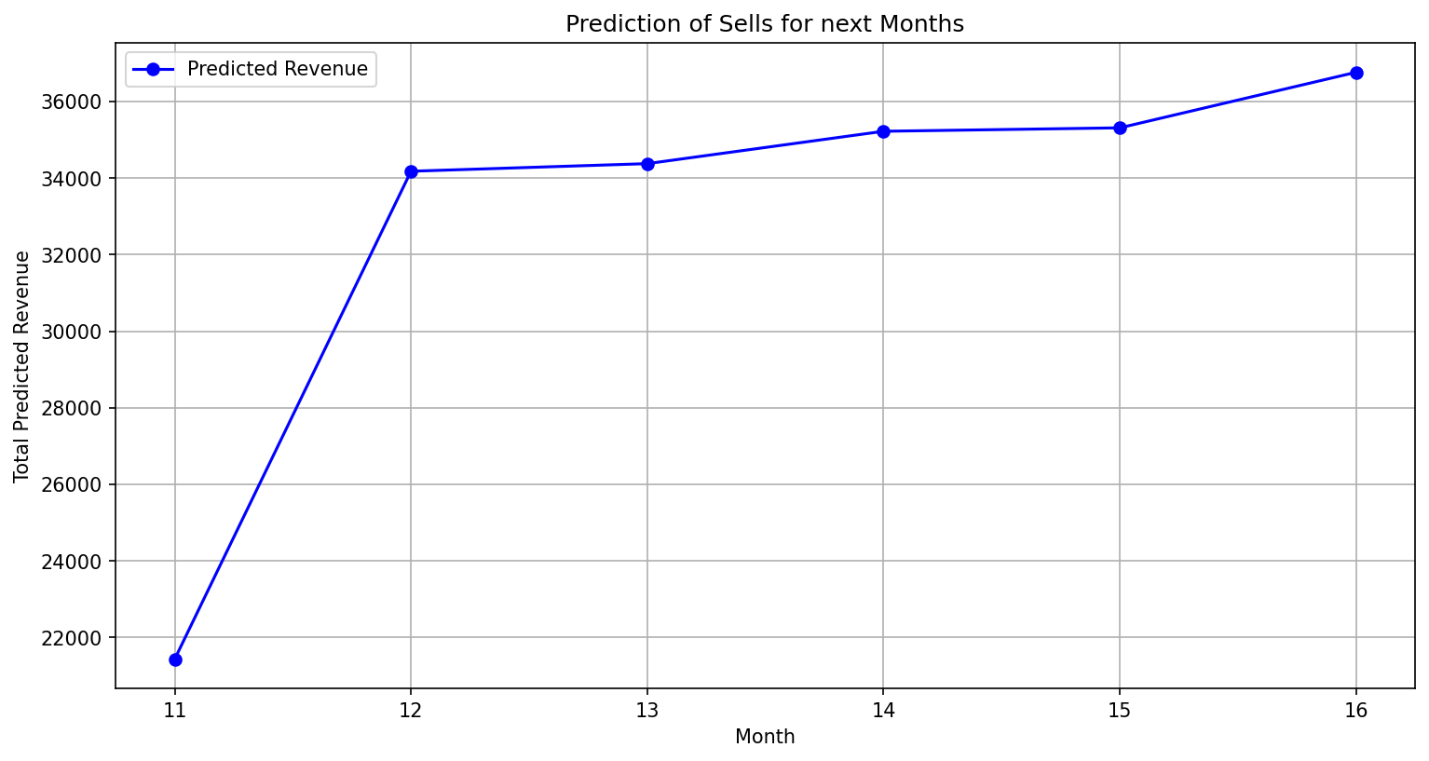

Slide 8
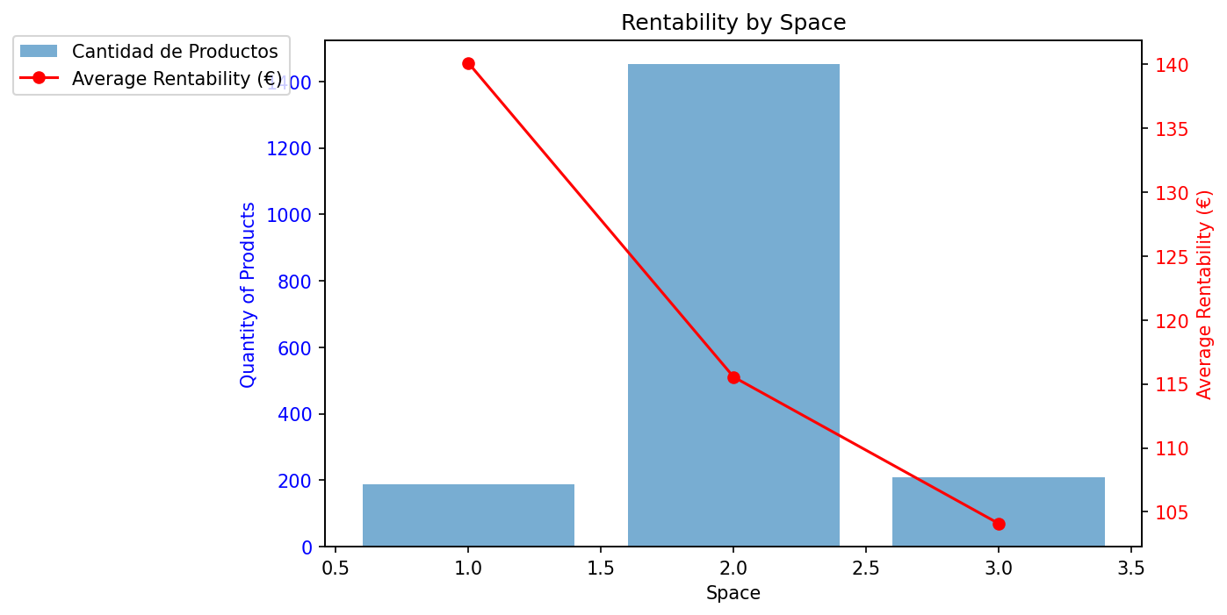

Slide 9
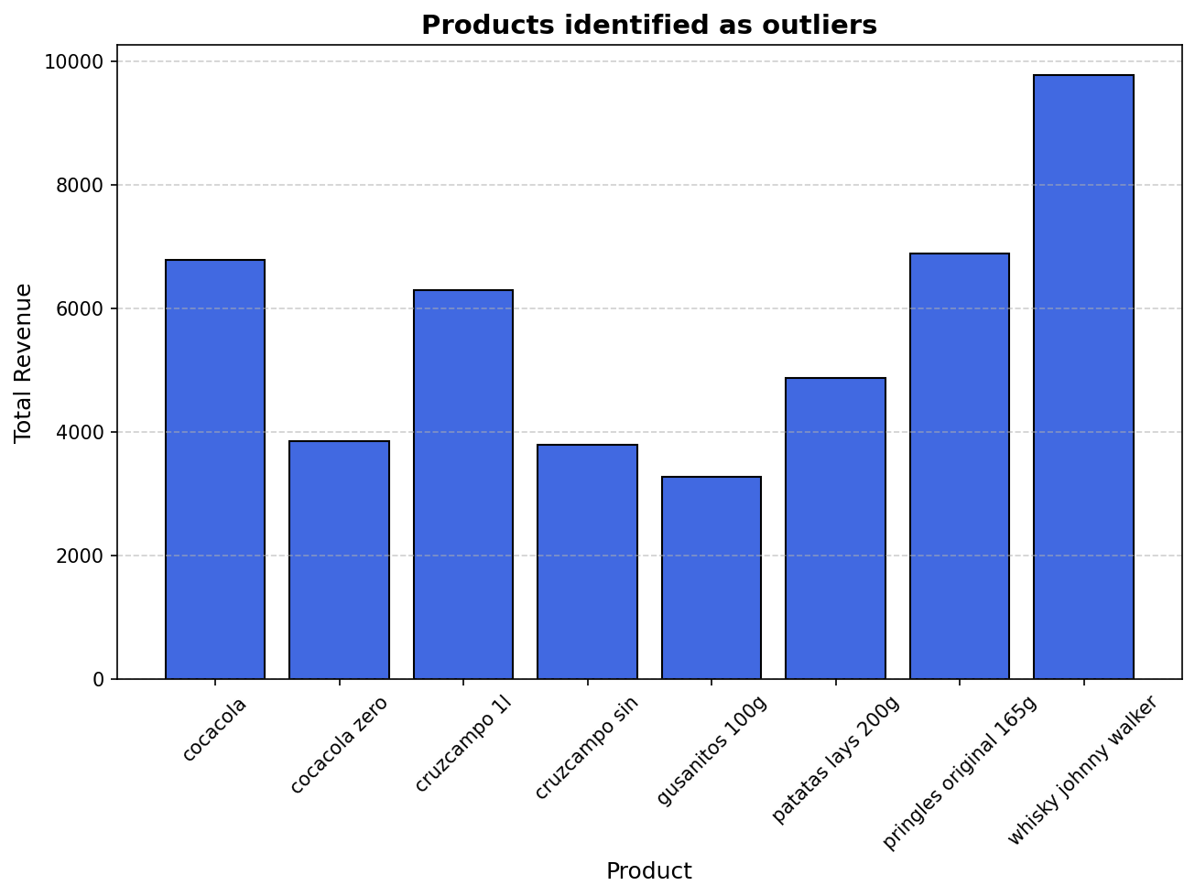

Slide 10
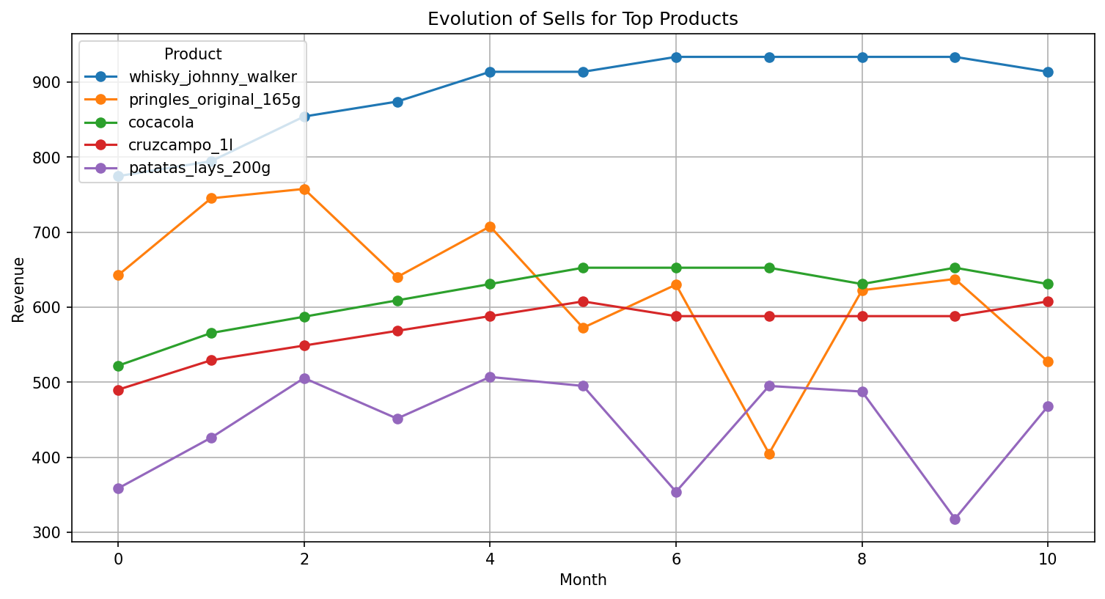

Slide 11
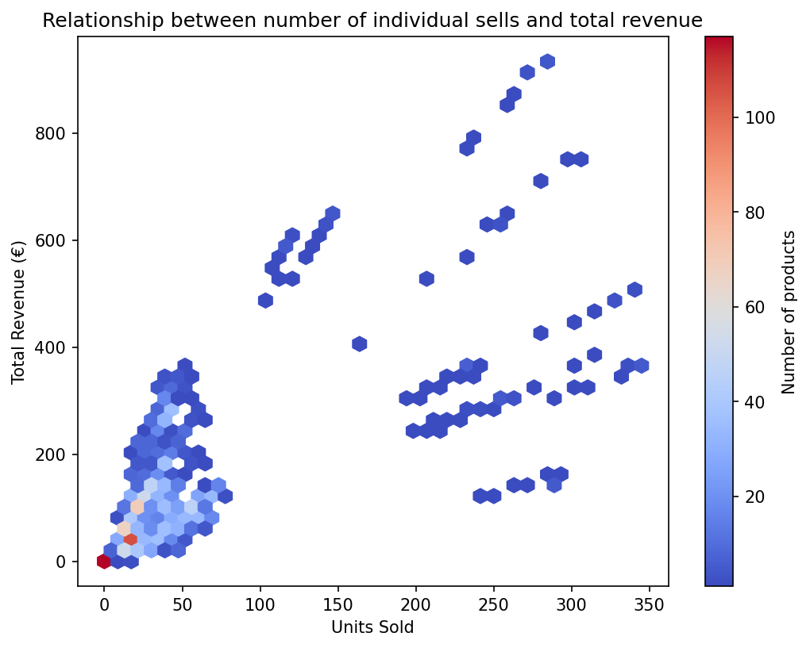
High Rotation vs Low Rotation
Correlation (Pearson): 0.67

Slide 12
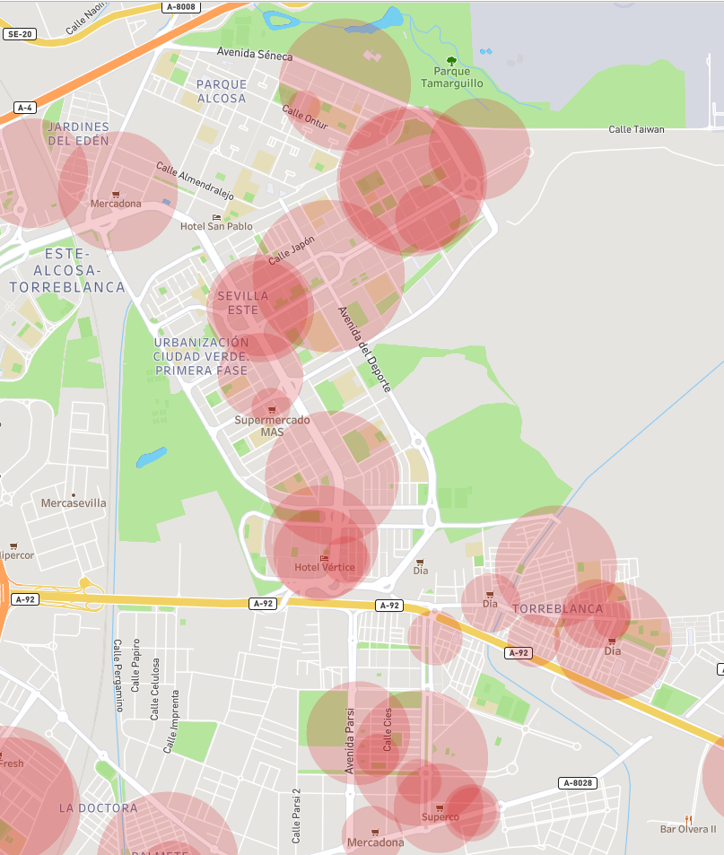


Radius of influence
Agregar algunas fotos de productos individuales

