Slide 1
WATER DAMAGE IN TENANCY
Sunita singh, enrico Klaus, klemens lehmann

Slide 2
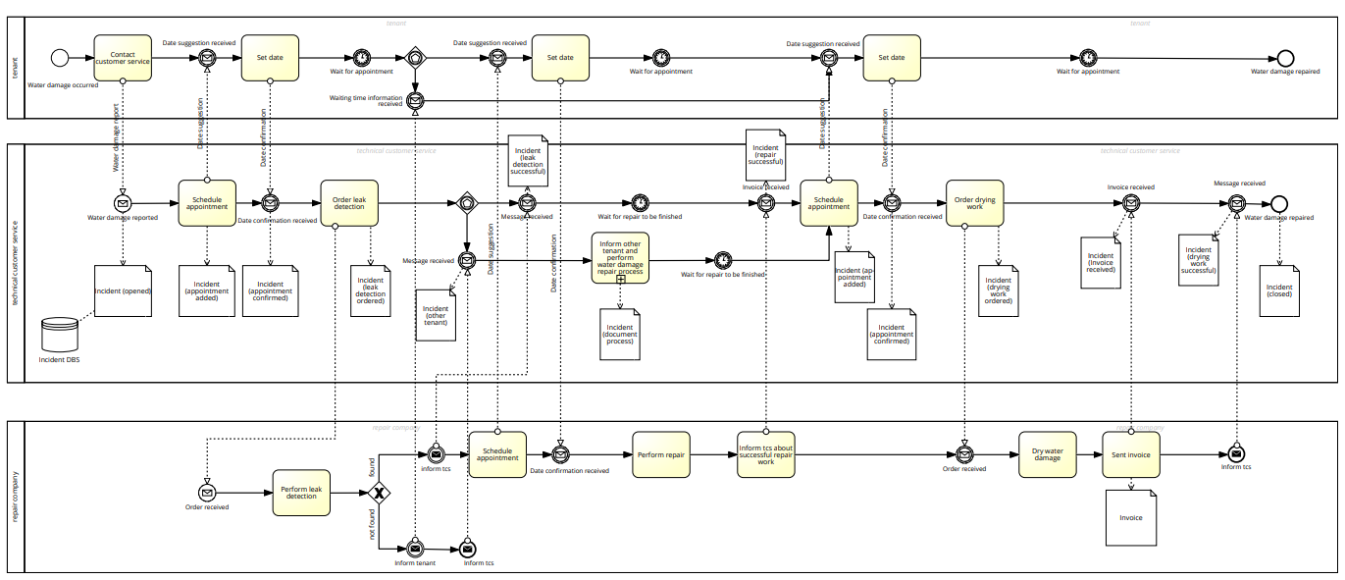
Recap
Process: Occurrence of a water damage
tenant
costumer
service
repair
company

Slide 3
Simplifications and Assumptions
One external company that does all three jobs: leak detection, repair and dry work
No involvement with tenant or costumer service as a separate pool
We use the same worker for all user tasks
We use manual task, where the process would just flow through
If tenant can't be reached, the whole process terminates after three days
We left out the Order-ID

