Slide 1


JFC Converter
AT-11
This Photo by Unknown author is licensed under CC BY-SA.

Slide 2








Introduction
Jalasoft File Converter is web application to convert files to another format.

Slide 3
Scope
FEATURE | INPUT | OUTPUT
PDF | pdf | jpg | png | gif | bmp
PPTX | pptx | pdf | jpg | png | gif | bmp
IMAGE | png/jpg/bmp/jpg | jpg | png | gif | bmp
VIDEO | mp4/avi/mkv | avi | mpg | mp4 | gif
AUDIO | wav | mp3
METADATA | all | xmp
MD5 | all | plain/text
FEATURE | functionality
USER | CRUD
Download | zip

Slide 4







Software Tools
Repository:
Versioning:
Code development:
Organization:
Testing:
Manages Data Base:
GITHUB
(repository)
TRELLO
(task board)
Skype
(reports)
GIT
(version-control system)
POSTMAN
(manage requests)
IntelliJ IDEA Community Edition
XAMPP
(manage DB)

Slide 5

Git Workflow
Gitflow

Slide 6












Technologies

Slide 7
HIBERNATE
ORM.
Driven by XML configuration files.

Slide 8
DATABASE JFC
user
[PK] id int
user_name varchar
password varchar
email varchar
Rol varchar
token varchar
fileupload
[PK] id int
md5 varchar
file_path varchar

Slide 9
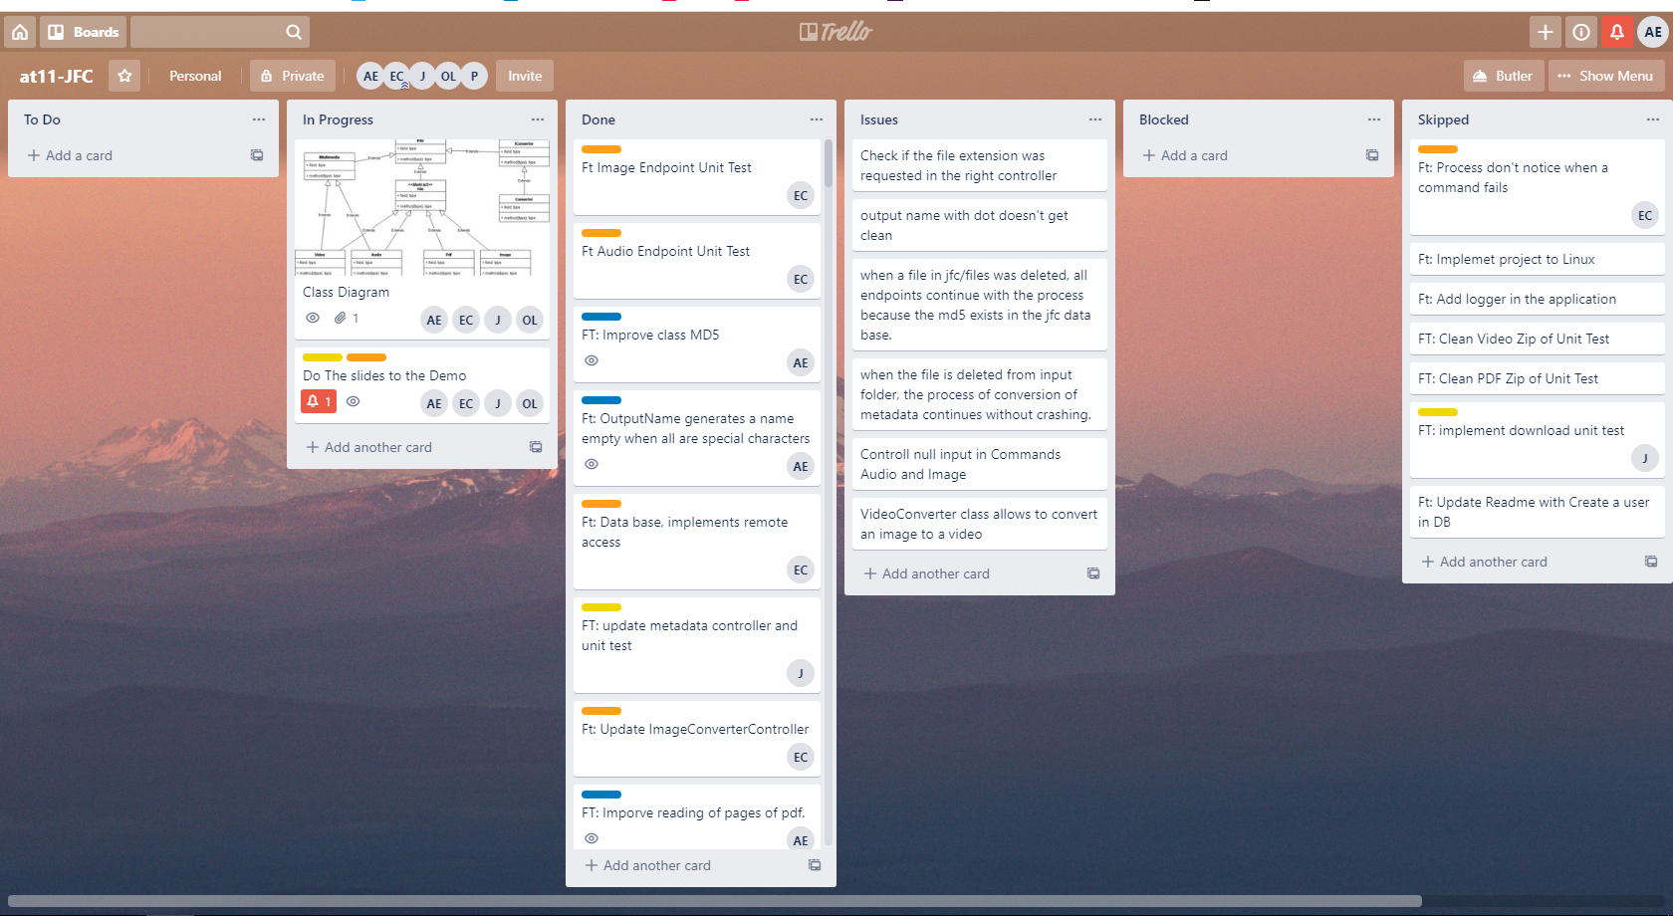
Organization

Slide 10
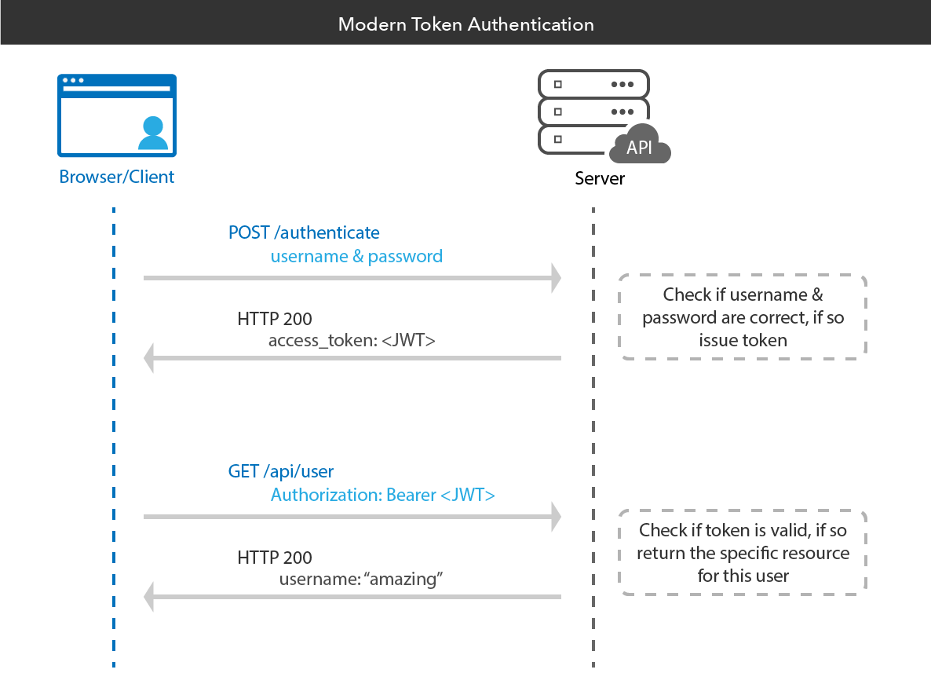
TOKENS

Slide 11
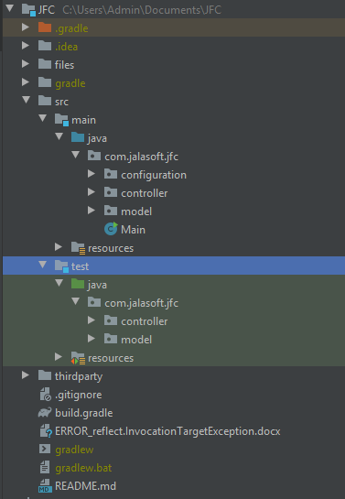
Packages

Slide 12
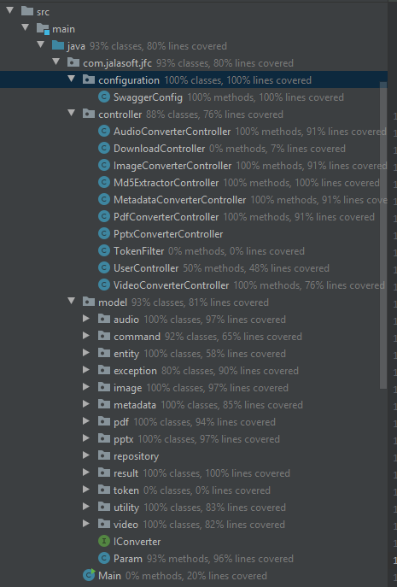
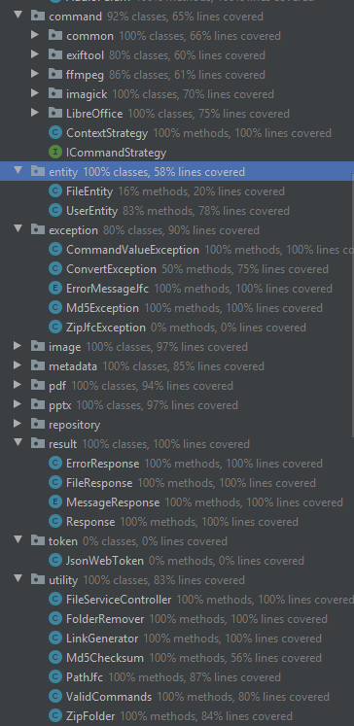
Packages

Slide 13
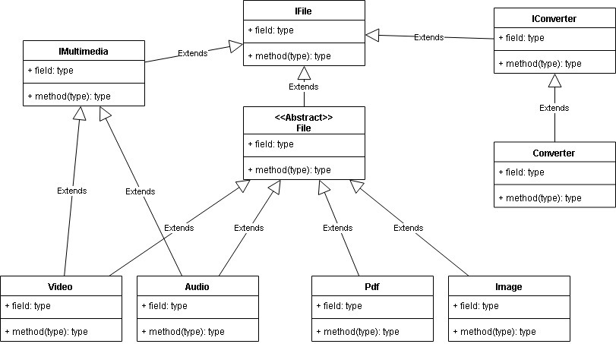
First Class Diagram

Slide 14
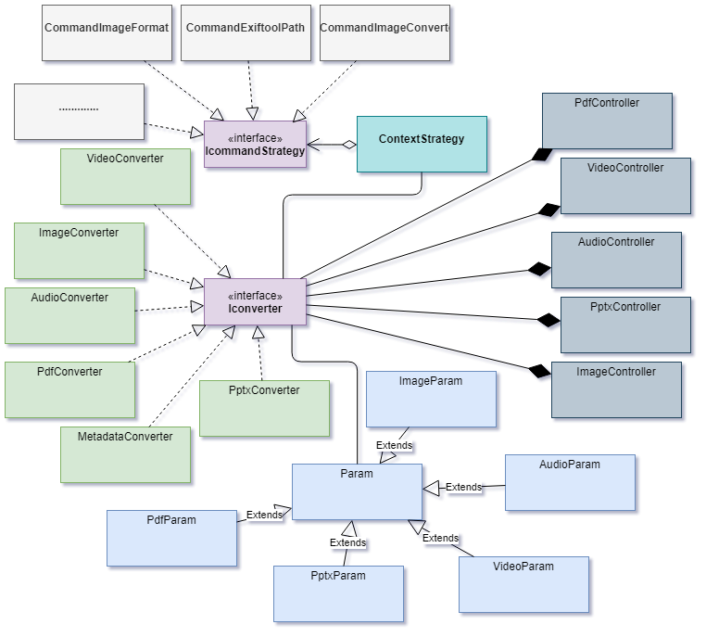
Class Diagram

Slide 15
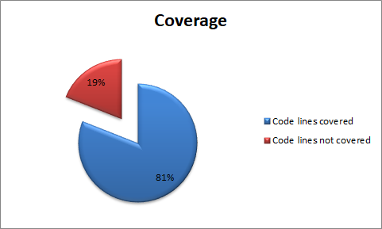
Code Coverage

Slide 16
Bugs known
Check if the file extension was requested in the right controller
VideoConverter class allows to convert an image to a video
The converter doesn't lunch an error when the command process failed.
Response ilegal state exception in swagger ui

Slide 17
JFC APPLICATION
LIVE DEMO

