Slide 1
PHIS / OPEN AGENT 2026
SYNTHETIC DEMO • TRACK 02
WHY HAS MY ENERGY
CHANGED LATELY?
An evidence-centered agent that can show what it knows,
what it tested, and why it abstains.
PHIS Open Agent
Track 02 · synthetic data · source-linked evidence
Notes:
Track 02 selected by founder and confirmed eligible by organizer: https://github.com/EnriqueDGProg/PHIS-OpenAgent-2026/pull/25#issuecomment-6383697898 . All demo records are synthetic.

Slide 2
PHIS / OPEN AGENT 2026
SYNTHETIC DEMO • TRACK 02
01 / PROBLEM & USERS
A personal “why” question needs evidence.
For a person reviewing changing energy, longitudinal records are incomplete and easy to overread.
The user
The friction
The standard
Wants to understand a recent change without receiving an invented diagnosis.
Scattered time series, missing days and tempting raw correlations obscure what is supportable.
Show observation, tested association, uncertainty and source lineage in one investigation.
TRACK 02 · THE AGENT THAT CAN EXPLAIN WHY
02
Notes:
Product positioning and target user are a proposal, not a clinical outcome. Official track wording: https://hackathon.genai.works/event/open-agent-hackathon-2026 .

Slide 3
PHIS / OPEN AGENT 2026
SYNTHETIC DEMO • TRACK 02
02 / SOLUTION
PHIS turns a question into a bounded investigation.
One longitudinal experience; every conclusion must survive the evidence gate.
01
02
03
04
Observe
Investigate
Verify
Explain / abstain
The time window, coverage and missing days are explicit.
Select tools and candidate families from the question and state.
Discovery evaluates frozen scientific gates and source links.
Return what is supportable and say what remains unknown.
TRACK 02 · THE AGENT THAT CAN EXPLAIN WHY
03
Notes:
Source: https://github.com/EnriqueDGProg/PHIS-OpenAgent-2026/pull/33 . The result is observational; do not say a specific factor caused an energy change.

Slide 4
PHIS / OPEN AGENT 2026
SYNTHETIC DEMO • TRACK 02
03 / GENUINE AGENTIC WORKFLOW
A decision loop with a scientific veto.
The next step depends on question, coverage, tool result and persisted context.
PLAN
TOOLS
EVIDENCE
Choose family and window
Retrieve records and run Discovery
Bind IDs to every candidate
VERIFY
RESPOND
ABSTAIN
Check gates and provenance
Explain bounded observations
Stop on weak or failed evidence
↳ Weak evidence triggers abstention; persisted World Model state changes a later follow-up.
TRACK 02 · THE AGENT THAT CAN EXPLAIN WHY
04
Notes:
Sources: https://github.com/EnriqueDGProg/PHIS-OpenAgent-2026/pull/33 and https://github.com/EnriqueDGProg/PHIS-OpenAgent-2026/pull/35 . PR35 critique accepted evidence; no unproven replan is claimed.

Slide 5
PHIS / OPEN AGENT 2026
SYNTHETIC DEMO • TRACK 02
04 / TECHNICAL ARCHITECTURE
A clear boundary between evidence and language.
The UI renders a typed result; it does not compute scientific findings.
SOURCE
DECISION
PRESENTATION
Data & provenance
Agent & science
Experience
Synthetic typed records → Zetaris query IDs → immutable source IDs.
Planner and verifier call deterministic Discovery; World Model stores follow-up state.
API result → longitudinal view, evidence panel, uncertainty and abstention.
Runtime boundary: no private health data • no fabricated sponsor response • no LLM-authored measurements
TRACK 02 · THE AGENT THAT CAN EXPLAIN WHY
05
Notes:
Five PREEXISTING PHIS Discovery modules were owner-authorized and released under MIT in PR33: https://github.com/EnriqueDGProg/PHIS-OpenAgent-2026/pull/33 . New orchestration, adapters, UI and synthetic validation were built during the event.

Slide 6
PHIS / OPEN AGENT 2026
SYNTHETIC DEMO • TRACK 02
05 / ZETARIS & METERLESS
Show what each sponsor actually does.
A proof belongs to a specific run, source mode and time window.
DATA LAYER
MEMORY LAYER
Zetaris
Meterless World Model
VERIFIED LIVE in PR33: authenticated local query, six pages and 1,080 fictional source records. This is a separate run from the NVIDIA receipt.
VERIFIED Engine: evidence persists; a follow-up reads prior state and selects sleep. This is not Power, Runtime or Nightshift.
TRACK 02 · THE AGENT THAT CAN EXPLAIN WHY
06
Notes:
Real PR33 proof: https://github.com/EnriqueDGProg/PHIS-OpenAgent-2026/blob/fb806023a5fb7d84cba05e299b2384acfbb02250/docs/JUDGE_RELEASE_GATE_2026-10-24.md . Live browser run SYN-RUN-955581f5ca45, follow-up SYN-RUN-330c2e6006b2. Screenshot docs/evidence/judge-release-live-zetaris.png from earlier exact runtime SHA 588c4046aa22e2ea60f77046ed40de3ec52195b5.

Slide 7
PHIS / OPEN AGENT 2026
SYNTHETIC DEMO • TRACK 02
06 / UNIQUE SPONSOR CONTRIBUTION
Source lineage meets persistent memory.
The meaningful combination is auditability across steps, not a list of logos.
SOURCE-BOUND
STATE-DEPENDENT
A retrieved row has a source ID. A scientific child has a plan and family ID. The final statement must cite the evidence that generated it.
A World Model event survives the first run. A subsequent question reads that event and selects different work—visible in the trace.
NVIDIA Lightning: genuine direct PLAN + CRITIQUE in local synthetic v4; not Meterless Power.
TRACK 02 · THE AGENT THAT CAN EXPLAIN WHY
07
Notes:
Direct hosted NVIDIA nvidia/nemotron-3.5-lightning-30b-a3b proof in PR35: https://github.com/EnriqueDGProg/PHIS-OpenAgent-2026/blob/815ac9ef426cd632732f7b7f22a3a200a025e3c5/docs/NEMOTRON_CONTRACT_RECOVERY_2026-10-24.md . v4 local synthetic run SYN-RUN-12a0a336e5cf, plan chatcmpl-f2bb11bd-fa90-49a7-839a-b195c8806a9e, critique chatcmpl-424b1863-d517-4b27-a3e5-9aa115e07699. Zetaris NOT_CONNECTED in this run.

Slide 8
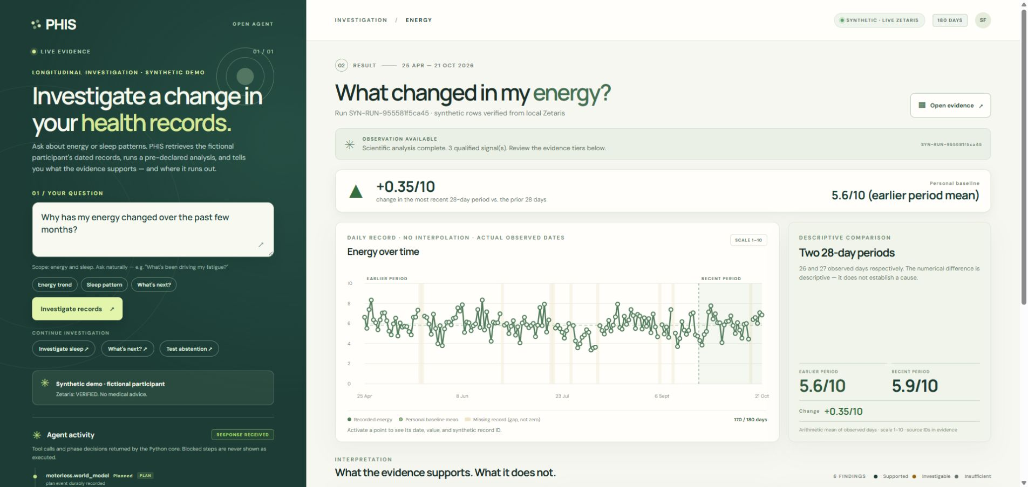
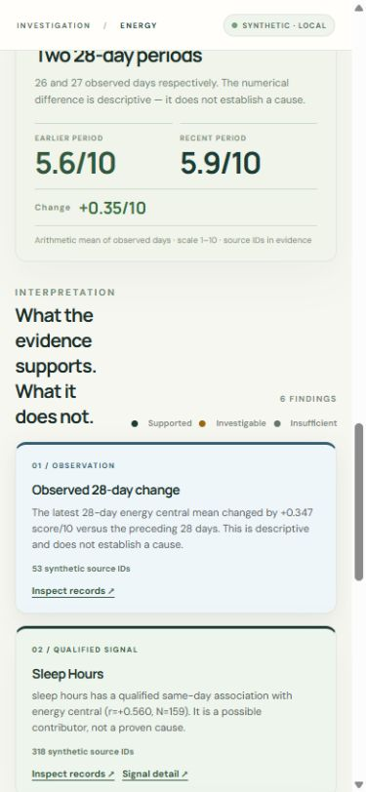
PHIS / OPEN AGENT 2026
SYNTHETIC DEMO • TRACK 02
07 / PRODUCT EXPERIENCE
An actual investigation, visible on screen.
Authentic PR33 Chrome captures; live Zetaris desktop and local synthetic mobile.
LIVE ZETARIS · EARLIER PR33 SHA
LOCAL · EARLIER PR33 SHA
TRACK 02 · THE AGENT THAT CAN EXPLAIN WHY
08
Notes:
Authentic images: docs/evidence/judge-release-live-zetaris.png and docs/evidence/judge-release-mobile-energy.png. Both documented in https://github.com/EnriqueDGProg/PHIS-OpenAgent-2026/blob/fb806023a5fb7d84cba05e299b2384acfbb02250/docs/JUDGE_RELEASE_GATE_2026-10-24.md . They are earlier PR33 evidence, not a claim that combined NVIDIA + live Zetaris was captured on final SHA.

Slide 9
PHIS / OPEN AGENT 2026
SYNTHETIC DEMO • TRACK 02
EVIDENCE INTEGRITY
Association is not explanation by itself.
The 180-day fictional run exposes coverage, gates and source IDs.
SYNTHETIC
DETERMINISTIC
SCOPE LIMIT
180-day scenario
Scientific gate
Uncertainty
1,080 fictional variable-day records; 170/180 observed energy days in the documented Chrome run.
Discovery reports qualified same-day associations, with source IDs and coverage; association is not cause.
The 28-day mean rose about 0.35/10. A different longer comparison can differ; no diagnosis follows.
TRACK 02 · THE AGENT THAT CAN EXPLAIN WHY
09
Notes:
Actual source: https://github.com/EnriqueDGProg/PHIS-OpenAgent-2026/blob/fb806023a5fb7d84cba05e299b2384acfbb02250/docs/JUDGE_RELEASE_GATE_2026-10-24.md and image docs/evidence/judge-release-live-zetaris.png . Six variables × 180 days means 1,080 variable-day records, not 1,080 patients or days.

Slide 10
PHIS / OPEN AGENT 2026
SYNTHETIC DEMO • TRACK 02
08 / ROADMAP & IMPACT
From inspectable prototype to consented insight.
The promise is better questions and clearer limits—not a clinical outcome claim.
NOW
Synthetic 180-day investigation, source lineage, World Model follow-up and honest abstention.
PROVEN SEPARATELY
PR33 live Zetaris; PR35 direct hosted NVIDIA planning and critique.
LATER
Consented ingestion, privacy controls and prospective usefulness validation.
Next gate: final SHA, recorded video and anonymous link checks.
TRACK 02 · THE AGENT THAT CAN EXPLAIN WHY
10
Notes:
This is a review deck, not evidence of HackOS submission. PR33 and PR35 proofs are separate: https://github.com/EnriqueDGProg/PHIS-OpenAgent-2026/pull/33 and https://github.com/EnriqueDGProg/PHIS-OpenAgent-2026/pull/35 . No Nightshift/Power/Runtime claim.

