Slide 1
PHIS / OPEN AGENT 2026
SYNTHETIC DEMO • TRACK 02
WHY HAS MY ENERGY
CHANGED LATELY?
An evidence-centered agent that can show what it knows,
what it tested, and why it abstains.
PHIS Open Agent
Track 02 · synthetic data · source-linked evidence
Notes:
Track 02 selected by founder and confirmed eligible by organizer: https://github.com/EnriqueDGProg/PHIS-OpenAgent-2026/pull/25#issuecomment-6383697898 . All demo records are synthetic.

Slide 2
PHIS / OPEN AGENT 2026
SYNTHETIC DEMO • TRACK 02
01 / PROBLEM & USERS
A personal “why” question needs evidence.
For a person reviewing changing energy, longitudinal records are incomplete and easy to overread.
The user
The friction
The standard
Wants to understand a recent change without receiving an invented diagnosis.
Scattered time series, missing days and tempting raw correlations obscure what is supportable.
Show observation, tested association, uncertainty and source lineage in one investigation.
TRACK 02 · THE AGENT THAT CAN EXPLAIN WHY
02
Notes:
Product positioning and target user are a proposal, not a clinical outcome. Official track wording: https://hackathon.genai.works/event/open-agent-hackathon-2026 .

Slide 3
PHIS / OPEN AGENT 2026
SYNTHETIC DEMO • TRACK 02
02 / SOLUTION
PHIS turns a question into a bounded investigation.
One longitudinal experience; every conclusion must survive the evidence gate.
01
02
03
04
Observe
Investigate
Verify
Explain / abstain
The time window, coverage and missing days are explicit.
Select tools and candidate families from the question and state.
Discovery evaluates frozen scientific gates and source links.
Return what is supportable and say what remains unknown.
TRACK 02 · THE AGENT THAT CAN EXPLAIN WHY
03
Notes:
Source: https://github.com/EnriqueDGProg/PHIS-OpenAgent-2026/pull/33 . The result is observational; do not say a specific factor caused an energy change.

Slide 4
PHIS / OPEN AGENT 2026
SYNTHETIC DEMO • TRACK 02
03 / GENUINE AGENTIC WORKFLOW
A decision loop with a scientific veto.
The next step depends on question, coverage, tool result and persisted context.
PLAN
TOOLS
EVIDENCE
Choose family and window
Retrieve records and run Discovery
Bind IDs to every candidate
VERIFY
RESPOND
ABSTAIN
Check gates and provenance
Explain bounded observations
Stop on weak or failed evidence
↳ Weak evidence triggers abstention; persisted World Model state changes a later follow-up.
TRACK 02 · THE AGENT THAT CAN EXPLAIN WHY
04
Notes:
Sources: https://github.com/EnriqueDGProg/PHIS-OpenAgent-2026/pull/33 and https://github.com/EnriqueDGProg/PHIS-OpenAgent-2026/pull/35 . PR35 critique accepted evidence; no unproven replan is claimed.

Slide 5
PHIS / OPEN AGENT 2026
SYNTHETIC DEMO • TRACK 02
04 / TECHNICAL ARCHITECTURE
A clear boundary between evidence and language.
The UI renders a typed result; it does not compute scientific findings.
SOURCE
DECISION
PRESENTATION
Data & provenance
Agent & science
Experience
Synthetic typed records → Zetaris query IDs → immutable source IDs.
Planner and verifier call deterministic Discovery; World Model stores follow-up state.
API result → longitudinal view, evidence panel, uncertainty and abstention.
Runtime boundary: no private health data • no fabricated sponsor response • no LLM-authored measurements
TRACK 02 · THE AGENT THAT CAN EXPLAIN WHY
05
Notes:
Five PREEXISTING PHIS Discovery modules were owner-authorized and released under MIT in PR33: https://github.com/EnriqueDGProg/PHIS-OpenAgent-2026/pull/33 . New orchestration, adapters, UI and synthetic validation were built during the event.

Slide 6
PHIS / OPEN AGENT 2026
SYNTHETIC DEMO • TRACK 02
05 / ZETARIS & METERLESS
Show what each sponsor actually does.
A proof belongs to a specific run, source mode and time window.
DATA LAYER
MEMORY LAYER
Zetaris
Meterless World Model
VERIFIED LIVE in the same PR43 run: six authenticated query pages returned 1,080 fictional variable-day records with exact source IDs.
VERIFIED Engine: six source, science, tool and decision events persisted and read back. Runtime and Power remain disconnected.
TRACK 02 · THE AGENT THAT CAN EXPLAIN WHY
06
Notes:
Same-run receipt: PR43 SHA 9c871532a2debd9877483dad9c937dbb881508ad, SYN-RUN-64e7acc2fa5e. Source digest fbc8653d5f0d8aeb84c65d06607d7821fbf1c3195088c6d023f17ae2c32a7cea; six pages total 1,080 synthetic rows. Meterless World Model Engine six-event readback. See submission/SOURCES_AND_CLAIMS.md.

Slide 7
PHIS / OPEN AGENT 2026
SYNTHETIC DEMO • TRACK 02
06 / UNIQUE SPONSOR CONTRIBUTION
Source lineage meets persistent memory.
The meaningful combination is auditability across steps, not a list of logos.
SOURCE-BOUND
STATE-DEPENDENT
A retrieved row has a source ID. A scientific child has a plan and family ID. The final statement must cite the evidence that generated it.
A World Model event survives the first run. A subsequent question reads that event and selects different work—visible in the trace.
NVIDIA Nemotron planned and reviewed this Zetaris-backed run; Discovery owned every scientific value.
TRACK 02 · THE AGENT THAT CAN EXPLAIN WHY
07
Notes:
Same-run NVIDIA direct response IDs: plan chatcmpl-0a91ce32-a642-4e8c-9472-2532d2d9c511; accepted critique chatcmpl-109cfe2d-87f6-486e-820e-980dcc037255. Cited PHIS signal 90ef93bc76d478a9059f1b1fefcf6486a10aeddab94aa349cbf8364ac77ab86a, positive same-day association, confounding and no causal claim. Meterless Power/Runtime not connected.

Slide 8
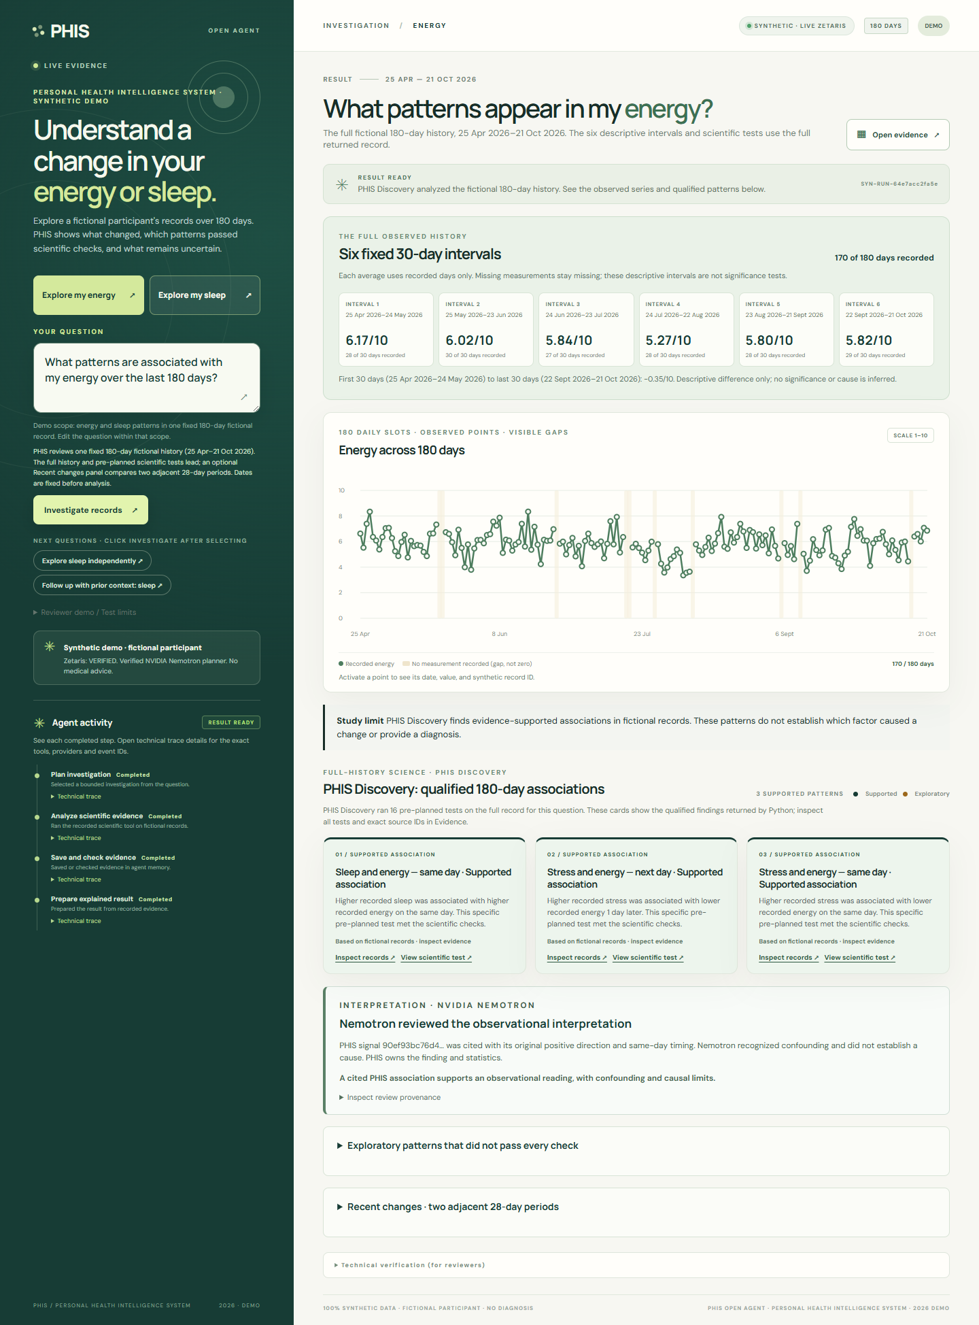
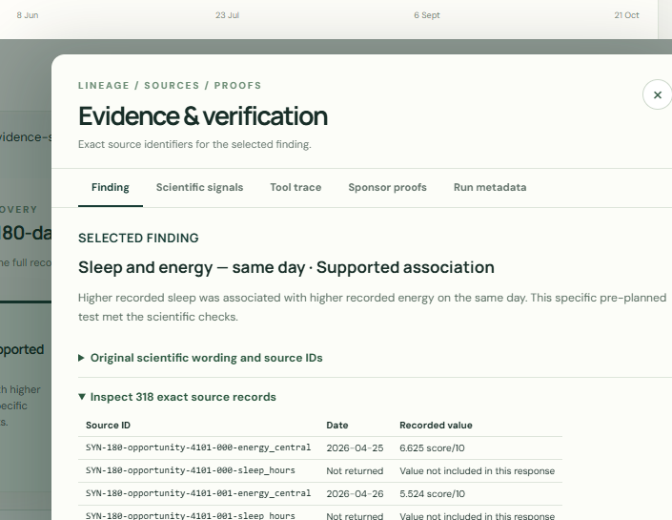
PHIS / OPEN AGENT 2026
SYNTHETIC DEMO • TRACK 02
07 / PRODUCT EXPERIENCE
One run. The full 180-day history.
170 of 180 Energy days recorded. Source-linked evidence from the same authenticated PR43 run.
180-DAY CHART · LIVE ZETARIS + NVIDIA
SOURCE IDS · SAME RUN
TRACK 02 · THE AGENT THAT CAN EXPLAIN WHY
08
Notes:
Native PPTX crops from two authentic installed-Chrome images of SYN-RUN-64e7acc2fa5e on exact PR43 SHA 9c871532a2debd9877483dad9c937dbb881508ad. The full original screenshots, including mobile, remain in submission/evidence. Six 30-day intervals and Nemotron review are visible in the original full-page capture; this slide enlarges the longitudinal chart and source evidence for presentation scale. No pixels or scientific values were synthesized.

Slide 9
PHIS / OPEN AGENT 2026
SYNTHETIC DEMO • TRACK 02
EVIDENCE INTEGRITY
Association is not explanation by itself.
The 180-day fictional run exposes coverage, gates and source IDs.
SYNTHETIC
DETERMINISTIC
INTERPRETATION
180-day scenario
Scientific gate
Model boundary
1,080 fictional variable-day records; 170/180 Energy days observed across six descriptive intervals.
Discovery ran 16 pre-planned tests: 3 qualified, 2 unstable and 11 weak. Every signal retains its source IDs.
Nemotron cited one qualified positive same-day association and recognized confounding. No cause or diagnosis follows.
TRACK 02 · THE AGENT THAT CAN EXPLAIN WHY
09
Notes:
Same-run PR43 scientific result on frozen fictional dataset digest fbc8653d5f0d8aeb84c65d06607d7821fbf1c3195088c6d023f17ae2c32a7cea. The 28-day comparison remains secondary in the UI. Inspect exact source IDs in submission/evidence/combined-pr43-founder-source-evidence.png. Six variables x 180 days means 1,080 observation slots, not people.

Slide 10
PHIS / OPEN AGENT 2026
SYNTHETIC DEMO • TRACK 02
08 / ROADMAP & IMPACT
From inspectable prototype to consented insight.
The promise is better questions and clearer limits—not a clinical outcome claim.
NOW
One synthetic 180-day investigation with source lineage, qualified findings and bounded review.
PROVEN TOGETHER
PR43 authenticated Zetaris, PHIS Discovery, hosted Nemotron and World Model Engine.
LATER
Consented ingestion, privacy controls and prospective usefulness validation.
Next gate: final SHA, recorded video and anonymous link checks.
TRACK 02 · THE AGENT THAT CAN EXPLAIN WHY
10
Notes:
This remains a review deck, not evidence of HackOS submission. Same-run proof is SYN-RUN-64e7acc2fa5e on PR43 SHA 9c871532a2debd9877483dad9c937dbb881508ad. Meterless Runtime/Power, real health data, clinical benefit and automatic ingestion are not claimed.

