Slide 1
BETA DIVERSITY
NORMALIZATION, DISTANCE MATRICES, & ORDINATION
VLCS 689
Mar 27, 2024

Slide 2
BETA DIVERSITY
Similarity of structure/composition between communities
Investigate how factors influence community composition
Identify taxa associated with specific factors

Slide 3
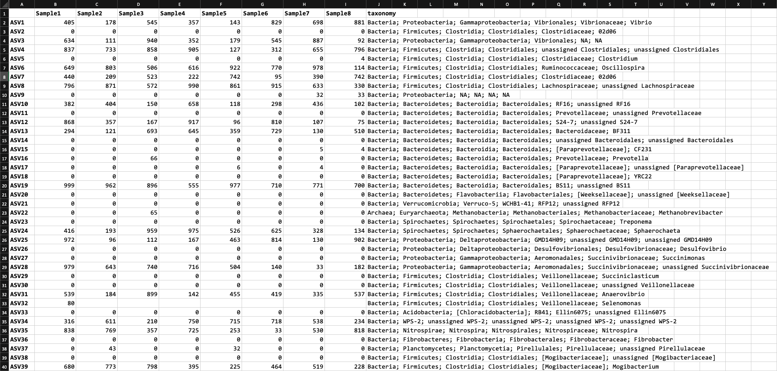
Use our count matrix/taxonomy information to do this

Slide 4
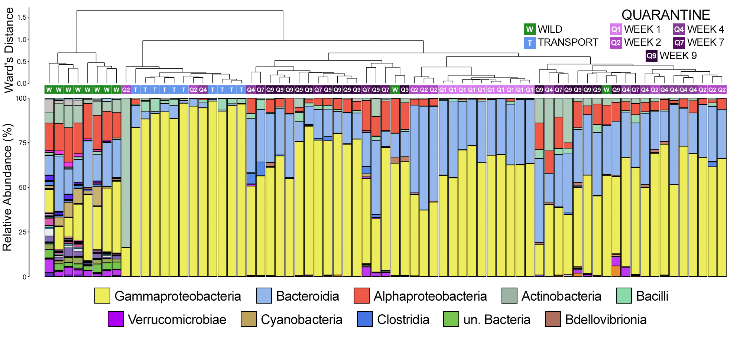
Investigate how factors influence community composition

Slide 5
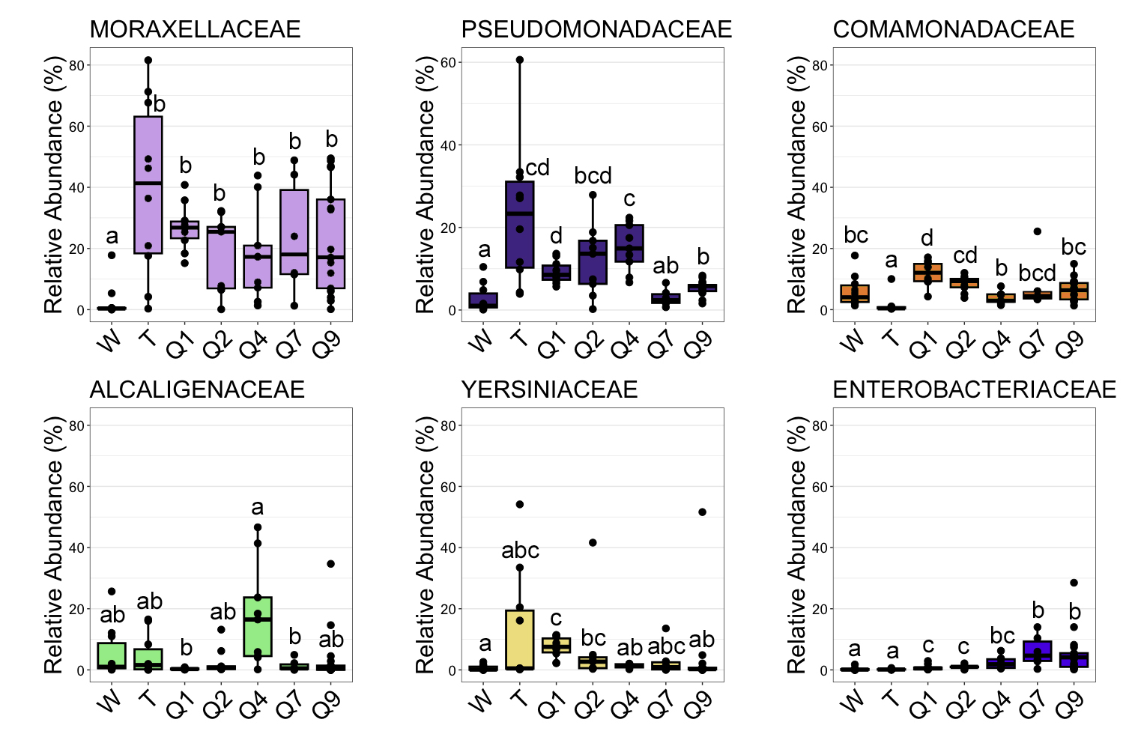
Identify taxa associated with specific factors

Slide 6
THE BASIC STEPS
Normalize our Counts
To account for different sequencing depths per sample
2. Calculate the similarity/dissimilarity
Using a measure we deem relevant/optimal
3. Ordinate our similarity/dissimilarity values
Ordinate the communities in space for visualization
4. Statistically compare composition and/or taxa RA
Determine if the difference is statistically significant

Slide 7
NORMALIZATION

Slide 8
1. NORMALIZE OUR COUNTS
To account for different sequencing depths per sample
Rarefying
Random subsampling to specific depth
2. Total Sum Scaling (TSS)
Scales counts to a number for every sample (i.e., sum within sample)
3. Cumulative Sum Scaling (CSS)
Scales the counts within each sample to the 75 percentile across all samples

Slide 9
RAREFYING
Select your sampling depth
To the lowest sequencing depth (you drop samples below your sampling depth)
Strike a balance between really low depth and losing too many samples
Randomly subsample ASVs from each sample to that depth
Now every sample has the exact same depth
BUT you’ve lost ASVs from samples with more ASVs originally

Slide 10
RAREFYING
Sample | Sequencing Depth
A | 12000
B | 10000
C | 17000
D | 43
E | 8500
Sample | Sequencing Depth
A | 8500
B | 8500
C | 8500
E | 8500
Randomly subsample to 8500
Randomly subsample to 8500
Randomly subsample to 8500
Dropped (< 8500)
No subsampling (already 8500)

Slide 11
TOTAL SUM SCALING
Calculate the total sum
Sum of all counts within a sample
Scale counts of each ASV to the total sum
Divide the count of each ASV by the total sum
Counts are now relative abundance (adding to 1)
Can also select the “sum” for each sample
The median depth
Depth of the lowest sample
Would multiply the scaled counts by the selected “sum”

Slide 12
TSS (scaled to lowest sample)
Sample | Sequencing Depth
A | 12000
B | 10000
C | 17000
D | 43
E | 8500
Sample | Sequencing Depth
A | 8500
B | 8500
C | 8500
E | 8500
Transform sum of counts to 8,500
Transform sum of counts to 8,500
Transform sum of counts to 8,500
Dropped*
Transform sum of counts to 8,500
*Dropped as a result of it clearly being a failed sequencing run
TRANSFORMED VS. RANDOM SUBSAMPLING
Notes:
MEDIAN is 11,000

Slide 13
TSS (scaled to lowest sample)
ORIGINAL COUNTS
TSS NORMALIZED COUNTS
 | Sample A | Sample B | Sample C | Sample D
ASV1 | 201 | 282 | 689 | 525
ASV2 | 102 | 761 | 715 | 57
ASV3 | 17 | 653 | 535 | 515
ASV4 | 446 | 331 | 624 | 740
ASV5 | 65 | 0 | 4 | 2
ASV6 | 592 | 791 | 860 | 697
ASV7 | 388 | 114 | 1023 | 522
ASV8 | 772 | 171 | 525 | 936
ASV9 | 926 | 643 | 820 | 91
ASV10 | 66 | 731 | 692 | 358
SUM | 3575 | 4477 | 6487 | 4443
 | Sample A | Sample B | Sample C | Sample D
ASV1 | 201 | 225.184 | 379.709 | 422.434
ASV2 | 102 | 607.678 | 394.038 | 45.864
ASV3 | 17 | 521.437 | 294.840 | 414.388
ASV4 | 446 | 264.312 | 343.888 | 595.431
ASV5 | 65 | 0 | 2.204 | 1.609
ASV6 | 592 | 631.634 | 473.948 | 560.832
ASV7 | 388 | 91.032 | 563.778 | 420.020
ASV8 | 772 | 136.548 | 289.329 | 753.140
ASV9 | 926 | 513.452 | 451.904 | 73.222
ASV10 | 66 | 583.722 | 381.363 | 288.060
SUM | 3575 | 3575 | 3575 | 3575
ASV1 in Sample A:
TSS normalized count = 201/3575 * 3575
= 201
ASV1 in Sample B:
TSS normalized count = 282/4477 * 3575
= 225.18
ASV1 in Sample C:
TSS normalized count = 689/6487 * 3575
= 379.71
ASV1 in Sample D:
TSS normalized count = 525/4443 * 3575
= 422.43
Notes:
MEDIAN is 11,000

Slide 14
CUMULATIVE SUM SCALING
Similar to TSS, but not every sample will end up with same total sum
Re-scales the samples based on a subset (75th quantile) of low abundance taxa in an attempt to reduce the impact of high abundant taxa on the normalization
Raw counts divided by the cumulative sum counts up to the 75th percentile within that sample

Slide 15
CSS (normalized to 75th quantile)
ORIGINAL COUNTS
ORIGINAL COUNTS SORTED BY ASV COUNTS
 | Sample A | Sample B | Sample C | Sample D
ASV1 | 201 | 282 | 689 | 525
ASV2 | 102 | 761 | 715 | 57
ASV3 | 17 | 653 | 535 | 515
ASV4 | 446 | 331 | 624 | 740
ASV5 | 65 | 0 | 4 | 2
ASV6 | 592 | 791 | 860 | 697
ASV7 | 388 | 114 | 1023 | 522
ASV8 | 772 | 171 | 525 | 936
ASV9 | 926 | 643 | 820 | 91
ASV10 | 66 | 731 | 692 | 358
SUM | 3575 | 4477 | 6487 | 4443
 | Sample A
ASV3 | 17
ASV5 | 65
ASV10 | 66
ASV2 | 102
ASV1 | 201
ASV7 | 388
ASV4 | 446
ASV6 | 592
ASV8 | 772
ASV9 | 926
SUM | 3575
 | Sample B
ASV5 | 0
ASV7 | 114
ASV8 | 171
ASV1 | 282
ASV4 | 331
ASV9 | 643
ASV3 | 653
ASV10 | 731
ASV2 | 761
ASV6 | 791
SUM | 4477
 | Sample C
ASV5 | 4
ASV8 | 525
ASV3 | 535
ASV4 | 624
ASV1 | 689
ASV10 | 692
ASV2 | 715
ASV9 | 820
ASV6 | 860
ASV7 | 1023
SUM | 6487
 | Sample D
ASV5 | 2
ASV2 | 57
ASV9 | 91
ASV10 | 358
ASV3 | 515
ASV7 | 522
ASV1 | 525
ASV6 | 697
ASV4 | 740
ASV8 | 936
SUM | 4443
Notes:
MEDIAN is 11,000

Slide 16
CSS (normalized to 75th quantile)
SORTED
RAW COUNTS
CUMULATIVE
SUM COUNTS
 | Sample A
ASV3 | 17
ASV5 | 65
ASV10 | 66
ASV2 | 102
ASV1 | 201
ASV7 | 388
ASV4 | 446
ASV6 | 592
ASV8 | 772
ASV9 | 926
SUM | 3575
 | Sample A
ASV3 | 17
ASV5 | 82
ASV10 | 148
ASV2 | 250
ASV1 | 451
ASV7 | 839
ASV4 | 1285
ASV6 | 1877
ASV8 | 2649
ASV9 | 3575
SUM | 3575
75th quantile = number of observations (10) * 0.75 = 7.5
Need to interpolate because it falls between 7 and 8
75th quantile = 1285 + (0.5 x (1877 – 1285))
= 1285 + 296
= 1654
70th
80th
Notes:
MEDIAN is 11,000

Slide 17
CSS (normalized to 75th quantile)
SORTED
RAW COUNTS
CUMULATIVE
SUM COUNTS
 | Sample B
ASV5 | 0
ASV7 | 114
ASV8 | 171
ASV1 | 282
ASV4 | 331
ASV9 | 643
ASV3 | 653
ASV10 | 731
ASV2 | 761
ASV6 | 791
SUM | 4477
 | Sample B
ASV5 | 0
ASV7 | 114
ASV8 | 285
ASV1 | 567
ASV4 | 898
ASV9 | 1541
ASV3 | 2194
ASV10 | 2925
ASV2 | 3686
ASV6 | 4477
SUM | 4477
75th quantile = number of observations (10) * 0.75 = 7.5
Need to interpolate because it falls between 7 and 8
75th quantile = 2194 + (0.5 x (2925 – 2194))
= 2194 + 365.5
= 2559.5
70th
80th
Notes:
MEDIAN is 11,000

Slide 18
CSS (normalized to 75th quantile)
SORTED
RAW COUNTS
CUMULATIVE
SUM COUNTS
 | Sample C
ASV5 | 4
ASV8 | 525
ASV3 | 535
ASV4 | 624
ASV1 | 689
ASV10 | 692
ASV2 | 715
ASV9 | 820
ASV6 | 860
ASV7 | 1023
SUM | 6487
 | Sample C
ASV5 | 4
ASV8 | 529
ASV3 | 1064
ASV4 | 1688
ASV1 | 2377
ASV10 | 3069
ASV2 | 3784
ASV9 | 4604
ASV6 | 5464
ASV7 | 6487
SUM | 6487
75th quantile = number of observations (10) * 0.75 = 7.5
Need to interpolate because it falls between 7 and 8
75th quantile = 3785 + (0.5 x (4604 – 3784))
= 3785 + 410
= 4195
70th
80th
Notes:
MEDIAN is 11,000

Slide 19
CSS (normalized to 75th quantile)
SORTED
RAW COUNTS
CUMULATIVE
SUM COUNTS
 | Sample D
ASV5 | 2
ASV2 | 57
ASV9 | 91
ASV10 | 358
ASV3 | 515
ASV7 | 522
ASV1 | 525
ASV6 | 697
ASV4 | 740
ASV8 | 936
SUM | 4443
 | SampleD
ASV5 | 2
ASV2 | 59
ASV9 | 150
ASV10 | 508
ASV3 | 1023
ASV7 | 1545
ASV1 | 2070
ASV6 | 2767
ASV4 | 3507
ASV8 | 4443
SUM | 4443
75th quantile = number of observations (10) * 0.75 = 7.5
Need to interpolate because it falls between 7 and 8
75th quantile = 2070 + (0.5 x (2767 – 2070))
= 2070 + 348.5
= 2418.5
70th
80th
Notes:
MEDIAN is 11,000

Slide 20
CSS (normalized to 75th quantile)
ORIGINAL COUNTS
SCALED COUNTS
 | Sample A | Sample B | Sample C | Sample D
ASV1 | 201 | 282 | 689 | 525
ASV2 | 102 | 761 | 715 | 57
ASV3 | 17 | 653 | 535 | 515
ASV4 | 446 | 331 | 624 | 740
ASV5 | 65 | 0 | 4 | 2
ASV6 | 592 | 791 | 860 | 697
ASV7 | 388 | 114 | 1023 | 522
ASV8 | 772 | 171 | 525 | 936
ASV9 | 926 | 643 | 820 | 91
ASV10 | 66 | 731 | 692 | 358
 | Sample A | Sample B | Sample C | Sample D
ASV1 | 0.1215 | 0.1102 | 0.1642 | 0.2171
ASV2 | 0.0617 | 0.2973 | 0.1704 | 0.0236
ASV3 | 0.0103 | 0.2551 | 0.1275 | 0.2129
ASV4 | 0.2696 | 0.1293 | 0.1487 | 0.3060
ASV5 | 0.0393 | 0.0000 | 0.0010 | 0.0008
ASV6 | 0.3579 | 0.3090 | 0.2050 | 0.2882
ASV7 | 0.2346 | 0.0445 | 0.2439 | 0.2158
ASV8 | 0.4667 | 0.0668 | 0.1251 | 0.3870
ASV9 | 0.5599 | 0.2512 | 0.1955 | 0.0376
ASV10 | 0.0399 | 0.2856 | 0.1650 | 0.1480
Scaling factors (cumulative sums):
Sample A = 1654
Sample B = 2559.5
Sample C = 4195
Sample D = 2418.5
ONE MORE STEP: MULTIPLY SCALED COUNTS BY MEDIAN CUMULATIVE SUM
Notes:
MEDIAN is 11,000

Slide 21
CSS (normalized to 75th quantile)
SCALED COUNTS
 | Sample A | Sample B | Sample C | Sample D
ASV1 | 0.1215 | 0.1102 | 0.1642 | 0.2171
ASV2 | 0.0617 | 0.2973 | 0.1704 | 0.0236
ASV3 | 0.0103 | 0.2551 | 0.1275 | 0.2129
ASV4 | 0.2696 | 0.1293 | 0.1487 | 0.3060
ASV5 | 0.0393 | 0.0000 | 0.0010 | 0.0008
ASV6 | 0.3579 | 0.3090 | 0.2050 | 0.2882
ASV7 | 0.2346 | 0.0445 | 0.2439 | 0.2158
ASV8 | 0.4667 | 0.0668 | 0.1251 | 0.3870
ASV9 | 0.5599 | 0.2512 | 0.1955 | 0.0376
ASV10 | 0.0399 | 0.2856 | 0.1650 | 0.1480
Multiply by the dynamically calculated median of cumulative sums
Cumulative sums = 1654, 2418.5, 2559.5, 4195
Median = (2418.5 + 2559.5) / 2
= 2489
Notes:
MEDIAN is 11,000

Slide 22
CSS (normalized to 75th quantile)
SCALED COUNTS
CSS NORMALIZED COUNTS
 | Sample A | Sample B | Sample C | Sample D
ASV1 | 0.1215 | 0.1102 | 0.1642 | 0.2171
ASV2 | 0.0617 | 0.2973 | 0.1704 | 0.0236
ASV3 | 0.0103 | 0.2551 | 0.1275 | 0.2129
ASV4 | 0.2696 | 0.1293 | 0.1487 | 0.3060
ASV5 | 0.0393 | 0.0000 | 0.0010 | 0.0008
ASV6 | 0.3579 | 0.3090 | 0.2050 | 0.2882
ASV7 | 0.2346 | 0.0445 | 0.2439 | 0.2158
ASV8 | 0.4667 | 0.0668 | 0.1251 | 0.3870
ASV9 | 0.5599 | 0.2512 | 0.1955 | 0.0376
ASV10 | 0.0399 | 0.2856 | 0.1650 | 0.1480
 | Sample A | Sample B | Sample C | Sample D
ASV1 | 302.41 | 274.29 | 408.69 | 540.36
ASV2 | 153.57 | 739.98 | 424.13 | 58.74
ASV3 | 25.64 | 634.94 | 317.35 | 529.91
ASV4 | 671.03 | 321.83 | 370.11 | 761.63
ASV5 | 97.82 | 0.00 | 2.49 | 1.99
ASV6 | 890.81 | 769.10 | 510.25 | 717.33
ASV7 | 583.92 | 110.76 | 607.07 | 537.13
ASV8 | 1161.62 | 166.27 | 311.37 | 963.24
ASV9 | 1393.59 | 625.24 | 486.60 | 93.59
ASV10 | 99.31 | 710.86 | 410.69 | 368.37
Multiply each count by 2489
Notes:
MEDIAN is 11,000

Slide 23
CSS (normalized to 75th quantile)
ORIGINAL COUNTS
CSS NORMALIZED COUNTS
 | Sample A | Sample B | Sample C | Sample D
ASV1 | 201 | 282 | 689 | 525
ASV2 | 102 | 761 | 715 | 57
ASV3 | 17 | 653 | 535 | 515
ASV4 | 446 | 331 | 624 | 740
ASV5 | 65 | 0 | 4 | 2
ASV6 | 592 | 791 | 860 | 697
ASV7 | 388 | 114 | 1023 | 522
ASV8 | 772 | 171 | 525 | 936
ASV9 | 926 | 643 | 820 | 91
ASV10 | 66 | 731 | 692 | 358
SUM | 3575 | 4477 | 6487 | 4443
 | Sample A | Sample B | Sample C | Sample D
ASV1 | 302.41 | 274.29 | 408.69 | 540.36
ASV2 | 153.57 | 739.98 | 424.13 | 58.74
ASV3 | 25.64 | 634.94 | 317.35 | 529.91
ASV4 | 671.03 | 321.83 | 370.11 | 761.63
ASV5 | 97.82 | 0.00 | 2.49 | 1.99
ASV6 | 890.81 | 769.10 | 510.25 | 717.33
ASV7 | 583.92 | 110.76 | 607.07 | 537.13
ASV8 | 1161.62 | 166.27 | 311.37 | 963.24
ASV9 | 1393.59 | 625.24 | 486.60 | 93.59
ASV10 | 99.31 | 710.86 | 410.69 | 368.37
SUM | 5379.72 | 4353.26 | 3848.74 | 4572.29
Notes:
MEDIAN is 11,000

Slide 24
β-DIVERSITY METRICS
Comparing composition (normalized counts for each ASV) between communities

Slide 25
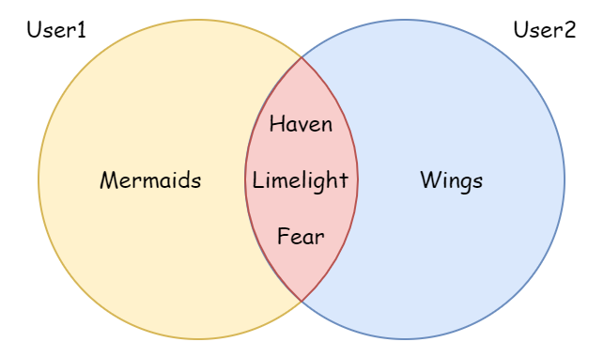

Jaccard Index
Similarity between two samples based on presence/absence
$$Jaccard\left(A,B\right)=\frac{|A∩B|}{|A∪B|}=\frac{|A∩B|}{\left|A\right|+\left|B\right|+|A∩B|}$$
$=$ $\frac{3}{\left|1\right|+\left|1\right|+|3|}$
$=$ $\frac{3}{5}$
$=0.6$
Jaccard distance = 1- Jaccard index
dissimilarity

Slide 26
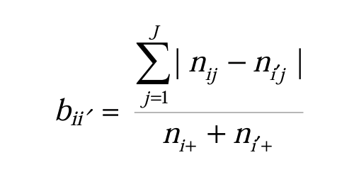
Bray-Curtis Dissimilarity
Dissimilarity between two communities based on the abundance of each species present
Sum of the absolute differences between the counts divided by the sum of the total abundances in the two samples
Fig 1. The “mathy” way of defining it

Slide 27
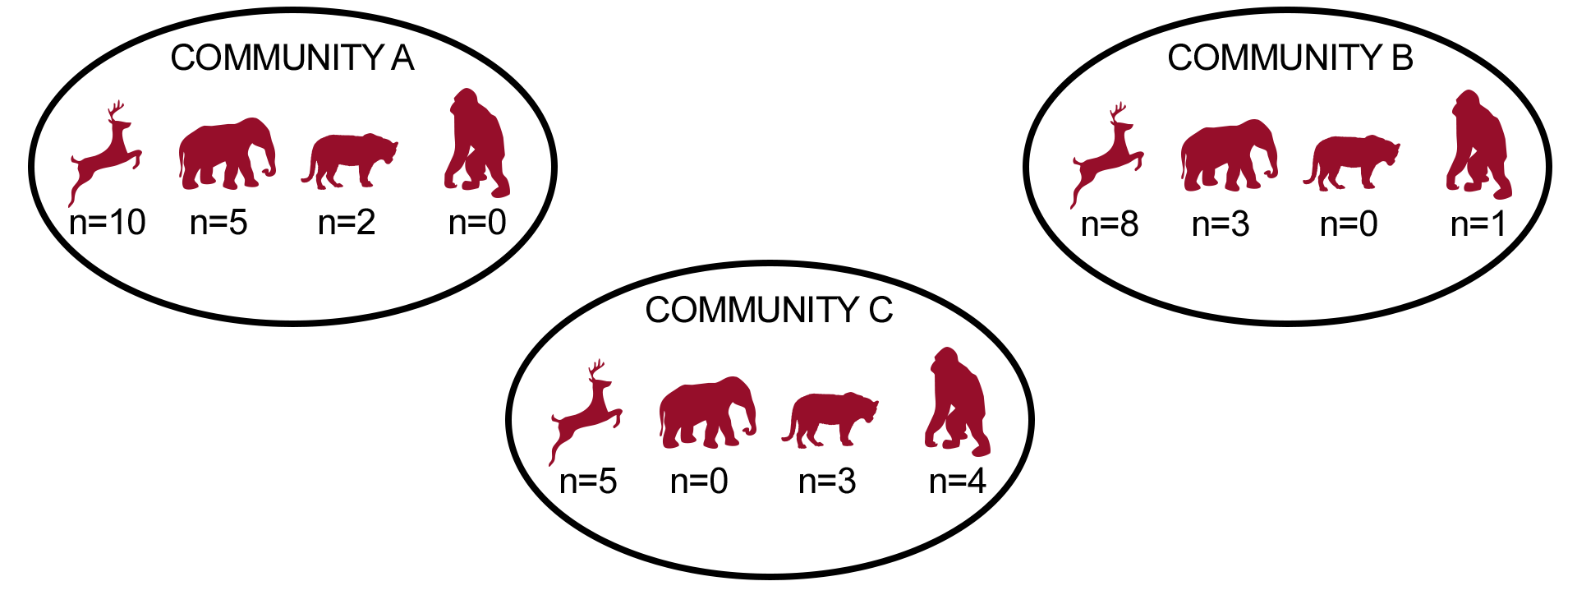
 | Community A | Community B | Community C
Species A | 10 | 8 | 5
Species B | 5 | 3 | 0
Species C | 2 | 0 | 3
Species D | 0 | 1 | 4

Slide 28
BRAY-CURTIS
 | Community A | Community B | Community C
Species A | 10 | 8 | 5
Species B | 5 | 3 | 0
Species C | 2 | 0 | 3
Species D | 0 | 1 | 4
Step 1. Calculate absolute differences in abundance between communities
COMMUNITY A VS. B
Species A: |10-8| = 2
Species B: |5-3| = 2
Species C: |2-0| = 2
Species D: |0-1| = 1
COMMUNITY A VS. C
Species A: |10-5| = 5
Species B: |5-0| = 5
Species C: |2-3| = 1
Species D: |0-4| = 4
COMMUNITY B VS. C
Species A: |8-5| = 3
Species B: |3-0| = 3
Species C: |0-3| = 3
Species D: |1-4| = 3

Slide 29
BRAY-CURTIS
COMMUNITY A VS. B
Species A: |10-8| = 2
Species B: |5-3| = 2
Species C: |2-0| = 2
Species D: |0-1| = 1
COMMUNITY A VS. C
Species A: |10-5| = 5
Species B: |5-0| = 5
Species C: |2-3| = 1
Species D: |0-4| = 4
COMMUNITY B VS. C
Species A: |8-5| = 3
Species B: |3-0| = 3
Species C: |0-3| = 3
Species D: |1-4| = 3
Step 2. Sum the absolute differences for each pair
COMMUNITY A VS. B
2 + 2 + 2 + 1 = 7
COMMUNITY A VS. B
5 + 5 + 1 + 4 = 14
COMMUNITY B VS. C
3 + 3 + 3 + 3 = 12

Slide 30
BRAY-CURTIS
 | Community A | Community B | Community C
Species A | 10 | 8 | 5
Species B | 5 | 3 | 0
Species C | 2 | 0 | 3
Species D | 0 | 1 | 4
Step 3. Calculate total abundance of all species in both samples
COMMUNITY A VS. B
Total abundance A= 10 + 5 + 2 + 0 = 17
Total abundance B= 8 + 3 + 0 + 1 = 12
COMMUNITY A VS. C
Total abundance A= 10 + 5 + 2 + 0 = 17
Total abundance C= 8 + 3 + 0 + 1 = 12
COMMUNITY B VS. C
Total abundance B= 8 + 3 + 0 + 1 = 12
Total abundance C= 5 + 0 + 3 + 4 = 12

Slide 31
BRAY-CURTIS
COMMUNITY A VS. B
Absolute differences in abundance:
2 + 2 + 2 + 1 = 7
COMMUNITY A VS. B
Absolute differences in abundance:
5 + 5 + 1 + 4 = 15
COMMUNITY B VS. C
Absolute differences in abundance:
3 + 3 + 3 + 3 = 12
COMMUNITY A VS. B
Total abundance A= 10 + 5 + 2 + 0 = 17
Total abundance B= 8 + 3 + 0 + 1 = 12
COMMUNITY A VS. C
Total abundance A= 10 + 5 + 2 + 0 = 17
Total abundance C= 8 + 3 + 0 + 1 = 12
COMMUNITY B VS. C
Total abundance B= 8 + 3 + 0 + 1 = 12
Total abundance C= 5 + 0 + 3 + 4 = 12
Step 4. Calculate Bray-Curtis Dissimilarity
BC(A,B) = 7 / (17 + 12)
= 7/29
= 0.241
BC(A,C) = 15/ (17 + 12)
= 15/29
= 0.517
BC(B,C) = 12/ (12 + 12)
= 12/24
= 0.500

Slide 32
BRAY-CURTIS
 | Comm. A | Comm. B | Comm. C
Comm A.
Comm. B | 0.241
Comm. C | 0.517 | 0.500

Slide 33
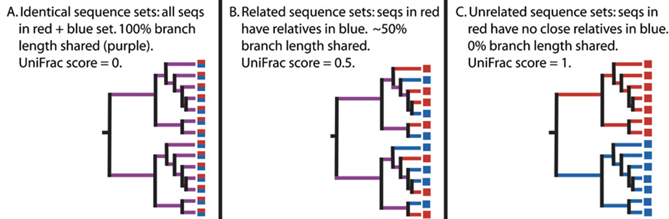
UniFrac Distance
Dissimilarity between two communities based on the fraction of the tree that is unique to one community or the other in each pair of communities in a shared phylogenetic tree
Sample A = Red
Sample B = Blue
Unique Fraction → UniFrac

Slide 34
Unweighted UniFrac
Presence/absence + shared branches in a tree
MORE EMPHASIS ON RARE TAXA
Weighted UniFrac
Abundance + shared branches in a tree
MORE EMPHASIS ON DOMINANT TAXA
Generalized UniFrac
Down-weighted (0-1) abundance + shared branches in a tree
ATTEMPTS TO LIMIT EMPHASIS ON DOMINANT OR RARE TAXA

Slide 35
ORDINATION
Visualize the dissimilarities between communities

Slide 36
NMDS vs. PCoA
Non-metric multidimensional scaling
Principal Co-ordinates Analysis
Non-metric: preserves the “rank-order”** of the distances rather than the actual distances
Should be used when measures between samples are not directly interpretable as distances (i.e., Jaccards, UniFrac)
Advantageous when data is qualitative (presence/absence) or when the assumption of linearity is not met/questionable
Example: dramatic shifts in community structure in response to changing environmental conditions
stress assessment= how well it represents original distances
Metric: preserves the actual distances between communities
Should be used when distances between samples can be represented as Euclidean distances or similar (i.e., Bray-Curtis)
If the relationship between variables are linear
Example: gradual/linear change in composition as pH changes

Slide 37
WHAT IS “RANK-ORDER”?
The relative ordering of distances between pairs of communities in the data set
Dissimilarity distances are ranked from smallest (rank #1) to largest
NMDS aims to find a low-dimensionality representation of the data that preserves these ranks
Communities with the highest rank (most dissimilar) should remain far apart and vice-versa
Goodness-of-fit of the reduced dimensionality is assessed using stress values
Lower stress values = better fit = the rank-order is better preserved

