Slide 1
Differential abundance testing for bioinformatic data

Slide 2
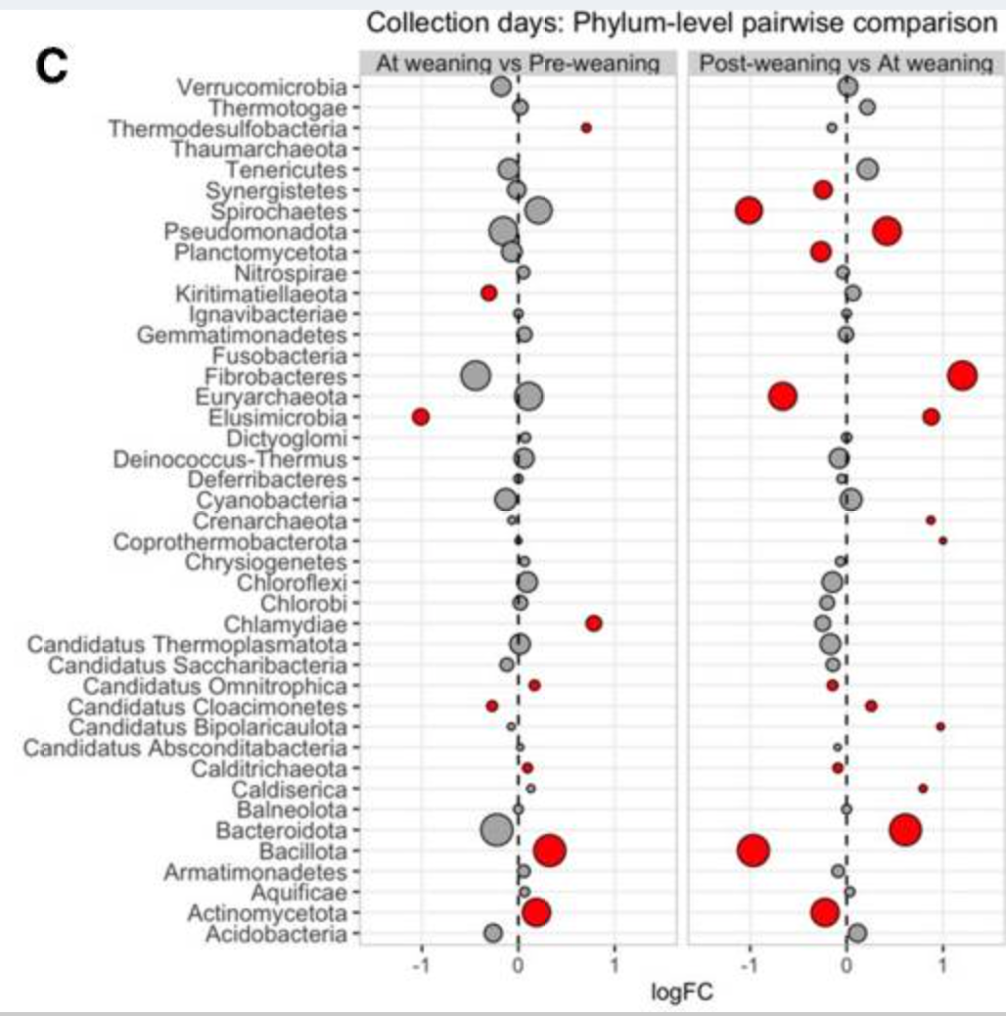
What is differential abundance?

Slide 3
“All models are wrong, some are useful.” –George Box

Slide 4
Learning objectives
Describe how differential abundance (DA) modeling tests which taxa are significantly different between groups (e.g. treatment, host, etc)
Be able to describe how count data is “compositional” and “sparse”, and why this influences our decision making
Understand the balance between type 1 and type 2 error based on your model selection for DA
Describe the 3 most common categories of statistical methods used

Slide 5
Outline
Review types of analyses you’ve learned so far
Review typical model selection
Sequencing data considerations
My recommendation : ANCOM-BC2
Hands-on activity in R

Slide 6
Starting from count data, we want to analyze:
Analysis type | Goal | Response variable | Example test
Alpha diversity | Compare richness and evenness | 1 diversity index per sample | Wilcox
Beta diversity | Compare community structure | Differences between samples | PERMANOVA
Differential abundance testing | Compare differences in taxa abundance | Counts/abundance of taxa | ANCOMBC

Slide 7
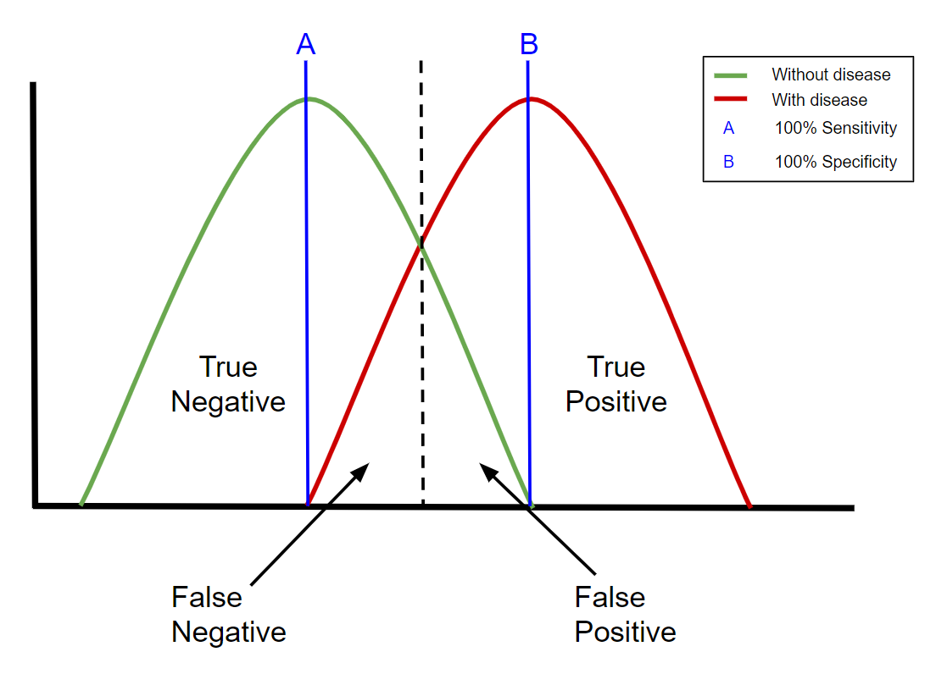
What do we want from a statistical test?
Accounts for data structure
Controls for multiple comparisons (100s of taxa)
Must balance Sensitivity vs Specificity

Slide 8
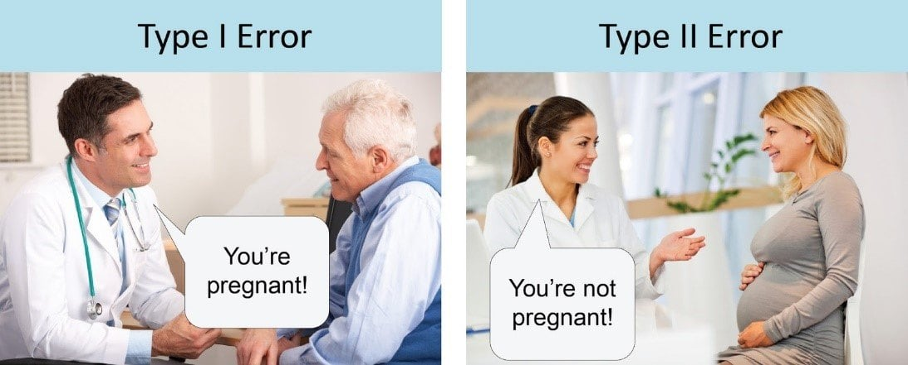
What do you prioritize? Type 1 error: reporting a difference, when there isn’t Type 2 error: reporting no difference, when there is
“it’s significant!”
“no significant findings”
Image source: unbiasedresearch.blogspot.com

Slide 9
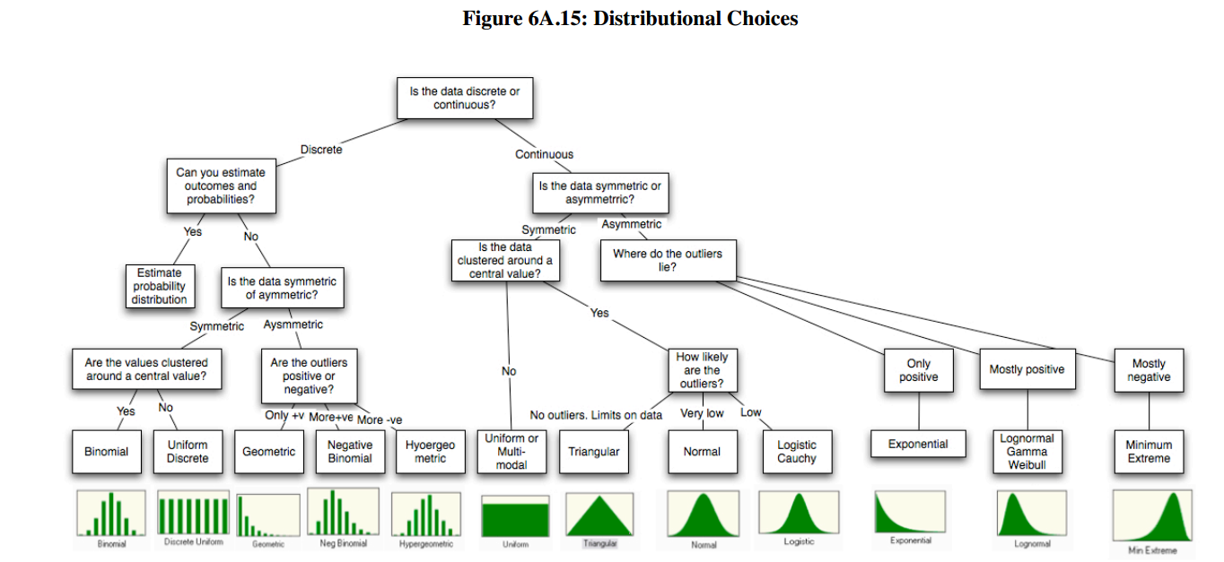
What model should we choose?
Image source: nyu.edu/adamodar

Slide 10
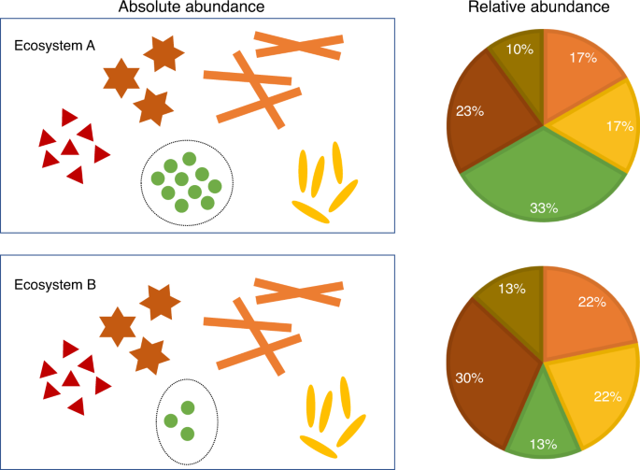
Extra considerations for sequencing data
“Count data”
Count data is typically modeled with a Poisson distribution
Sequencing count data is different
Microbiome Datasets Are Compositional: And This Is Not Optional
Zero-inflated/sparse
Lots of features have 0’s
Compositional due to a finite amount of sequencing
Changes in one taxa, affect the others
Image source: https://www.nature.com/articles/s41467-020-17041-7

Slide 11
What options do we have?
Microbiome differential abundance methods produce different results across 38 datasets (Langille et. al. 2022)
In my opinion, I prefer a conservative approach that minimizes Type 1 error and accounts for sequencing count data structure
Current recommendation: Analysis of Compositions of Microbiomes with Bias Correction 2 (ANCOM-BC2)
Takes raw counts (not normalized)
Models the log ratios between features
Runs sensitivity analysis to reduce false positive results
Flexible model creation (repeated measures, random variables, interactions, etc)

Slide 12
ANCOMBC2
Takes raw counts (not normalized)
Models the log ratios between features (instead of counts)
Flexible model creation (repeated measures, random variables, interactions, etc)
Reduces Type1 error with sensitivity test and FDR
Identifies “structural zeros” (only present in one group)

Slide 13
Hands-on activity for differential abundance
We’ll use the R package “testDA” to run multiple types of differential abundance tests
Then, we’ll run the ANCOM-BC2 model on it’s own

