Slide 1
Concepts around microbiome data and statistical considerations

Slide 2
Learning objectives
Understand that answering your research question likely requires using various analytic and statistical methods
Be able to describe typical characteristics of count data (what are rows vs columns, sparse, compositional, etc.)
Understand typical considerations for cleaning up count data

Slide 3
Outline
What is a count table?
What is unique about a sequencing count data?
Sparse
Multidimensional
Compositional
What are some techniques to overcome these challenges?
Transformation
Dimension reduction
Model selection

Slide 4
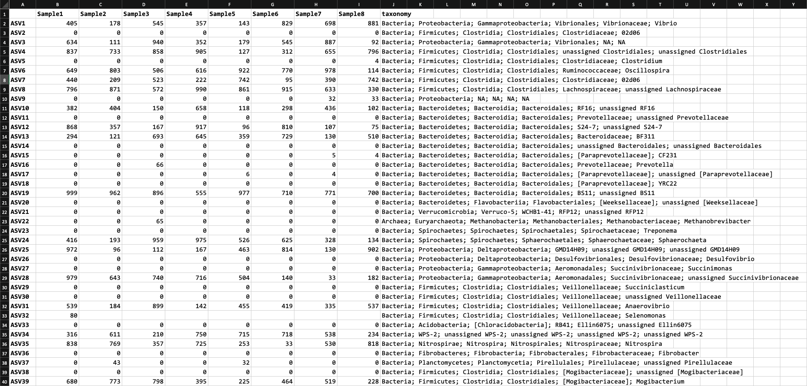
The “count table”

Slide 5
Sparsity = lots of zeros

Slide 6
Transformation of count data
For some analyses, we can perform Hellinger transformation to convert taxa abundances from absolute to relative values (i.e. standardizes the abundances to sample totals) and then square roots them.
This decreases the impact of highly abundant features
Some research questions might require transformation to determine the presence/absence of each taxa

Slide 7
Multidimensional data – how to compare across 100s of taxa?

Slide 8
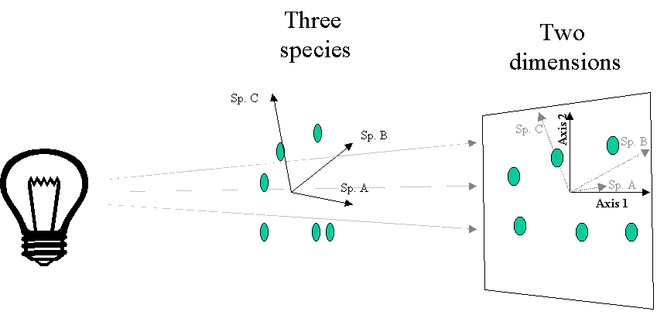
Simplified example
https://ordination.okstate.edu/overview.htm

Slide 9
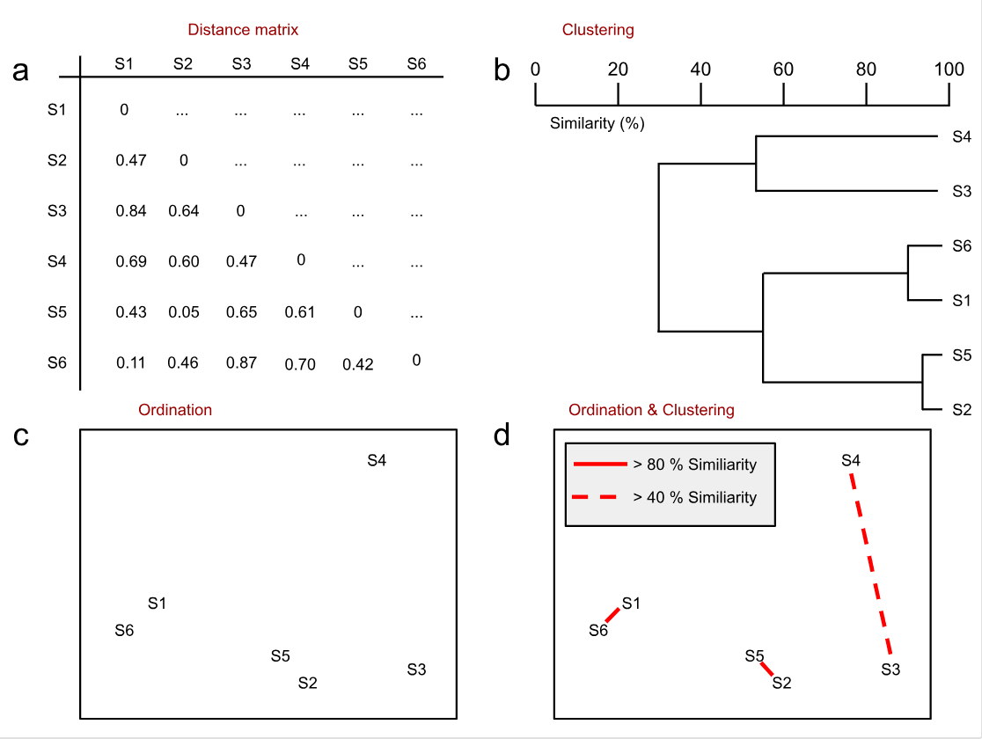
Dimension reduction - Ordination
We can use dissimilarity indices (beta diversity) and ordination to visualize the differences between all samples
Then, we can use ordination to view results in 2 dimensions
Testing is not done on ordination
https://sites.google.com/site/mb3gustame/dissimilarity-based-methods/cluster-analysis-ordination

Slide 10
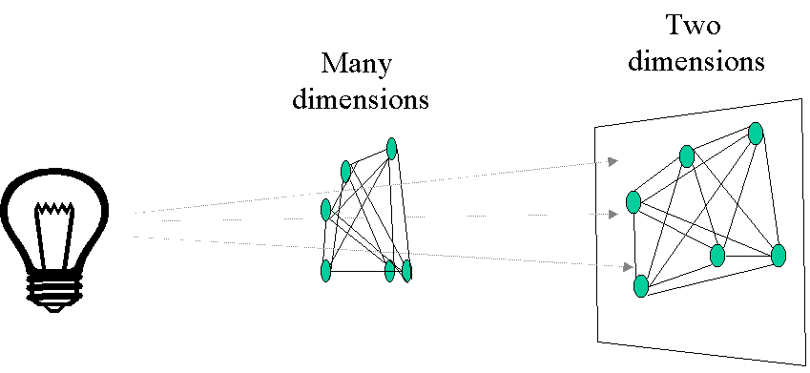
More realistically, with distances between samples
https://ordination.okstate.edu/overview.htm

Slide 11
Compositional = counts are out of 100% for each sample

Slide 12
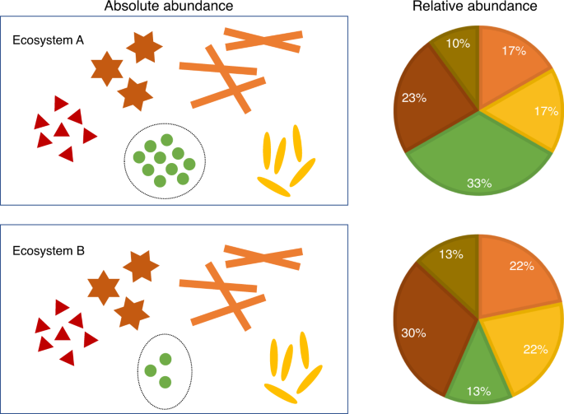
Modeling sequencing count data for differential abundance
“Count data”
Count data is typically modelled with a Poisson distribution
Sequencing count data is different
Microbiome Datasets Are Compositional: And This Is Not Optional
Zero-inflated/sparse
Lots of features have 0’s
Compositional due to a finite amount of sequencing
Changes in one taxa, affect the others
Image source: https://www.nature.com/articles/s41467-020-17041-7

Slide 13
What strategies can we employ?
Differences in sequencing depth
Normalization
Sparse counts
Transformation, Filtering
Multidimensional data
Ordination
Compositional data
Model selection

Slide 14
Thoughts on interpreting results from multiple tests
Each test we run contributes to our analyses and tells us something slightly different about our data
It’s important to keep in mind what your research question is and what tests help you get there.
For example:
Does antimicrobial treatment affect microbiome composition = ordination
Which taxa were affected by antimicrobial treatment = differential abundance

