Slide 1
Demultiplexing
Quality Control
Generating ASVs
Assigning Taxonomy
Data Analysis

Slide 2
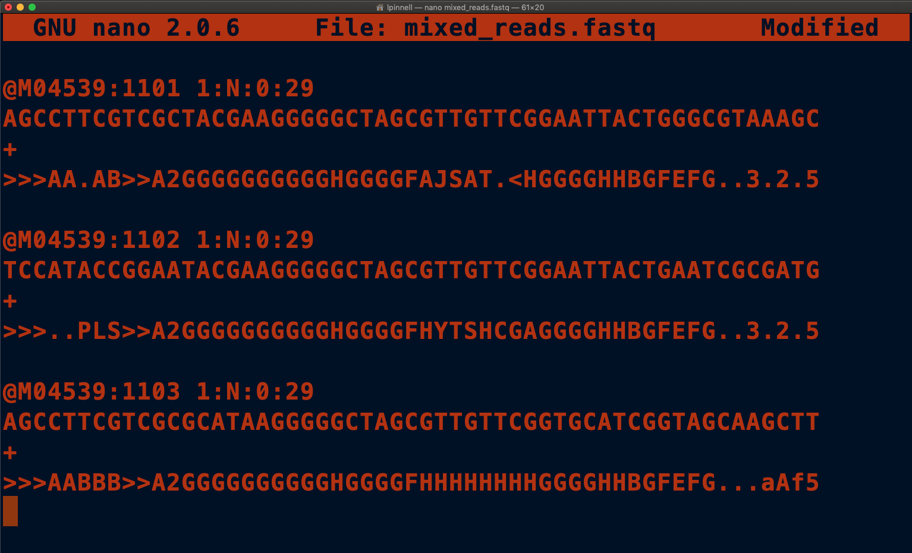
Fresh off the sequencer!

Slide 3
Step 1: Demultiplexing
Sample ID
Sample A
Sample B
Barcode
AGCCTT
TCCATA

Slide 4
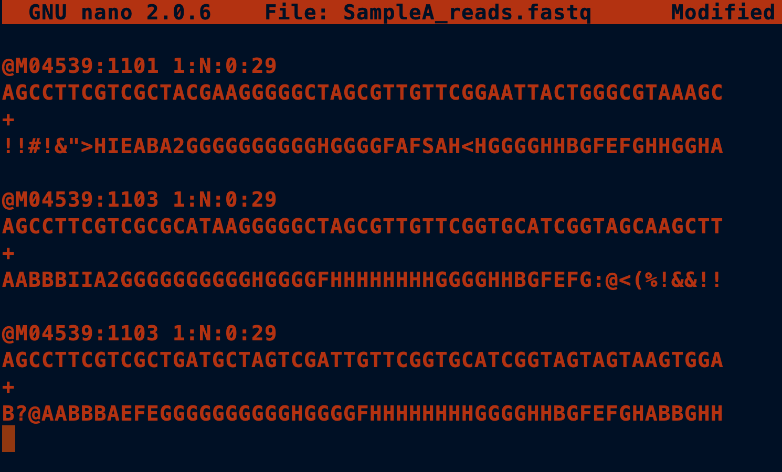
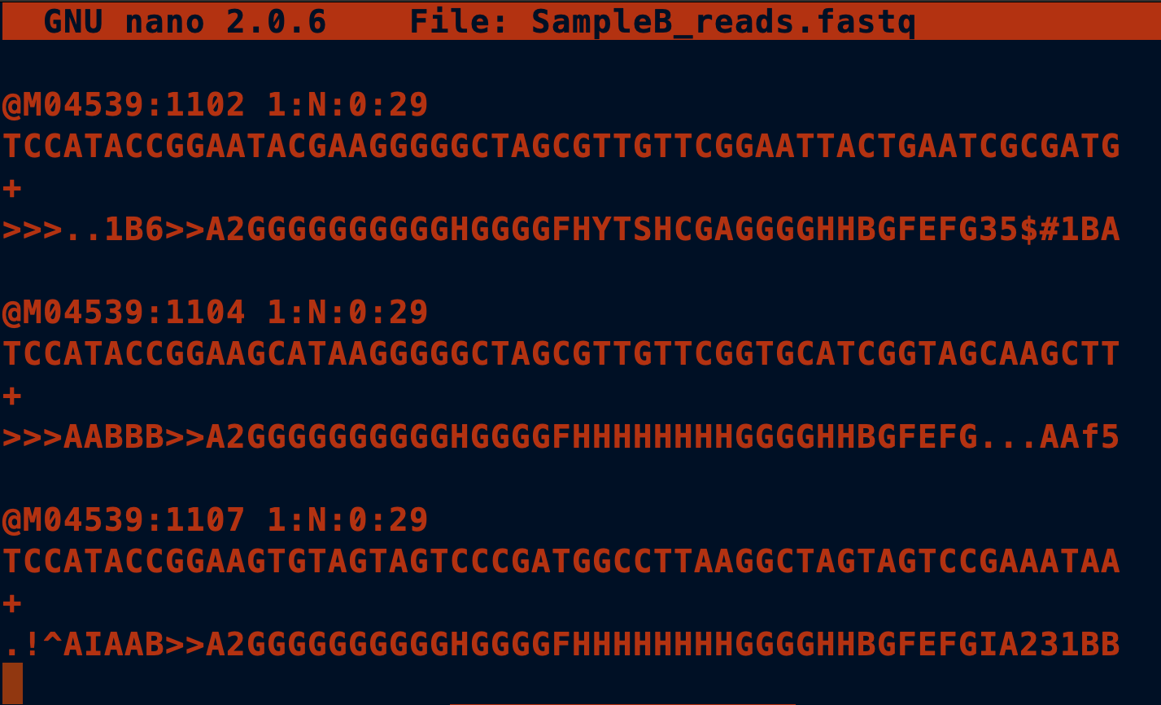
Step 1: Demultiplexing

Slide 5
Step 2: Quality Control

Slide 6
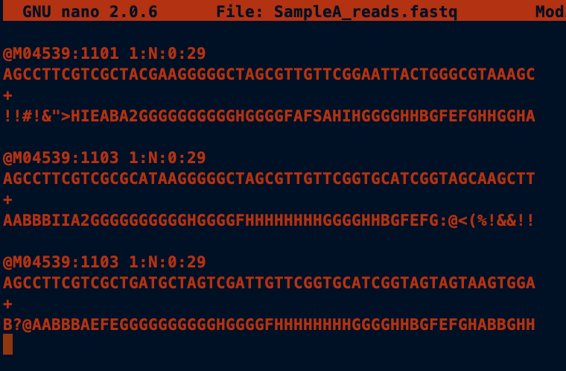
Step 2: Quality Control

Slide 7
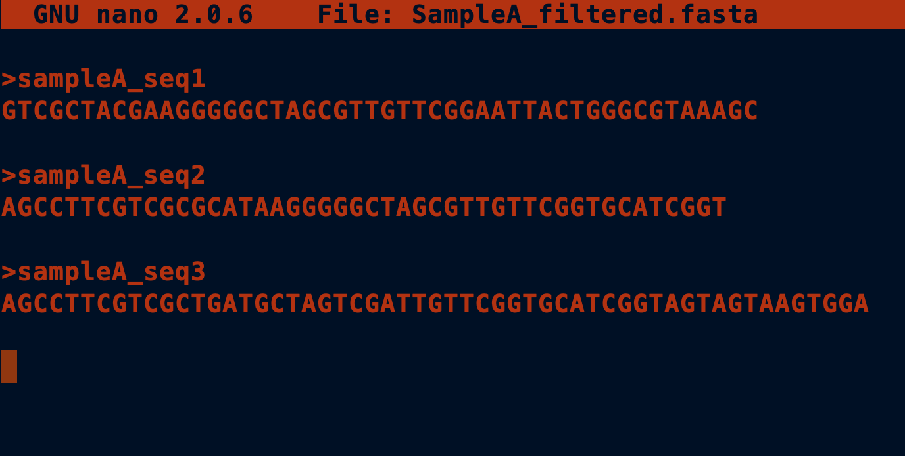
Step 2: Quality Control
PRE (FASTQ)
POST (FASTA)

Slide 8
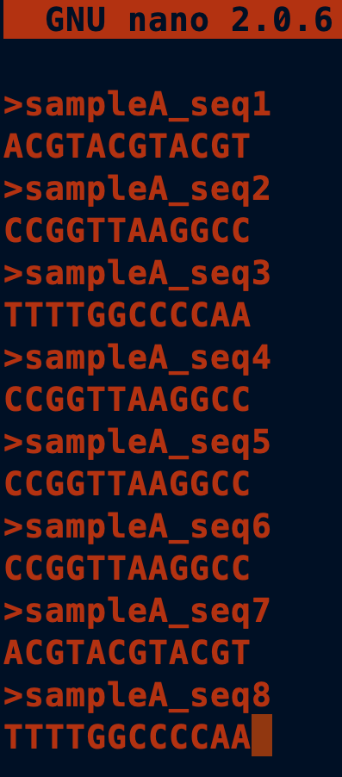
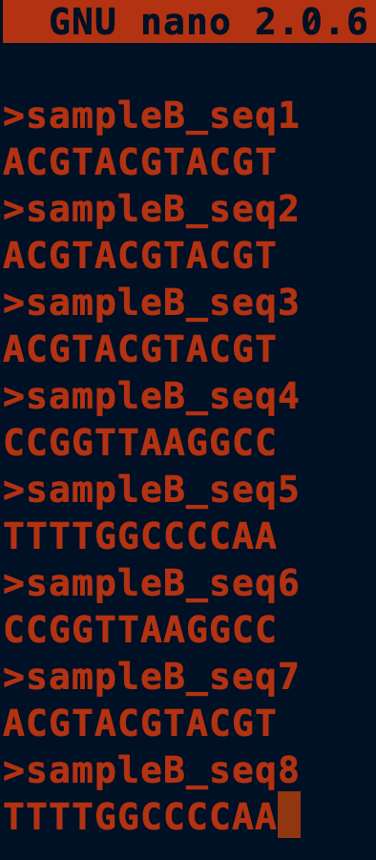
Step 3: OTU Table
OTU ID | Sample A | Sample B
OTUID1 | 0.25 | 0.50
OTUID2 | 0.50 | 0.25
OTUID3 | 0.25 | 0.25

Slide 9
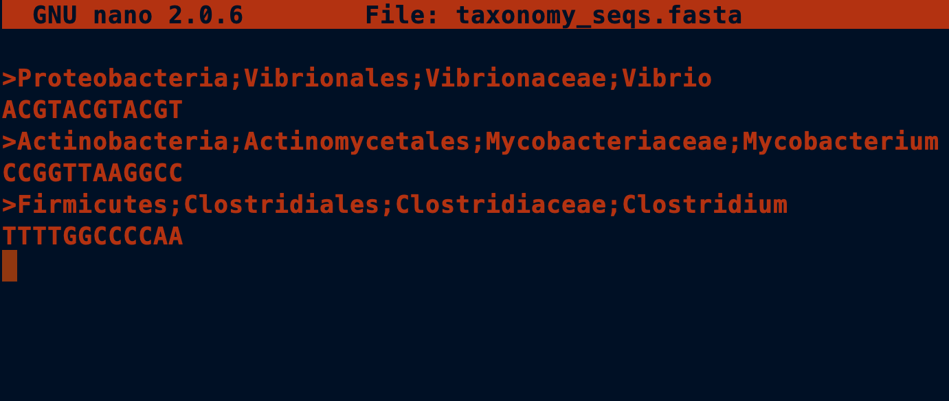
Step 4: Taxonomy

Slide 10
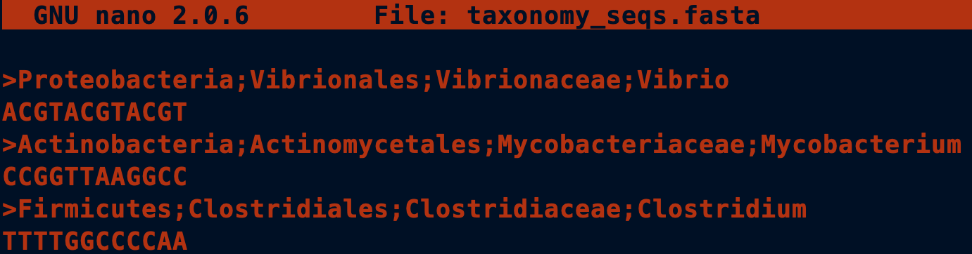
Step 4: Taxonomy
OTU ID | Taxonomy | Sample A | Sample B
OTUID1 | Vibrio | 0.25 | 0.50
OTUID2 | Mycobacterium | 0.50 | 0.25
OTUID3 | Clostridium | 0.25 | 0.25

Slide 11
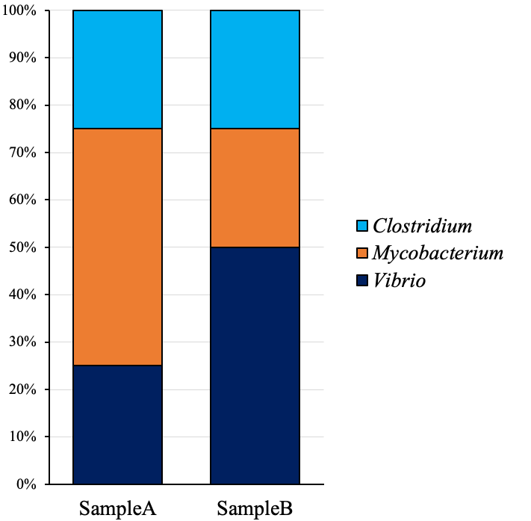
Step 5: Data Analysis

