Slide 1
Differential abundance testing for bioinformatic data
A discussion led by Enrique Doster (enriquedoster@tamu)
VLCS 689

Slide 2
Key take-aways
Differential abundance testing tells you which taxa are significantly different between groups (e.g. treatment, “animals”)
Sequencing count data is “compositional” and “sparse”, which requires certain statistical considerations
“All models are wrong, some are useful.” –George Box

Slide 3
Outline
Review types of analyses you’ve learned so far
Review model selection
Sequencing data considerations
My recommendation : ANCOM-BC2
Hands-on activity in R

Slide 4
Starting from count data, we want to analyze:
 | Goal | Response variable | Example test
Alpha diversity | Compare richness and evenness | 1 diversity index per sample | Wilcox
Beta diversity | Compare community structure | Differences between samples | PERMANOVA
Differential abundance testing | Compare differences in taxa abundance | Counts/abundance of taxa | ANCOMBC

Slide 5
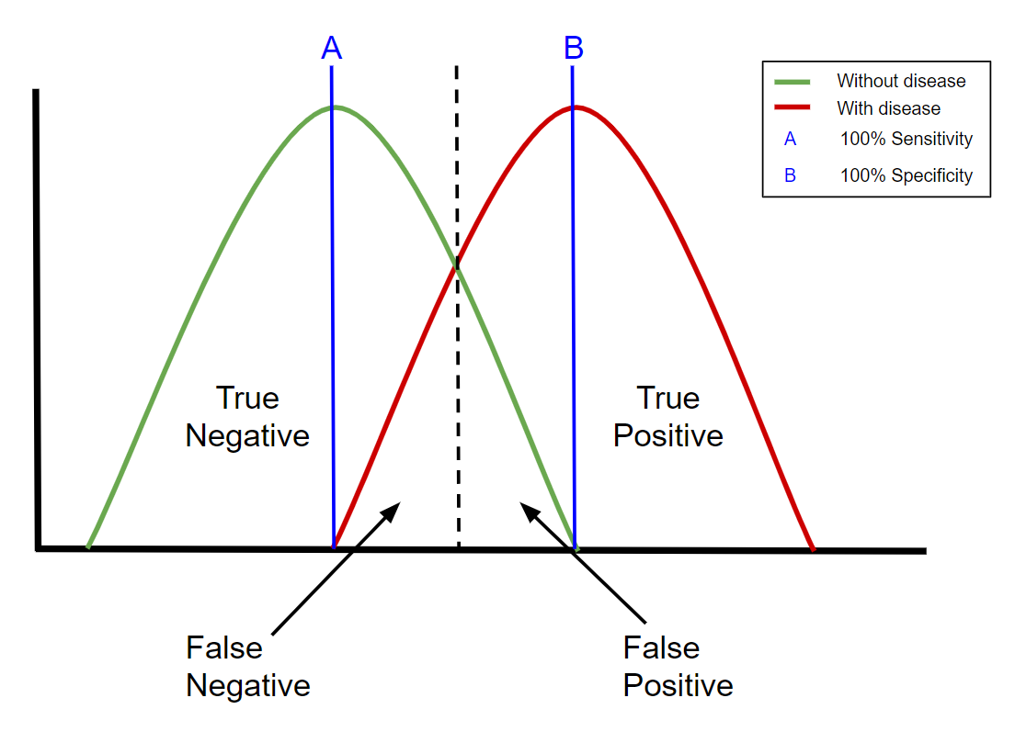
What do we want from a statistical test?
Accounts for data structure
Controls for multiple comparisons (100s of taxa)
Must balance Sensitivity vs Specificity

Slide 6
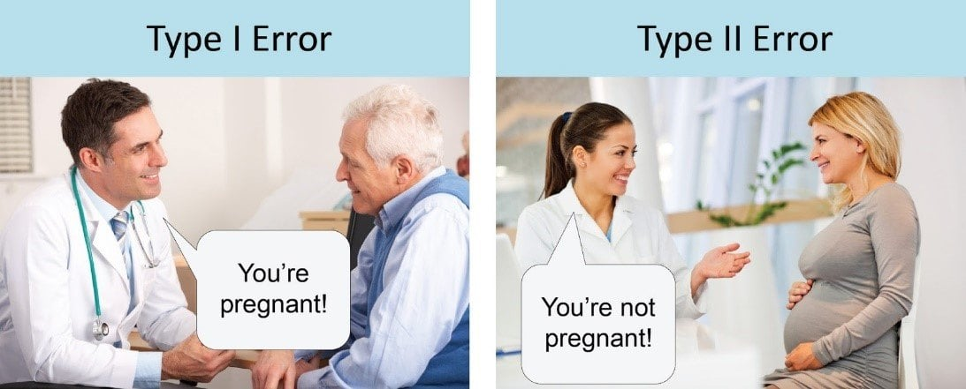
What do you prioritize? Type 1 error: reporting a difference, when there isn’t Type 2 error: reporting no difference, when there is
“it’s significant!”
“no significant findings”

Slide 7
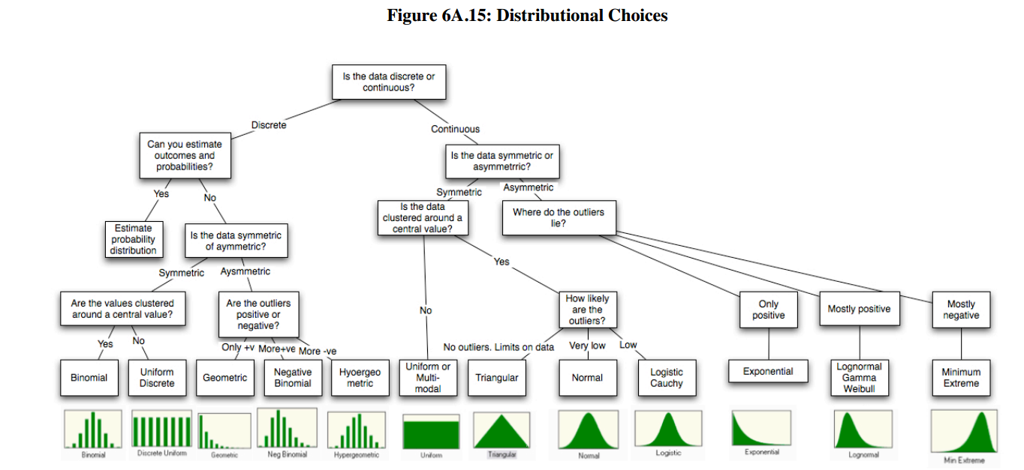
What model should we choose?

Slide 8
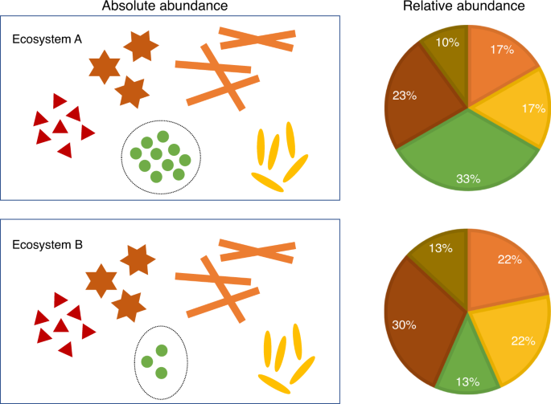
Considerations for sequencing data
“Count data”
Typical count data can be modeled with a Poisson distribution
Sequencing count data is different
Microbiome Datasets Are Compositional: And This Is Not Optional
Zero-inflated/sparse
Lots of features have 0’s
Compositional due to a finite amount of sequencing
Changes in one taxa, affect the others

Slide 9
What options do we have?
Microbiome differential abundance methods produce different results across 38 datasets (Langille et. al. 2022)
In my opinion, I prefer a conservative approach that minimizes Type 1 error and accounts for sequencing count data structure
Current recommendation: Analysis of Compositions of Microbiomes with Bias Correction 2 (ANCOM-BC2)
Takes raw counts (not normalized)
Models the log ratios between features
Runs sensitivity analysis to reduce false positive results
Flexible model creation (repeated measures, random variables, interactions, etc)

Slide 10
Hands-on activity for today
We’ll use the R package “testDA” to run multiple types of differential abundance tests
Then, we’ll run the ANCOM-BC2 model as I currently use it
Finally, we’ll explore the effect of removing “sparse” features

Slide 11
Reach out for any questions!
enriquedoster@tamu

