Slide 1
Frogger (for the Spartan 3E-500 development board)
ECE 525.442 FPGA Microprocessor Design
Erik Lee, Edward Jones, Emily Kan

Slide 2
Outline
Introduction
Background
Design
Implementation & Verification
Results & Analysis
Conclusion
References

Slide 3
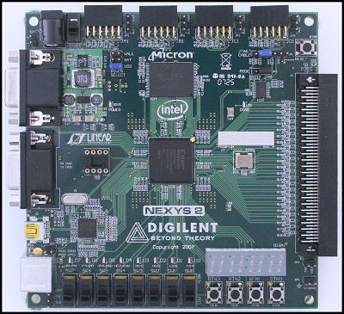
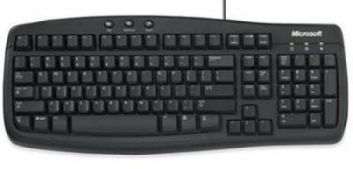
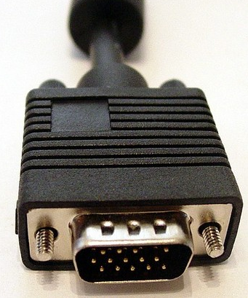
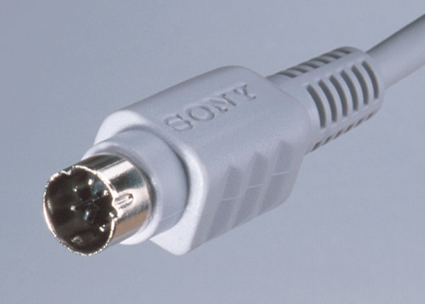
Introduction

Slide 4
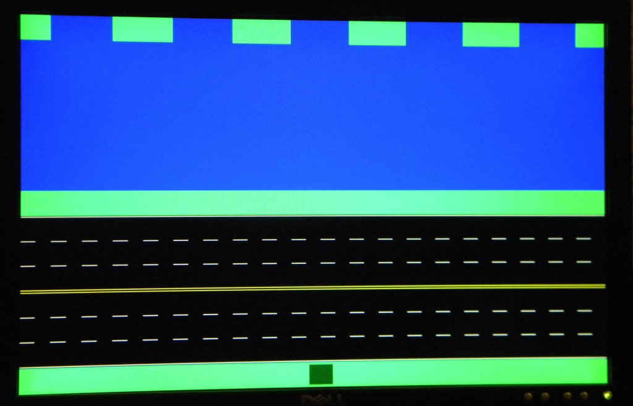
Background VGA controller
640
Display 640 x 480
50MHz board clock → 25MHz pixel clock
Horizontal sync and Vertical sync pulses driven by 25MHz clock
8-bit color vector
2-bit blue
3-bit green
3-bit red
480
Game Module
Horizontal sync
Vertical sync
Red
Green
Blue
VGA Port
Hsync
Vsync
Red
Green
Blue

Slide 5
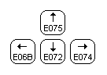
Background PS/2 Keyboard
Component Instantiation of
PS/2 driver core given
Basic connection and logic
Output clock to keyboard
Input keypress data from keyboard (11-bits)
Map data to frog direction
Keyboard
Data
Clock
PS/2 Module
Data
Clock
Up | Down | Left | Right
Game Module

Slide 6
Design Overview
Block Diagram
Object generator
Frog generator
Background generator
Frog Location
Collision Detection – Implements Rules and Interactions

Slide 7
Design
Structure of Frogger
Background
Road
Grass
River
Objects
Cars
Logs
Frog

Slide 8
Game Layout
Erik
Structure of the game
Background
Objects
Images of early stages of the game
Images of final product of the game

Slide 9
Design Rules Implementation
Finite State Machine - Mealy
Define outputs
Dead
Reset
On a log
Define inputs
Object colors
Background colors
Frog position
Define states
Define transitions (interactions with objects and background)
Notes:
Finite State Machine – 5 states
Define Outputs:
Flag when frog is hit by a car
Flag when frog is on a log
Flag for resetting frog back to homebase
Define Inputs:
4 corners of frog (xy-pixel)
Object color
Background color
Frog Position
Define states:
5 states – onGrass, onRoad, onRiver, Dead, Win
Transitions

Slide 10
Design Finite State Machine Diagram
All
Bgcolor=green/
Dead=‘0’
All Bgcolor=black /
Dead=‘0’
Any Objcolor/=black /
Dead=‘0’
onRoad_state
Any Bgcolor=black /
Dead=‘0’
All Bgcolor=green/
Dead=‘0’
onGrass_state
dead_state
Counter>=3secs/
Dead=‘0’ Reset=‘1’
All Bgcolor=blue /
Dead=‘0’
All objcolor=black/
Dead=‘0’
Counter>=3secs/
Reset=‘1’
Any objcolor=green and Row=0 /
Dead=‘0’
Counter< 3secs /
Dead=‘1’
win_state
onRiver_state
Any objcolor=brown/
OnLog=‘1’
Counter< 3secs /
win=‘1’

Slide 11
Implementation & Verification
VGA drivers
2 Counters ( pixel count)
35 DFFs
2 Adders/Subtractors
8 Comparators
PS/2 Keyboard driver
1 Counter
20 DFFs
1 Xor
Background Generator
8 DFFs
Object Generator
2 Accumulators
8 DFFs
1 Adder/Subtractor
5 Comparators
Frog Generator
1 Counter
8 DFFs
5 Comparators
Frog Location
1 ROM (frog Row location)
42 DFFs
3 Adders/Subtractors
5 Comparators
1 Finite State Machine
5 states, 61 transitions, 22 inputs, 3 outputs
1 Counter
64 DFFs
8 Comparators

Slide 12
Results and Analysis
Resource | Quantity
ROM | 1
Adders/ Subtractors | 29
Counters | 13
Accumulators | 48
Registers | 96
Comparators | 156
Xors | 8
Flip-Flops | 964
Inputs | 15
Outputs | 10
Device Utilization
Number of Slices | 1345/4656 =(28%)
Number of Slice Flip-Flops | 964/9312 = (10%)
Number of 4 input LUTs | 2572/9312 = (27%)

Slide 13
Demonstration

Slide 14
Conclusion

Slide 15
References
NEXYS2 Reference Manual
http://www.digilentinc.com/showcase/contests/designcontest.cfm?contestid=8
Need references for keyboard vhdl code
http://www.pyroelectro.com/tutorials/ps2_keyboard_interface/theory_ps2.html

