Slide 1
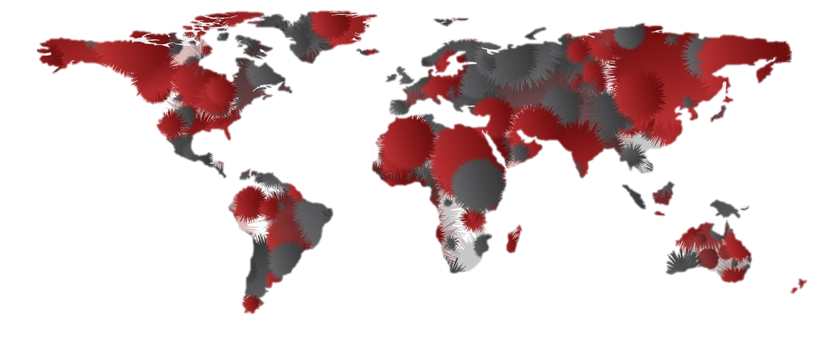
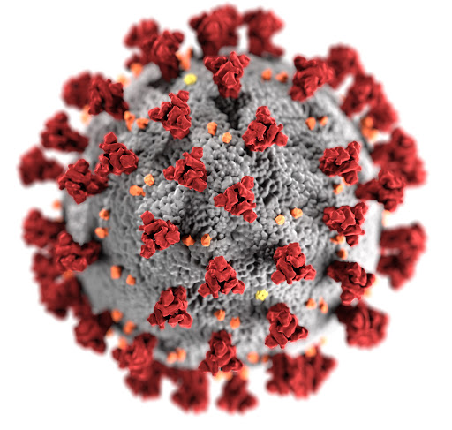
COVID EXPLORATORY DATA TOOL

Slide 2
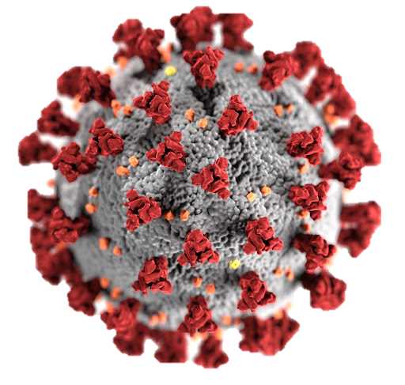
COVID EXPLORATORY DATA TOOL

