Slide 1
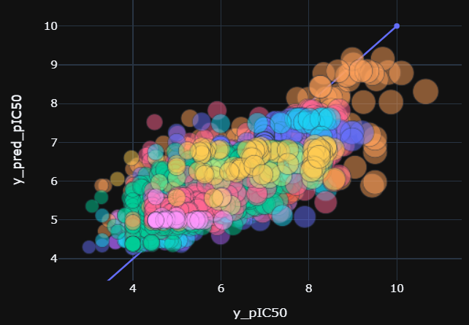
Top 3 molecular targets with highest drug activity
Glutamate carboxipeptidase II
Lysine-specific demethylase 5B
Mitogen-activated protein kinase 8

