Slide 1
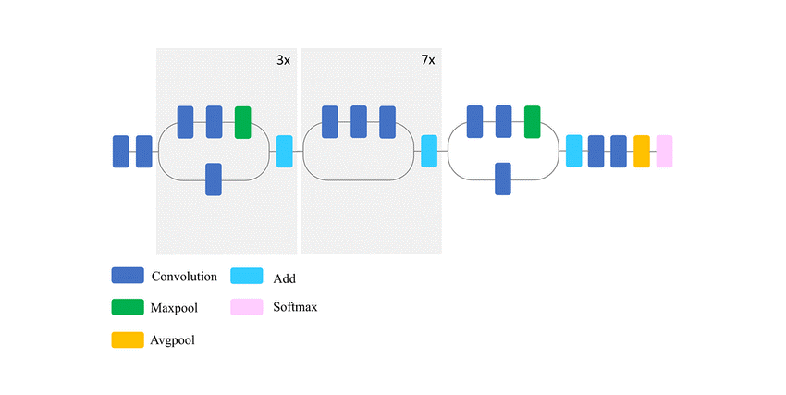
Flower-Classifier-Workflow-Summary
Base_model (Xception – 2 last layers)
My_model
Model
Convolution
Add
AvgPool
Flatten
Maxpool
Softmax
Dense
Dropout
Avgpool
Softmax (Output 5)
Model.compile (loss="sparse_categorical_crossentropy", optimizer="adam", metrics=["accuracy“])
Round 1: Xception layers frozen
0.98 (train_set)
0.94 (valid)_set)
0.98 (test_set)
Model.fit (datagen.flow (X_train, y_train), epochs=10,
validation_data=(X_valid, y_valid))
Accuracy:
Round 2,3: Xception layers unfrozen

Slide 2
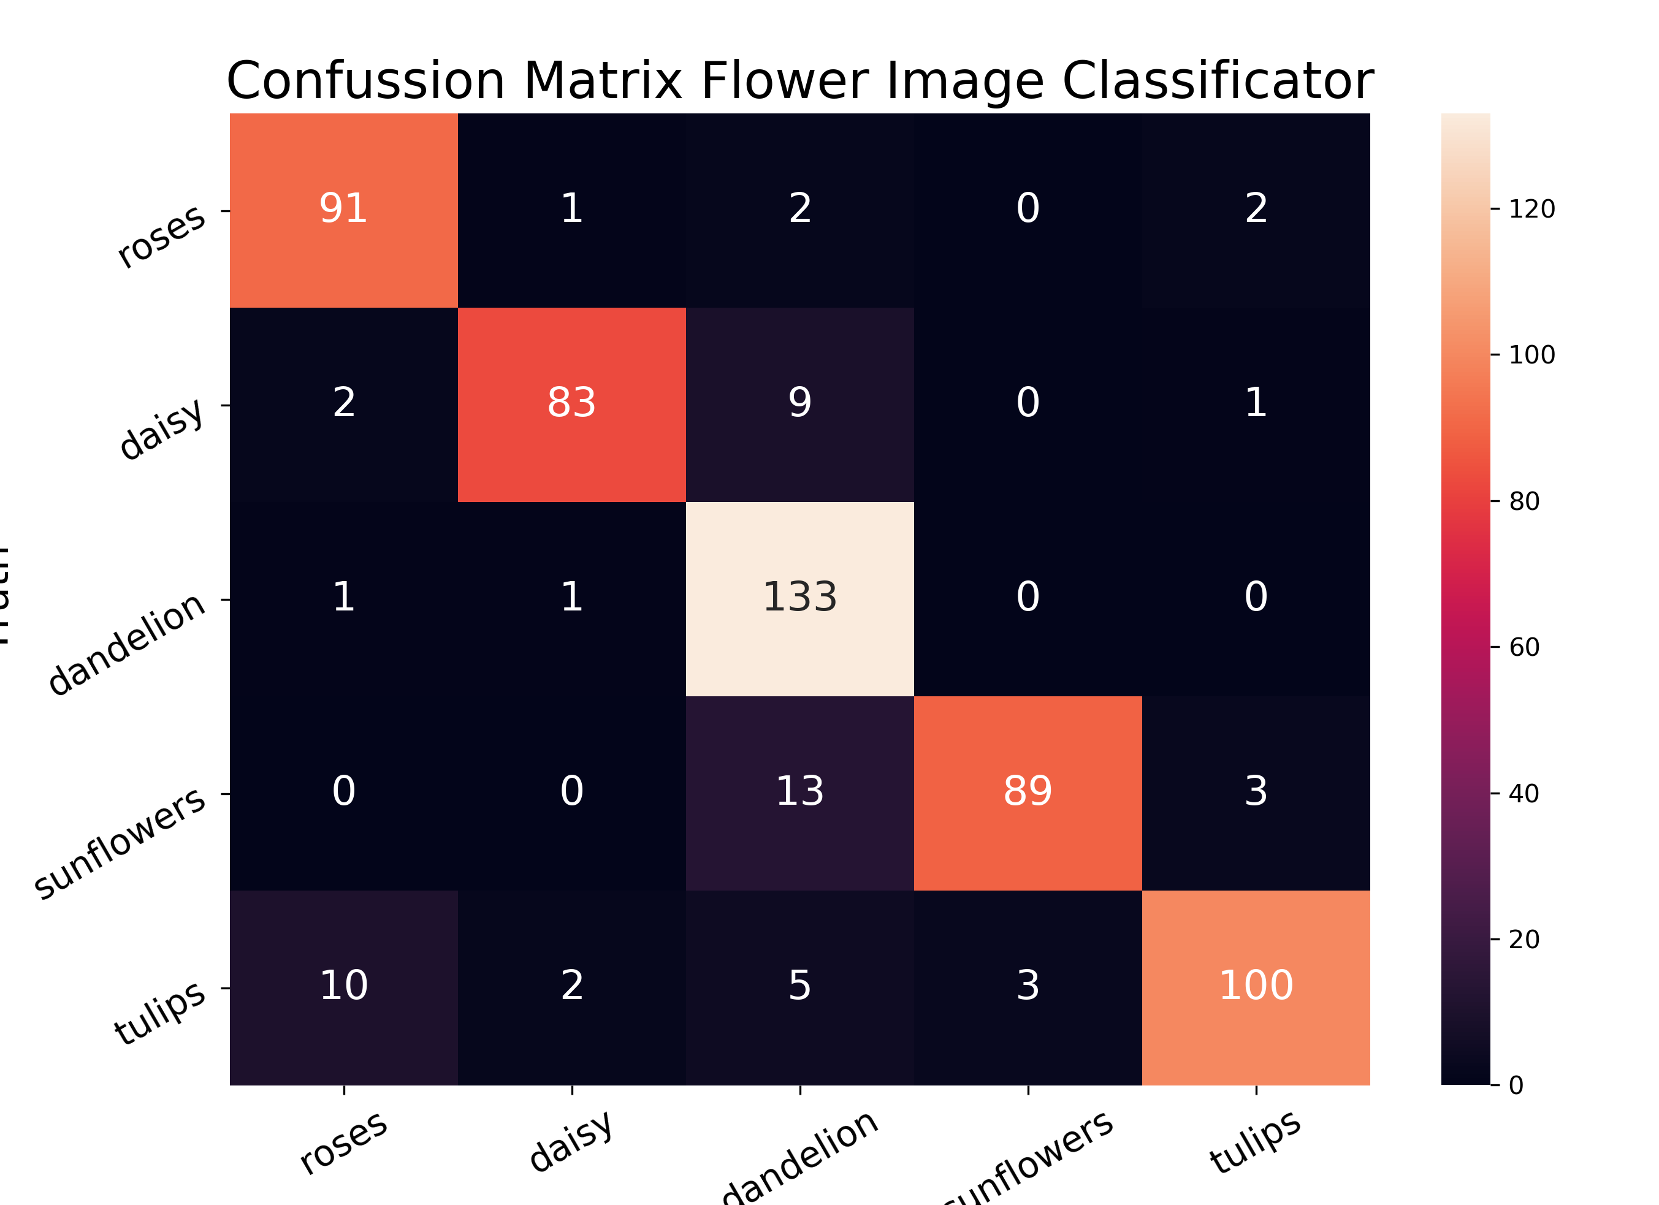
truth
dandelion
sunflowers
predicted

Slide 3







