Slide 1



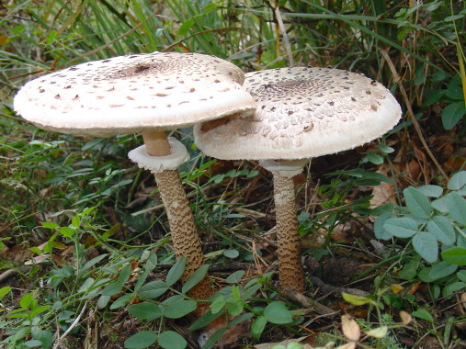
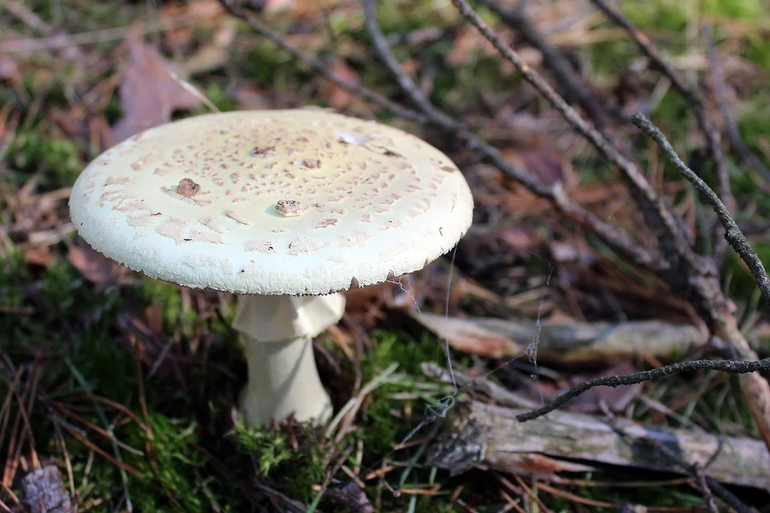
!
👌🏼
Macrolepiota mastoidea
Amanita phaloides
vs

