Slide 1




Genetic Algorithm
Gaona Andrés
Solarte Enrique

Slide 2
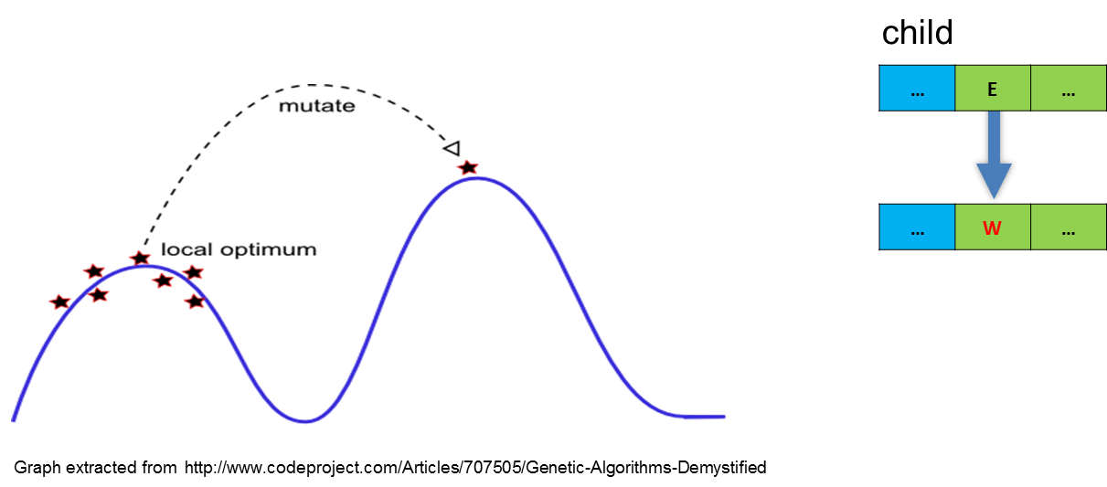
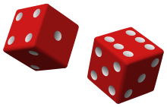


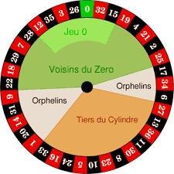
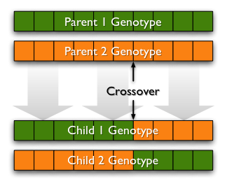
Genetic Algorithm
Random Population
Population
Number of features
Mutation
Random Mutation
pMutation: Mutation probability
Selection
(Roulette wheel)
Better populations
Increasing maximum fitness
Crossover
Reproduction of selected genes
pCross: Crossover probability
Gaona Andrés
Solarte Enrique

Slide 3








Programing Structure
Fitness.cs
Function.cs
Evaluation() :double[,]
Features.cs
Evaluation by population,
Fitness information,
Function definition,
Results.cs
Best feature,
Population,
Range of feature
maxFitnessGA :double[]
meanFitnessGA :double[]
maxErrorGA :double[]
bestFeatureGA :double[][]
evaluationGA :double[,]
theBestFeatureGA :double[]
generations :int
GeneticAlgorithm.cs
result :Result
GeneticAlgorithm() +2 :constr
Evaluation() :double[,]
EvaluationJagged() :double[][]
Run() :void
Gaona Andrés
Solarte Enrique

Slide 4
Program
double[] xVar;
double[] yVar;
// Target
// Target
double[,] rangeFeatures = new double[,] { { 1, 20 }, { 5, 50 }, {1, 20 }, { 0.001, 3.5 } };
GeneticAlgorithm GA = new GeneticAlgorithm(1000, rangeFeatures, xVar, yVar);
// GeneticAlgorithm( population , range of features , x target , y target)
double[,] target;
double[] xVar;
// Target
// Range of measurement
GeneticAlgorithm GA = new GeneticAlgorithm(1000, rangeFeatures, target, xVar);
// GeneticAlgorithm( population , range of features , target, x target )
Gaona Andrés
Solarte Enrique

Slide 5
Program
int generations;
double pCross;
double pMutation;
GA.Run(generations, pCross, pMutation);
Results.cs
maxFitnessGA {get;} :double[]
meanFitnessGA {get;} :double[]
maxErrorGA {get;} :double[]
bestFeatureGA {get;} :double[][]
evaluationGA {get;} :double[,]
theBestFeatureGA {get;} :double[]
generations {get;} :int
Evaluation(double[] _features) :double[,]
EvaluationJagged(double[] _features) :double[][]
Gaona Andrés
Solarte Enrique

Slide 6
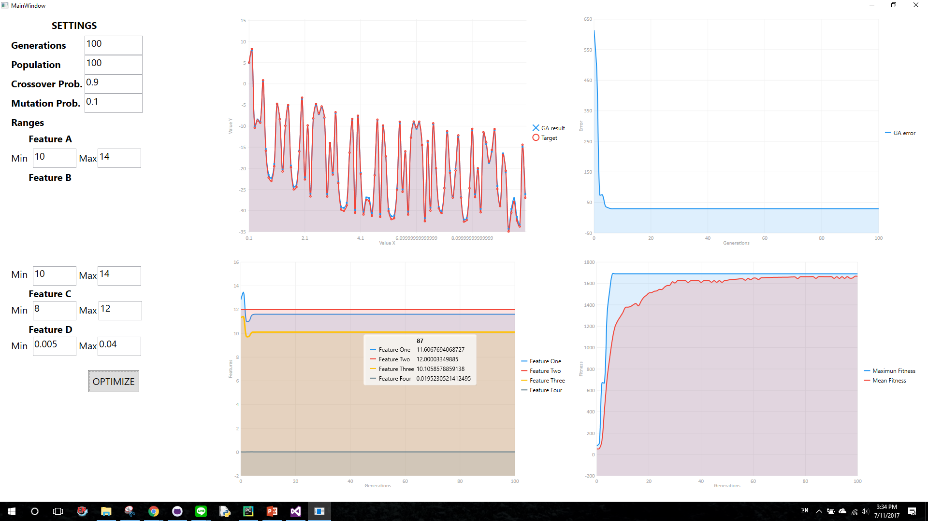
Interface Program
Gaona Andrés
Solarte Enrique

Slide 7

Gaona Andrés
Solarte Enrique

