Slide 1

An Overview for 2017 Coverage

Slide 2
What is the SHOP Marketplace?
The Small Business Health Options Program =
SHOP Marketplace
Each SHOP Marketplace is a Health Insurance MarketplaceSM created by the Affordable Care Act (ACA)
Offers small employers (generally those with 1-50 full-time employees) a choice of quality health and dental plans provided by private insurance companies
States may choose to allow employers with 1-100 full-time employees to participate in the SHOP Marketplace and enroll in small group market coverage
Small employers who offer coverage through a SHOP Marketplace may be eligible for the Small Business Health Care Tax Credit which may be worth up to 50% of their contributions to premiums (up to 35% for tax-exempt employers)
Works with health insurance reforms to help spur competition based on price and quality

Slide 3
Benefits of the SHOP Marketplace
Convenience and choice:
Complete a new group enrollment at any point during the year
Browse, compare, apply, and enroll in SHOP Marketplace health and dental plans on HealthCare.gov
Offer one or multiple plans
Receive one bill and make one premium payment a month, per state
Renew coverage online, on your own or with an agent or broker
Control over spending:
Employers decide which plan(s) to offer qualified employees and how much they want to contribute to health and dental insurance premiums
Access to tax credits:
When you offer and purchase coverage through the SHOP Marketplace, you may be eligible for a tax credit worth up to 50% of your contributions to premiums (35% for tax exempt employers)
Many ways to get help:
Information and assistance are available through HealthCare.gov, the SHOP Call Center, SHOP Marketplace registered agents and brokers and through navigators

Slide 4
Which Employers can Participate in a SHOP Marketplace?
To be eligible to purchase coverage in the SHOP Marketplace, employers must:
Are you eligible to participate? Use the SHOP FTE Calculator on HealthCare.gov to count full-time employees and full-time equivalent employees: https://www.healthcare.gov/shop-calculators-fte/
1
Be a “small employer” (generally, a small employer has 1-50 employees)
2
Offer coverage to all full-time employees (those working 30 or more hours per week, on average)
3
Have at least one employee enrolling in coverage
4
Have a principal business address or eligible employee worksite in the state in which coverage is offered

Slide 5
Options for the Self-Employed
Self-employed individuals are not eligible to enroll through the SHOP Marketplace unless they have at least one employee who enrolls
Self-employed individuals with no employees may be able to enroll in coverage through the Health Insurance MarketplaceSM for Individuals & Families on HealthCare.gov
Health Insurance MarketplaceSM for Individuals & Families:
Premium tax credits may be available, depending on annual household income
Individuals generally must enroll during the Open Enrollment period, unless they have a life event, such as getting married or having a child
Open Enrollment for 2017 is November 1, 2016 - January 31, 2017

Slide 6
SHOP Marketplace Minimum Participation Requirement
In most states, 70% of a group’s employees offered coverage generally must accept the offer of SHOP Marketplace coverage or be enrolled other qualified health coverage for a group to participate in the SHOP Marketplace
Unless the group enrolls between November 15 and December 15 when no Minimum Participation Rate (MPR) applies
Use the SHOP Marketplace Minimum Participation Rate (MPR) Calculator to find out about the MPR in you state and help predict if your small group will meet the MPR for you state:
https://www.healthcare.gov/small-businesses/shop-calculators-mpr/
Employees with Non-SHOP Coverage Count Towards a Group’s Minimum Participation Rate
Employees with other qualified non-SHOP Marketplace health coverage, such as through a spouse or government program, will be counted toward the MPR.

Slide 7
Calculating the Minimum Participation Rate
Here’s how the SHOP Marketplace MPR is calculated:
MPR = Number of Full-time Employees Enrolling in Other Qualified Coverage
Number of Full-time Employees Offered SHOP Marketplace Coverage
Here’s an example:
If an employer offers coverage to 10 full-time employees, and 2 have coverage through a spouse’s employer, and 1 is covered by Medicare
70% of 10 employees = 7 employees
3 employees have other coverage that counts towards the MPR, so 4 additional employees must accept the employer’s offer of SHOP Marketplace coverage or be enrolled in other types of qualified health coverage, before the employer can enroll
From November 15th- December 15th, eligible small employers can enroll in SHOP Marketplace coverage without meeting the MPR requirement

Slide 8
Health & Dental Coverage Options in the SHOP Marketplace
Employers may offer their qualified employees one of three options through the SHOP Marketplace:
Only health coverage
Only dental coverage
Both health and dental coverage
If a qualified employee is offered both health and dental coverage, he/she may choose to enroll in both health and dental coverage, only health coverage, or only dental coverage
Employers may also offer health and dental coverage to their employees’ dependents
Dependents must enroll in the same health and/or dental plan as the qualified employee
If a qualified employee is offered both health and dental coverage and enrolls in both, dependents will be able to enroll in either the health or dental coverage the employee picks, or in both
10

Slide 9
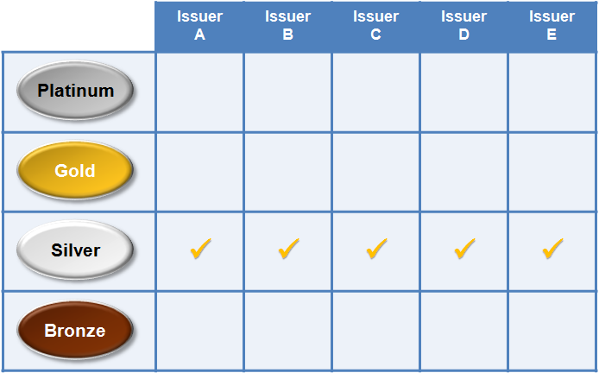
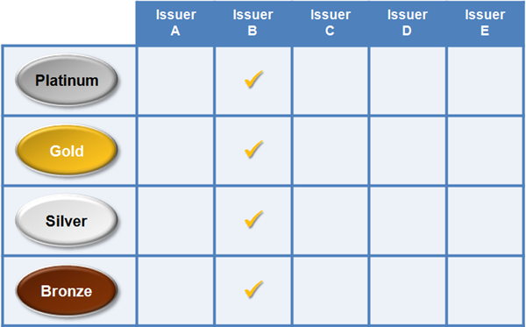
Employee Choice: Offering Employers Flexibility & Control
Employee Choice by Plan Category
Employers can offer qualified employees:
A single health or dental plan
A choice of plans within a plan category the employer chooses
Qualified employees choose any plan across insurance companies within the selected plan category
And, in some states a choice of plans offered by a single health insurance company the employer chooses
Qualified employees choose any plan across coverage categories offered by the selected health insurance company
Employee Choice by Insurance Company
13

Slide 10
Employee Choice: Offering Employers Flexibility & Control (Continued)
Advantages of offering qualified employees a choice of plans:
They can choose plans that best fit their coverage needs
Employer does not have to predict their health care needs
Employer receives and pays just one monthly bill even when offering multiple plans with different health insurance companies, per state
Employer sets choice limits to control health care costs
14

Slide 11
What’s New in the SHOP Marketplace for 2017?
Greater Visibility of Agents/Brokers Registered with the SHOP Marketplace
Agents/brokers registered with the SHOP Marketplace will no longer have to create a separate profile within the SHOP Agent/Broker Portal
After signing the SHOP Marketplace Privacy and Security Agreement on the MLMS, agents and brokers will automatically be searchable to employers at HealthCare.gov seeking help with SHOP Marketplace enrollment
Agents and brokers may edit their searchable profile information through the MLMS
New Employee Choice Option
In some states, employers will have the ability to offer their employees and, if applicable, dependents a choice of health and dental plans by insurance company

Slide 12
What’s New in the SHOP Marketplace for 2017? (Continued)
Premium Breakdown by Employee and Dependent
Users will be able to see premium breakdowns by employee and dependent throughout the enrollment process
Previously premium amounts were only listed as total employer and employee amounts
Address Standardization
When entering employer and employee addresses on the SHOP user interface, the system will suggest a standard address format
Users may accept or edit the suggested format

Slide 13
See Plans & Prices on HealthCare.gov
Browse available SHOP Marketplace health and dental plans before choosing coverage
Save time with the application process by becoming familiar with coverage options before you get started
See plan and pricing options that are available in your area without creating an account
Generate estimates for customized premium and out-of-pocket plan costs
Choose coverage that is affordable for both employers and employees
Compare plans based on product network type, plan category, insurance company, premium, deductible, and out-of-pocket maximum
Make an informed decision that fits employers’ and employees’ budget and coverage needs

Slide 14
How to Enroll in the SHOP Marketplace: Employers
Enroll on your own:
Select the “Small Business” tab on the top of HealthCare.gov and then the green “For Employers” button
Select your state from the drop-down menu and click “Apply Now”
Create a HealthCare.gov account
Complete a SHOP Marketplace application
Select coverage, contribution, and make an offer to employees
Track employee participation and submit enrollment
Submit initial premium payment

Slide 15
How to Enroll in the SHOP Marketplace: Employees
Enroll online through HealthCare.gov
Receive an email from the SHOP Marketplace that includes the employer’s offer of coverage and a SHOP participation code
Create a HealthCare.gov account and log in
Select “Visit Employee Marketplace”
Confirm eligibility by entering the participation code included in your offer email
Review your coverage offer; if the employer is offering you a choice of plans, select a plan, and add dependents if applicable
NOTE: If an employee does not sign up for SHOP Marketplace coverage during the initial enrollment period, he/she can only enroll later due to a life-changing event, such as having or adopting a child or getting married, or wait until the annual renewal period for the employer.

Slide 16
What is the Small Business Health Care Tax Credit?
The Small Business Health Care Tax Credit is generally only available to employers who have purchased coverage through a SHOP Marketplace
Small employers ability to get back a portion of their premium contributions through the tax credit
The tax credit may be worth up to 50% of eligible employers’ premium contributions (up to 35% for tax-exempt employers)
To qualify for the tax credit, employers must:
Have employees enrolled in SHOP Marketplace health or dental plan(s)
Have fewer than 25 FTEs (based on a 40 hour work week)
Pay average wages of less than around $50,000 per year per FTE, adjusted annually for inflation
Contribute at least 50% toward employee-only premium costs
File for the tax credit with IRS

Slide 17
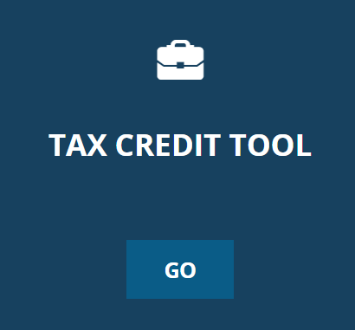
Small Business Health Care Tax Credit (continued)
For tax years 2014 and beyond, employers can claim the tax credit for two consecutive years
Use the Tax Credit Estimator on HealthCare.gov to see if you might be eligible and how much the credit could be worth for your business
https://www.healthcare.gov/small-businesses/provide-shop-coverage/small-business-tax-credits/

Slide 18
Getting Help in the SHOP Marketplace
The SHOP Call Center is open and available to assist navigators/assisters, employers and employees with an offer of SHOP Marketplace coverage, when needed
Contact the SHOP Call Center at: 1-800-706-7893 (TTY: 711)
Open Monday through Friday, 9:00 AM to 7:00 PM ET
Closed New Year’s Day, Martin Luther King Day, Memorial Day, July 4th, Labor Day, Veterans Day, Thanksgiving and the day after, and Christmas
The SHOP Call Center is busiest from the 13th to the 15th of the month. For shorter wait times, call earlier or later in the month

Slide 19
What Can the SHOP Call Center Help Me With?
General inquiries related to SHOP Marketplace eligibility, policies, and procedures
Complex cases, such as:
Difficulty accessing or questions related to an employer or employee application or enrollment
Employers and employees with an offer of SHOP Marketplace coverage may also call the SHOP Call Center for assistance

Slide 20
SHOP Marketplace Tools
SHOP Tool | Functionality & Value
1. FTE Calculator | Helps employers determine if they may be a small employer for purposes of SHOP Marketplace eligibility helping them count their full-time and FTE employees
2. MPR Calculator | Helps employers determine if they meet the minimum participation requirement in their state needed to enroll in a SHOP Marketplace
3. Tax Credit Estimator | Helps employers determine if they may be eligible for the Small Business Health Care Tax Credit, and estimate its value
Looking for the tools? Visit https://www.healthcare.gov/small-businesses/

Slide 21
SHOP Marketplace Resources
Top Questions About the SHOP Marketplace healthcare.gov/small-businesses/get-answers
Information on the Small Business Health Care Tax Credit irs.gov/Affordable-Care-Act
Affordable Care 101 Webinar: What the Healthcare Law Means for Small Employers bit.ly/AffordableCare101
Detailed Instructions on How to Enroll for Employers marketplace.cms.gov/outreach-and-education/enroll-in-shop.pdf
How to Enroll in the SHOP Marketplace - Employees marketplace.cms.gov/outreach-and-education/enroll-in-shop-employees-2016.pdf
Detailed Instructions on How to Enroll for Employees marketplace.cms.gov/outreach-and-education/enroll-in-shop-employees.pdf
What Employees Should Know About the SHOP Marketplace marketplace.cms.gov/outreach-and-education/employees-should-know-about-shop-2016.pdf
26

Slide 22
SHOP Marketplace Resources (continued)
Connect with the SHOP Marketplace on LinkedIn:
go.hc.gov/shop
Watch SHOP Marketplace Enrollment videos: https://www.youtube.com/playlist?list=PLUslxKz-YuChNTtMYNZfSWBwr2B-pg10t
SHOP Marketplace resources for employers, employees and assisters: https://marketplace.cms.gov/outreach-and-education/shop-resources-2016.html
SHOP Call Center 1-800-706-7893 (TTY: 711) Available Monday – Friday, 9am – 7pm ET
27

