Slide 1
Engaging Consumers in the Health Insurance Marketplace
Tips
For Assisters
September 2015
Notes:
Engaging Consumers in the Health Insurance Marketplace, Tips for Assisters, includes assister best practices that have been proven to be helpful in getting consumers to engage in the Health Insurance Marketplace.
This training module was developed and approved by the Centers for Medicare & Medicaid Services (CMS), the federal agency that administers Medicare, Medicaid, the Children’s Health Insurance Program (CHIP), and the Federally-facilitated Health Insurance Marketplace. The information in this module was correct as of September 2015. To check for an updated version of this training module, visit Marketplace.cms.gov.
The information presented is for CMS partners. It is not intended for press purposes and is not on the record. If you are a member of the press, please email the press office at press@cms.hhs.gov.

Slide 2
Tips For Assisters
Target Your Audience
The 2 Es – Educate and Enroll
Be Inclusive
Emphasize Affordability
Keep It Simple
Keep the Door Open
Persistence With Permission
Share Feedback
Stay Up-to-Date
Notes:
The following are tips for engaging consumers in the Health Insurance Marketplace. These tips come from feedback shared by people who helped consumers enroll in the Marketplace.
These tips include
Target Your Audience
The 2 Es – Educate and Enroll
Be Inclusive
Emphasize Affordability
Keep It Simple
Keep the Door Open
Persistence With Permission
Share Feedback
Stay Up-to-Date

Slide 3
1. Target Your Audience
Focus outreach to your specific audience
Reach through multiple mediums using
CMS provided drop-in articles, publications, fact sheets, customizable posters, videos, and Public Service Announcements (PSAs)
Partnerships with local media and businesses to advertise services
Social media
Develop strategic partners
Collaborate with other assisters
Notes:
Promotion and outreach activities should be planned based on the population you serve (e.g. age group, geographical location, ethnicity, gender, etc.). Having information about the people you want to attend is helpful in establishing a targeted outreach plan so you can increase your reach. A variety of mediums should be used depending on your audience and their preferences. Identify organizations and agencies that may be helpful in getting these consumers to engage in the event.
In an effort to reach multiple segments of a population, use multiple outreach methods, like drop-in articles (short, customizable articles for use in partner publications), advertising on websites of partnering organizations, fliers, targeted television commercials, newspaper advertisements, and outdoor advertising (such as posters on billboards, at bus stops or signs posted at location of the event).
Develop strategic partnerships in your area. In general, assisters found that strategic partnerships are important during the promotional stage of enrollment events. Consumers tend to more readily accept information from sources that they know and trust. Strategic partners are groups and organizations that can help you spread your message using avenues and methods that you might not otherwise have access to. Businesses and organizations may allow you to post flyers or provide event space; public television or radio stations may allow you to advertise your events (CMS provides pre-recorded Public Service Announcements); and using social media can provide access to additional audiences.
In addition, valuable outreach information can be gathered through collaboration with other assisters.

Slide 4
Target Your Audience
Use an effective messenger who
Is trusted by the audience
Knows how to tailor the message to the particular audience
Know what motivates consumers
Use personalized and localized messages, and tailored resources
Notes:
Knowing your target population and customizing the message to meet their needs may be helpful to identify factors that would motivate them to enroll by addressing “what’s in it for them.” If you target your audience, such as age group, ethnic composition and other demographics, you’re better able to coordinate an enrollment event suitable for the population being served.
Consumers more readily accepted information presented by sources that they know and trust. Trusted messengers include assisters and local organizations that are familiar to prospective consumers, such as faith-based organizations, community health centers, grassroots organizers, community recreation centers, state agencies and community leaders.
In addition, personalized messages and resources were better received by consumers. For example, for a population of women, it may be helpful to include information highlighting the preventive health services available to women in qualified health plans, such as well-woman visits, mammograms, contraception, etc.

Slide 5

2. The 2 Es – Educate and Enroll
Education helps take consumers from uncertain and confused to
X
Enrollment events need an education component
Comfort levels increase with knowledge
Provide basic health insurance and Marketplace information
How health insurance works; what’s covered; basic insurance concepts like premiums, deductibles, and copayments
Enrollment deadlines
The value of insurance
What the application process looks like
Notes:
Many events were successful because they didn’t just ask people to enroll, but also provided education. Consumers were more willing to engage in the Marketplace when they felt that they were making informed decisions. Informational sessions should be aimed at moving a consumer from being uncertain and confused about Marketplace enrollment and choices, to providing them with enough information to make informed enrollment decisions.
A successful Marketplace event often included basic Marketplace and enrollment information, such as how the Marketplace works, essential benefits covered in qualified health plans and important enrollment deadlines. It’s also important to address essential insurance concepts like premiums, deductibles, and copayments. One of the main points of confusion for consumers after they enrolled in coverage was the need to pay out of pocket before their insurance coverage began. Many consumers also don’t understand why they will be asked to pay a doctor or hospital if they already paid a premium. Make sure that you explain these concepts to consumers prior to their enrollment, and explain the financial impact of these concepts.
Consumers may also benefit from information on the value of health insurance coverage, including the importance of having access to essential health benefits such as routine exams and preventive services.

Slide 6
The Uninsured
Most uninsured individuals think that having health insurance is important. More than 4 in 10 have looked into getting insurance on their own in the last year and 56% say they are likely to go to the Marketplace in the future.
Cost remains the main barrier to insurance. Those who have looked made a calculated decision based on more than just the premium. They also consider out-of-pocket expenses, deductibles, copayments and other factors in their decision.
Data courtesy of Robert Wood Johnson Foundation poll June, 2015
Notes:
Most uninsured individuals think that having health insurance is important. More than 4 in 10 have looked into getting insurance on their own in the last year and 56% say they are likely to go to the Marketplace in the future.
Cost remains the main barrier to insurance. Those who have looked made a calculated decision based on more than just the premium. They also consider out-of-pocket expenses, deductibles, copayments and other factors in their decision.
Data courtesy of Robert Wood Johnson Foundation poll June, 2015

Slide 7
Understand the Uninsured
Many are struggling financially but are optimistic about the future. They believe their finances will improve soon and that they may get insurance then.
There are other reasons uninsured individuals may be putting off insurance, such as the ability to still get care and pay for it out-of-pocket even without insurance and a perception of insurance as a “commitment” rather than something temporary to get in between jobs.
Data courtesy of Robert Wood Johnson Foundation poll June, 2015
Notes:
Many are struggling financially but are optimistic about the future. They believe their finances will improve soon and that they may get insurance then.
There are other reasons uninsured individuals may be putting off insurance, such as the ability to still get care and pay for it out-of-pocket even without insurance and a perception of insurance as a “commitment” rather than something temporary to get in between jobs.
Data courtesy of Robert Wood Johnson Foundation poll June 2015.

Slide 8
Understand the Uninsured– continued
Almost half (47%) haven’t gone to the Health Insurance Marketplace and another 10% are unsure if they have. This means there is still a substantial number of uninsured to reach with information encouraging them to look into their options.
There are substantial knowledge gaps around the tax credits and special enrollment periods that need to be filled. Education about the increasing fee amount could drive about one-quarter of the uninsured to enroll.
Data courtesy of Robert Wood Johnson Foundation poll June, 2015
Notes:
Almost half (47%) haven’t gone to the Health Insurance Marketplace and another 10% are unsure if they have. This means there is still a substantial number of uninsured to reach with information encouraging them to look into their options.
There are substantial knowledge gaps around the tax credits and special enrollment periods that need to be filled. Education about the increasing fee amount could drive about one-quarter of the uninsured to enroll.
Data courtesy of Robert Wood Johnson Foundation poll June 2015.

Slide 9

3. Be Inclusive
Ensure language access and access for people with disabilities
Directly, or through the Call Center, referrals to other assisters, or online
Provide culturally-appropriate enrollment assistance based on the community you serve
Consider ethnic heritage, nationality of family origin, age, religion, sexual orientation, gender identity, disability, and socioeconomic status
Have multilingual sessions if appropriate
Have materials in alternative formats, like Braille or large print
Notes:
Promote your ability to provide special accommodations and assistance to consumers with disabilities.
You are encouraged to provide culturally sensitive enrollment assistance that is reasonably accessible to all regardless of ethnic heritage/race, nationality of family origin, age, gender, religion, sexual orientation, disability, or socioeconomic status. To achieve this, you may use other available resources. For example, referrals of limited English proficient (LEP) consumers to the Call Center or other assisters such as Navigators, who are required to provide services in a culturally and linguistically appropriate manner.
In the same manner, if an enrollment event will occur in a known multilingual area, there may be a need for multilingual resources in an effort to optimize Marketplace engagement. Materials should be offered in alternate formats, including large print, Spanish, and Braille. Marketplace materials/resources in other languages can be found at Marketplace.cms.gov.

Slide 10
4. Emphasize Affordability
More than 8 in 10 individuals with a plan selection for 2015 Marketplace plans qualified for an advance premium tax credit
The average net premium was $105 per month among individuals with plan selections qualifying for an advance premium tax credit
The average advance premium tax credit covered about 72% of the premium cost
Notes:
Financial assistance messages were motivating in getting consumers to engage in the Marketplace. Consumers are interested in how much their insurance coverage will cost them and most who needed help didn’t know that a premium tax credit is available to help lower costs.
More than 8 in 10 individuals with a plan selection for 2015 Marketplace plans qualified for an advance premium tax credit.
The average net premium was $105 per month among individuals with plan selections qualifying for an advance premium tax credit .
The average advance premium tax credit covered about 72% of the premium cost.
Data from 2015 Department of Health and Human Services Office of the Assistant Secretary for Planning and Evaluation research brief “Health Insurance Marketplace 2015: Average Premiums After Advance Premium Tax Credits Through January 30 in 37 States using the Healthcare.gov Platform.”

Slide 11
Consumer Affordability Information
HealthCare.gov
Tool showing income qualification standards for
Lower costs on premiums and out-of-pocket costs
Low-cost health care through Medicaid and the Children’s Health Insurance Program (CHIP)
See Plans & Prices
Answer a few questions to see premium estimates for plans in your area
Notes:
The “Quick check chart” shows if a consumer qualifies to save on health insurance coverage. It indicates the income levels that qualify for lower costs. Consumer are able to match their household size and income level to see if they qualify for lower costs on premiums and out-of-pocket costs for private health insurance, and for low-cost health care through Medicaid or the Children’s Health Insurance Program (CHIP). For information on how to use this quick check chart ,visit HealthCare.gov/how-can-i-save-money-on-Marketplace-coverage-508//.
HealthCare.gov has a tool that allows consumers to answer a few quick questions to see the premium estimates for plans in their area. For access to the premium estimator visit Healthcare.gov/find-premium-estimates/.

Slide 12
Can’t Afford Health Coverage?
If you didn’t qualify for Medicaid or Children’s Health Insurance Program (CHIP) coverage, and you aren’t eligible for lower costs through the Health Insurance Marketplace, you still have options that could help.
You can apply for an exemption so you won’t have to pay a fee for going without coverage.
Visit HealthCare.gov/exemptions for details.
You may be able to get low-cost health care at a community health center. To locate a community health center near you, visit findahealthcenter.hrsa.gov.
Notes:
If you can’t afford health coverage, you’re not required to buy it, If you can afford health insurance but choose not to buy it, you must have a health coverage exemption or pay a fee. (The fee is sometimes called the "penalty," "fine," "individual responsibility payment," or "individual mandate.") The fee will be higher in 2016 than in 2015.
If you didn’t qualify for Medicaid or Children’s Health Insurance Program (CHIP) coverage, and you aren’t eligible for lower costs through the Health Insurance Marketplace, you still have options that could help.
You can apply for an exemption so you won’t have to pay a fee for going without coverage. Visit HealthCare.gov/exemptions for details.
You may be able to get low-cost health care at a community health center. To locate a community health center near you, visit findahealthcenter.hrsa.gov.

Slide 13
5. Keep It Simple
Consumers may not understand Marketplace or insurance terminology, including “Open Enrollment”
Use consistent, short, and easy to understand messages
Instead of “There are affordability programs to help you pay lower monthly premiums,” say “You may pay lower costs”
Don’t avoid talking about specific concepts because you are concerned they may be too complicated (deductibles, cost-sharing, etc.)
Find clear ways to talk about them
Notes:
You will reach more consumers when messages are in plain language, consistent, short and easy to understand. Consumers have a variety of educational levels, knowledge of Marketplace or insurance information, or levels of understanding of the language in which the message relayed.
Do not avoid talking about specific concepts because you are concerned they may be too complicated (deductibles, cost-sharing, etc.). Find clear ways to talk about them.

Slide 14


Coverage to Care
Coverage to Care is an initiative to help people with new health care coverage understand their benefits and connect to primary care and preventive services.
There are toolkits, publications, and videos to use to help people understand and use their health care coverage.
The tools are available on Marketplace.cms.gov/technical-assistance-resources/c2c.html
Notes:
From Coverage to Care is an initiative to help people with new health care coverage understand their benefits and connect to primary care and the preventive services that are right for them, so they can live a long and healthy life.
There are toolkits, publications, and videos to use to help people understand and use their health care coverage.
We also hope you share information about local resources during your conversations, to help individuals know where and how to access care in your community.
The tools are available on Marketplace.cms.gov/technical-assistance-resources/c2c.html.

Slide 15

6. Keep the Door Open
Provide a handout with contact information at the event encouraging consumers to connect with you again in the future
Many were interested in enrolling after events
Friends and families of attendees may also be interested in enrolling
Emphasize that free help is continually available
Remind them about reporting life changes
Notes:
Provide a handout with contact information so consumers can reconnect with you and/or the Marketplace after the event. Assisters who provided their contact information during enrollment events found that there was continued interest after events from those who didn’t enroll at the event, from family and friends of those who attended, and from other consumers.
Handout should include the following information:
The availability of options for Marketplace exploration and enrollment
That free help is continually available and how to access it
How to report life changes
Once you have Marketplace coverage, you must report certain life changes. This information may change the coverage or savings you’re eligible for. For more information, visit Healthcare.gov/how-do-i-report-life-changes-to-the-Marketplace/.
In addition to following up with consumers, assisters may provide consumers with their contact information (telephone number, email, business cards or agency brochures) which may be helpful should consumers have follow-up questions.
There are many Marketplace materials that you can use to educate people posted on https://marketplace.cms.gov/outreach-and-education/outreach-and-education.html

Slide 16
7. Persistence with Permission
Assisters may contact consumers directly without permission for outreach and public education
Contact consumers about applying or enrolling only if they’ve asked you to/contacted you first OR you have a preexisting relationship (e.g., existing client or patient)
For those who didn’t enroll during the event
Seek their consent to follow up and keep a record of this consent
Include a way to capture contact information
Keep them informed of upcoming events
Multiple touches led to increased enrollment
Notes:
Assisters may directly contact consumers without their permission to perform outreach and public education. However, directly contact individual consumers about applying and enrolling in a Marketplace plan only if:
They’ve asked you to
Or if they’ve contacted you first
Or you have a preexisting relationship with them.
Some assisters included a method to capture the contact information of eligible consumers who attended enrollment events, but didn’t engage in the Marketplace. Prospective consumers completed a contact information form with their names, contact information and their signature if they agreed to be contacted at a later time, Keep a record of the consent provided by consumers. Research conducted by Enroll America indicates that multiple touches led to increased enrollment. Continual outreach to uninsured consumers is an important step in increasing the chances of them getting coverage.

Slide 17
8. Share Feedback
Share feedback with/learn from
Other organizations that enroll people in the Marketplace
Federal, state and local governments
Look at websites, publications, social media
Attend in-person training
Make adjustments based on lessons learned
Notes:
You should identify strategies that achieved goals more successfully. Adjust future activities based on lessons learned from your best practices, and the best practices of others. Look at websites, attend webinars, read publications, access social media and attend in-person training sponsored by federal, state or local governments and organizations.

Slide 18
9. Stay Up-To-Date
Remain up-to-date on information related to Marketplace enrollment
Know how to get helpful materials on Marketplace.cms.gov and HealthCare.gov
Receive assister information
Sign up for the CMS weekly assister newsletter
Email assisterlistserv@cms.hhs.gov and write “Add to listserv” in the subject line
Participate in the CMS assister webinars
Notes:
You’ll feel more capable and confident in your ability to provide enrollment assistance when you have up-to-date resources for providing enrollment help to consumers. Well-informed assisters know where to find information to assist consumers and provided more seamless assistance during the enrollment process.
The weekly assister newsletter is primarily intended for Assisters. It highlights the latest information needed to counsel consumers, training events available to assisters and other up-to-date resources. To sign up for the CMS weekly assister newsletter, send a request to assisterlistserv@cms.hhs.gov and write “Add to listserv” in the subject line.
Join the CMS assister webinars and connect with other organizations that support assisters.

Slide 19
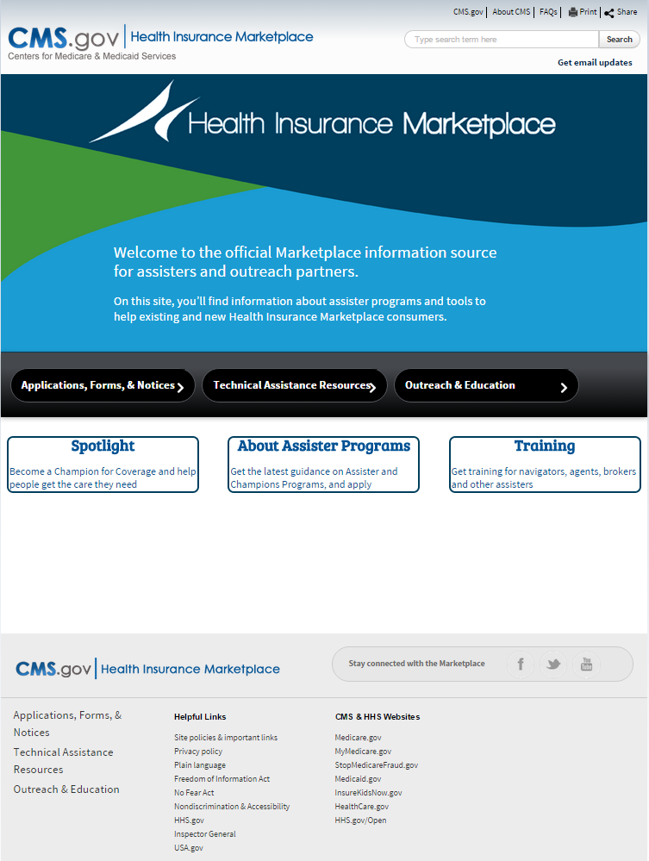
Marketplace.cms.gov
Notes:
Marketplace.cms.gov/outreach-and-education/outreach-and-education.html is your best source for Marketplace materials to help you counsel consumers. These resources help you to be better able to help consumers.

Slide 20
Stay Connected
Sign up for updates at HealthCare.gov/subscribe or CuidadoDeSalud.gov/es/subscribe
Twitter.com/HealthCareGov – Follow @HealthCareGov
Facebook.com/HealthCareGov
YouTube.com/HealthCareGov
The Health Insurance Blog: HealthCare.gov/blog/
Notes:
Don’t miss key dates and information about the Health Insurance Marketplace. Here’s how to stay connected:
Sign up for email or text updates at HealthCare.gov/subscribe or CuidadodeSalud.gov/es/subscribe. Get updates in your inbox or on your mobile phone.
Twitter: Twitter.com/HealthCareGov. Follow @HealthCareGov
Facebook: Facebook.com/HealthCareGov. Join the conversation. Like, share, and respond to our latest posts.
YouTube: Youtube.com/HealthCareGov. Watch and share videos about the Marketplace.
The Health Insurance Blog on http://www.healthcare.gov/blog/. Find tips for consumers and small businesses, top things to know about the Marketplace, frequently asked questions, and more. Make comments to continue the discussion.

