Slide 1

Exemptions from the Share Responsibility Fee
Overview of Health Coverage Exemptions
November 2016
Notes:
The information in this presentation was correct as of November 2016. Please note HealthCare.gov undergoes updates on a regular basis so screenshots and language may change as part of the ongoing effort to improve consumer experience.
The information presented is for CMS partners. It’s not intended for press purposes and is not on the record. If you are a member of the press, please email the press office at press@cms.hhs.gov.
This CMS National Training Program presentation provides basic information about the Marketplace program. You should always consult the relevant statutes, regulations, and rulings for official legal guidance.

Slide 2
Individual Shared Responsibility & Exemptions Overview
Individuals must either
Have minimum essential health care coverage,
Have a health coverage exemption, or
Make a shared responsibility payment with their tax return
Also known as the “fee,” “penalty,” “individual shared responsibility payment,” or “individual mandate”
Notes:
Individuals must have minimum essential health care coverage, have a health coverage exemption, or make a shared responsibility payment with their tax return.
The shared responsibility payment is also known as the “fee,” “penalty,” “individual shared responsibility payment,” or “individual mandate.”

Slide 3
What is Minimum Essential Coverage?
The following types of coverage are considered minimum essential coverage. If a consumer has it, they’re covered and don’t have to do anything.
Employer-sponsored coverage, including COBRA and retiree coverage
Individual coverage (outside the Marketplace)
Marketplace coverage
Medicare (Part A) and Medicare Advantage Plans
Most Medicaid coverage
Children’s Health Insurance Program (CHIP)
Certain veteran’s health coverage (from the VA)
Notes:
The following types of coverage are considered minimum essential coverage. If a consumer has it, they’re covered and don’t have to do anything.
Employer-sponsored coverage, including self-insured plans, COBRA coverage and retiree coverage
Coverage purchased in the individual market, including a qualified health plan offered by the Health Insurance Marketplace
Medicare (Part A) coverage and Medicare Advantage Plans
Most Medicaid coverage
Children’s Health Insurance Program (CHIP) coverage
Certain types of veteran’s health coverage administered by the Department of Veterans Affairs

Slide 4
What is Minimum Essential Coverage? (continued)
Minimum essential coverage also includes
Most types of TRICARE coverage
Coverage provided to Peace Corp volunteers
Coverage under the Nonappropriated Fund Health Benefit Program
Refugee Medical Assistance supported by the Administration for Children and Families (ACF)
Self-funded health coverage offered to students by universities
State high-risk pools
Other coverage recognized by the Secretary of the Department of Health and Human Services
Notes:
Minimum essential coverage also includes
Most types of TRICARE coverage under Chapter 55 of Title 10 of the United States Code
Coverage provided to Peace Corps volunteers
Coverage under the Nonappropriated Fund Health Benefit Program
Refugee Medical Assistance supported by the Administration for Children and Families
Self-funded health coverage offered to students by universities for plan or policy years that began on or before December 31, 2014 (check with the university to see if its plan qualifies as minimum essential coverage)
State high-risk pools for plan or policy years that begin on or before December 31, 2014 (check with the consumer’s state’s high risk pool plan to see if the plan qualifies as minimum essential coverage)
Other coverage recognized by the Secretary of the Department of Health and Human Services as minimum essential coverage
Minimum essential coverage doesn’t include coverage providing only limited benefits, such as coverage only for vision care or dental care; and Medicaid covering only certain benefits such as family planning; workers' compensation; or disability policies.

Slide 5
Exemption Overview
Exemptions are available based on a number of circumstances, including certain hardships, some life events, health coverage or financial status, and membership in some groups
Consumers who qualify for an “exemption” don’t have to pay the fee
Some health coverage exemptions are claimed on their federal tax return, and others with a paper application through the Marketplace
Notes:
Under certain circumstances, consumers who don’t maintain minimum essential coverage won’t have to make the shared responsibility payment. In these circumstances, consumers qualify for an “exemption.”
Depending on the type of exemption, it can be filed through the Marketplace or the IRS. Consumers may claim the exemption when filling out their 2016 federal tax return (or a future federal tax return), which is due in April each year, or they may apply prior to submitting a tax return by sending the appropriate paper exemption application to the Marketplace for processing.

Slide 6
Exemption Overview (continued)
Consumers should research the exemption type to determine where to claim it
Use the exemptions screener tool, visit healthcare.gov/exemptions-tool/#/
For exemptions claimed on a federal tax return, there’s no need to apply for an exemption through the Marketplace
Consumers don’t have to pay the fee for any month they’re covered by a plan that qualifies as minimum essential coverage
If they’re uncovered only 1 or 2 months, they don’t have to pay the fee for any month
Notes:
If the individual is able to claim the exemption on their federal tax return, they don’t need to apply to the Marketplace.
Consumers should research the exemption they believe they may qualify for to determine whether it may be claimed on a tax return or through the Marketplace. Use the exemptions screener tool, visit healthcare.gov/exemptions-tool/#/

Slide 7
Who is Eligible for an Exemption?
Exemption Categories
Can’t afford coverage (greater than 8.05% of household) Experiences a hardship (including those who don’t qualify for Medicaid solely based on state’s decision not to expand Medicaid) Not lawfully present in the U.S. Incarcerated during coverage year | Experiences a short coverage gap (1 or 2 months of the year) Member of: Federally recognized tribe Health care sharing ministry Recognized religious sect with religious objections to insurance Household income below the tax filing threshold Eligible for care through an Indian health care provider
Notes:
Under certain circumstances, a consumer may qualify for an exemption from the individual shared responsibility payment. This means he or she won’t be required to pay a fee (as part of filing his/her tax return) for not having health coverage during the year. Exemption categories include consumers who:
Didn’t have access to affordable coverage (cost of available coverage greater than 8.05% of household income)
Weren’t lawfully present in the U.S. (learn more about the definition of “lawfully present”)
Were incarcerated (unless pending disposition of charges)
Had a short coverage gap (1 or 2 consecutive months)
Are a member of a recognized religious sect with religious objections to insurance
Are a member of a recognized health care sharing ministry
Are a member of a federally recognized tribe or eligible for services through an Indian Health Services provider
Don’t make the minimum income required to file taxes
Suffered a hardship that affects the consumer’s ability to purchase health insurance coverage. Those who would have qualified for Medicaid if their state had expanded (see the form and the list of hardships at Marketplace.cms.gov/applications-and-forms/hardship-exemption.pdf.
Other exemptions include:
U.S. citizens living abroad and certain noncitizens (such as those not lawfully present)

Slide 8
Two Ways to Get an Exemption
IRS exemptions that consumers can get from the IRS when they file their tax return
Marketplace exemptions that consumers need to request by completing a paper application and mailing it to the Marketplace
Visit healthcare.gov/health-coverage-exemptions/ for a complete list of exemptions and applications
Notes:
If consumers and all of their dependents had coverage for each month of the tax year, they’ll indicate this on their 2016 tax return simply by checking a box on their Form 1040, 1040A or 1040EZ. Consumers use IRS Form 8965 “Health Coverage Exemptions” to report an exemption granted by the Marketplace or to claim an exemption on their tax return. In addition, if for any month they or another member of their tax household had neither health care coverage nor an exemption, these instructions provide the information they’ll need to calculate their shared responsibility payment.
For additional information about how to get exemptions that the Marketplace may grant, visit HealthCare.gov/health-coverage-exemptions/.

Slide 9
How to File an Exemption
Consumers use IRS Form 8965 to report an exemption granted by the Marketplace or to claim an exemption on their federal tax return
Complete Part I if they or another member of their tax household was granted an exemption from the Marketplace
Use Part II of Form 8965 to claim an exemption if their income is below the filing threshold but they choose to file a tax return
Use Part III to claim other exemptions on their federal tax return
Use a separate line for each individual and exemption type claimed on the federal tax return
Notes:
Consumers use IRS Form 8965 “Health Coverage Exemptions” to report an exemption granted by the Marketplace or to claim an exemption on their tax return. In addition, if for any month they or another member of their tax household had neither health care coverage nor an exemption, these instructions provide the information they’ll need to calculate their shared responsibility payment.
Some exemptions are available to consumers only from the Marketplace, others are available only by claiming them on their federal tax return, and others are available from either the Marketplace or by claiming them on their federal tax return. If the consumer or another member of their tax household was granted an exemption from the Marketplace, they complete Part I of IRS Form 8965. If they or another member of their tax household is claiming an exemption on their federal tax return, they complete Part II or Part III of IRS Form 8965. Depending on their situation, they may need to complete one or more parts of the form. Consumers will claim or report exemptions on IRS Form 8965, and attach it to Form 1040, Form 1040A, or Form 1040EZ. They can file any of these forms electronically. Consumers will use Part II of IRS Form 8965, Coverage Exemptions for Your Household Claimed on Your Return, to claim an exemption if their income is below the filing threshold for their filing status but they choose to file a federal tax return. If they aren’t required to file a federal tax return and don’t want to file a return, they don’t need to file a return solely to claim this exemption.
Consumers may claim other coverage exemptions on their tax return using Part III of IRS Form 8965, Coverage Exemptions for Individuals Claimed on Your Return. They should use a separate line for each individual and exemption type claimed on the return. If the Marketplace hasn’t processed their exemption application before they file their individual tax return, they should complete Part I of IRS Form 8965 and enter “pending” in Column C for each person listed. If they claim the exemption on their return, they don’t need an ECN from the Marketplace. IRS Form 8965 is available at irs.gov/pub/irs-pdf/f8965.pdf. Instructions for completing the form are available at irs.gov/instructions/i8965/ch01.html.

Slide 10
Exemptions Granted by the Marketplace
Exemption for
Members of certain religious sect
Individuals without access to affordable coverage based on projected household income
Hardship exemption for individuals
Without access to affordable coverage based on projected income under a Qualified Health Plan (QHP)
Ineligible for Medicaid based on a state’s decision not to expand
Whose individual insurance plan was cancelled and believe other Marketplace plans are unaffordable
General hardship exemption for individuals experiencing circumstances that prevent them from obtaining coverage
Notes:
Exemptions granted by the Marketplace include
Exemption for
Members of certain religious sect
Individuals without access to affordable coverage based on projected household income
Hardship exemption for individuals
Without access to affordable coverage based on projected income under a Qualified Health Plan (QHP)
Ineligible for Medicaid based on a state’s decision not to expand
Whose individual insurance plan was cancelled and believe other Marketplace plans are unaffordable
General hardship exemption for individuals experiencing circumstances that prevent them from obtaining coverage

Slide 11
Exemptions Claimed on a Tax Return
Exemptions for
Members of Health Care Sharing Ministries
Incarcerated individuals
Individuals not lawfully present
Individuals who experience a short coverage gap
Individuals without access to affordable coverage based on actual household income
Individuals with household income below the income tax filing threshold
Members of Federally-recognized Indian Tribes and Alaska Native Corporation Shareholders, and individuals eligible for care from an Indian health care provider
Hardship exemption for two or more family members whose aggregate cost of self-only employer-sponsored coverage is unaffordable
Notes:
The following exemptions may only be claimed on a federal tax return:
Exemptions for
Members of Health Care Sharing Ministries
Incarcerated individuals
Individuals not lawfully present
Individuals who experience a short coverage gap
Individuals without access to affordable coverage based on actual household income
Individuals with household income below the income tax filing threshold
Members of Federally-recognized Indian Tribes and Alaska Native Corporation Shareholders, and individuals eligible for care from an Indian health care provider
Hardship exemption for two or more family members whose aggregate cost of self-only employer-sponsored coverage is unaffordable

Slide 12
How to Apply for Marketplace Exemptions
Complete the appropriate application and mail to:
Health Insurance Marketplace – Exemption Processing 465 Industrial Boulevard London, KY 40741
The Marketplace will send an exemption eligibility determination notice after the application is processed
Or request additional information if necessary
Approved notice includes a unique Exemption Certificate Number (ECN)
Consumers use the ECN when they file their federal taxes for the tax year during which they didn’t have coverage
Complete IRS Form 8965—Health Coverage Exemptions
Each member of a household who qualifies for an exemption will get their own ECN
Notes:
Consumers who want an exemption (Consumers can apply via mail for hardships due to cancelled plans) should complete the appropriate exemption application and mail for processing. There is no online or telephone exemption application at this time.
Exemption forms should be sent to:
Health Insurance Marketplace – Exemption Processing
465 Industrial Boulevard
London, KY 40741
If an exemption application is incomplete, the Marketplace will contact the consumer to collect the missing information. To collect missing information, the Marketplace will call the consumer if a phone number is available. If the consumer is not reachable by phone, or if there is no phone number listed on the application, the Marketplace will request missing information by mail. Once the exemption application is processed, the Marketplace will send the individual an eligibility determination notice by mail to the mailing address listed on the application. When an exemption is approved, the notice will include a unique Exemption Certificate Number (ECN) the consumer will need to put on his or her federal income tax return.
Consumers use their ECN when they file their federal taxes for the tax year during which they didn’t have coverage. They’ll use it to complete IRS Form 8965—Health Coverage Exemptions. Each member of their household who qualifies for an exemption will get their own unique ECN.

Slide 13
Requesting a Hardship Exemption
Read the hardship application and instructions healthcare.gov/exemption-form-instructions/
Be sure to include on the application everybody who’s on the consumer’s federal income tax return, even if they don’t need this exemption
The application allows consumers to claim other kinds of hardships for themselves, or others on their federal tax return
Complete, sign, and mail the application to the address shown on the form
Notes:
How to claim the exemption due to current health insurance being cancelled, or any hardship type listed:
Read the hardship application and instructions. It can be found at HealthCare.gov/exemption-form-instructions/
Be sure to include on the application everybody who’s on the consumer’s tax return, even if they don’t need this exemption. If necessary, make copies of Step 2 (page 4) for each person. List everyone who’ll be on the tax return so the IRS can match their information.
The hardship application allows consumers to claim other kinds of hardships for themselves or others on their federal tax return. If they think they qualify for other hardships, they should fill out that part of the application and include any of the required documents listed on the application.
The consumer should complete, sign, and mail the application to the address shown on the form. When a consumer signs the application, they agree that they’re signing under penalty of perjury. This means they’ve answered all questions correctly to the best of their knowledge and understand that they could face criminal penalties if they provide information that’s untrue.
Consumers should get a written response from the Marketplace within 2 to 4 weeks. If their exemption is granted, the notice will include an Exemption Certificate Number (ECN) for each household member.
Consumers use their ECN when they file their federal taxes for the tax year during which they didn’t have coverage. Keep the written response and ECNs in a safe place so they’re easy to find when it’s time to file their taxes.

Slide 14
Time for Processing Exemption Application
Time of processing will vary upon
The complexity of the exemption requested
Whether the application is missing any information
Whether additional supporting documentation is required
Should get a written response from the Marketplace within 2 to 4 weeks
If the exemption is granted, the notice will include an Exemption Certificate Number (ECN) for each household member
Use the ECNs to claim the exemption on their federal tax returns
Keep the written response and ECNs in a safe place so it’s easy to find them when it’s time to file their federal income tax return
Notes:
The time it takes the Marketplace to process an exemption application will vary depending upon the complexity of the exemption requested, whether the application is missing any information, and whether additional supporting documentation is required. If additional information is needed, the processing could take longer.
To process exemption applications most efficiently, we encourage consumers to submit the required documentation with their applications. Complete applications should take about 2 to 4 weeks. The consumer will receive an eligibility determination in the mail when the application has been processed.
Consumers should get a written response from the Marketplace within 2 to 4 weeks. If their exemption is granted, the notice will include an Exemption Certificate Number (ECN) for each household member.
Consumers need the ECNs to claim the exemption on their federal tax return for the tax year during which they didn’t have coverage. Keep the written response and ECNs in a safe place so they’re easy to find when it’s time to file their federal income tax return.

Slide 15
Catastrophic Coverage
Individuals who qualify for a hardship exemption can purchase catastrophic coverage even if they are over age 30
To purchase a catastrophic plan:
Download, complete, and submit an application for an affordability or a hardship exemption
After consumer receives exemption eligibility notice, go to HealthCare.gov to find catastrophic plan information: HealthCare.gov/choose-a-plan/plans-categories/#catastrophic
Apply for coverage on HealthCare.gov and enter the ECN during the Plan Compare process to unlock catastrophic plans
Notes:
Individuals who qualify for a hardship exemption can purchase catastrophic coverage even if they are over age 30.
To purchase a catastrophic plan, individuals should download, complete, and submit an application for an affordability or a hardship exemption. After the individual receives the exemption eligibility notice they should apply for coverage on HealthCare.gov and enter the ECN during the Plan Compare process to unlock catastrophic plans. For more information on catastrophic plans, visit HealthCare.gov/choose-a-plan/plans-categories/#catastrophic.

Slide 16
Marketplace Appeals
If consumers don’t agree with a decision made by Health Insurance Marketplace, they may be able to file an appeal
For a complete list of the types of appeals or how to file an appeal, consumers can visit healthcare.gov/marketplace-appeals
Notes:
If consumers don’t agree with a decision made by Health Insurance Marketplace, they may be able to file an appeal
For a complete list of the types of appeals or how to file an appeal, consumers can visit www.HealthCare.gov/marketplace-appeals/
Examples of the kinds of Marketplace decisions that can be appealed include:
Whether they’re eligible to buy a Marketplace plan
Whether they can enroll in a Marketplace plan outside the regular Open Enrollment Period
Whether they’re eligible for lower costs based on their income
The amount of savings they’re eligible for
Whether they’re eligible for Medicaid or the Children’s Health Insurance Program (CHIP)
Whether they’re eligible for an exemption from the individual responsibility requirement (fee)

Slide 17

You May Pay a Fee (Shared Responsibility Payment)
Consumers may pay a fee when they file their federal tax return
If they don’t have minimum essential coverage, and
Don’t qualify for an exemption
Paying the fee doesn’t provide health coverage
Notes:
When an uninsured person requires urgent—often expensive—medical care but doesn’t pay the bill, everyone else ends up paying the price. That’s why the Affordable Care Act requires all people who can afford it to take responsibility for their own health insurance by maintaining minimum essential coverage (MEC) or paying a fee (shared responsibility payment). Individuals who fail to maintain MEC may not be protected from the kind of very high medical bills that can sometimes lead to bankruptcy.
Consumers generally can’t enroll in a private health plan through a Marketplace for coverage after Open Enrollment ends, unless they have a qualifying life event that provides for a Special Enrollment Period. They can apply for Medicaid or CHIP at any time.
If a consumer enrolled in a Marketplace plan during open enrollment, and paid the premiums, and maintained coverage throughout the benefit year, he or she won’t have to pay a fee for a short gap in coverage (see slide #6). For more information visit irs.gov/Affordable-Care-Act/Individuals-and-Families/Individual-Shared-Responsibility-Provision.

Slide 18
How much is the fee?
Consumers who didn’t have health insurance in 2016 will pay the higher of these two amounts:
2.5% of a consumer’s yearly household income (Only the amount of income above the tax filing threshold is used to calculate the penalty)
$695 per person ($347.50 per child under 18)
The maximum penalty per family using this method is $2,085
The penalty for noncompliance can’t exceed the national average premium for a Bronze level Marketplace plan (for the relevant family size)
The amounts for 2017 are the same, but could increase in future years
Notes:
Consumers pay whichever of these amounts is higher:
2.5% of their yearly household income (Only the amount of income above the tax filing threshold is used to calculate the penalty.) The maximum penalty is the national average premium for a Bronze plan.
$695 per person ($347.50 per child under 18) The maximum penalty per family using this method is $2,085.
Any penalty that taxpayers are required to pay for themselves or their dependents must be included in their return for the taxable year. Those individuals who file joint returns are jointly liable for the penalty.
The amounts for 2017 are the same, but could increase in future years.

Slide 19
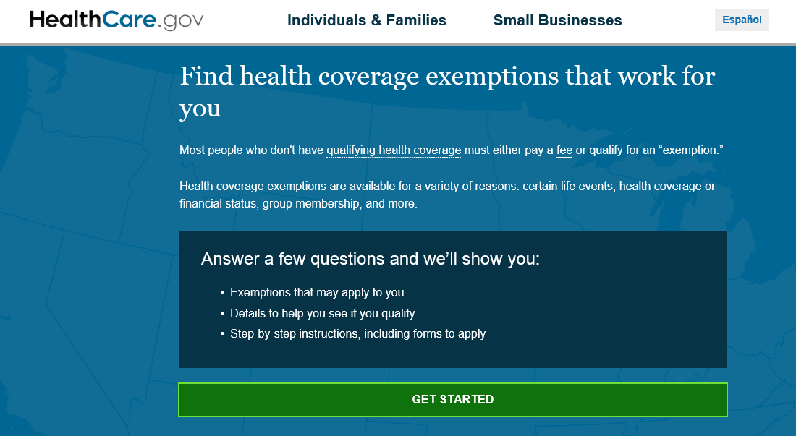
HealthCare.gov Exemptions Screener Tool
To use this tool, visit HealthCare.gov/exemptions-tool/#/
Answer a few questions to see exemptions that may apply to the consumer
Notes:
The Exemptions Screener tool is a HealthCare.gov feature that allows consumers to find health coverage exemptions that may apply to them to avoid the fee for going without health insurance coverage. It can’t tell consumers if they qualify for exemptions, but it can let them know what exemptions may work for them based on their responses to a few questions and their specific situations. If there are exemptions that apply to their situation, the tool will also provide details to help them decide whether to apply for an exemption, and step-by-step instructions on how to apply. This tool is found at HealthCare.gov/exemptions-tool/#/

Slide 20
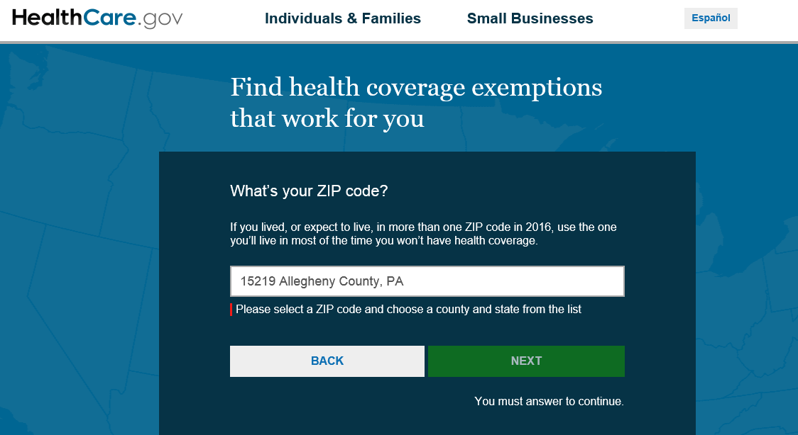
Enter ZIP Code
Enter the consumer’s ZIP Code and choose the correct county/state
Notes:
To start, enter the ZIP code and county where the consumer lived during 2016 to determine whether they live in a federally-facilitated or state-based Marketplace (SBM). All SBMs are using HealthCare.gov for exemptions except for Connecticut, which issues its own exemptions. Residents of Connecticut need to contact the state directly. Click NEXT to continue.
Note: If a consumer lived in more than one ZIP code during the year, use the one he or she lived in most of the time he or she didn’t have health coverage.

Slide 21
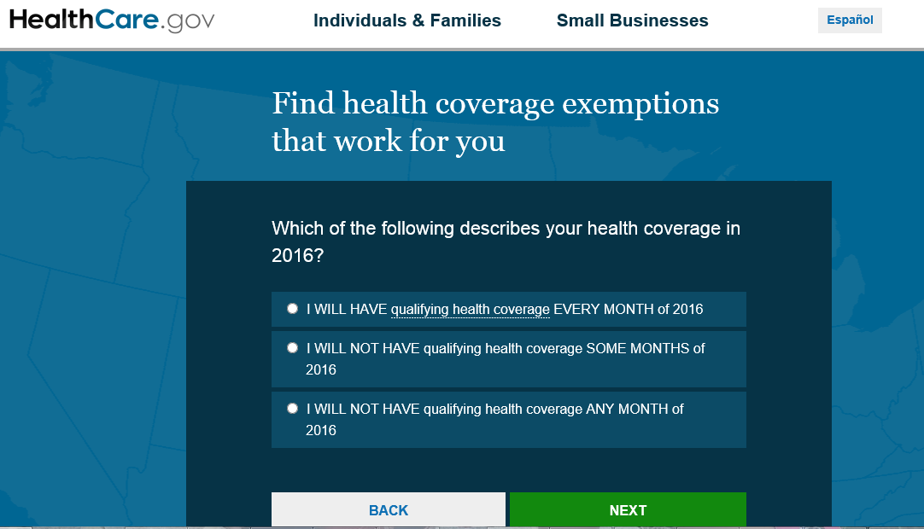
Describe Your Health Coverage in 2016
If consumers have a period of non-coverage, they click here and then select the months they had no coverage
Notes:
Next, consumers select the scenario that applies to them for how long they had or went without health coverage in 2016.
Qualifying coverage during EVERY MONTH of 2016
No qualifying coverage during SOME MONTHS of 2016 (next screen will ask which months the consumer had no coverage)
No qualifying coverage during ANY MONTH of 2016

Slide 22
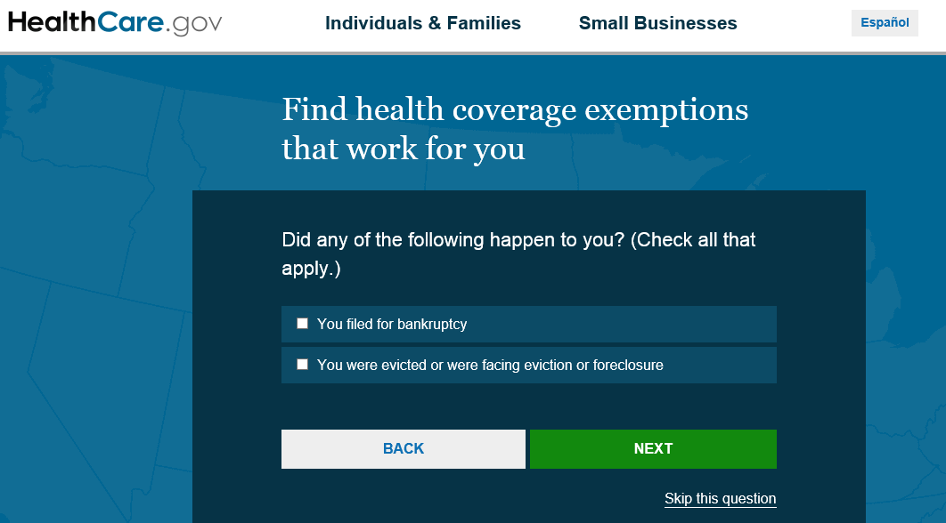
What Happened?
Select one or both if they apply
Notes:
The next few screens are all additional optional questions that help screen consumers for specific exemptions. They have the option to skip these questions or click next to continue. Note: If they skip questions, they could miss exemptions that could cover them for all months—and wind up paying the fee when they don’t have to. This question regarding bankruptcy and eviction or foreclosure is asked to screen for a possible “hardship” exemption. Hardships are life situations that keep consumers from getting health insurance.
On this screen, consumers select if either happened to them in 2016.
Did they file for bankruptcy?
Were they evicted or were they facing eviction or foreclosure?

Slide 23
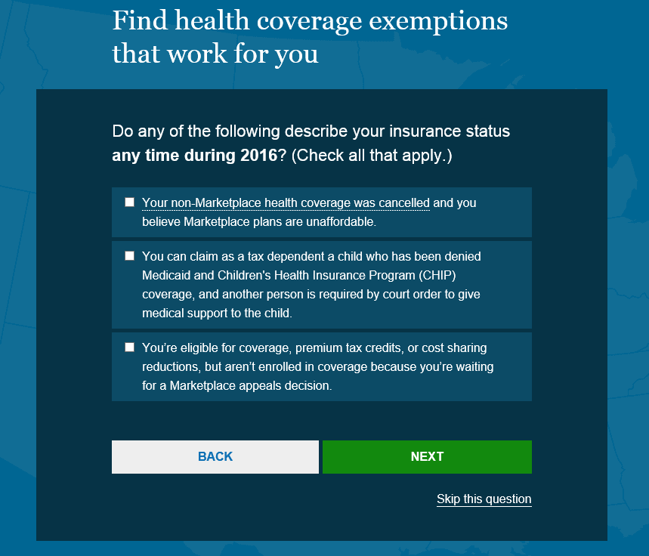
Screening for Health Coverage-related Exemptions
Consumers may check all that apply to them to better describe their insurance status during 2016
Notes:
Again, if any of these statements describe a consumer’s situation at any time during 2016, check all that may apply.

Slide 24
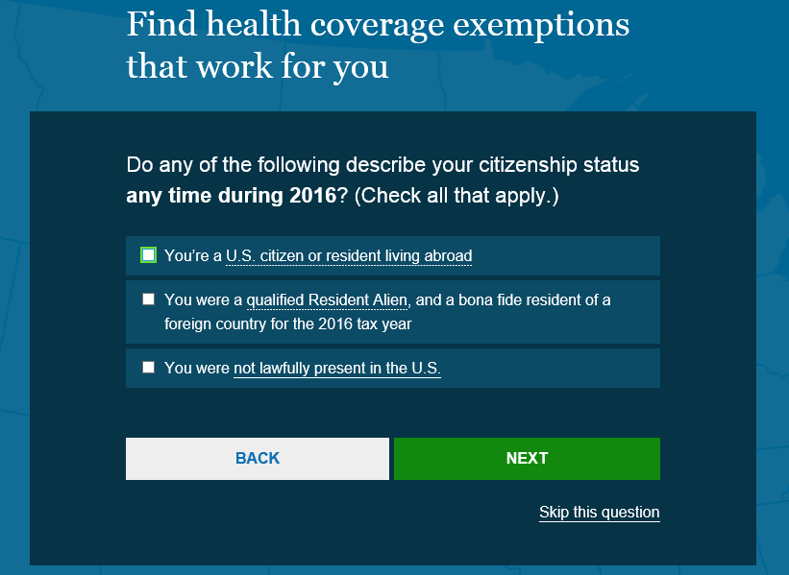
Citizenship Status
Consumers may check the citizenship status that applies to them
Notes:
Again, consumers may select the status that best describes them during 2016.

Slide 25
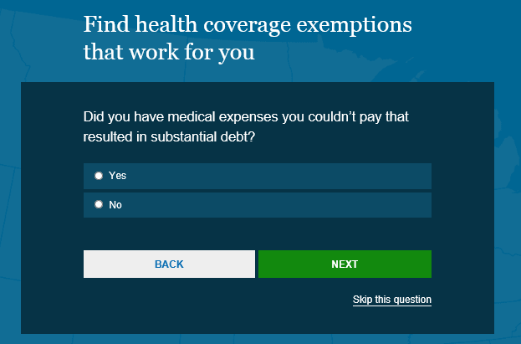
Screened for Specific Hardship Exemption
Notes:
If consumers have medical expenses they couldn’t pay, this is considered a “hardship” that kept them from getting health insurance.

Slide 26
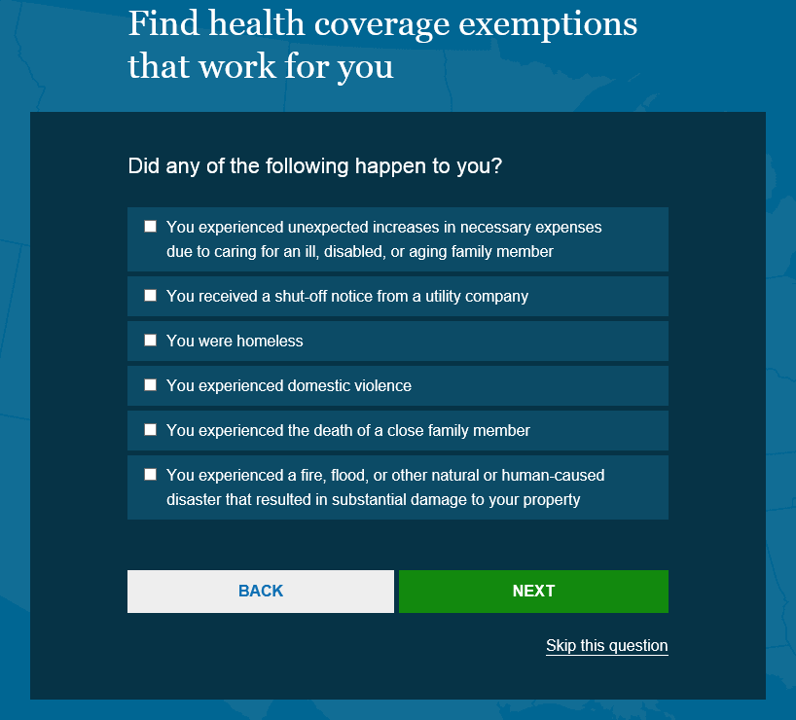
Other Consumer Experiences
Consumers may check all that applied to them in 2016
Notes:
Again, consumers may select the status that best describes them during 2016.

Slide 27
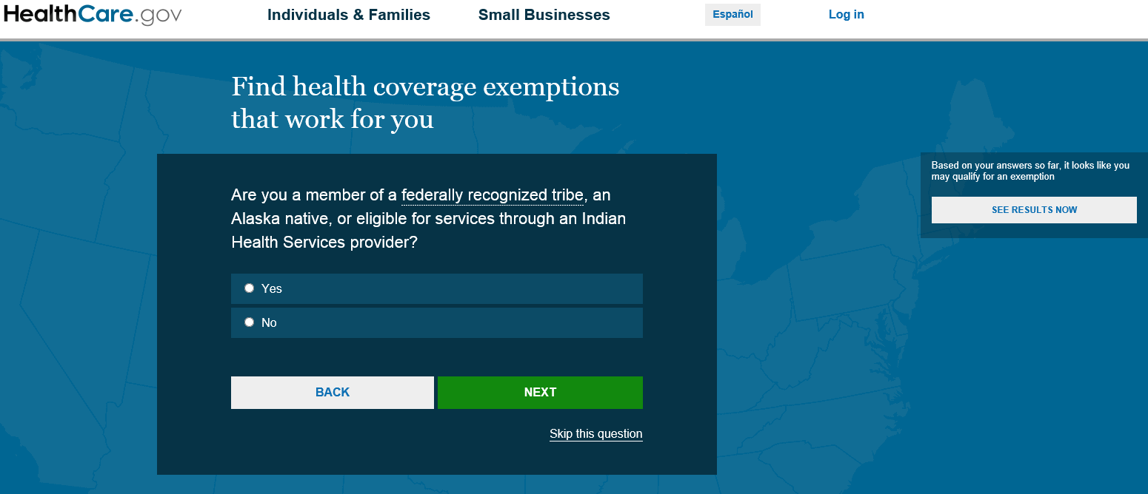
Group Membership Exemption Screener
Notes:
This question screens consumers for a group membership exemption.

Slide 28
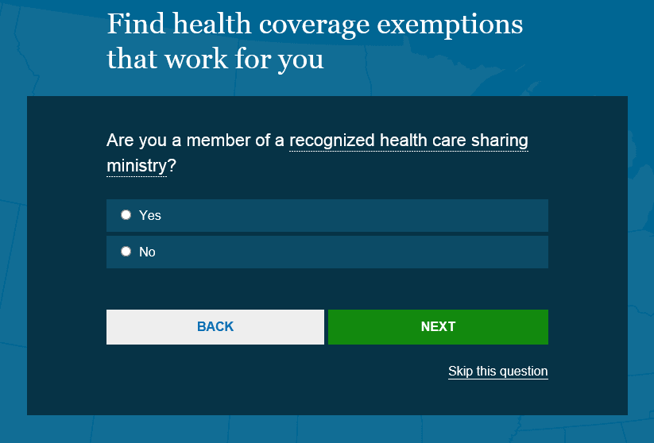
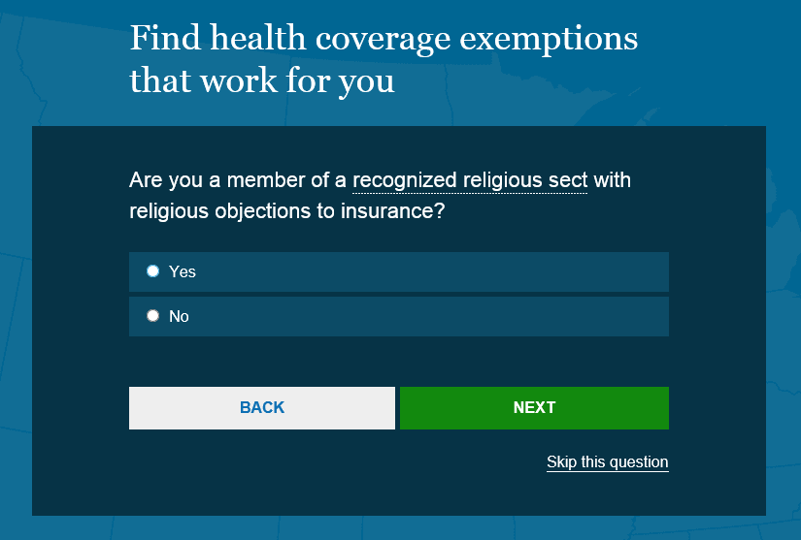
Group Membership Exemption Screener (continued)
Notes:
There are questions that screen consumers for group membership exemption. Consumers are asked if they are a member of a recognized health care sharing ministry and if they are a member of a religious sect with religious objections to insurance.

Slide 29
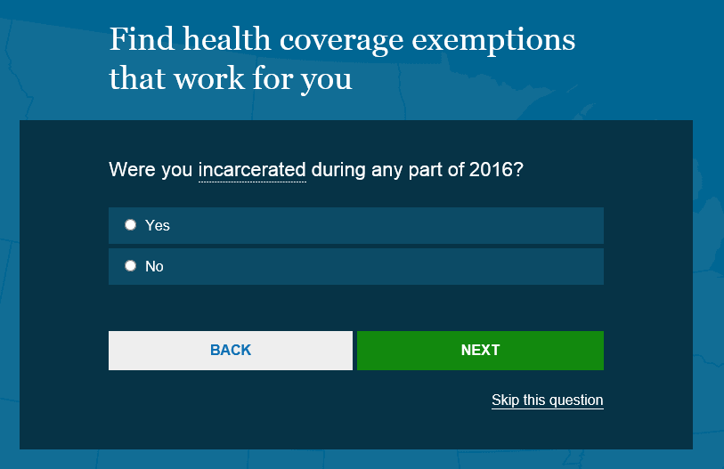
Another Optional Screening Question for Other Exemptions
Notes:
Another optional screening question for other exemptions.

Slide 30
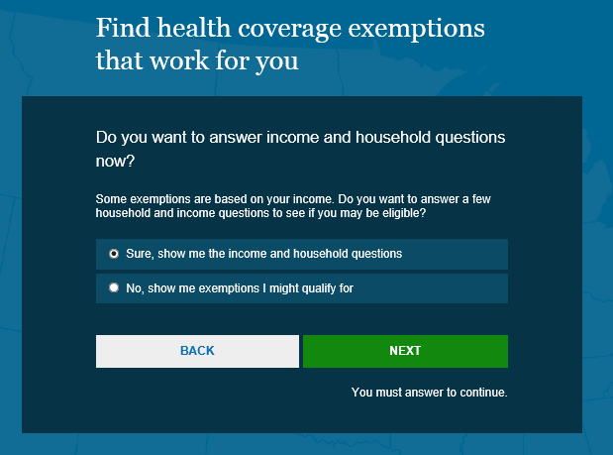
Answer Income and Household Questions
Choose to answer income and household questions
Or choose to see other possible exemptions
Notes:
Here, consumers can choose to either answer some income and household questions to see some exemptions that are based on their 2016 income, or see other exemptions they might qualify for. The upper right box is a feature included to help tax preparers and other assisters see results right away based on the information already provided.
In our scenario, we’ll choose to answer the few questions to see if there are exemptions that may apply based on 2016 income.

Slide 31
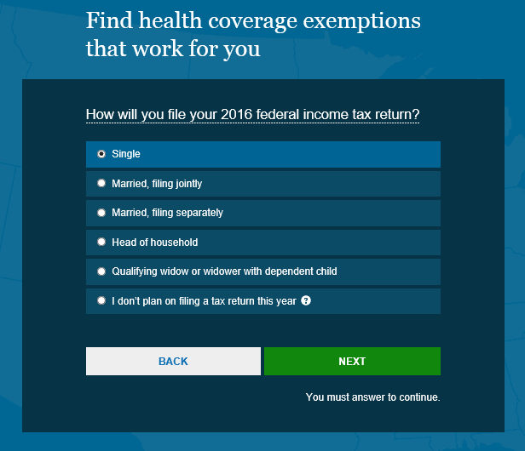
Income and Household Questions
Notes:
Answer these income and household questions.

Slide 32
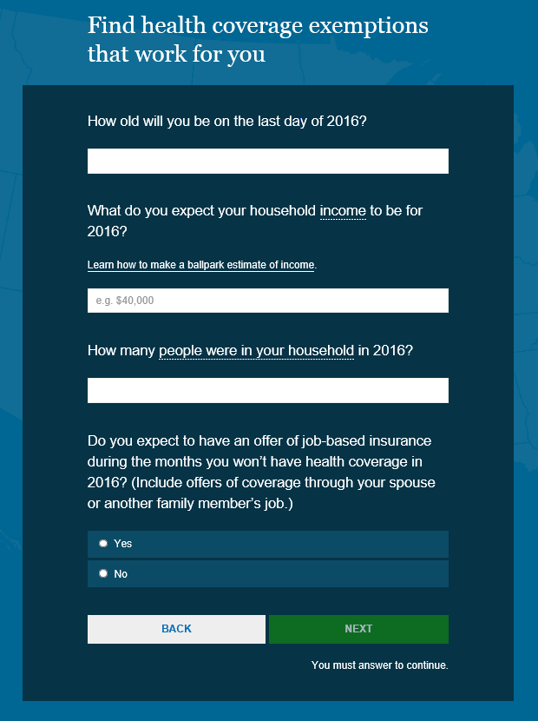
Screening Questions for Other Exemptions
Notes:
Answer these screening questions for other exemptions.

Slide 33
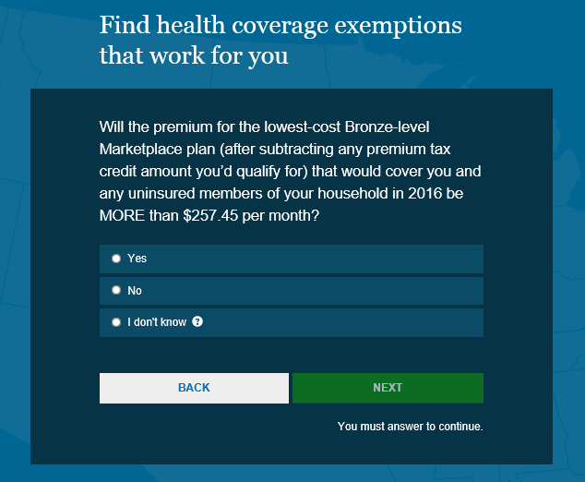
Marketplace Health Coverage Unaffordable?
Check the premium for the lowest cost Bronze plan available to the consumer in 2016?
If the consumer doesn’t know the amount, get 2016 premium information from their employer. They can’t get accurate results without this information. Select “I don’t know” and we’ll explain what to do on the results page for this exemption
Amounts will vary. $257.45 is based on the income provided for this example.
Notes:
Next, consumers are asked whether the premium for the lowest-cost Bronze Marketplace plan (less any tax credit amount they would have qualified for) available to them in 2016 was more than $257.45 per month. (This amount may vary based on the income amount provided). This question screens for an income-related exemption to see whether the lowest-priced coverage available to them, through either a Marketplace or job-based plan, would cost more than 8% of their household income.
If they don’t know the amount they can select the “I don’t know” button. They can hover over the question icon, and a pop-up will explain why and how to get this information from their employer, and their results will include what to do for this exemption.

Slide 34
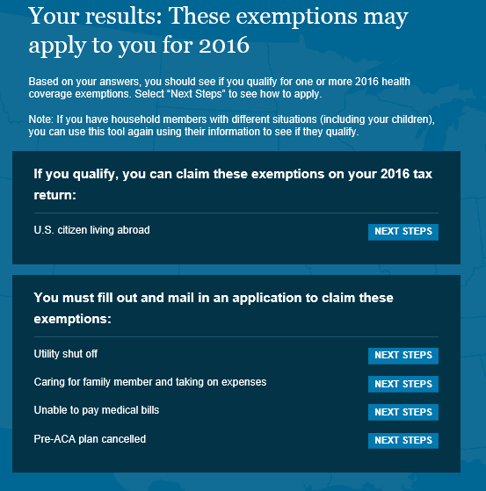
YOUR RESULTS
Notes:
The consumer’s results will be based on their answers. They could qualify for one or more exemptions, or none. Their results will list those IRS exemptions they can claim on their 2016 tax return and any Marketplace exemptions that require them to fill out and mail in an application to claim an exemption. Click on “Next Steps” for details about each exemption, and step-by-step instructions on how to apply.
Note: Consumers can email their results, but keep in mind emailing or sharing may expose sensitive information. Share this information only with trusted people.

Slide 35
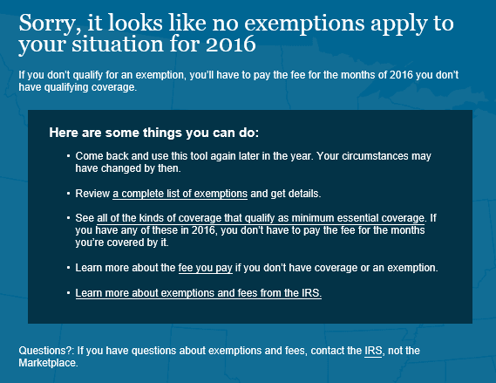
If No Exemptions Apply to Your Situation
If consumers didn’t have qualifying coverage, and don’t qualify for an exemption, they’ll have to pay the fee for the months of 2016 they didn’t have coverage
Notes:
If no exemptions apply to a consumer’s situation, they’ll have to pay the fee for any of the months in 2016 they didn’t have qualifying coverage. If they have questions about exemptions and fees, be sure to contact the IRS or visit IRS.gov/Help-&-Resources for more information.

Slide 36
Tips for Helping Consumers with Exemption Applications
Read about each exemption type to determine which best fits the consumer’s situation
Ensure the consumer completes all questions, including Step 2 of the application for every adult in the tax household
Encourage consumers to submit any supporting documents requested on the application (note: different exemptions require different documents) or processing will be delayed
Originals (other than the application itself) should not be sent.
Consumers should keep a copy of the completed application and all documents submitted to the Marketplace, along with proof of mailing
Notes:
Read about each exemption type to determine which best fits the consumer’s situation.
Ensure the consumer completes all questions, including Step 2 of the application for every adult in the tax household. The Marketplace may have to contact the consumer to collect missing information.
Encourage consumers to submit any supporting documents requested on the application (note: different exemptions require different documents) or processing will be delayed.
Originals (other than the application itself) should not be sent.
Consumers should keep a copy of the completed application and all documents submitted to the Marketplace, along with proof of mailing.

Slide 37
Resources
Exemption Application Forms at HealthCare.gov/health-coverage-exemptions/forms-how-to-apply/
Form 8965 and its instructions at irs.gov/uac/About-Form-8965
Catastrophic Plan Information at HealthCare.gov/choose-a-plan/plans-categories/#catastrophic
Exemption types at HealthCare.gov/exemptions
Marketplace resources at Marketplace.cms.gov
Notes:
Find more information about:
Exemption Application Forms at HealthCare.gov/health-coverage-exemptions/exemptions-from-the-fee/
Form 8965 and its instructions at irs.gov/uac/About-Form-8965
Catastrophic Plan Information at HealthCare.gov/choose-a-plan/plans-categories/#catastrophic
Exemption types at HealthCare.gov/health-coverage-exemptions/hardship-exemptions/

Slide 38
National Training Program Contact Information
This training module is provided by the
CMS National Training Program (NTP)
For questions about training products email training@cms.hhs.gov.
To view all available NTP materials,
or to subscribe to our email list, visit cms.gov/outreach-and-education/training/cmsnationaltrainingprogram/.
Notes:
This training module is provided by the CMS National Training Program (NTP).
For questions about training products, email training@cms.hhs.gov.
To view all available CMS NTP materials, or to subscribe to our email list, visit cms.gov/outreach-and-education/training/cmsnationaltrainingprogram.

