Slide 1

An Overview for 2017 Coverage

Slide 2
Presentation Overview
This presentation provides an overview of the benefits of the Small Business Health Options Program Marketplaces (a SHOP Marketplace) available through on HealthCare.gov
Topics Covered:
What is a SHOP Marketplace
Benefits of a SHOP Marketplace
Which employers can participate in a SHOP Marketplace and when can they enroll
Marketplace options for the self-employed
Who is required to offer health insurance coverage
SHOP Marketplace Minimum Participation Rate
Health and dental coverage options
How a SHOP Marketplace works
Employee choice
SHOP Marketplace enrollment process
How to pay SHOP Marketplace premiums
The Small Business Health Care Tax Credit
SHOP Marketplace resources and tools

Slide 3
What is the SHOP Marketplace?
The Small Business Health Options Program =
SHOP Marketplace
Each SHOP Marketplace is a Health Insurance MarketplaceSM created by the Affordable Care Act (ACA)
Offers small employers (generally those with 1-50 full-time employees) a choice of quality health and dental plans provided by private insurance companies
States may choose to allow employers with 1-100 full-time employees to participate in the SHOP Marketplace and enroll in small group market coverage
Small employers who offer coverage through a SHOP Marketplace may be eligible for the Small Business Health Care Tax Credit which may be worth up to 50% of their contributions to premiums (up to 35% for tax-exempt employers)
Works with health insurance reforms to help spur competition based on price and quality

Slide 4
Benefits of the SHOP Marketplace
Convenience and choice:
Complete a new group enrollment at any point during the year
Browse, compare, apply, and enroll in SHOP Marketplace health and dental plans on HealthCare.gov
Offer one or multiple plans
Receive one bill and make one premium payment a month, per state
Renew coverage online, on your own or with an agent or broker
Control over spending:
Employers decide which plan(s) to offer qualified employees and how much they want to contribute to health and dental insurance premiums
Access to tax credits:
When you offer and purchase coverage through the SHOP Marketplace, you may be eligible for a tax credit worth up to 50% of your contributions to premiums (35% for tax exempt employers)
Many ways to get help:
Information and assistance are available through HealthCare.gov, the SHOP Call Center, SHOP Marketplace registered agents and brokers and through navigators

Slide 5
Which Employers can Participate in a SHOP Marketplace?
To be eligible to purchase coverage in the SHOP Marketplace, employers must:
Are you eligible to participate? Use the SHOP FTE Calculator on HealthCare.gov to count full-time employees and full-time equivalent employees: https://www.healthcare.gov/shop-calculators-fte/
1
Be a “small employer” (generally, a small employer has 1-50 employees)
2
Offer coverage to all full-time employees (those working 30 or more hours per week, on average)
3
Have at least one employee enrolling in coverage
4
Have a principal business address or eligible employee worksite in the state in which coverage is offered

Slide 6
Options for the Self-Employed
Self-employed individuals are not eligible to enroll through the SHOP Marketplace unless they have at least one employee who enrolls
Self-employed individuals with no employees may be able to enroll in coverage through the Health Insurance MarketplaceSM for Individuals & Families on HealthCare.gov
Health Insurance MarketplaceSM for Individuals & Families:
Premium tax credits may be available, depending on annual household income
Individuals generally must enroll during the Open Enrollment period, unless they have a life event, such as getting married or having a child
Open Enrollment for 2017 is November 1, 2016 - January 31, 2017

Slide 7
What Size Employers are Required to Offer Health Insurance Coverage?
REQUIRED 50 or MORE Full-Time and FTE Employees
NOT REQUIRED FEWER THAN 50 Full-Time and FTE Employees
If employers do not offer health coverage to at least 95% of their full-time employees (and their dependents) that meets the affordability standard and the minimum value standard, they may be subject to an Employer Shared Responsibility Payment
Employers with fewer than 50 full time and full-time equivalent (FTE) employees are not subject to the Employer Shared Responsibility Payment provisions.
If they choose not to offer health coverage to their full-time employees (and their dependents), they will not be assessed an Employer Shared Responsibility Payment
For more information on Employer Shared Responsibility requirements, visit IRS.gov

Slide 8
SHOP Marketplace Minimum Participation Requirement
In most states, 70% of a group’s employees offered coverage generally must accept the offer of SHOP Marketplace coverage or be enrolled other qualified health coverage for a group to participate in the SHOP Marketplace
Unless the group enrolls between November 15 and December 15 when no Minimum Participation Rate (MPR) applies
Use the SHOP Marketplace Minimum Participation Rate (MPR) Calculator to find out about the MPR in you state and help predict if your small group will meet the MPR for you state:
https://www.healthcare.gov/small-businesses/shop-calculators-mpr/
Employees with Non-SHOP Coverage Count Towards a Group’s Minimum Participation Rate
Employees with other qualified non-SHOP Marketplace health coverage, such as through a spouse or government program, will be counted toward the MPR.

Slide 9
Calculating the Minimum Participation Rate
Here’s how the SHOP Marketplace MPR is calculated:
MPR = Number of Full-time Employees Enrolling in Other Qualified Coverage
Number of Full-time Employees Offered SHOP Marketplace Coverage
Here’s an example:
If an employer offers coverage to 10 full-time employees, and 2 have coverage through a spouse’s employer, and 1 is covered by Medicare
70% of 10 employees = 7 employees
3 employees have other coverage that counts towards the MPR, so 4 additional employees must accept the employer’s offer of SHOP Marketplace coverage or be enrolled in other types of qualified health coverage, before the employer can enroll
From November 15th- December 15th, eligible small employers can enroll in SHOP Marketplace coverage without meeting the MPR requirement

Slide 10
Health & Dental Coverage Options in the SHOP Marketplace
Employers may offer their qualified employees one of three options through the SHOP Marketplace:
Only health coverage
Only dental coverage
Both health and dental coverage
If a qualified employee is offered both health and dental coverage, he/she may choose to enroll in both health and dental coverage, only health coverage, or only dental coverage
Employers may also offer health and dental coverage to their employees’ dependents
Dependents must enroll in the same health and/or dental plan as the qualified employee
If a qualified employee is offered both health and dental coverage and enrolls in both, dependents will be able to enroll in either the health or dental coverage the employee picks, or in both
10

Slide 11
How the SHOP Marketplace Works: Different Plans for Different Budgets
SHOP Marketplace health plans are available in four plan categories: Bronze, Silver, Gold, and Platinum
Categories generally reflect how much enrollees pay for premiums, deductibles, copayments, and the total amount they’d expect to have to spend out-of-pocket for the year
Example:
Platinum health plans may be expected to cover 90% of the total cost of covering essential health benefits, but the monthly premium will generally be the highest compared to plans in the other categories
All plans cover “essential health benefits,” but can differ by provider network, prescription drug formularies, or additional benefits offered, among other things
Plans cannot charge higher premiums for enrollees based on high medical costs or pre-existing medical conditions, raise premiums because an enrollee needs care, or charge women more than men based on gender
Plan Category | Total cost of care paid by the plan (on average) | Total cost of care paid by the employee (on average)
Bronze | 60% | 40%
Silver | 70% | 30%
Gold | 80% | 20%
Platinum | 90% | 10%
11

Slide 12
How the SHOP Marketplace Works: Different Plans for Different Budgets
SHOP Marketplace dental plans are available in two plan categories: High and Low
Categories generally reflect how much enrollees pay for premiums, deductibles, copayments, and the total amount they’d expect to pay out-of-pocket for the year
High dental plans have generally higher premiums but lower copayments and deductibles compared to low dental plans. So you’ll generally pay more every month, but less when you go to the dentist
Low dental plans generally have lower premiums but higher copayments and deductibles compared to high dental plans. So you’ll generally pay less every month, but more when you go to the dentist
12

Slide 13
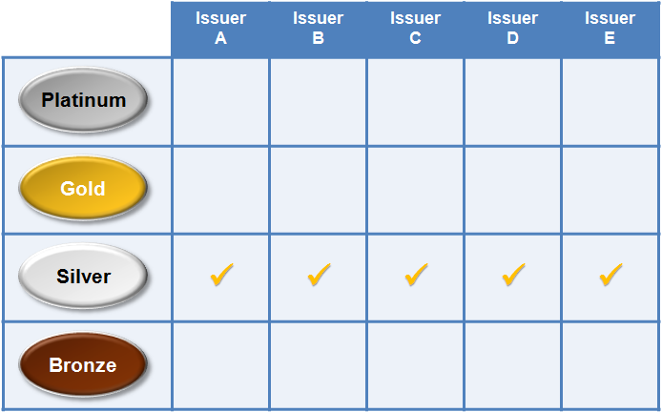
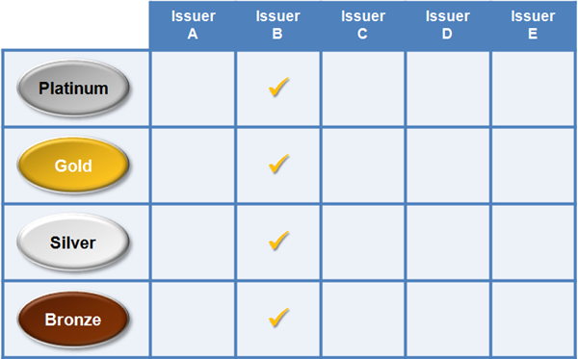
Employee Choice: Offering Employers Flexibility & Control
Employee Choice by Plan Category
Employers can offer qualified employees:
A single health or dental plan
A choice of plans within a plan category the employer chooses
Qualified employees choose any plan across insurance companies within the selected plan category
And, in some states a choice of plans offered by a single health insurance company the employer chooses
Qualified employees choose any plan across coverage categories offered by the selected health insurance company
Employee Choice by Insurance Company
13

Slide 14
Employee Choice: Offering Employers Flexibility & Control (Continued)
Advantages of offering qualified employees a choice of plans:
They can choose plans that best fit their coverage needs
Employer does not have to predict their health care needs
Employer receives and pays just one monthly bill even when offering multiple plans with different health insurance companies, per state
Employer sets choice limits to control health care costs
14

Slide 15
See Plans & Prices on HealthCare.gov
Browse available SHOP Marketplace health and dental plans before choosing coverage
Save time with the application process by becoming familiar with coverage options before you get started
See plan and pricing options that are available in your area without creating an account
Generate estimates for customized premium and out-of-pocket plan costs
Choose coverage that is affordable for both employers and employees
Compare plans based on product network type, plan category, insurance company, premium, deductible, and out-of-pocket maximum
Make an informed decision that fits employers’ and employees’ budget and coverage needs

Slide 16
How to Enroll in the SHOP Marketplace: Employers
There are two ways employers may enroll their group in SHOP Marketplace coverage through HealthCare.gov:
Option 1: Enroll with a SHOP Marketplace registered agent or broker:
Create an account on HealthCare.gov
Log in and select the “Get Assistance/ Find an Agent or Broker” tab to find and authorize a SHOP Marketplace registered agent/broker to assist with your SHOP Marketplace application and enrollment.
Authorize a SHOP Marketplace registered agent or broker to help enroll your group in SHOP Marketplace coverage
Submit initial premium payment—you should submit your initial premium payment once your employees have responded to your offer of coverage after the applicable minimum participation rate has been met. Agents and brokers can’t submit payments for you

Slide 17
How to Enroll in the SHOP Marketplace: Employers (continued)
Option 2: Enroll on your own without an agent or broker
Select the “Small Business” tab on the top of HealthCare.gov and then the green “For Employers” button
Select your state from the drop-down menu and click “Apply Now”
Create a HealthCare.gov account
Complete a SHOP Marketplace application
Select coverage, contribution, and make an offer to employees
Track employee participation and submit enrollment
Submit initial premium payment

Slide 18
How to Enroll in the SHOP Marketplace: Employees
Enroll online through HealthCare.gov
Receive an email from the SHOP Marketplace that includes the employer’s offer of coverage and a SHOP participation code
Create a HealthCare.gov account and log in
Select “Visit Employee Marketplace”
Confirm eligibility by entering the participation code included in your offer email
Review your coverage offer; if the employer is offering you a choice of plans, select a plan, and add dependents if applicable
NOTE: If an employee does not sign up for SHOP Marketplace coverage during the initial enrollment period, he/she can only enroll later due to a life-changing event, such as having or adopting a child or getting married, or wait until the annual renewal period for the employer.

Slide 19
How to Pay SHOP Marketplace Premiums
QUALIFIED
EMPLOYEES generally pay SHOP Marketplace premiums to their employer through a payroll deduction or upfront (unless their employer is paying their entire premium)
EMPLOYER receives one monthly bill from the SHOP Marketplace in each state, even if employees are enrolled in different plans with different insurance companies
EMPLOYER pays SHOP Marketplace premiums using one of the following options:
- Online
- Phone
- Mail
SHOP MARKETPLACE disburses employer’s premium payment to the insurance company(ies) upon receipt
NOTE: The SHOP Marketplace must receive the initial premium payment by the 20th of the month for coverage to begin on the 1st of the following month.

Slide 20
Employer Options for Premium Contributions
Contribution methods available through the SHOP Marketplace:
Fixed percentage
Reference Plan Contribution
Fixed Percentage: Employer chooses a fixed percentage to contribute to employees and (if applicable) dependents’ monthly premiums before any applicable tobacco surcharge is applied(marketplace.cms.gov/outreach-and-education/shop-premium-payments.pdf). Employer offering a single plan must use this method.
Example: Jane is 25 and her plan premium is $200, John is 60 and his plan premium is $300. The fixed percentage is 80%. The employer will pay $160 toward Jane’s plan premium and $240 toward John’s plan premium
 | Jane | John
Plan Premium | $200 | $300
Fixed Percentage | 80%
Employer Contribution | $160 | $240
*premium prices reflected here do not include any applicable tobacco surcharge
20

Slide 21
Employer Options for Premium Contributions (continued)
Reference Plan Contribution: When an employer decides to offer their employees a choice of plans, they can select to calculate premiums based off of a fixed contribution or they can select one plan to base their premium contribution off of (“reference plan”). The amount the employer decides to contribute towards all of his/her employee contributions will be based off of this reference plan regardless of the plan the employee chooses. If dependent coverage is offered, the employer can choose a different contribution amount. The employer’s contribution is calculated based on an enrollee’s premium before any applicable tobacco surcharge is applied.
Example: If the reference plan premium is $100 for an employee and the employer’s contribution is 50%, the employer will pay $50 toward the employee’s plan premium—even if the employee chooses a plan other than the reference plan
Reference Plan | $100
Percentage | 50%
Employer Contribution | $50
*premium estimates do not include any applicable tobacco surcharge
21

Slide 22
Contribution Comparison
Fixed Percentage
EMPLOYEE | PLAN A | PLAN B | PLAN C
Jane Doe (25) | $ 200 x 80% $160 | $250 x 80% $200 | $275 x 80% $220
John Doe (60) | $300 x 80% $240 | $350 x 80% $280 | $375 X 80% $300
Assume an 80% employer contribution for both examples
In the fixed percentage, employer contributions vary by plan and enrollee age
Assume the employer chooses Plan B as a reference plan
Employer contribution is constant across plans (but still varies for each enrollee based on age)
Reference Plan Contribution
EMPLOYEE | PLAN A | PLAN B (Reference) | PLAN C
Jane Doe (25) | $ 200 $200 | $250 x 80% $200 | $275 $200
John Doe (60) | $300 $280 | $350 x 80% $280 | $375 $280

Slide 23
What is the Small Business Health Care Tax Credit?
The Small Business Health Care Tax Credit is generally only available to employers who have purchased coverage through a SHOP Marketplace
Small employers ability to get back a portion of their premium contributions through the tax credit
The tax credit may be worth up to 50% of eligible employers’ premium contributions (up to 35% for tax-exempt employers)
To qualify for the tax credit, employers must:
Have employees enrolled in SHOP Marketplace health or dental plan(s)
Have fewer than 25 FTEs (based on a 40 hour work week)
Pay average wages of less than around $50,000 per year per FTE, adjusted annually for inflation
Contribute at least 50% toward employee-only premium costs
File for the tax credit with IRS

Slide 24
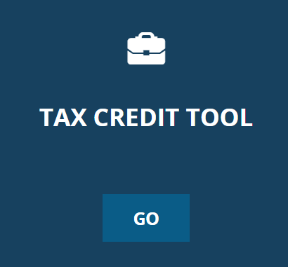
Small Business Health Care Tax Credit (continued)
For tax years 2014 and beyond, employers can claim the tax credit for two consecutive years
Use the Tax Credit Estimator on HealthCare.gov to see if you might be eligible and how much the credit could be worth for your business

Slide 25
SHOP Marketplace Tools for Employers
SHOP Tool | Functionality & Value
2. FTE Calculator | Helps employers determine if they may be a small employer for purposes of SHOP Marketplace eligibility helping them count their full-time and FTE employees
3. MPR Calculator | Helps employers determine if they meet the minimum participation requirement in their state needed to enroll in a SHOP Marketplace
4. Tax Credit Estimator | Helps employers determine if they may be eligible for the Small Business Health Care Tax Credit, and estimate its value
Looking for the tools? Visit https://www.healthcare.gov/small-businesses/

Slide 26
SHOP Marketplace Resources
Top Questions About the SHOP Marketplace healthcare.gov/small-businesses/get-answers
Information on the Small Business Health Care Tax Credit irs.gov/Affordable-Care-Act
Affordable Care 101 Webinar: What the Healthcare Law Means for Small Employers bit.ly/AffordableCare101
Agent/Broker Essentials: Information on the SHOP Marketplace healthcare.gov/small-businesses/for-agents-and-brokers
SHOP Marketplace Agent/Broker Portal (for SHOP-registered Agents/Brokers) healthcare.gov\marketplace\small-businesses\agent
SHOP Marketplace Registration Information for Agents and Brokers cms.gov\cciio\programs-and-initiatives\health-insurance-marketplaces\a-b-resources.html
Working with an Agent or Broker in the SHOP Marketplace
http://go.hc.gov/shop-videos
Connect with the SHOP Marketplace on LinkedIn
go.hc.gov/shop
26

Slide 27
SHOP Marketplace Resources (continued)
Using Agents and Brokers in the SHOP Marketplace healthcare.gov/small-businesses/provide-shop-coverage/using-insurance-agents-and-brokers/
Detailed Instructions on How to Enroll for Employers marketplace.cms.gov/outreach-and-education/enroll-in-shop.pdf
How to Enroll in the SHOP Marketplace - Employees marketplace.cms.gov/outreach-and-education/enroll-in-shop-employees-2016.pdf
Detailed Instructions on How to Enroll for Employees marketplace.cms.gov/outreach-and-education/enroll-in-shop-employees.pdf
What Employees Should Know About the SHOP Marketplace marketplace.cms.gov/outreach-and-education/employees-should-know-about-shop-2016.pdf
ACA Rules, Guidance, Agent and Broker Resource Page cms.gov\cciio\programs-and-initiatives\health-insurance-marketplaces\a-b-resources.html
SHOP Call Center 1-800-706-7893 (TTY: 711) Available Monday – Friday, 9am – 7pm ET
27

