Slide 1
HealthCare.gov Data Collection
August 24, 2010
Training

Slide 2
Today’s Training
Discuss what we are collecting for the October release
  Product Refresh – quick summary
  Portal Plan information
Provide Technical Training on Data Entry for Portal Plans
Answer questions, and prepare for future training

Slide 3
Product Refresh
For July you submitted product information - Individual and small group major medical
New administrative fields
  Number applications
  Number denials
  Number of up-ratings
  SERFF Number

Slide 4
HIOS Re-opens
New rules go into effect with a significant shift in blocks
HIOS Re-opens August 26th though Sept. 2
You want to enter Products that will be effective in October

Slide 5
Portal Plan Requirement
  Portal plans: the combination of benefits and cost sharing before premium calculation
    Open blocks
    Linked to reported products
    Not Associations
    Individual and small group
  1% of Corporate enrollment for market in that zip code

Slide 6
Elements Requested
  Corporate information appropriate for consumers
  Tracking info (NAIC, SERFF / HIOS IDs)
  Geographic coverage: state, county, zip codes
  Standard benefits / Cost sharing
  Rating Information (Individual / Small Group)
  Enrollment by plan to get at the 1% rule (may be used in sorting)

Slide 7
Dates
Training: August 13, 24, 31, 2010
Help Desk Opens: Aug. 16
Submissions Deadline: Sept. 3
Quality Assurance: Ongoing
Release: Oct. 1
Weekly Meetings: Wed., September 1

Slide 8
Support
If you need additional assistance, please call the HIOS Help Desk at
1-877-343-6507
or email them at insuranceoversight@hhs.gov.
CMP Help for Portal Plan entry
1-877-425-3708
cmp-support@ehealth.com.

Slide 9
Content Management Portal
PRA Disclosure Statement
According to the Paperwork Reduction Act of 1995, no persons are required to respond to a collection of information unless it displays a valid OMB control number. The valid OMB control number for this information collection is 0938-1086. The time required to complete this information collection is estimated to average (106 hours) or (6,360 minutes) per response, including the time to review instructions, search existing data resources, gather the data needed, and complete and review the information collection. If you have comments concerning the accuracy of the time estimate(s) or suggestions for improving this form, please write to: CMS, 7500 Security Boulevard, Attn: PRA Reports Clearance Officer, Mail Stop C4-26-05, Baltimore, Maryland 21244-1850.

Slide 10
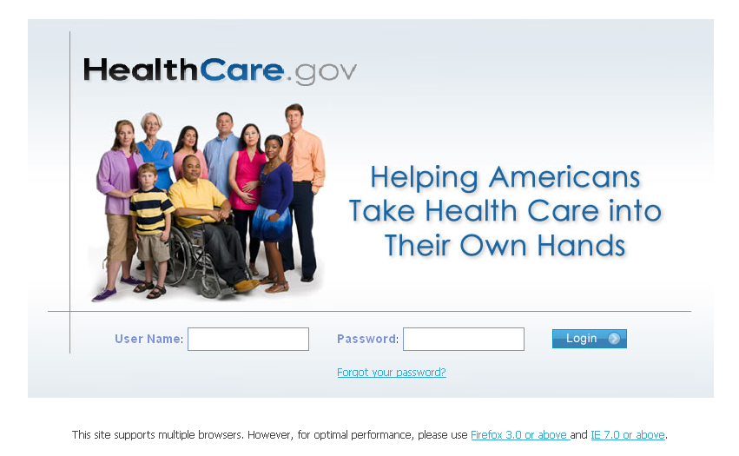
How Does CMP Work
The Content Management Portal (CMP) is a secure site for issuers to log in and enter their initial individual and small group plan data requirements.

Slide 11
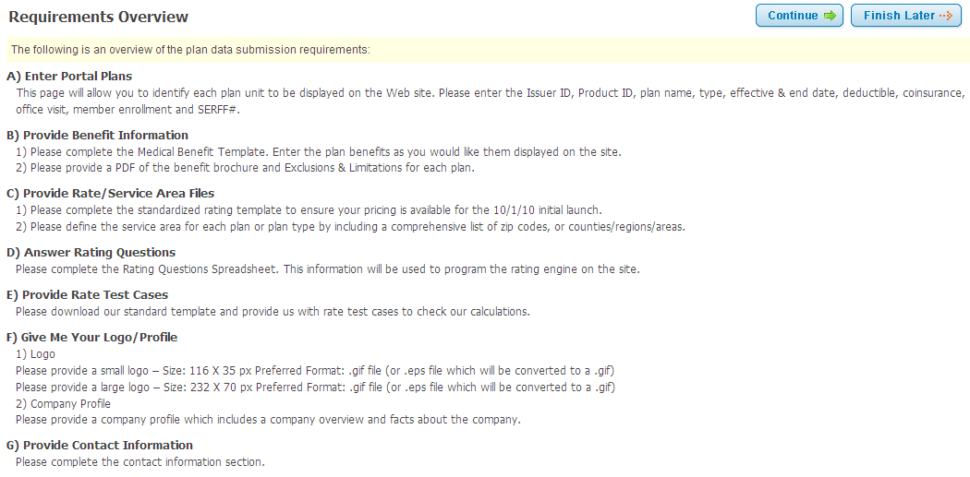
Requirements Overview
There are seven sections that need to be completed.

Slide 12
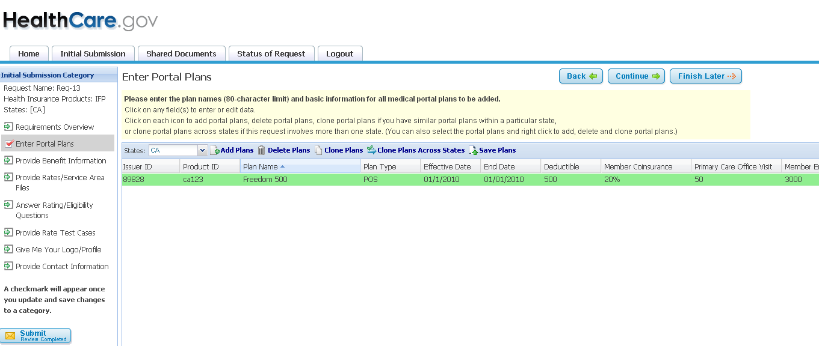
Enter Portal Plans
Issuers will be required to submit information on at least all portal plans that are open for enrollment effective 10/1/10 and that represent 1 percent or more of the issuers’ total enrollment for the respective individual or small group market within that zip code.

Slide 13
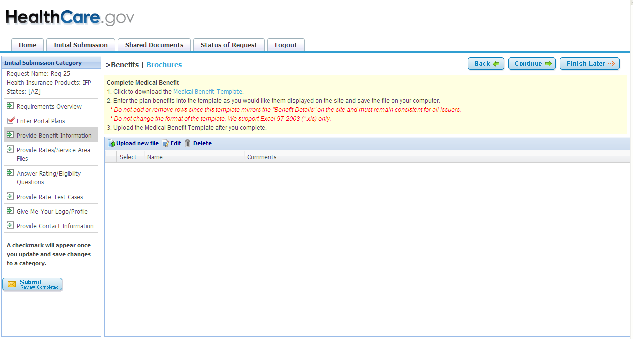
Complete Medical Benefit Template
Download the Excel Medical Benefits template by selecting Medical Benefit Template link.
There is a preferred format for the benefit category definitions, but the template also provides the flexibility to enter free form text in most of the fields.

Slide 14
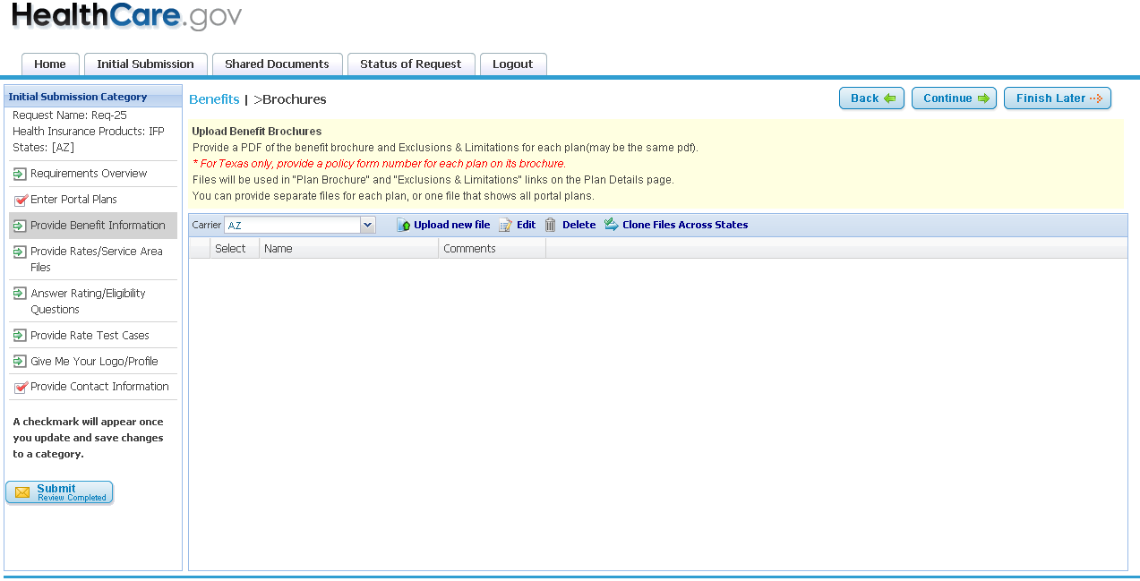
Provide Benefit Brochures
Upload Benefit Brochure pdf file and E&Ls by selecting Upload New File button.

Slide 15
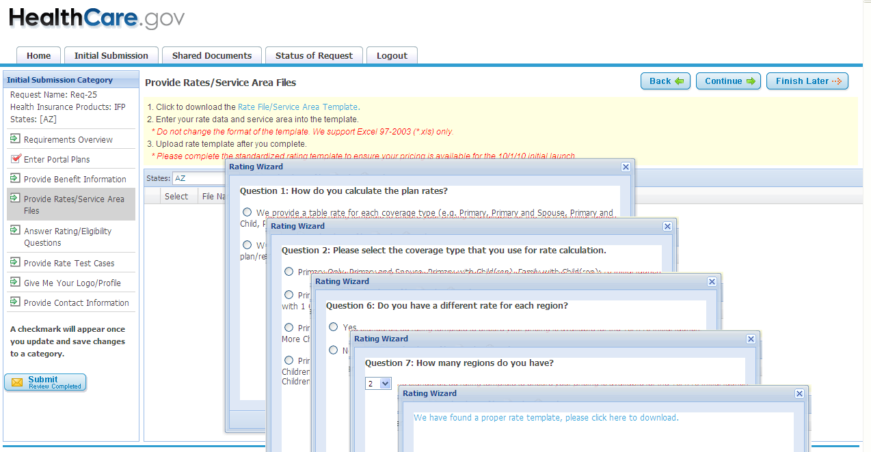
Complete Rate Template
CMP will determine which Excel rate template to download after a series of questions are answered.

Slide 16
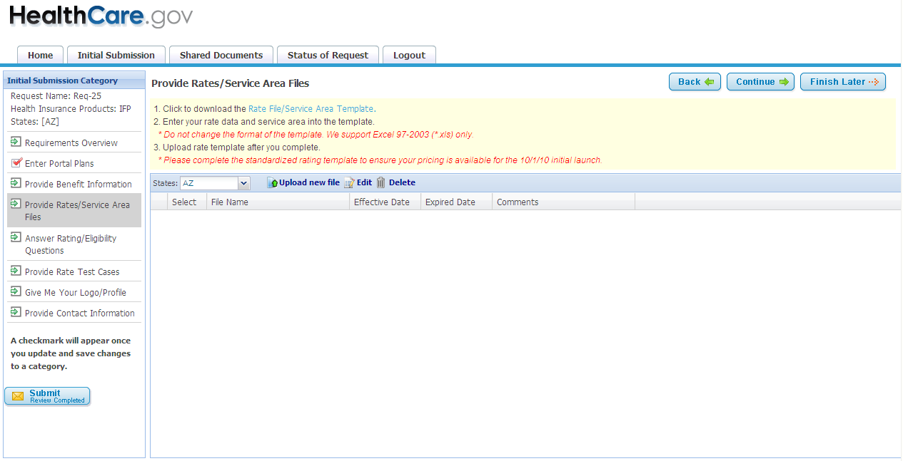
Complete Service Area Template
Complete Service Area Excel Template.

Slide 17
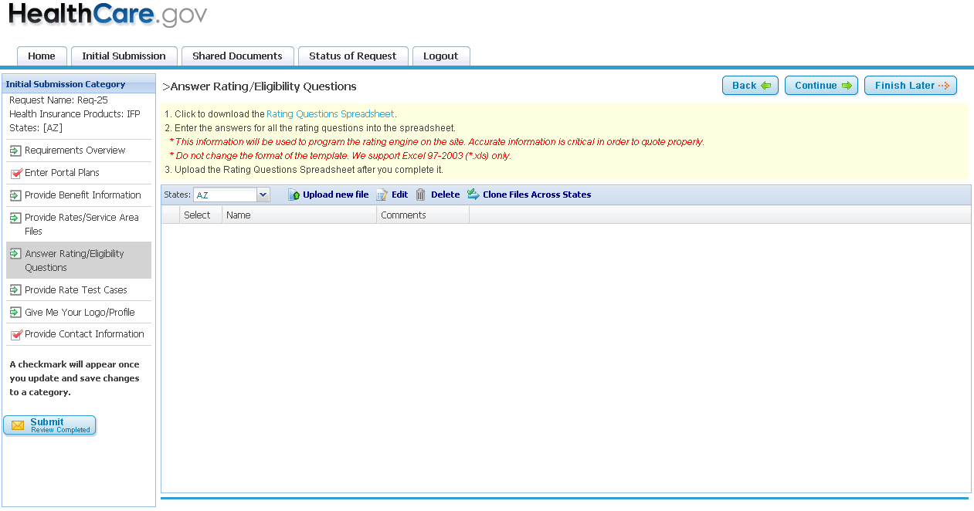
Rating/Eligibility Questions Template
Download the Rating/Eligibility Questions Excel template. The information is used in the quoting process.

Slide 18
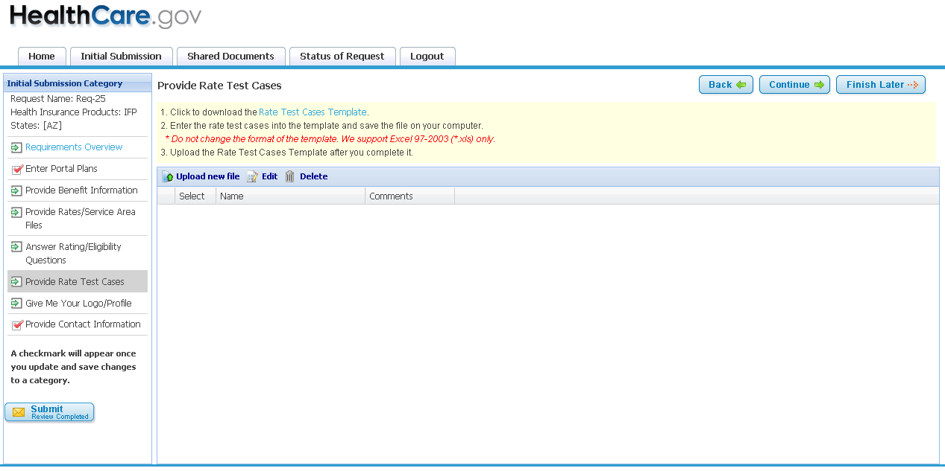
Rate Test Cases Template
Download the Excel Rate Test Cases Template.

Slide 19
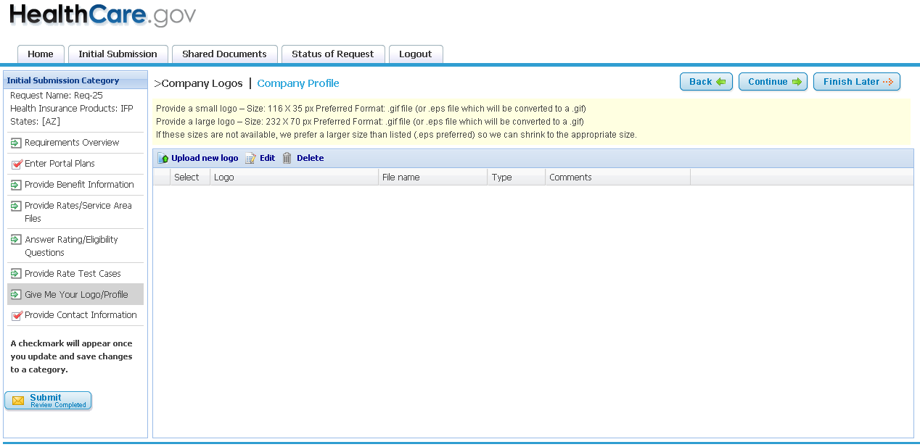
Company Profile Template
Upload Company Logos and download the Excel Company Profile.

Slide 20
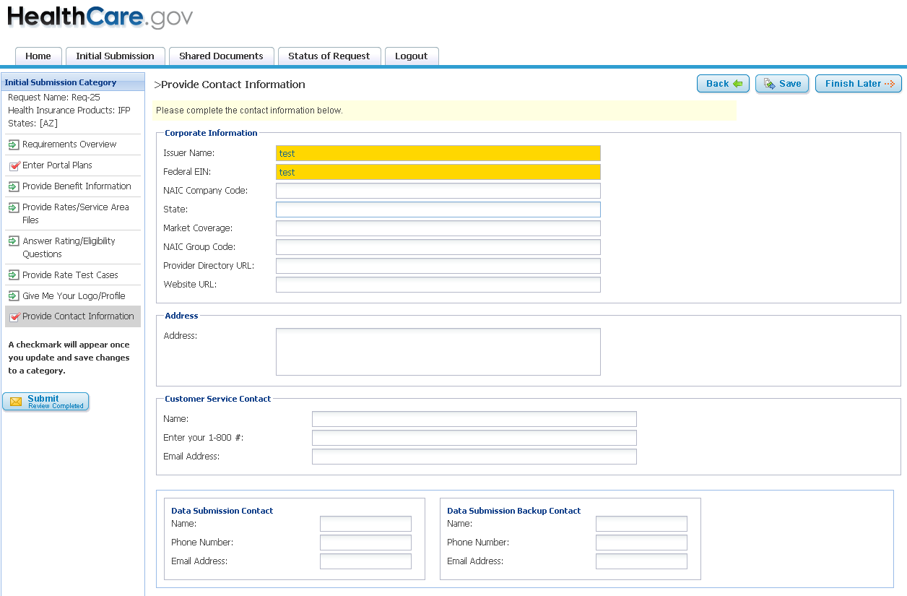
Contact Information
Enter Company Contact Information.

Slide 21
Next Steps
It is recommended that the issuer designate one data collection contact person to access CMP and coordinate the data collection internally.
Data collection contact person will complete the registration process and log onto CMP with a user ID and password. Go to https://cmp.healthcare.gov/cmp and click on the registration link.
We recommend you print out and review the Technical Instructions before you begin.
If you have any questions you can send us an email at cmp-support@ehealth.com or call 1-877-425-3708.

Slide 22
Thank You
Thank You !

