Slide 1
Content Management Portal
PRA Disclosure Statement
According to the Paperwork Reduction Act of 1995, no persons are required to respond to a collection of information unless it displays a valid OMB control number. The valid OMB control number for this information collection is 0938-1086. The time required to complete this information collection is estimated to average (106 hours) or (6,360 minutes) per response, including the time to review instructions, search existing data resources, gather the data needed, and complete and review the information collection. If you have comments concerning the accuracy of the time estimate(s) or suggestions for improving this form, please write to: CMS, 7500 Security Boulevard, Attn: PRA Reports Clearance Officer, Mail Stop C4-26-05, Baltimore, Maryland 21244-1850.

Slide 2
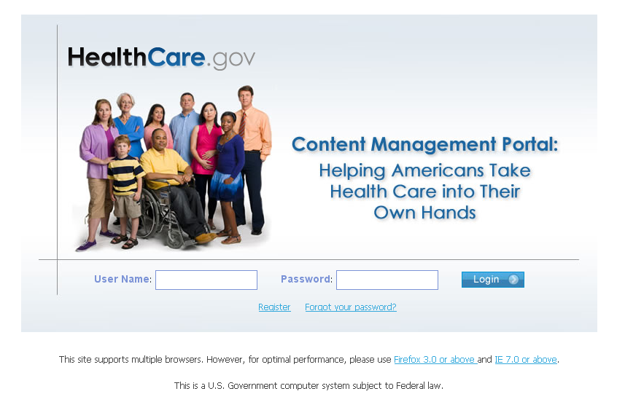
First Time Users - CMP
The Content Management Portal (CMP) is a secure site for issuers to log in and enter their initial individual and small group plan data requirements.

Slide 3
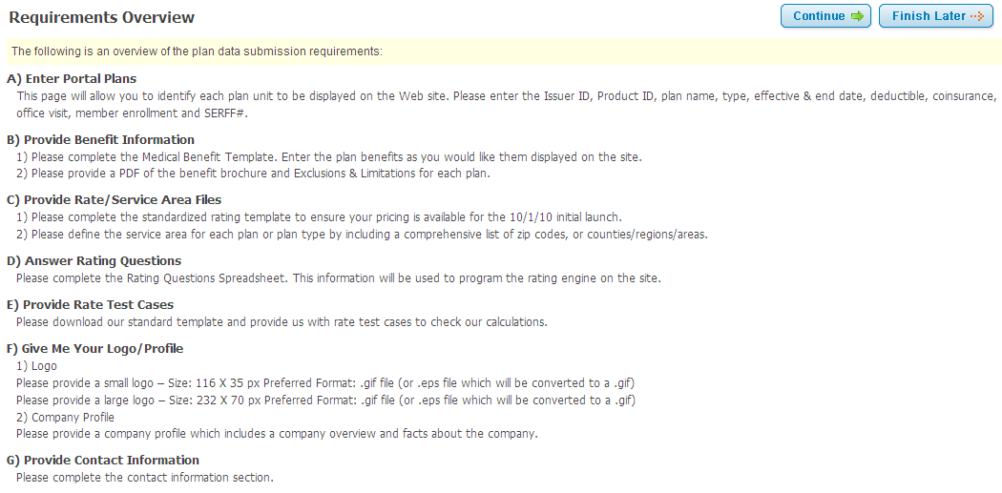
Requirements Overview
There are seven sections that need to be completed.

Slide 4
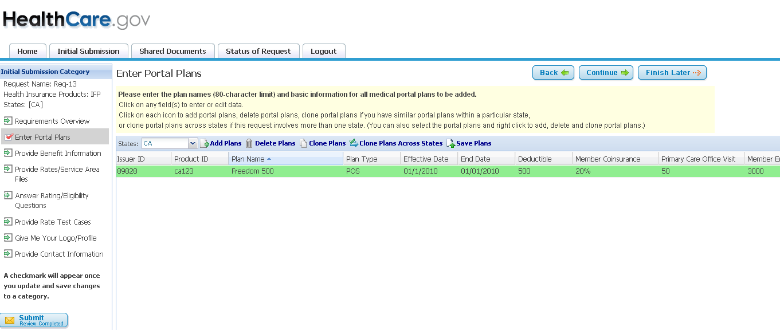
Enter Portal Plans
Issuers must obtain a HIOS Issuer ID and product ID before submitting plan data into CMP.
This information along with plan name, Plan Type, Effective & End Date, Deductible, Coinsurance, Office Visit, Member Enrollment and SERFF# must be entered into the Portal Plans page.

Slide 5
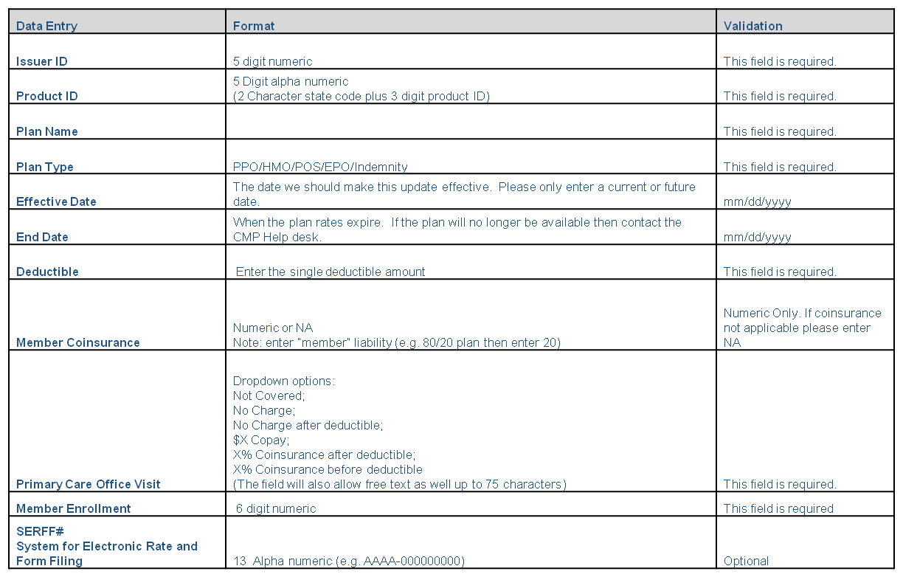
Enter Portal Plans continued…

Slide 6
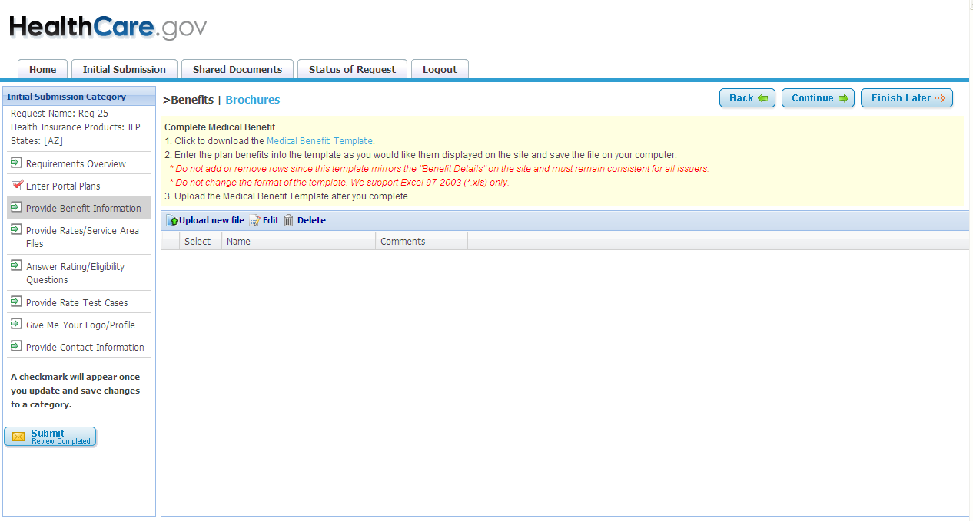
Complete Medical Benefit Template
Download the Excel Medical Benefits template by selecting Medical Benefit Template link.
There is a standardized format for the benefit category definitions to allow for plans to be compared side-by-side.

Slide 7
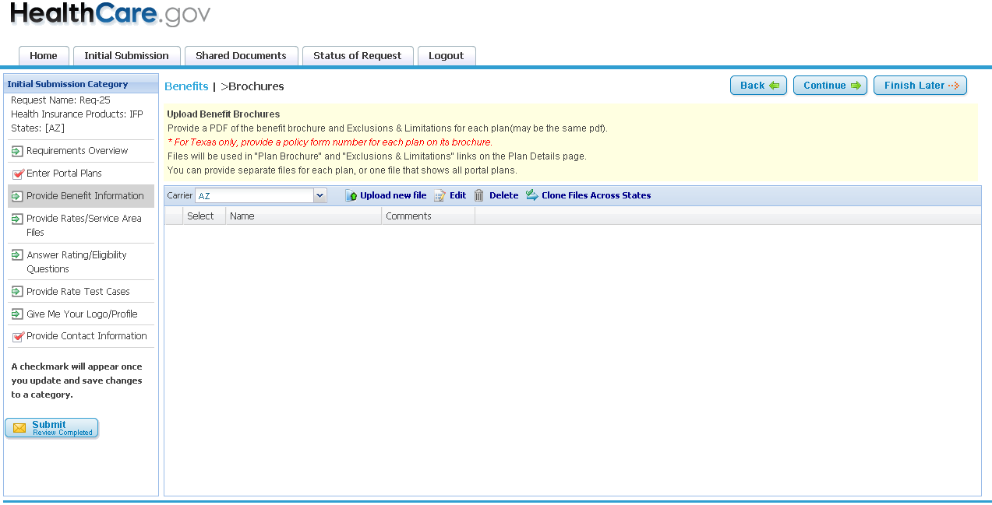
Provide Benefit Brochures
Upload Benefit Brochure pdf file and E&Ls by selecting Upload New File button.

Slide 8
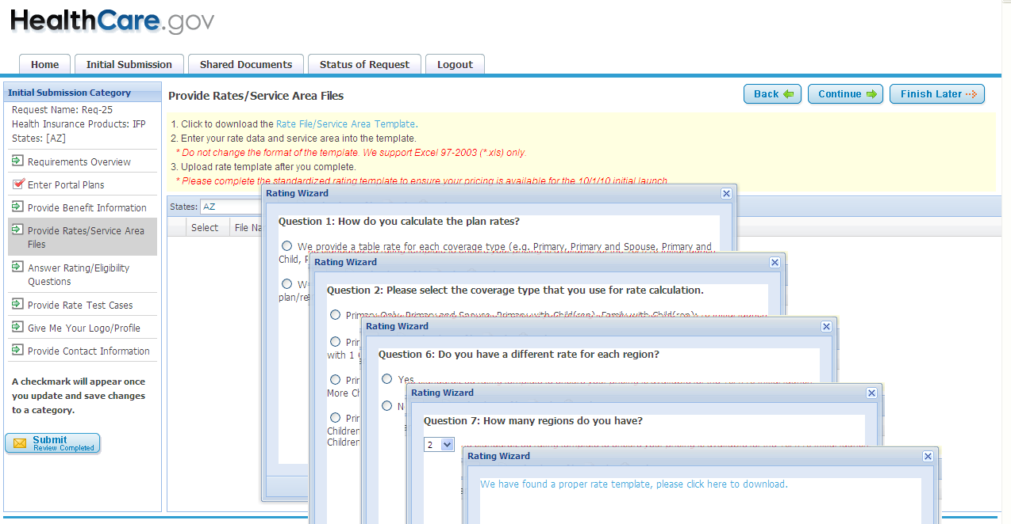
Complete Rate Template
CMP will determine which Excel rate template to download after a series of questions are answered.

Slide 9
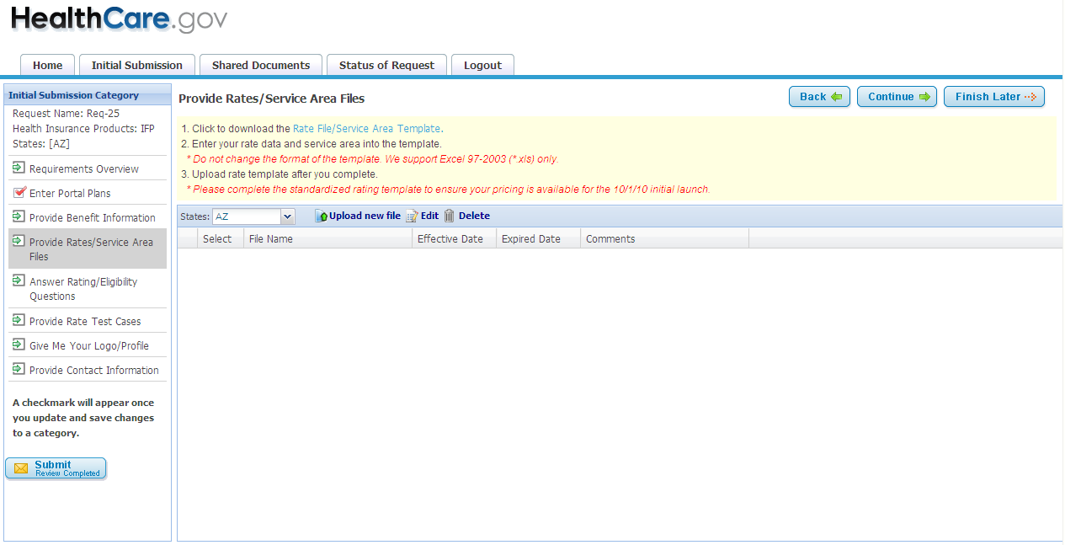
Complete Service Area Template
Download and complete Service Area Excel Template.

Slide 10
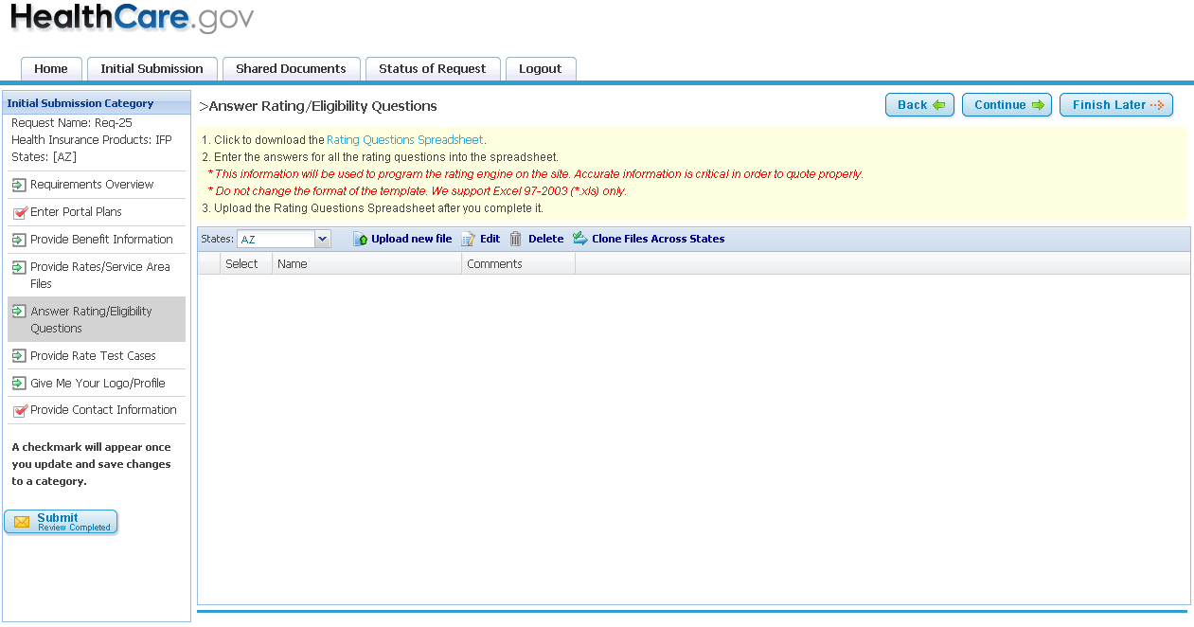
Rating/Eligibility Questions Template
Download and complete the Rating Questions Excel template. The information is used in the quoting process.

Slide 11
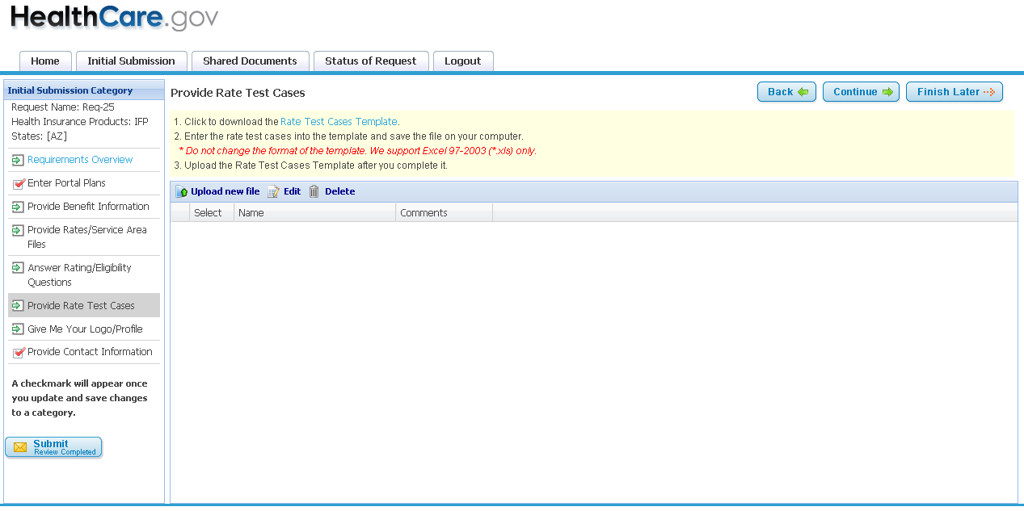
Rate Test Cases Template
Download and complete the Excel Rate Test Cases Template.

Slide 12
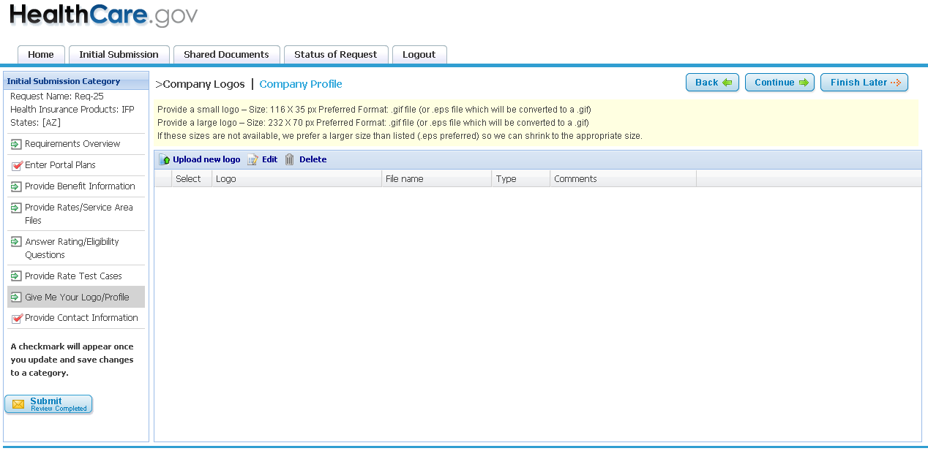
Company Profile Template
Upload Company Logos and download the Excel Company Profile.

Slide 13
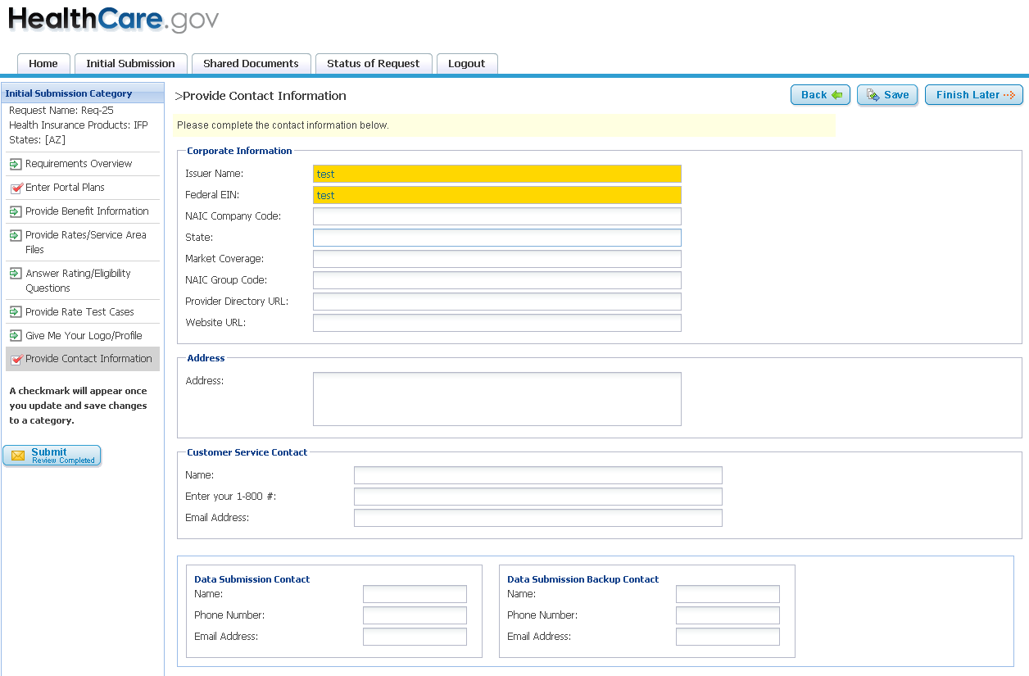
Contact Information
Enter Company Contact Information.

Slide 14
Existing Issuers - CMP
Adding New States or new plans – Create a new request.
Update rates or Service Area - Go back to the original initial submission request and upload a new rate and/or Service Area template and resubmit.
Update benefits - Go back to the original initial submission request and update the current benefit template with all changes highlighted and resubmit.
Rating rule changes – Go back to the original request and update the rate questions template with all changes highlighted.
Remove plans – Send the CMP help desk an email with the Issuer#, plan name, product ID and cancellation date.
Rate extension – Send the CMP help desk an email with the Issuer#, Plan Name, Product ID and new effective and end dates.

Slide 15
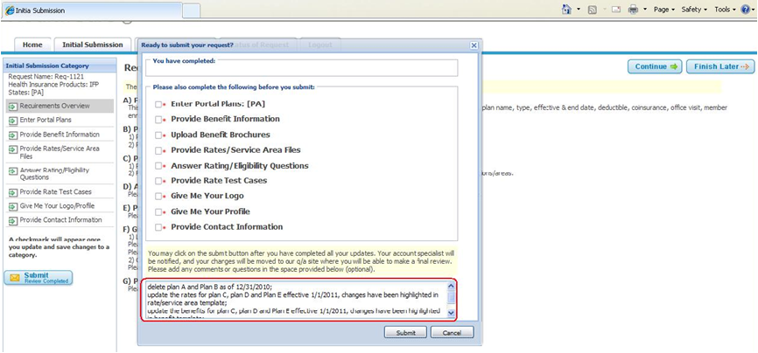
Existing Issuers - CMP
Please describe the updates made when you submit.
Existing Issuers - CMP

Slide 16
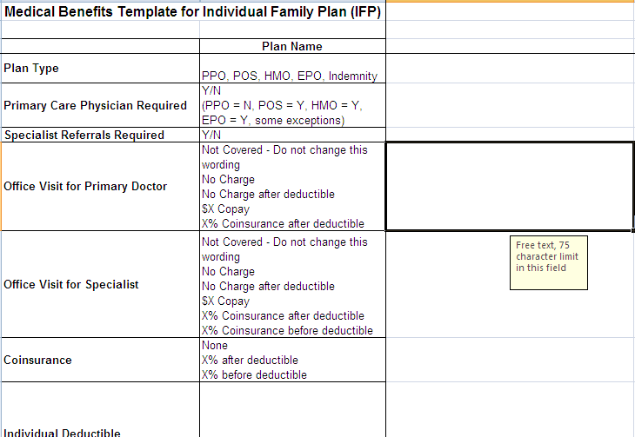
Common Errors – Benefit Pad
Office Visit for Primary Doctor – 75 Character Maximum
Common Errors – Benefit Pad

Slide 17
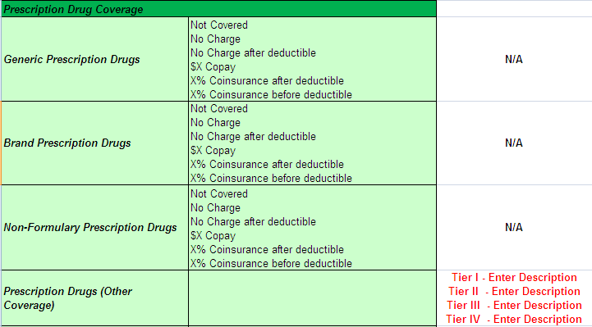
Common Errors – Benefit Pad
Prescription Rx – Must enter “N/A” to use “Other Coverage”
Common Errors – Benefit Pad

Slide 18
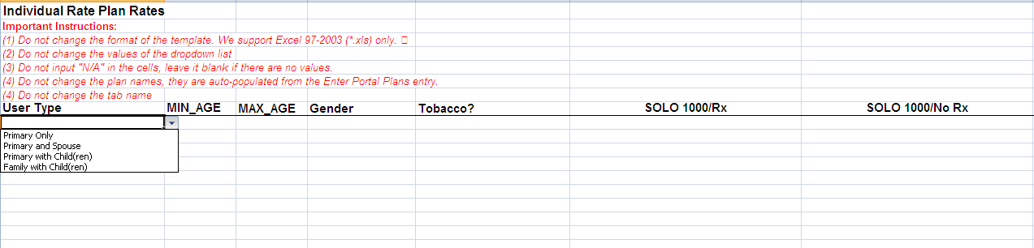
Common Errors – Rate Template
See important Instructions in red font
Common Errors – Rate Template

Slide 19
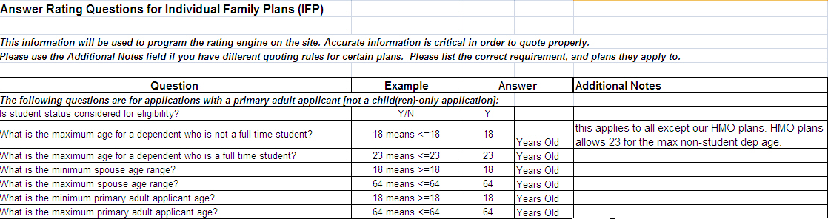
Common Errors – Rating Questions
The Answer Column should only have one answer.
If some plans have different rules then indicate this in the Additional Notes.

Slide 20
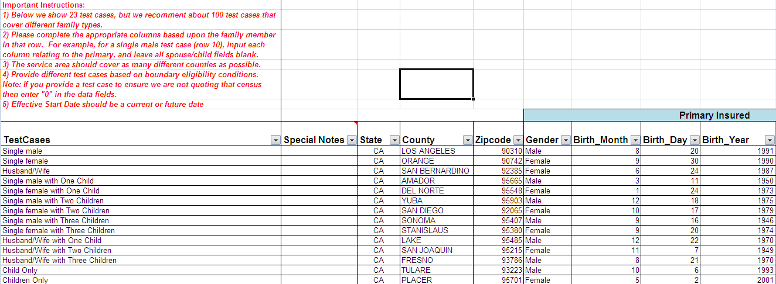
Common Errors – Rate Test Cases
See important Instructions in red font
Common Errors – Rate Test Cases

Slide 21
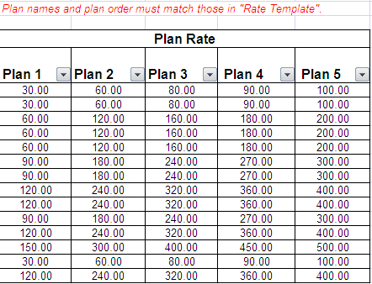
Common Errors – Rate Test Cases
Common Errors – Rate Test Cases

Slide 22
Next Steps
If you have any questions you can send us an email at cmp-support@ehealth.com or call 1-877-425-3708.

Slide 23
Thank You
Thank You !

