Slide 1

Goal of the Portal
“Establish immediately a mechanism, including an internet website, through which a resident of, or small business in, any State may identify affordable health insurance coverage options in that State”

Slide 2
Statutory Basis
The Patient Protection and Affordable Care Act (P.L. 111-148), (Affordable Care Act) enacted on March 23, 2010. Section 1103(a), as amended by section 10102(b)
Health Care Reform Insurance Web Portal Requirements, 45 CFR Part 159, 75 FR 24470

Slide 3
Today’s Training
Explain the data request
Provide Technical Training on Data Entry

Slide 4
Nature of Request
For July Product Information from state filings
Individual and small group major medical
Information on how consumers can reach your firm
Information on how consumers can request quotes
October will seek fuller plan level information

Slide 5
Request for July 1st Release:
  Corporate and Contact Information
  Product level information
  Geographic coverage: state, county, zip codes
  Individual or small group
  Product name and identifying number
  Product type and link to brochure
  Link to network provider

Slide 6
Dates
Training: Today, May 7, 2010
Help Desk Opens: May 7
Send Log-In information: May 10
Start data entry: May 12
Deadline for Submissions: May 21
Release: July 1

Slide 7
Support
If you need additional assistance, please call the HIOS Help Desk at
1-877-343-6507
or email them at insuranceoversight@hhs.gov.

Slide 8
Initial Submission
Issuer Data Submission Template
Today’s training uses the draft templates and instructions for the OMB data collection number 0938-1086.
Next week, you will receive the final Excel template and technical instructions on how to complete the data entry.
Once completed and prior to May 21, 2010, you should email your template to hios_submissions@hhs.gov
Towards the middle of May, we will begin to process the templates. You will receive an email that either indicates a successful submission or highlights errors with your submission.
  If there are errors with your submission, you will need to correct the file, and submit the entire corrected file to the same email address.

Slide 9
System Requirements
Excel 2003 or greater
We recommend the following for your macro settings:
  Excel 2003 – Security set to Medium. Select ‘Enable Macros’ upon opening the file
  Excel 2007 – Security set to ‘Disable all macro with notification’. You must enable the content prior to opening the file

Slide 10
Issuer Data Submission Template
The issuer template has 3 tabs:
  Issuer General Info
    Gather data about the submitting issuer, contact information, and rating information.
  Product Info
    Gather data about each product offered by the issuer with a subset of attributes.
  Geographic Coverage
    If a product is not offered throughout the state, you will need to indicate all the zip codes in which it is offered.

Slide 11
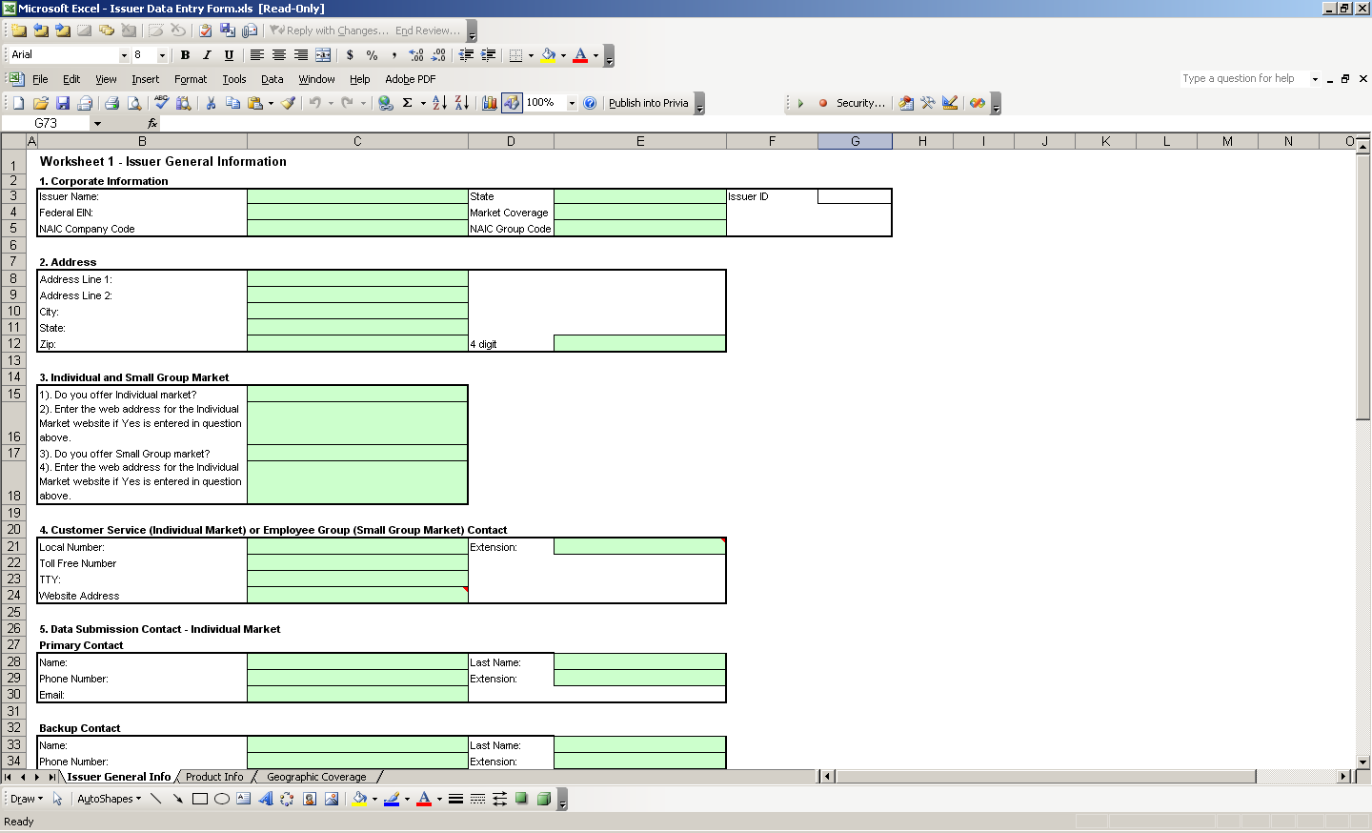
Data Entry
Issuer General Info

Slide 12
Data Entry
Issuer General Info Data Entry Tips
Fields are marked required or optional.
Certain fields are conditional based on data entered in other cells (e.g. you only need to enter a website address for your small group market if you have offerings for this market type).
Back up contacts are not systematically required, but strongly recommended.
Enter all ratings issued by a ratings company

Slide 13
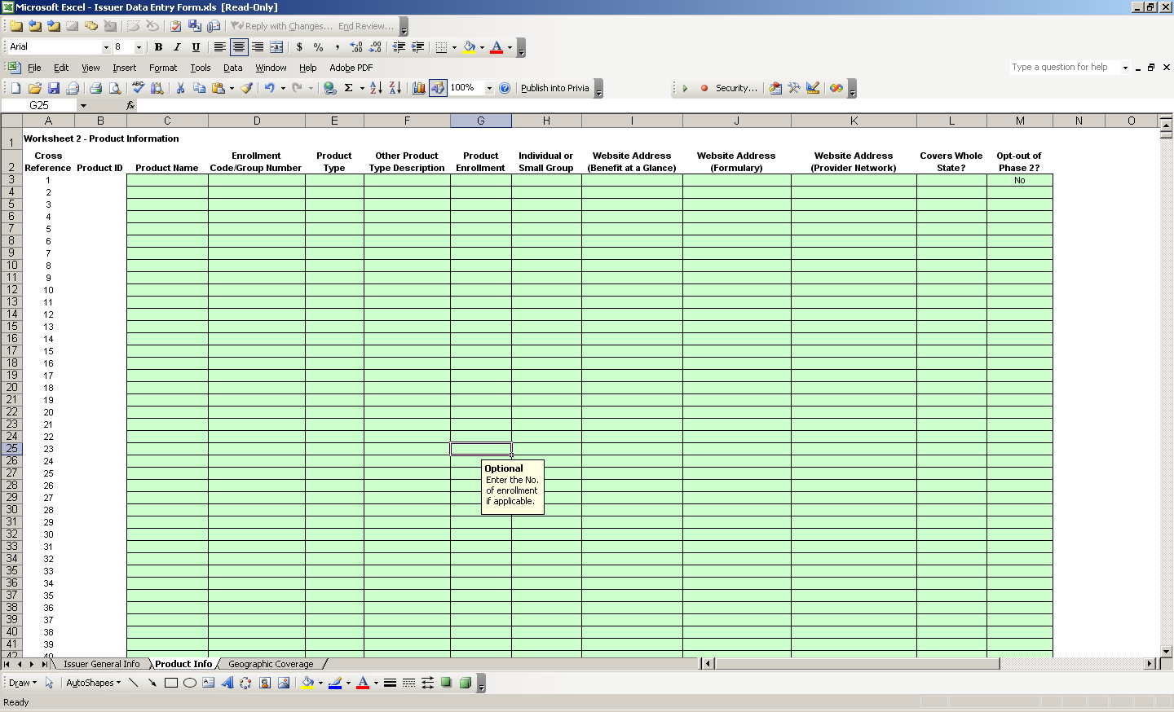
Data Entry
Product Info

Slide 14
Data Entry
Product Info Tab Data Entry Tips
One row per product offered
All cells except for Formulary Website are required.
Select ‘No’ in column L if the product is not offered in the whole state.
If at least one product is not offered in the whole state, you will need to enter data into the Geographic Coverage worksheet.

Slide 15
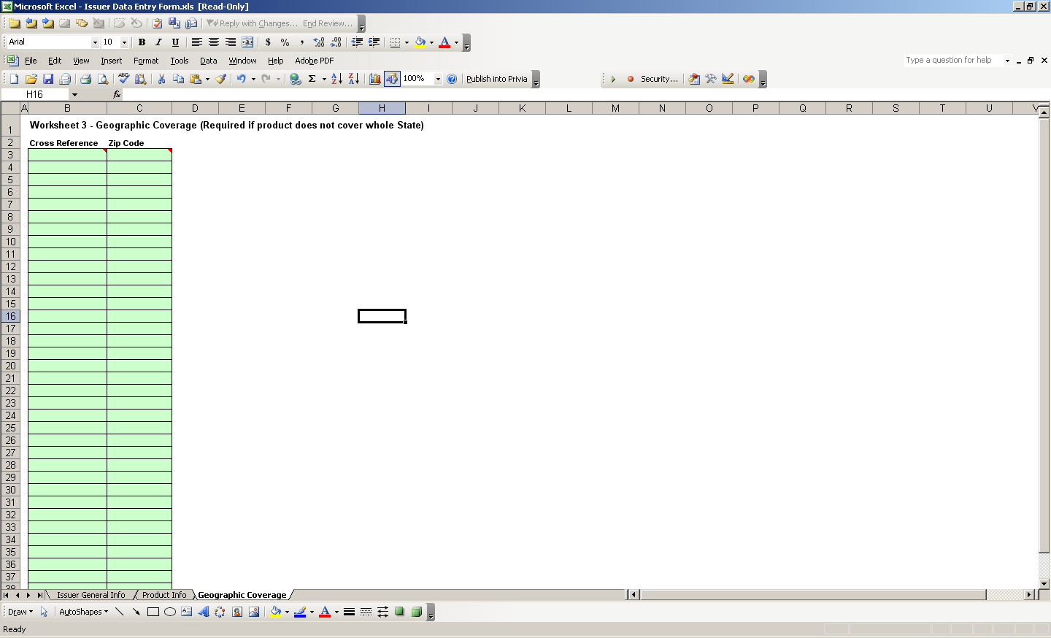
Data Entry
Geographic coverage

Slide 16
Data Entry
Geographic Coverage Data Entry Tips
For products offered in partial states,
  Enter one row for each zip code in which the product is offered.
  Verify that the cross reference for the product matches the cross reference from the Product Info worksheet.

Slide 17
Validating your Data
The Issuer Data Entry workbook has validations built in to help you validate the correctness and accuracy of your data prior to submission.
It is strongly recommended that you validate your data throughout the data entry process by clicking on the ‘Validate’ button or by clicking CTRL+SHIFT+V.
Red circles will appear surrounding the cells that require your attention. A message box will also describe these errors.

Slide 18
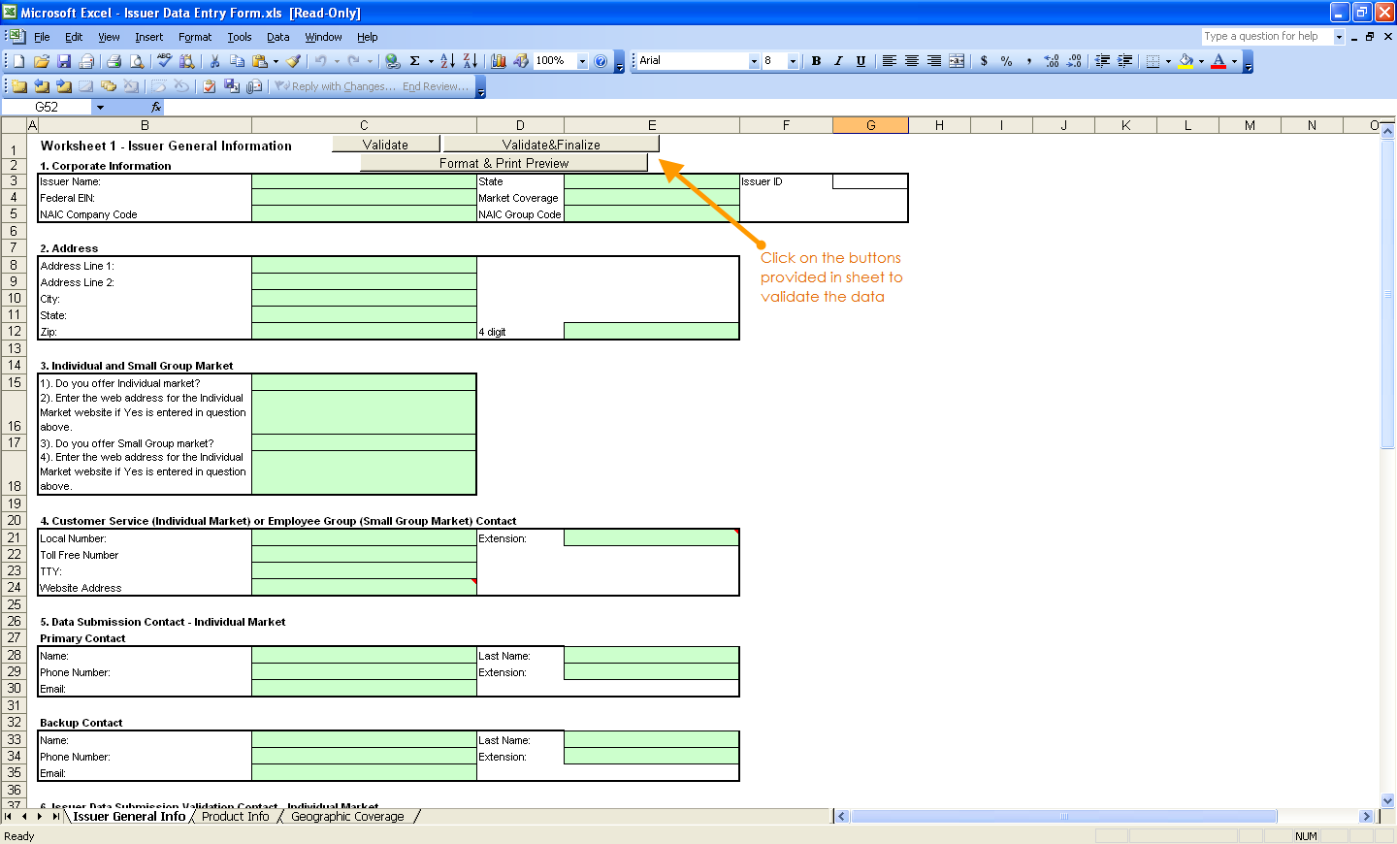
Validating your Data

Slide 19
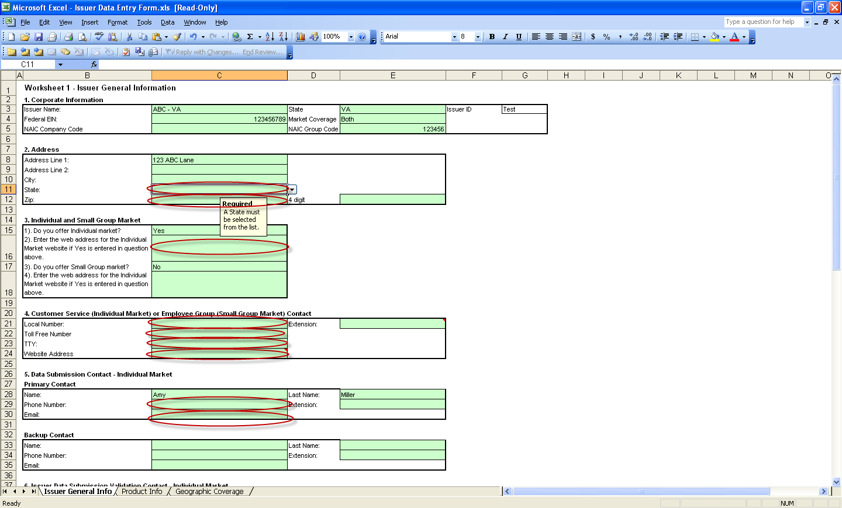
Validating your Data
Red Circle Validations

Slide 20
Correcting your Data
In some cases, the red circle will disappear upon correcting the data.
In other cases, you will need to click “Validate” again to verify that the red circle is no longer valid.
Once you have no red circles, you are ready for the finalization process.

Slide 21
Finalizing your File
Once all the data is entered and validated, click “Validate&Finalize” or click CTRL+SHIFT+S.
If there are critical validations that fail, the file will not finalize and an error message will appear.

Slide 22
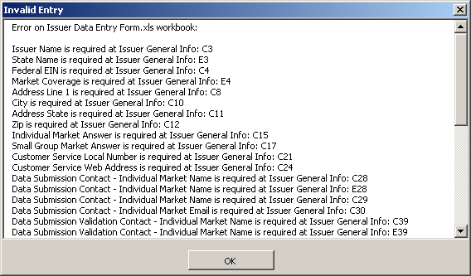
Finalization – Critical Errors

Slide 23
Finalizing your File
Once all critical errors have been checked, the finalization process will continue:
  A new READ ONLY file will be created in the same location as your working file.
  This file will be generated based on a special naming convention.
    If you modify the name of the finalized file, it will not be processed.
    You may name your working file as you wish.
  YOU MUST SUBMIT YOUR FINALIZED FILE. DO NOT SUBMIT YOUR WORKING FILE; IT WILL NOT BE PROCESSED.

Slide 24
Next Steps
Once your file is processed, you will either need to correct the data and resubmit, or verify your data online.
Online verification of data will be available on 5/21/10. Website information will be made available prior to that date.
In the near future, you will be able to upload your files directly to the website, as well as edit online.

Slide 25
Access to the Website
You should have received an email on 4/30 with instructions on how to request access to the Health Insurance Oversight System (HIOS).
Data submission/ validation contacts in template will also be granted access to HIOS once submission is processed.

Slide 26
Questions?
Please contact the HIOS Help Desk at insuranceoversight@hhs.gov

