Slide 1

Goal of the Portal
“Establish immediately a mechanism, including an internet website, through which a resident of, or small business in, any State may identify affordable health insurance coverage options in that State”

Slide 2
Statutory Basis
The Patient Protection and Affordable Care Act (P.L. 111-148), (Affordable Care Act) enacted on March 23, 2010. Section 1103(a), as amended by section 10102(b)
Health Care Reform Insurance Web Portal Requirements, 45 CFR Part 159, 75 FR 24470

Slide 3
Today’s Training
Explain the data request
Provide Technical Training on Data Entry
Answer questions

Slide 4
Nature of Request
Trying to Minimize the Burden
  Medicaid, CHIP from CMS
  High Risk Pools through agreement with NASCHIP
  Details from Issuers
Major Medical Product Filings
Information on how consumers can reach the state

Slide 5
Request for July 1st Release:
General Information
  Contact Information and Guidance
  Does State Use Community Rating or Medical Underwriting
  Does your state have an online comparison tool where we should direct consumers
  If not is there another online site where we should direct consumers for health insurance information
  Contact Information for data submission
  Contact information for data validation

Slide 6
Request for July 1st Release:
Issuer & Product Information
Issuer Name
Type of product by market (individual / small group)
Who is your contact with the Issuer
Number of products offered by type:
    Fee for Service
    HMO
    PPO
    EPO
    POS
    Other

Slide 7
Dates
Training: Today, May 7, 2010
Send Log-In information: May 6
Start data entry: May 6
Help Desk Opens: May 7
Deadline for Submissions: May 21
Open for Validation: May 21
Release: July 1

Slide 8
Issuer Requirements
For July 1 Release
  Contact information
  List of All products from state form filings
  Market type and product type
  Whether they are open for enrollment / number enrolled
  Link to benefit summaries
For October Release
  All open plans
  Benefits
  Pricing
  Plan contact Information

Slide 9
Support
If you need additional assistance, please call the HIOS Help Desk at
1-877-343-6507
or email them at insuranceoversight@hhs.gov.

Slide 10
Initial Submission
State Data Submission Template
You will receive an Excel template and technical instructions on how to complete the data entry.
Once completed and prior to May 21, 2010, you should email your template to hios_submissions@hhs.gov
Towards the middle of May, we will begin to process the templates. You will receive an email that either indicates a successful submission or highlights errors with your submission.
  If there are errors with your submission, you will need to correct the file, and submit the entire corrected file to the same email address.

Slide 11
System Requirements
Excel 2003 or greater
We recommend the following for your macro settings:
  Excel 2003 – Security set to Medium. Select ‘Enable Macros’ upon opening the file
  Excel 2007 – Security set to ‘Disable all macro with notification’. You must enable the content prior to opening the file

Slide 12
State Data Submission Template
The state template has 2 tabs:
  General State Info
    Gather data about the submitting state and contact information.
  Issuer & Product Info
    Gather data about the different issuers in the corresponding state and quantify their offerings within the state.

Slide 13
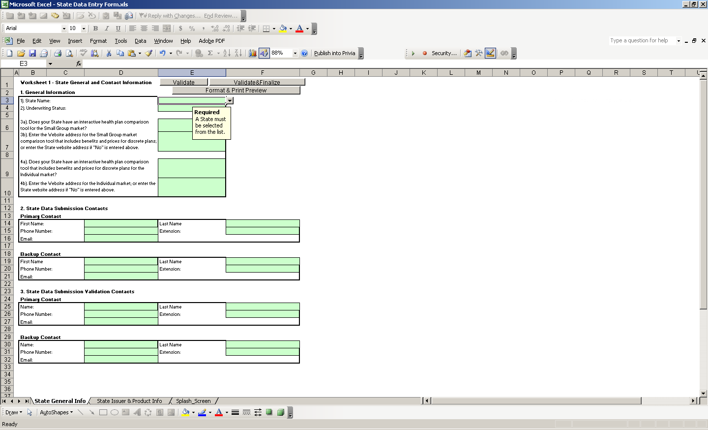
Data Entry
State General Info

Slide 14
Data Entry
State General Info Data Entry Tips
All fields are required with the exception of the back up contacts.
  Even though not systematically required, we encourage the data entry of back up contacts.
If your state does not currently offer comparative online tools, please enter No into cells E6 and E8 and enter your state website address into cells E7 and E9.
If your state offers interactive online tools, this data will be made public on the web portal.

Slide 15
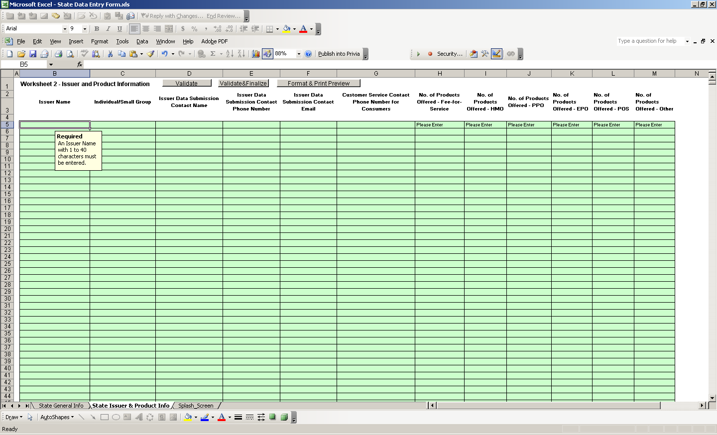
Data Entry
Issuer & Product Info

Slide 16
Data Entry
Issuer & Product Info Tab
One row per combination of Issuer/Market type.
If an Issuer covers both the Individual and Small Market group, you will need to enter 2 rows for that issuer.
Columns H – M are required; If the issuer does not have any offerings for that product type, enter 0.

Slide 17
Validating your Data
The State Data Entry workbook has validations built in to help you validate the correctness and accuracy of your data prior to submission.
It is strongly recommended that you validate your data throughout the data entry process by clicking on the ‘Validate’ button or by clicking CTRL+SHIFT+V.
Red circles will appear surrounding the cells that require your attention. A message box will also describe these errors.

Slide 18
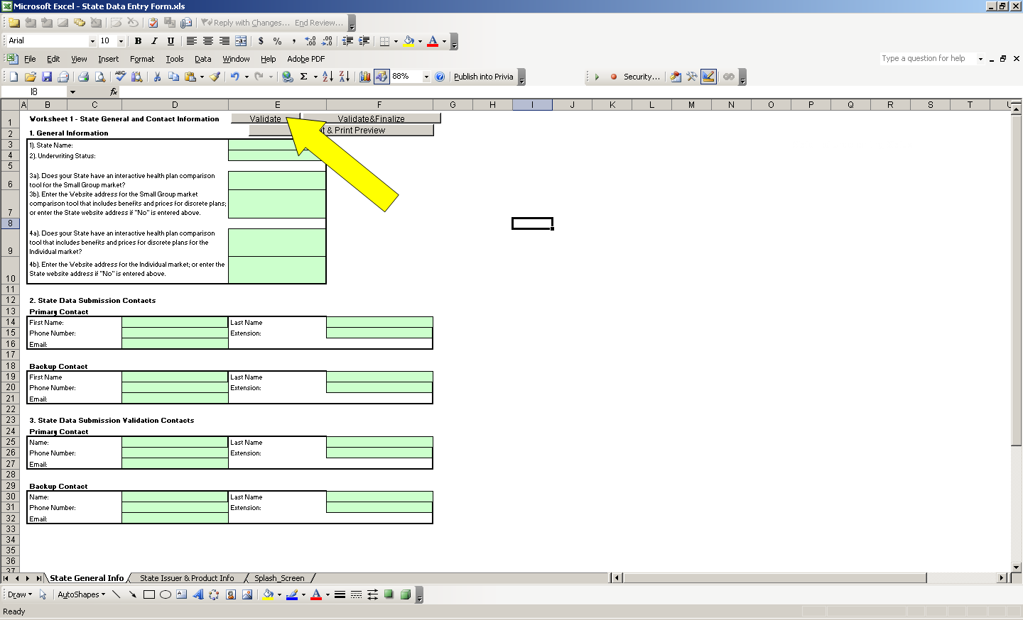
Validating your Data

Slide 19
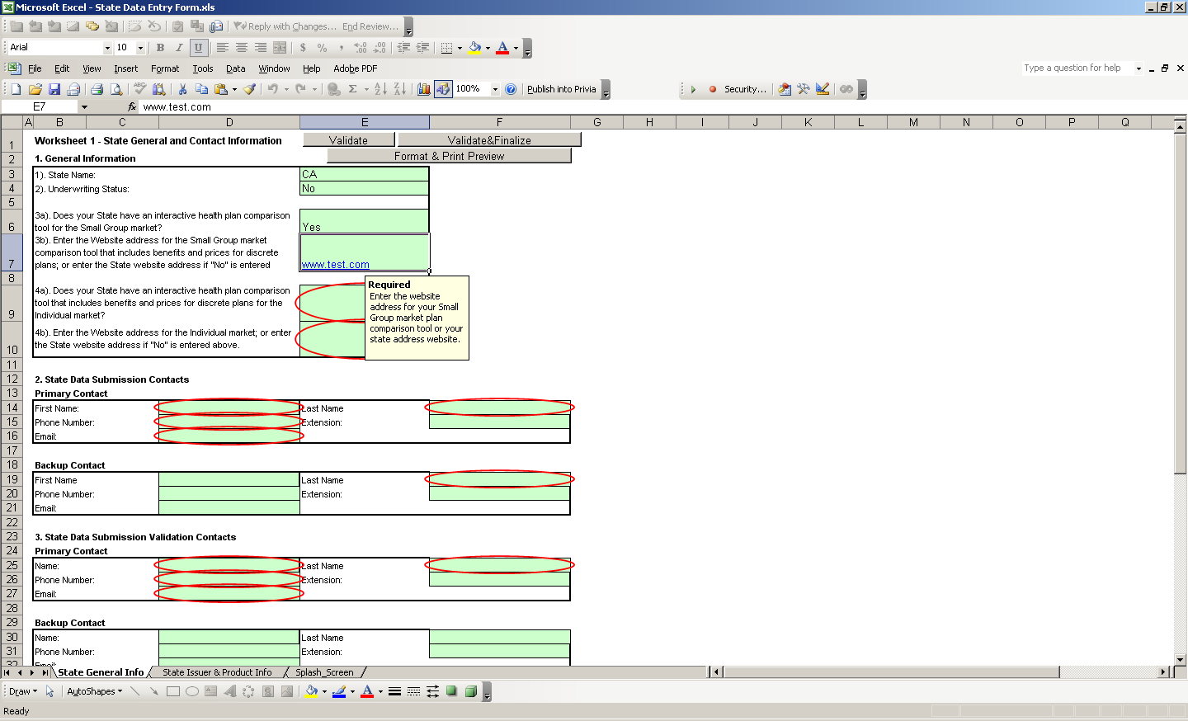
Validating your Data
Red Circle Validations

Slide 20
Correcting your Data
In some cases, the red circle will disappear upon correcting the data.
In other cases, you will need to click “Validate” again to verify that the red circle is no longer valid.
Once you have no red circles, you are ready for the finalization process.

Slide 21
Finalizing your File
Once all the data is entered and validated, click “Validate&Finalize” or click CTRL+SHIFT+S.
If there are critical validations that fail, the file will not finalize and an error message will appear.

Slide 22
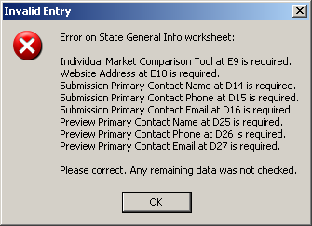
Finalization – Critical Errors

Slide 23
Finalizing your File
Once all critical errors have been checked, the finalization process will continue:
  A new READ ONLY file will be created in the same location as your working file.
  This file will be generated based on a special naming convention.
    If you modify the name of the finalized file, it will not be processed.
    You may name your working file as you wish.
  YOU MUST SUBMIT YOUR FINALIZED FILE. DO NOT SUBMIT YOUR WORKING FILE; IT WILL NOT BE PROCESSED.

Slide 24
Next Steps
Once your file is processed, you will either need to correct the data and resubmit, or verify your data online.
Online verification of data will be available on 5/21/10. Website information will be made available prior to that date.
In the near future, you will be able to upload your files directly to the website, as well as edit online.

Slide 25
Access to the Website
The data submission and validation contacts contained in your submitted templates will be granted access to the Health Insurance Oversight System.

Slide 26
Questions?
Please contact the HIOS Help Desk at insuranceoversight@hhs.gov

