Slide 1
Content Management Portal
PRA Disclosure Statement
According to the Paperwork Reduction Act of 1995, no persons are required to respond to a collection of information unless it displays a valid OMB control number. The valid OMB control number for this information collection is 0938-1086. The time required to complete this information collection is estimated to average (106 hours) or (6,360 minutes) per response, including the time to review instructions, search existing data resources, gather the data needed, and complete and review the information collection. If you have comments concerning the accuracy of the time estimate(s) or suggestions for improving this form, please write to: CMS, 7500 Security Boulevard, Attn: PRA Reports Clearance Officer, Mail Stop C4-26-05, Baltimore, Maryland 21244-1850.

Slide 2
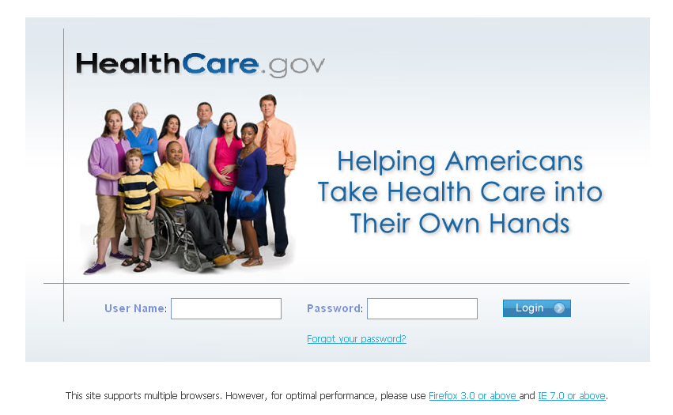
How Does CMP Work
The Content Management Portal (CMP) is a secure site for issuers to log in and enter their initial individual and small group plan data requirements.

Slide 3
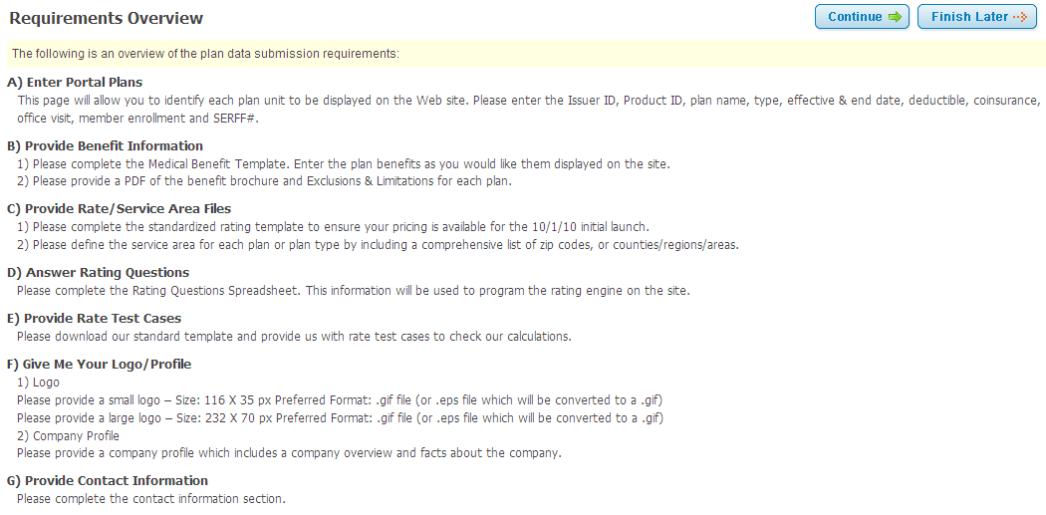
Requirements Overview
There are seven sections that need to be completed.

Slide 4
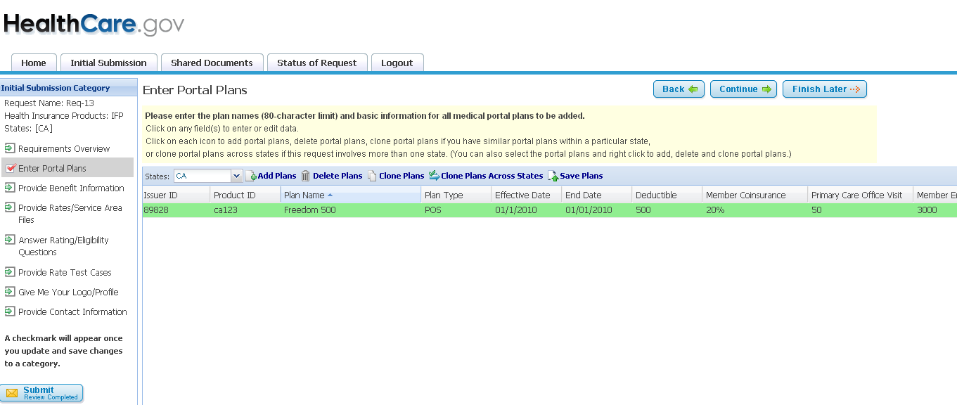
Enter Portal Plans
Issuers will be required to submit information on at least all portal plans that are open for enrollment effective 10/1/10 and that represent 1 percent or more of the issuers’ total enrollment for the respective individual or small group market within that zip code.

Slide 5
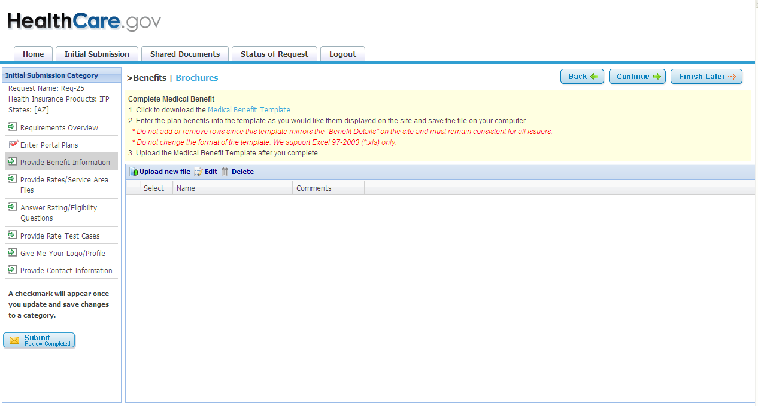
Complete Medical Benefit Template
Download the Excel Medical Benefits template by selecting Medical Benefit Template link.
There is a preferred format for the benefit category definitions, but the template also provides the flexibility to enter free form text in most of the fields.

Slide 6
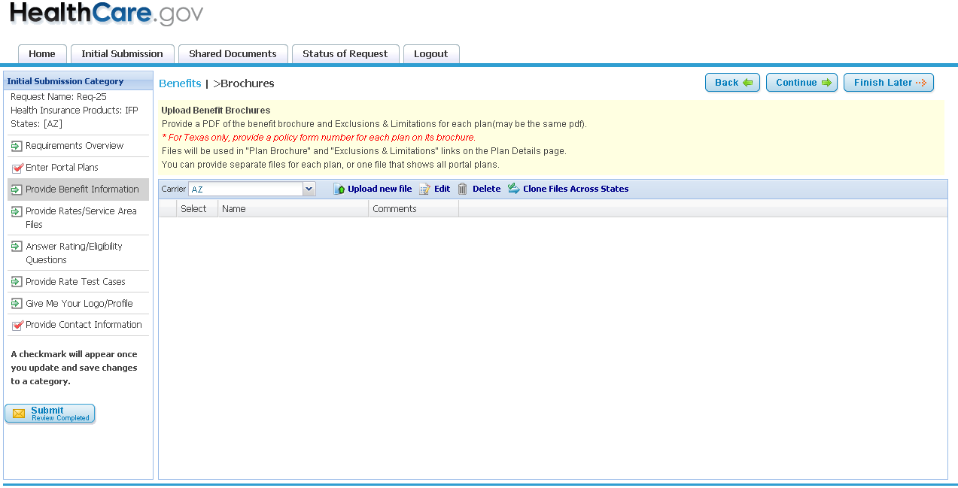
Provide Benefit Brochures
Upload Benefit Brochure pdf file and E&Ls by selecting Upload New File button.

Slide 7
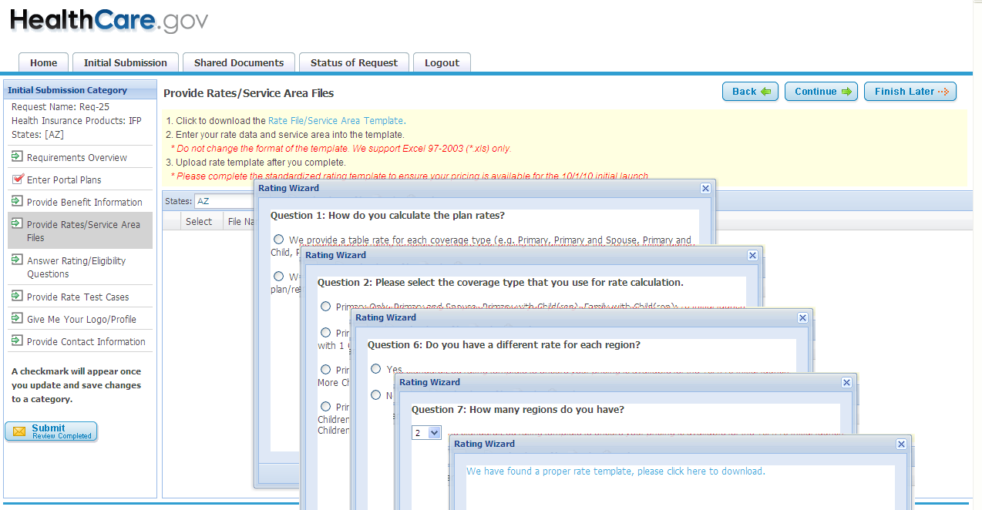
Complete Rate Template
CMP will determine which Excel rate template to download after a series of questions are answered.

Slide 8
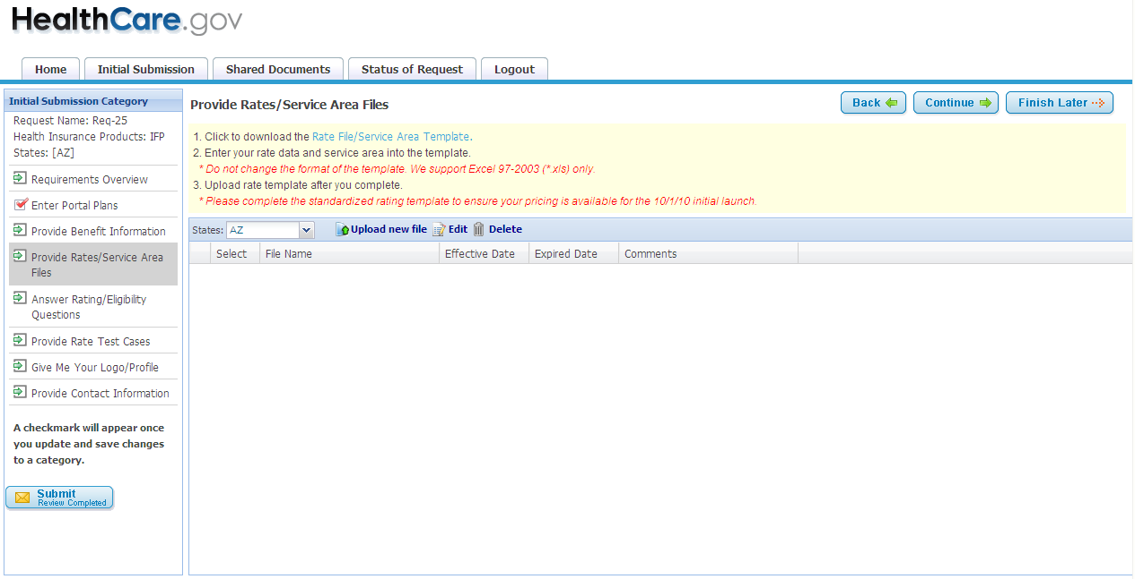
Complete Service Area Template
Complete Service Area Excel Template.

Slide 9
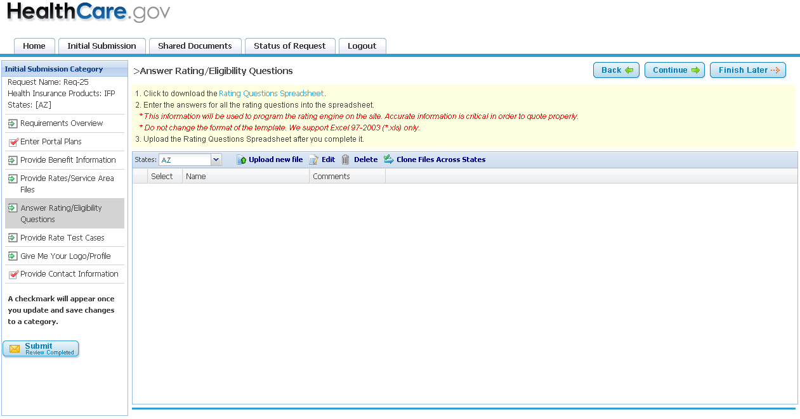
Rating/Eligibility Questions Template
Download the Rating/Eligibility Questions Excel template. The information is used in the quoting process.

Slide 10
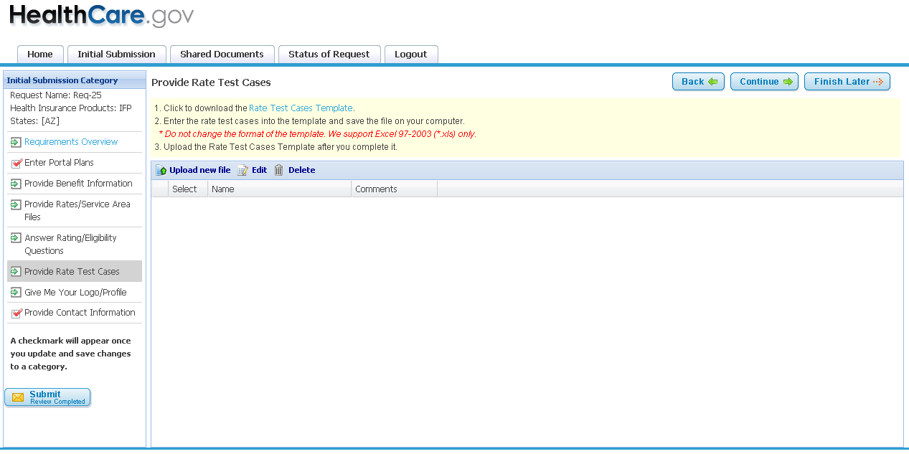
Rate Test Cases Template
Download the Excel Rate Test Cases Template.

Slide 11
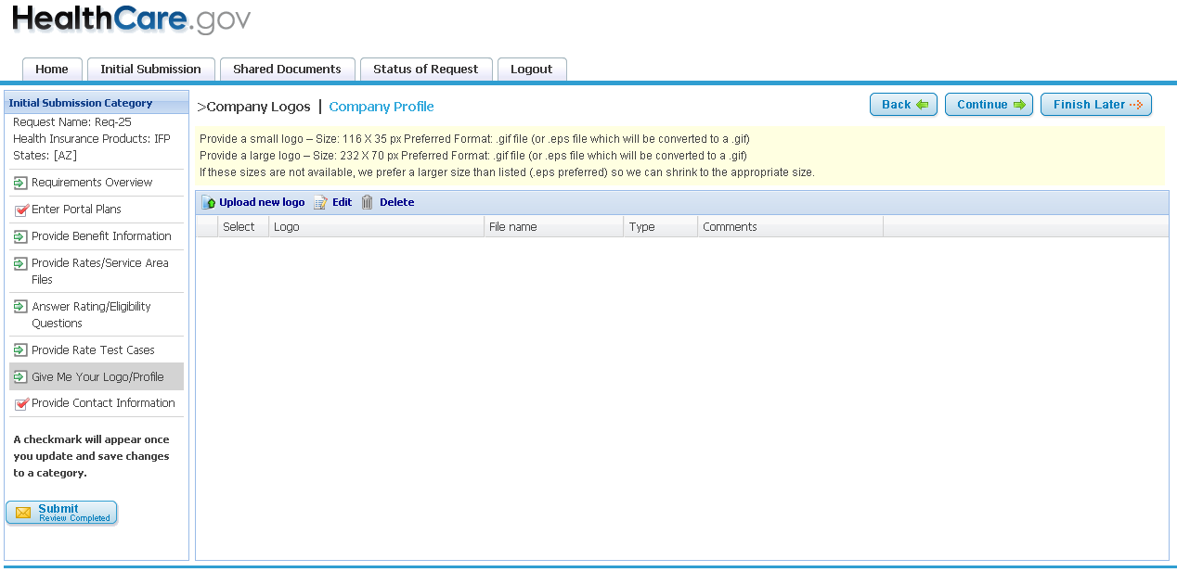
Company Profile Template
Upload Company Logos and download the Excel Company Profile.

Slide 12
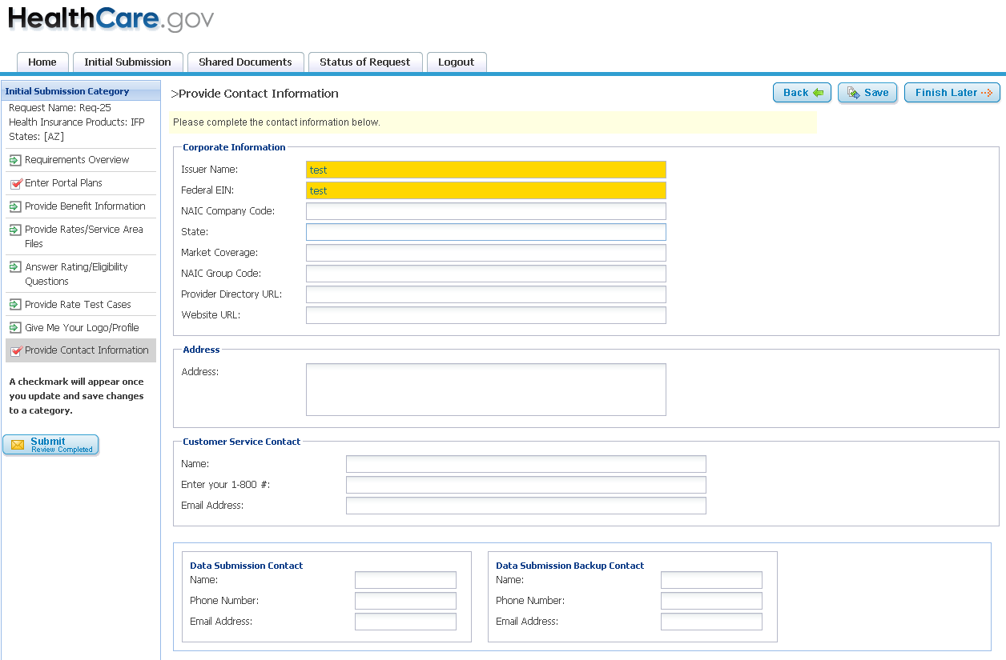
Contact Information
Enter Company Contact Information.

Slide 13
Next Steps
It is recommended that the issuer designate one data collection contact person to access CMP and coordinate the data collection internally.
Data collection contact person will complete the registration process and log onto CMP with a user ID and password. Go to https://cmp.healthcare.gov/cmp and click on the registration link.
We recommend you print out and review the Technical Instructions before you begin.
Starting Monday 8/15, If you have any questions you can send us an email at cmp-support@ehealth.com or call 1-877-425-3708.

Slide 14
Thank You
Thank You !

