Slide 1
Health Insurance Oversight System (HIOS)
Issuer Data Entry Form Updates

Slide 2
Issuer Legal and Marketing Name
The issuer user is now required to enter both the Legal and Marketing names of their organization on the Issuer General Information tab. These fields have been put in place to avoid the confusion of a single Issuer Name field in the form previously.

Slide 3
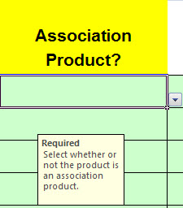
Association Product
The issuer user will now be required to identify whether or not a product is an Association Product on the Product Information tab. As a result of this new field, the value “Association” has been removed from the Product Type field.

Slide 4
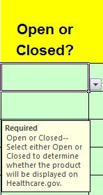
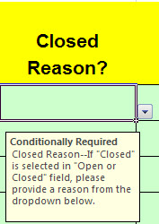
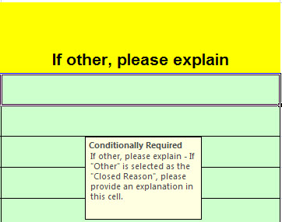
Open/Closed Fields
The field to determine whether or not a product entered will be displayed on Healthcare.gov has been clarified to Open/Closed. The issuer user will be required to fill out this field on the Product Information tab. If the issuer user selects “Closed”, then the user is required to select a reason from the “Closed Reason” dropdown to explain.

Slide 5
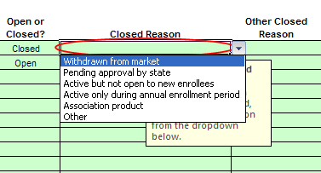
Open/Closed Fields (2)
For “Closed Reason” most should select one of 3 categories: withdrawn from market, pending approval by the State, and active only during annual enrollment period. Additionally, “active but not open to new enrollees” is included for general circumstances. While “Association Product” is included, this is to create consistency with the prior data collection. “Other” is included, but should be used sparingly, and requires an explanation in “Other Closed Reason” which is free text.

Slide 6
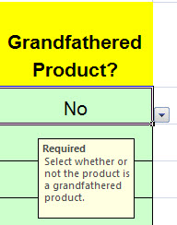
Grandfathered Product
The issuer user will be required to identify whether or not a product is a Grandfathered Product on the Product Information tab. The issuer user will have a choice of either “Yes” or “No.”

