Slide 1
Health Insurance Oversight System (HIOS)
Issuer Data Entry Form Updates
September 26, 2011

Slide 2
Enhancements Purpose
The updates that have been made to the Issuer Data Entry Form are necessary for the Rate Benefit Information System (RBIS) implementation in October.
In preparation for the RBIS Small Group market data collection period, the following elements must be collected in addition to normally submitted HIOS issuer data:
Secondary backup data submission contact information (optional)
Secondary backup data validation contact information (optional)
Attestation user contact information (minimum of one is required)
Product effective start date (required)
Product effective end date (optional)

Slide 3
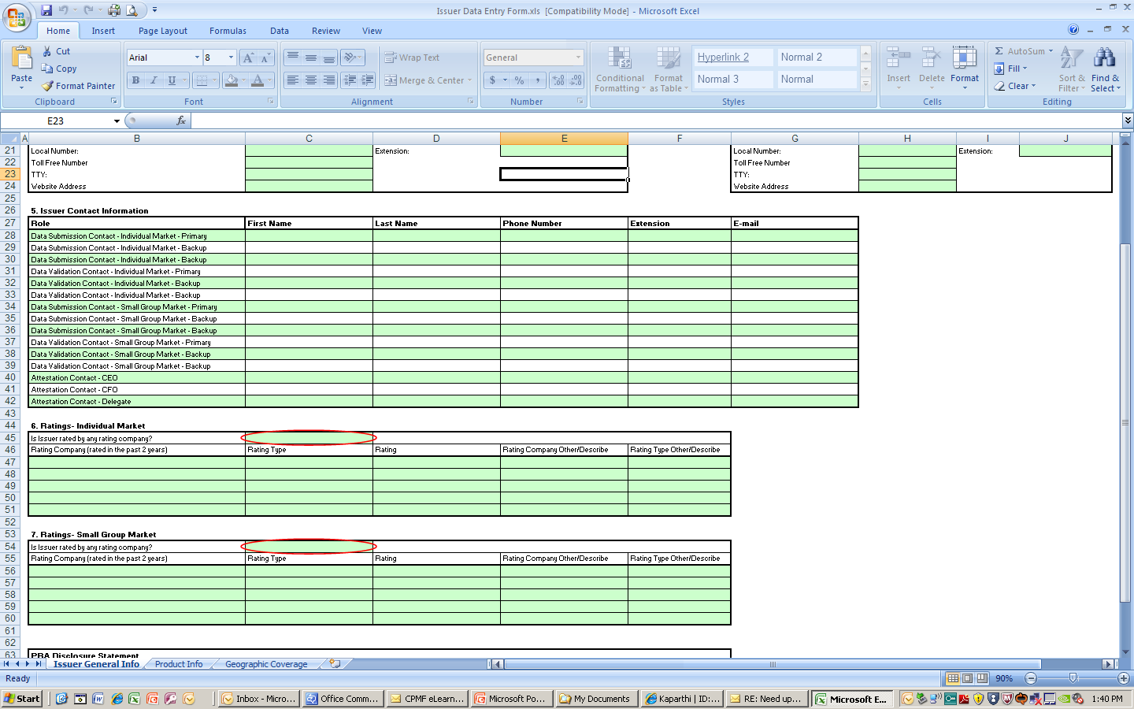
Issuer Contact Information
The collection of the contact information for the various issuer roles has been consolidated into a chart. Existing contact information will be pre-populated into the new format for editing.
There are two new roles and space for a secondary backup contact for each existing issuer role. Although a secondary backup is not required, at least one of the attestation contacts must be complete. A user cannot have a data submission/validation role and an attestation role.

Slide 4
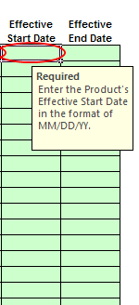
Effective Start & End Dates
The issuer user will now be able to identify each product’s effective start date and end date.
Effective Start Date is required
Effective End Date is optional
The database will not automatically process product status changes to “Closed” if the refresh date is past the “Effective End Date”. The issuer will be responsible for making these edits in the subsequent refresh window.

Slide 5
HIOS XML Submission Available
Development is underway to allow users to submit issuer data via XML.
XSD document will be available on HIOS download page
October 3-7: HIOS Submission Window
October 11-21: RBIS Submission Window

Slide 6
Rate and Benefits Information System Training
September 16, 2011
Confidential

Slide 7
Agenda
Introduction
Login and Home screen
Submission Materials
Templates
Upload and System Validations
User Validations
Attestations
Helpdesk and Questions
Confidential

Slide 8
What is RBIS
The RBIS system collects rate and benefit information for display on Healthcare.gov
Access to RBIS is through the HIOS home screen with your HIOS user account.
RBIS operates much like HIOS. Submission, Validation and Attestation must be completed during the submission window.
Confidential

Slide 9
Key Takeaways
Use of RBIS is necessary for small group products to display on Healthcare.gov
The RBIS process involves 3 actions: Successful Submission, User Validation and Attestation
RBIS is significantly more automated and returns all errors in a submission.
Finder Verify occurs during the window.
Confidential

Slide 10
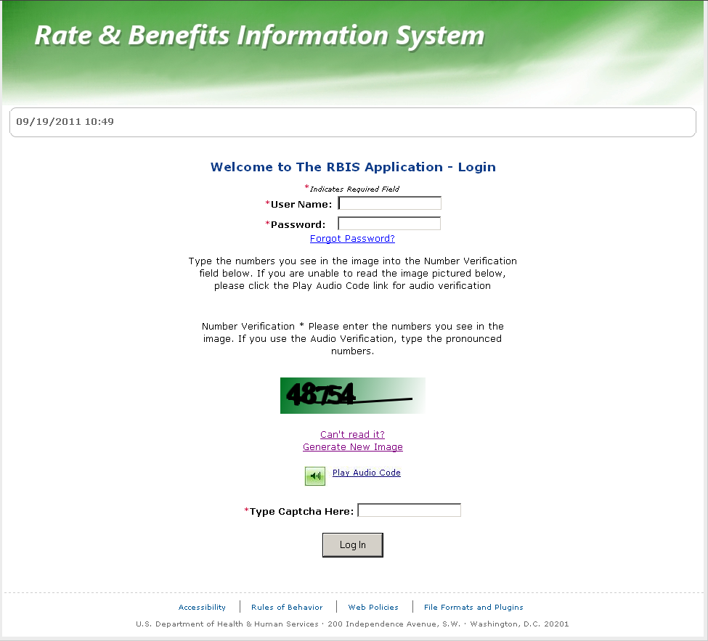
Login
Confidential

Slide 11
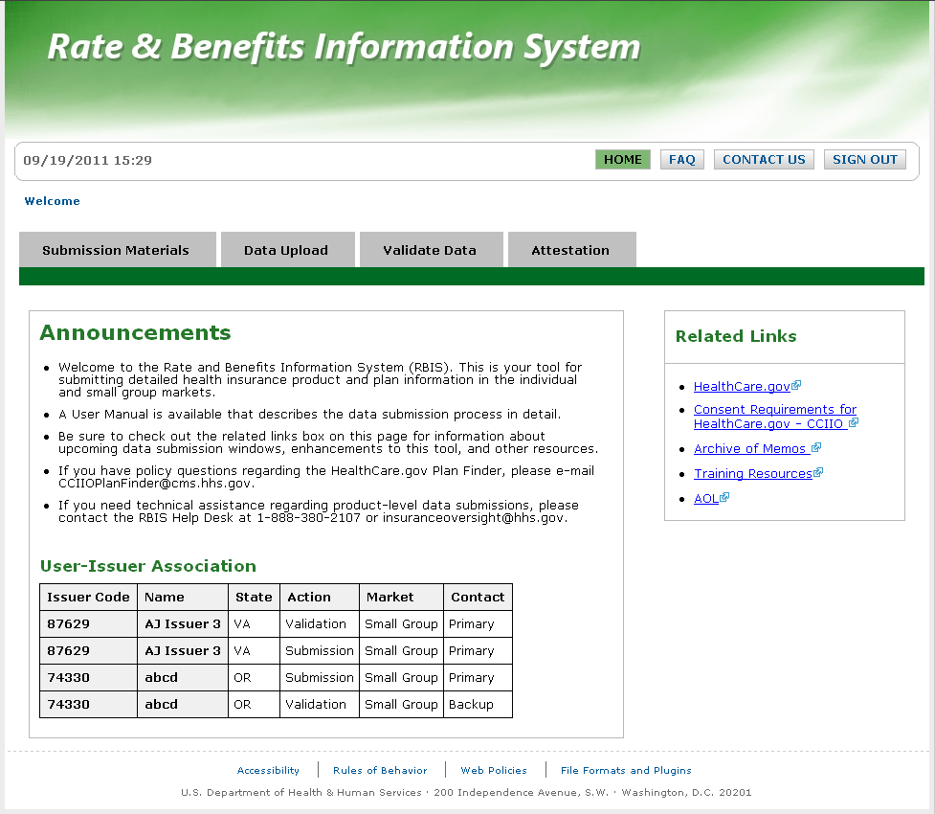
Home
Confidential

Slide 12
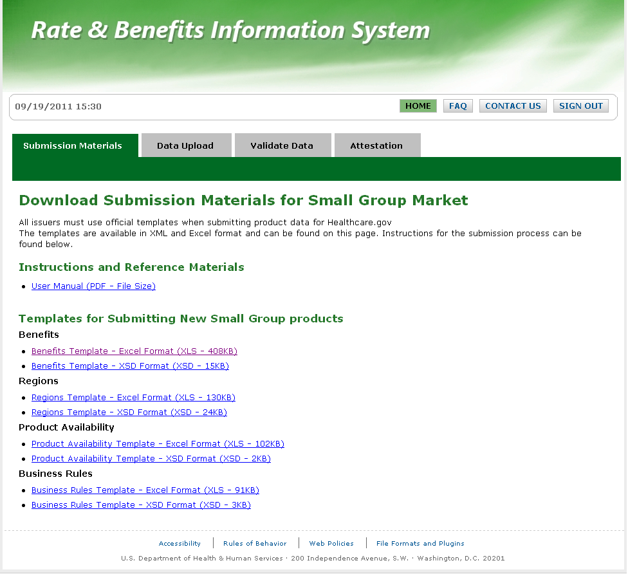
Submission Materials
Confidential

Slide 13
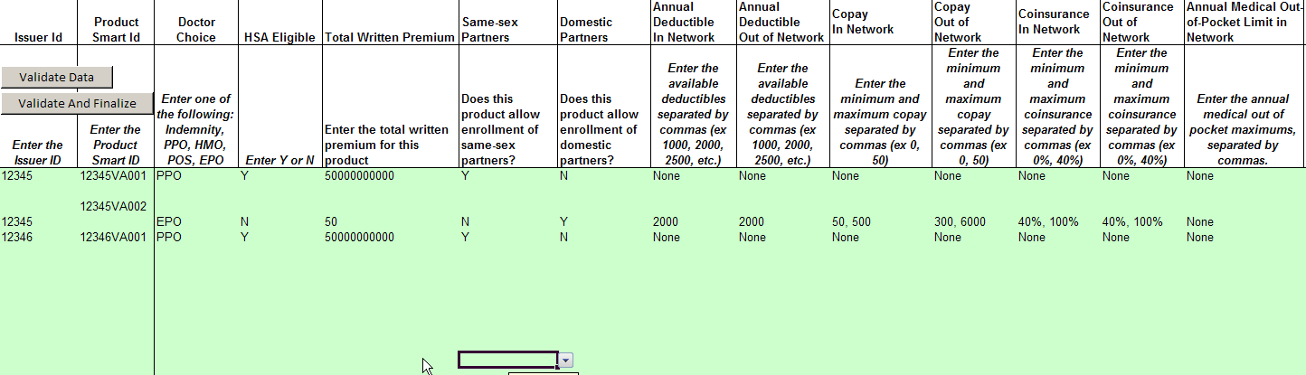
Benefits Template
Confidential

Slide 14
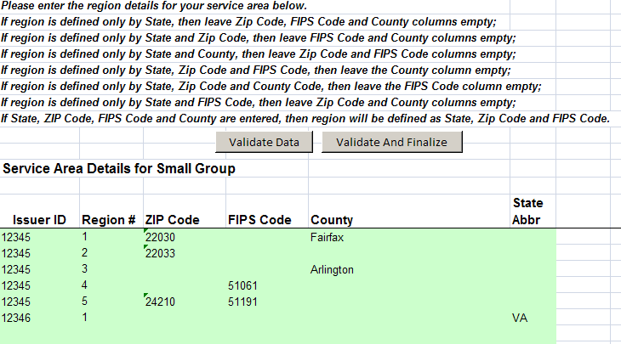
Regions Template
Confidential

Slide 15
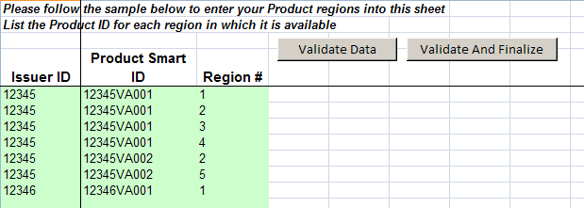
Product Availability Template
Confidential

Slide 16
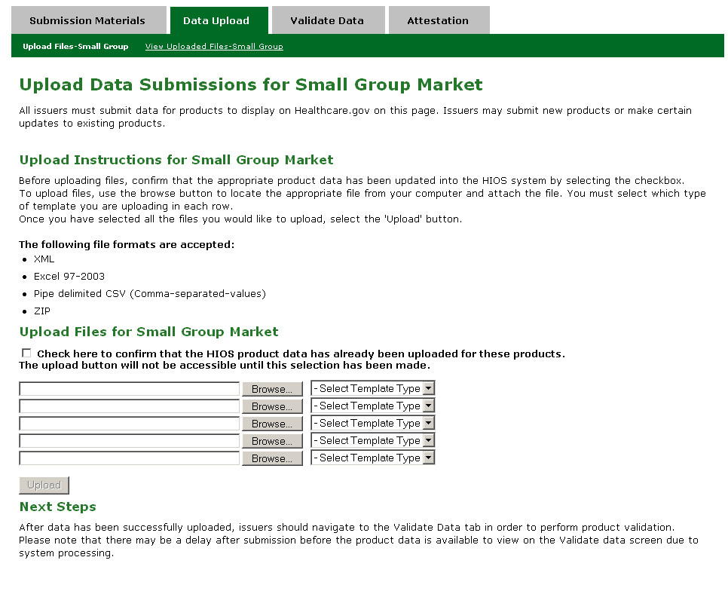
Data Upload
Confidential

Slide 17
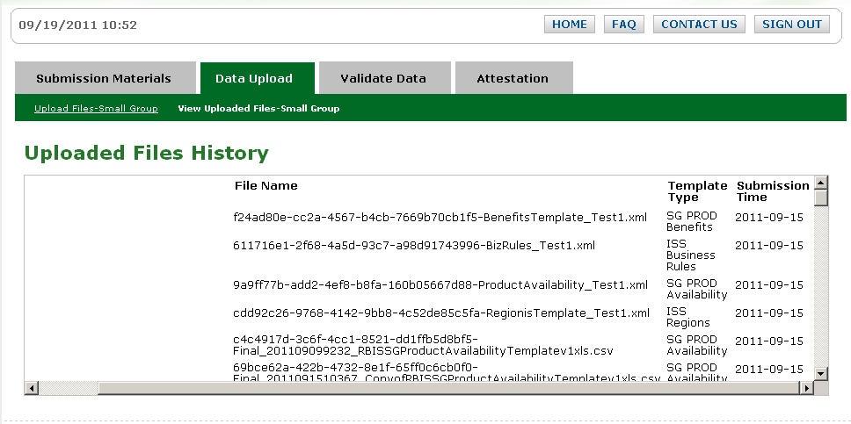
View Uploaded Files
Confidential

Slide 18
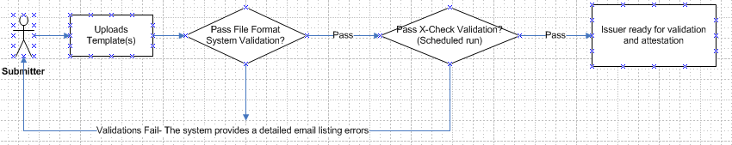
System Validations
Confidential

Slide 19
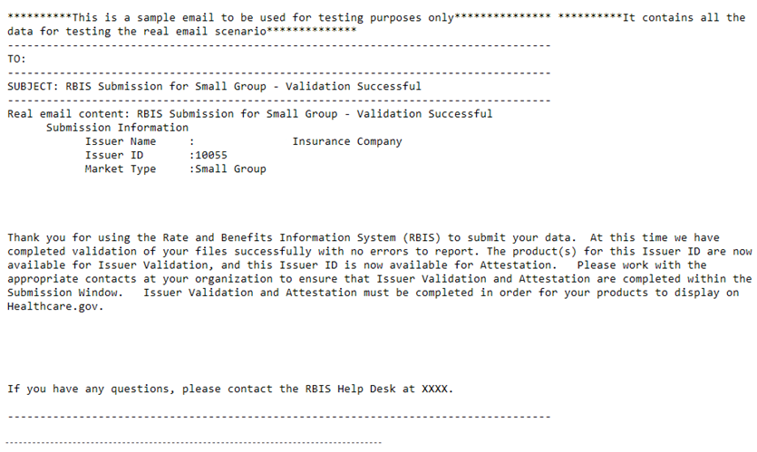
System Validations: Successful
Confidential

Slide 20
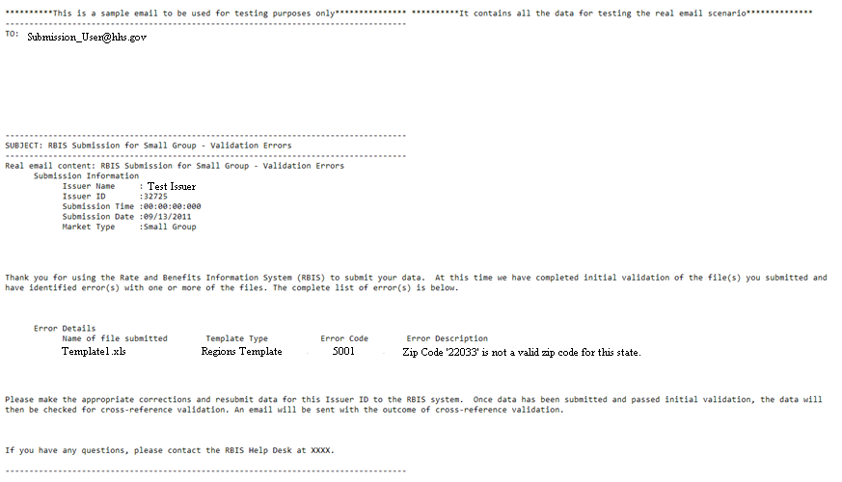
System Validations: Errors
Confidential

Slide 21
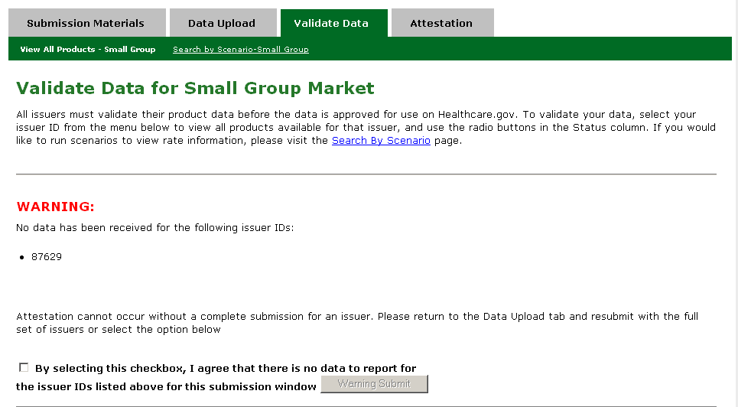
Validate Data pt. 1
Confidential

Slide 22
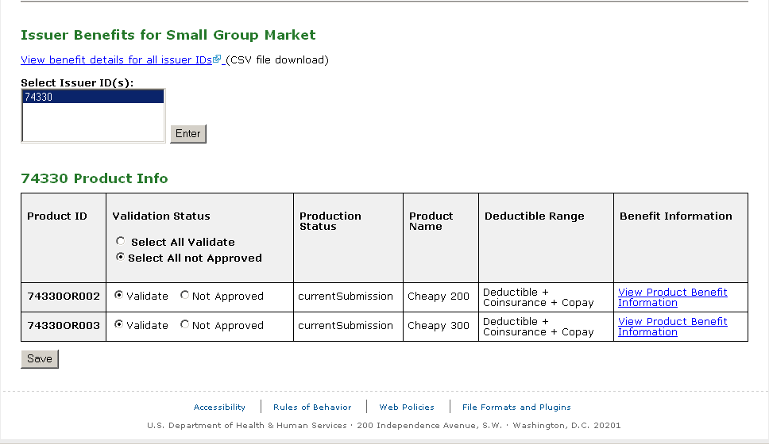
Validate Data pt. 2
Confidential

Slide 23
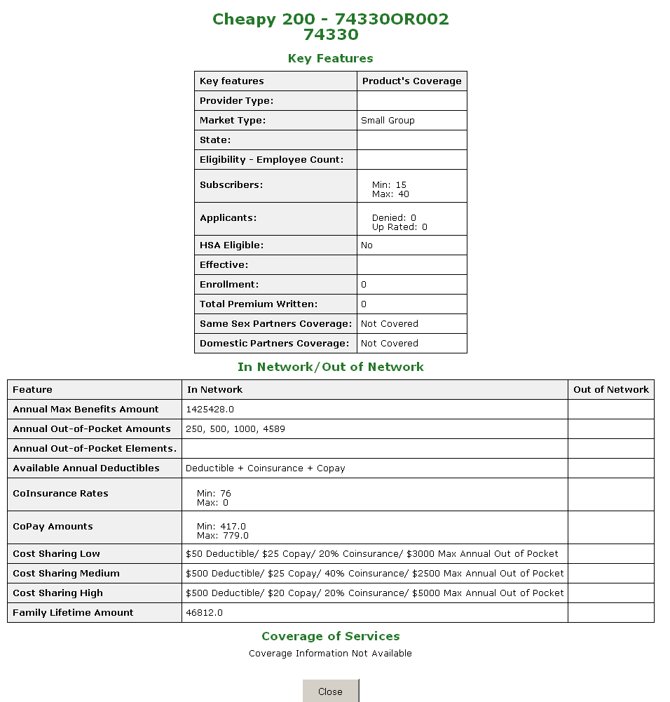
View Product Benefit Detail
Confidential

Slide 24
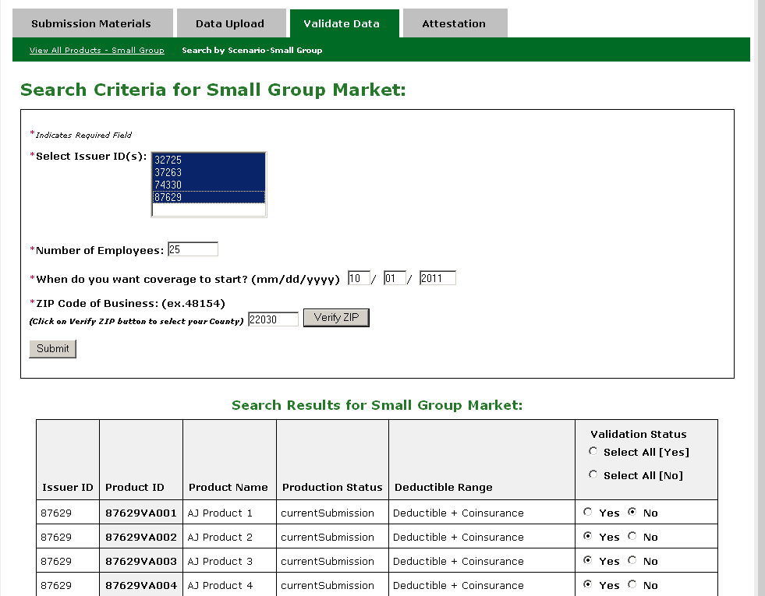
Validation Scenarios
Confidential

Slide 25
Resubmission
Submission is at the issuer level and overwrites previously submitted data.
Validation is at the product level and needs re-validation for each re-submission.
Attestation only needs to be completed once per submission window.
Confidential

Slide 26
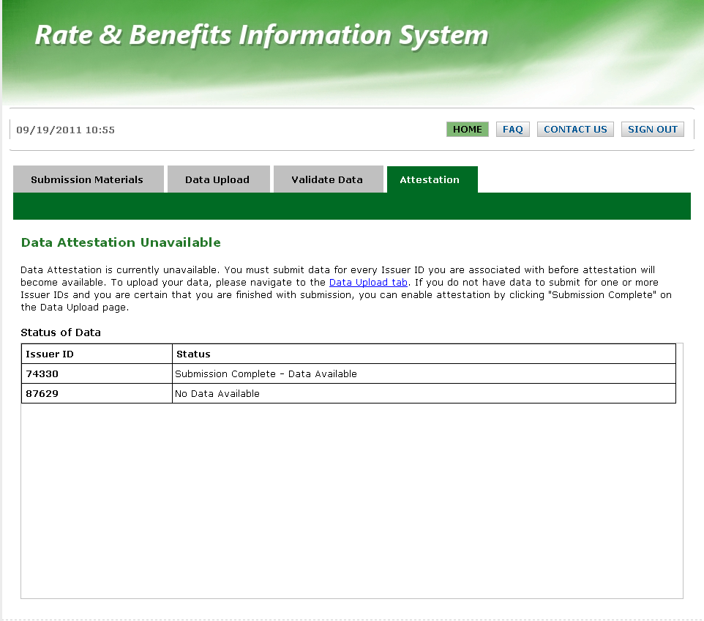
Attestation unavailable
Confidential

Slide 27
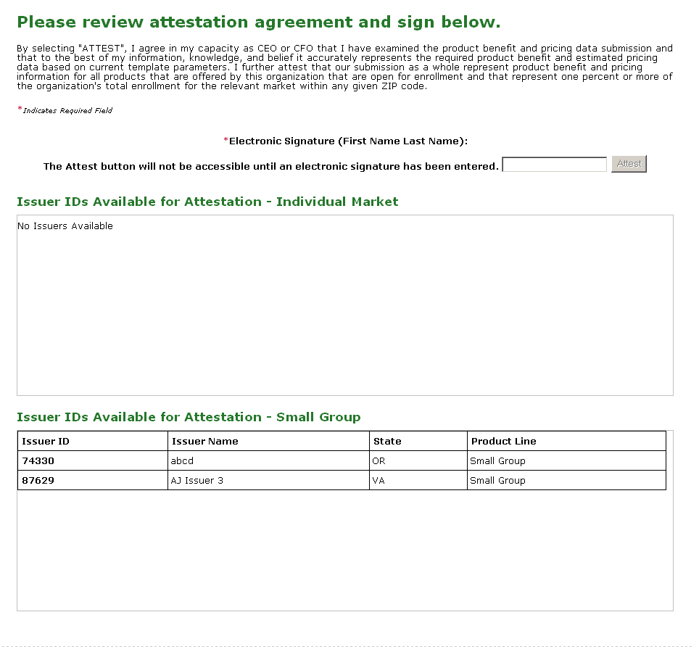
Attestation Available
Confidential

Slide 28
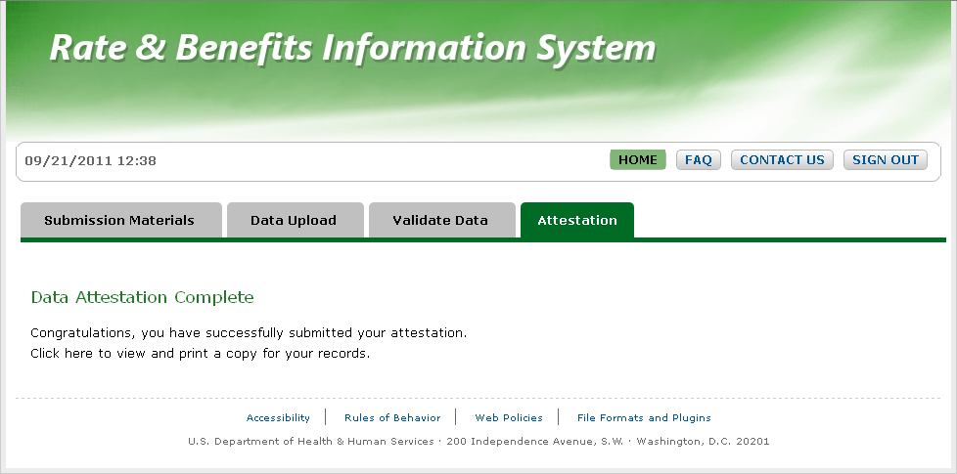
Attestation Complete
Confidential

Slide 29
RBIS Technical Support
The RBIS Helpdesk is available 8:30AM-7:30PM ET Mon-Fri.
We are available via phone at 1-888-380-2107 or email at insuranceoversight@hhs.gov
Please get in touch if you need help or have any issues with RBIS.
Confidential

Slide 30
Recap
You must: Submit, Validate and Attest.
All actions must be completed during the submission window.
You must submit to HIOS before submitting to RBIS and your RBIS users are your HIOS users.
Attestation is not available until all issuers for an attester have submitted.
Confidential

Slide 31
Questions?
Confidential

